Slide 1
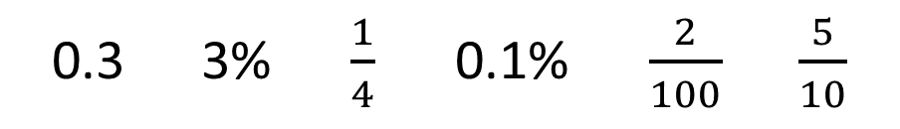
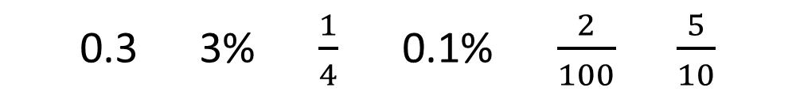
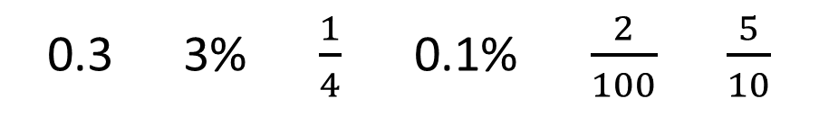
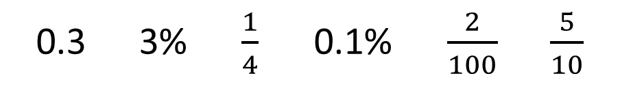
1) Convert the following numbers all into decimals.
2) Convert the following numbers all into fractions
(in their simplest form).
0.3 3% $\frac{1}{4}$ 0.1% $\frac{2}{100}$ $\frac{5}{10}$
0.3 3% $\frac{1}{4}$ 0.1% $\frac{2}{100}$ $\frac{5}{10}$
3) Convert the following numbers all into percentages.
4) Order the numbers in descending order.
0.3 3% $\frac{1}{4}$ 0.1% $\frac{2}{100}$ $\frac{5}{10}$
0.3 3% $\frac{1}{4}$ 0.1% $\frac{2}{100}$ $\frac{5}{10}$

Slide 2
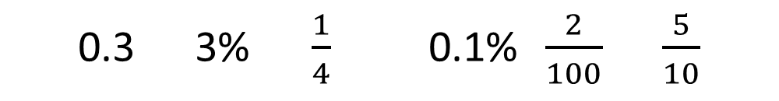
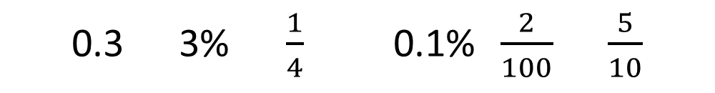
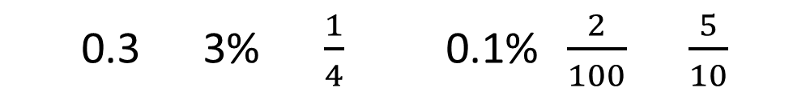
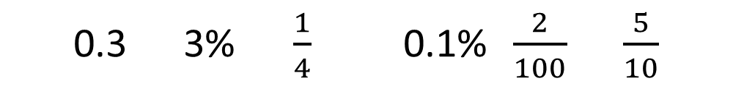
5) Order the numbers in ascending order.
6) Find the median of the following numbers.
0.3 3% $\frac{1}{4}$ 0.1% $\frac{2}{100}$ $\frac{5}{10}$
0.3 3% $\frac{1}{4}$ 0.1% $\frac{2}{100}$ $\frac{5}{10}$
7) Find the mean of the following numbers.
8) Find the mode of the following numbers.
0.3 3% $\frac{1}{4}$ 0.1% $\frac{2}{100}$ $\frac{5}{10}$
0.3 3% $\frac{1}{4}$ 0.1% $\frac{2}{100}$ $\frac{5}{10}$

Slide 3
ANSWERS

Slide 4
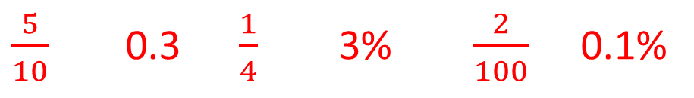
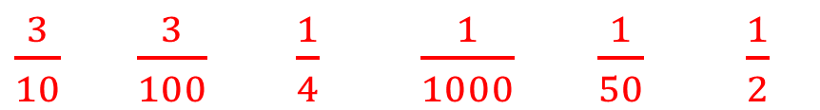
1) Convert the following numbers all into decimals.
2) Convert the following numbers all into fractions
(in their simplest form).
0.3 3% $\frac{1}{4}$ 0.1% $\frac{2}{100}$ $\frac{5}{10}$
0.3 3% $\frac{1}{4}$ 0.1% $\frac{2}{100}$ $\frac{5}{10}$
0.3 0.03 0.25 0.001 0.02 0.5
$\frac{3}{10}$ $\frac{3}{100}$ $\frac{1}{4}$ $\frac{1}{1000}$ $\frac{1}{50}$ $\frac{1}{2}$
3) Convert the following numbers all into percentages.
4) Order the numbers in descending order.
0.3 3% $\frac{1}{4}$ 0.1% $\frac{2}{100}$ $\frac{5}{10}$
0.3 3% $\frac{1}{4}$ 0.1% $\frac{2}{100}$ $\frac{5}{10}$
$\frac{5}{10}$ 0.3 $\frac{1}{4}$ 3% $\frac{2}{100}$ 0.1%
30% 3% 25% 0.1% 2% 50%

Slide 5
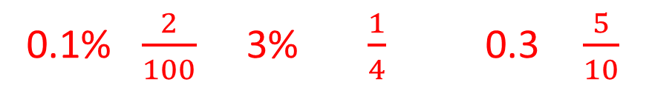
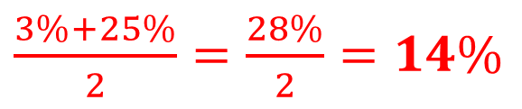

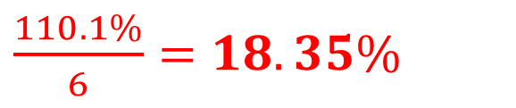
5) Order the numbers in ascending order.
6) Find the median of the following numbers.
0.3 3% $\frac{1}{4}$ 0.1% $\frac{2}{100}$ $\frac{5}{10}$
0.3 3% $\frac{1}{4}$ 0.1% $\frac{2}{100}$ $\frac{5}{10}$
0.1% $\frac{2}{100}$ 3% $\frac{1}{4}$ 0.3 $\frac{5}{10}$
0.1% $\frac{2}{100}$ 3% $\frac{1}{4}$ 0.3 $\frac{5}{10}$
$\frac{3\%+25\%}{2}=\frac{28\%}{2}=14\%$
7) Find the mean of the following numbers.
8) Find the mode of the following numbers.
0.3 3% $\frac{1}{4}$ 0.1% $\frac{2}{100}$ $\frac{5}{10}$
0.3 3% $\frac{1}{4}$ 0.1% $\frac{2}{100}$ $\frac{5}{10}$
30% 3% 25% 0.1% 2% 50%
There is no mode
$\frac{110.1\%}{6}=18.35\%$

