Slide 1

Senior Challenge 1
GOLD

Slide 2
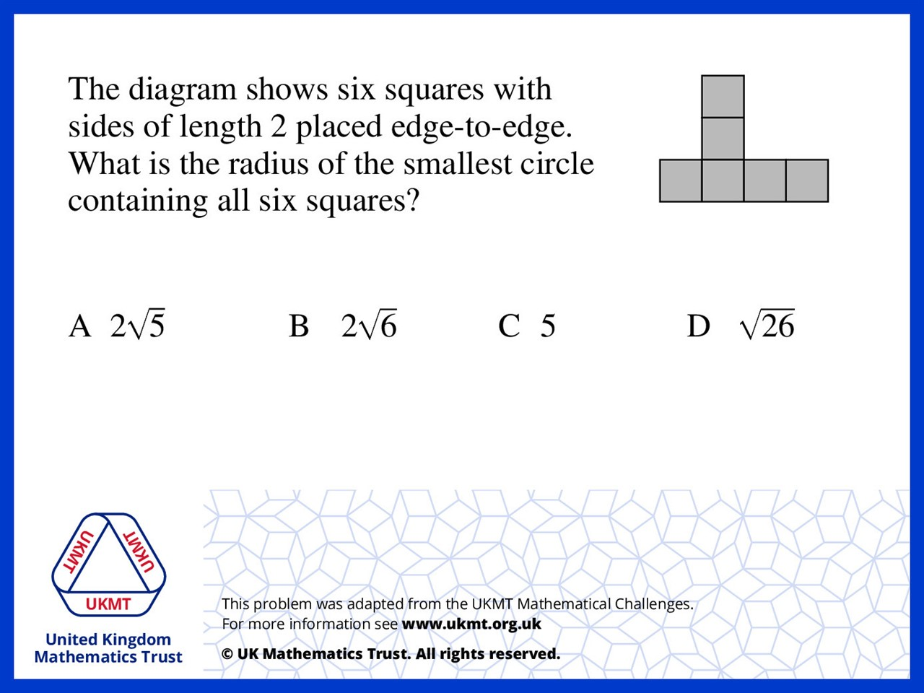
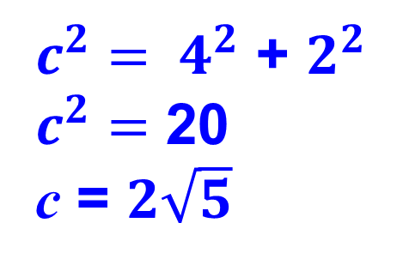
Q1.
$c^{2}= 4^{2}$ + $2^{2}$
$c^{2}=$ 20
c = $2\sqrt{5}$

Slide 3
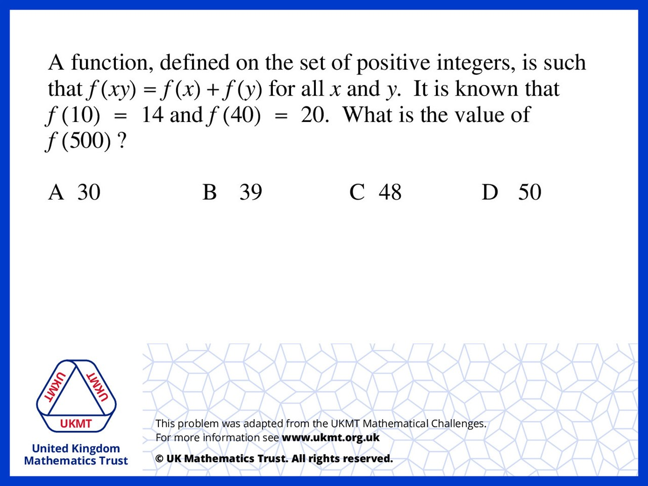
Q2.
f(40) = f(2) + f(2) + f(10)
f(40) = 2f(2) + 14
20 = 2f(2) + 14
f(2) = 3
f(10) = f(2) + f(5)
14 = 3 + f(5)
f(5) = 11
f(500) = f(5) + f(10) + f(10)
f(500) = 11 + 14 + 14

Slide 4
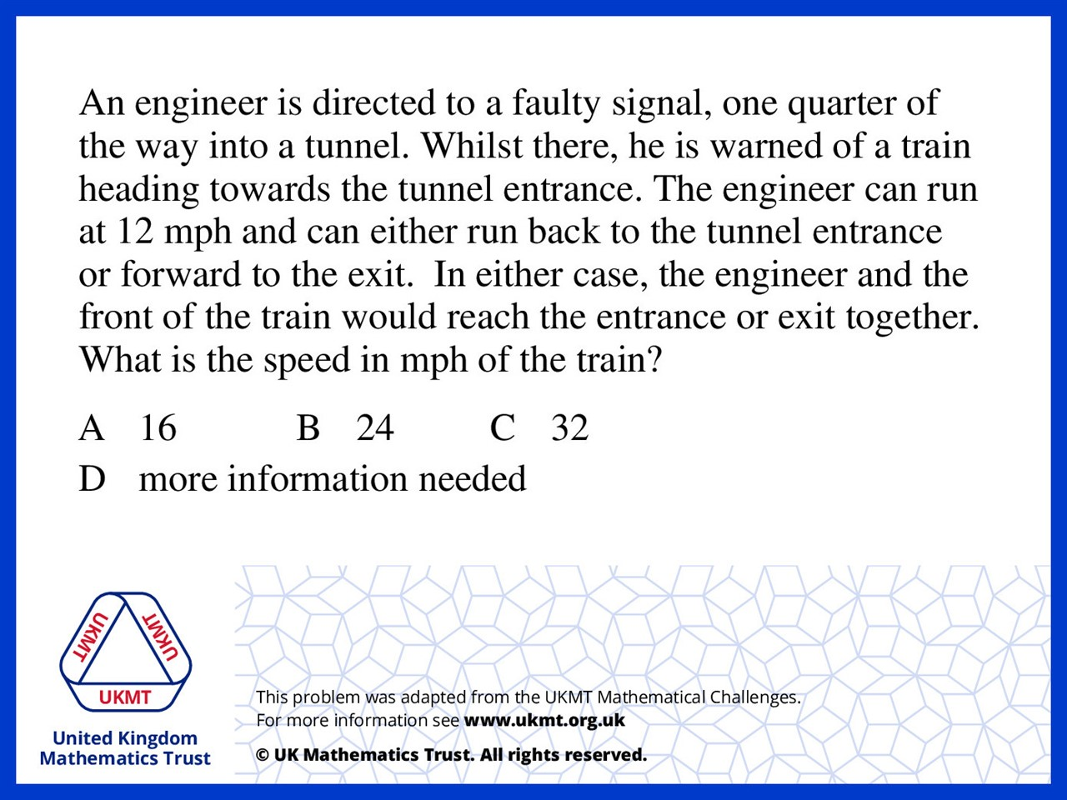
Q3.
if the distance between the train's front and the entrance is d,
and the tunnel is assumed to be 48m long,
the question states the train's speed is:
d/h = (48+d)/3h solving: d = 24m train's speed = 24mph

Slide 5
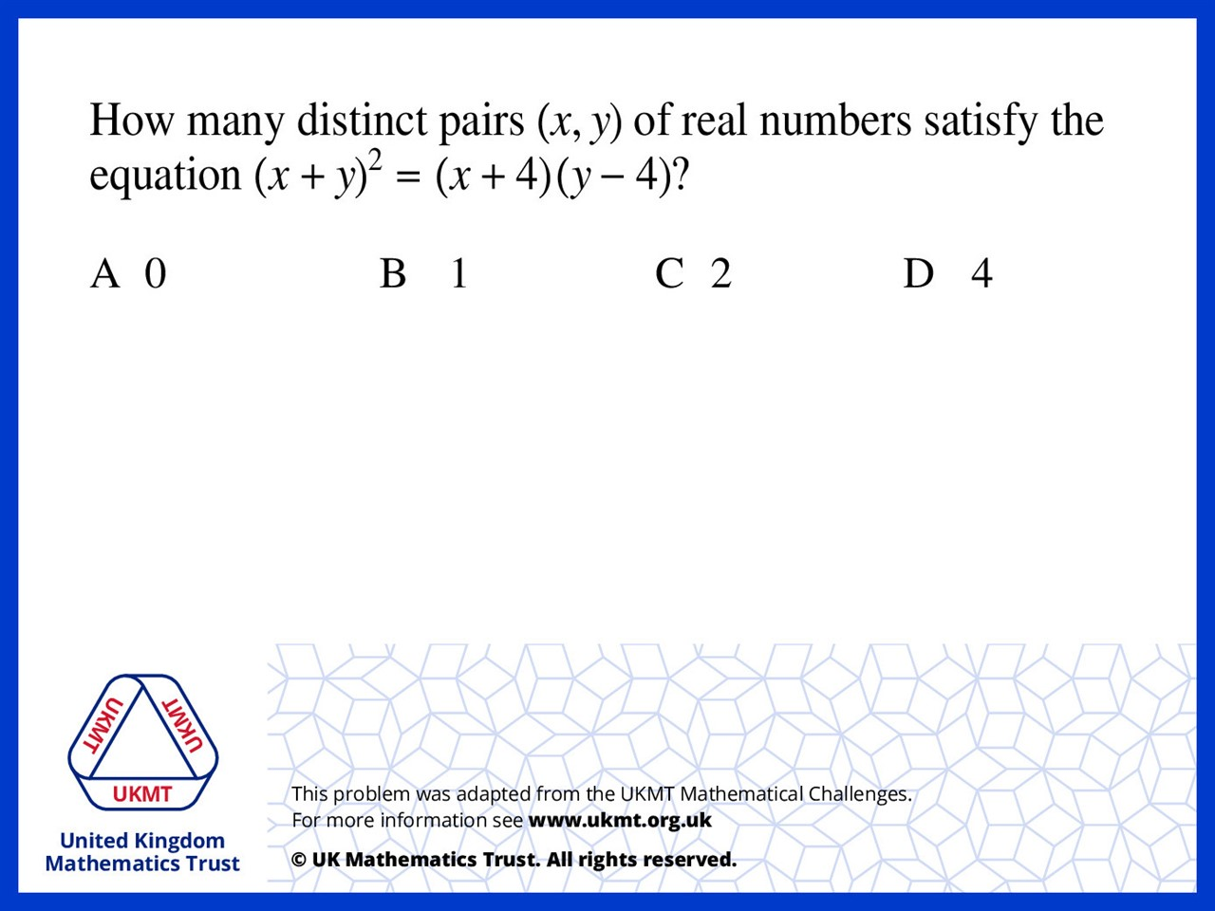
Q4.
(x + y)(x + y) = (x + 4)(y - 4)
so x + y = x + 4,
therefore y = 4
Similarly, x + y = y - 4
so x = -4 and only solution

Slide 6
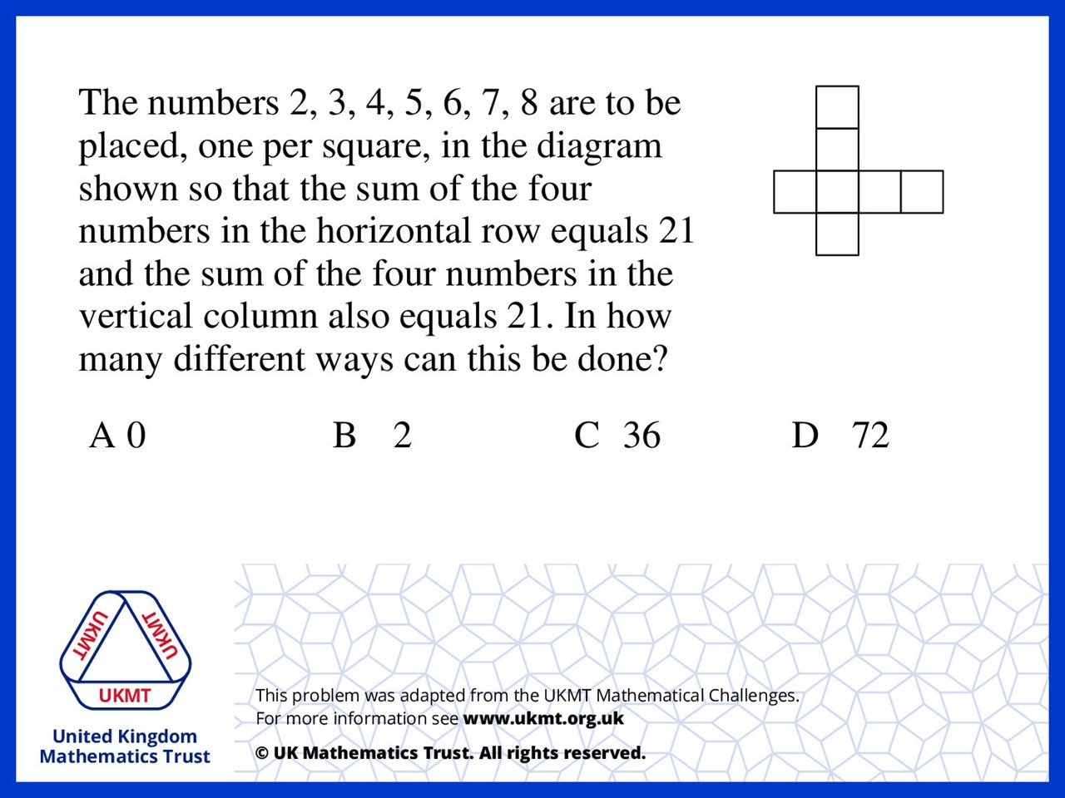
Q5.
Number in middle = 42 - 35 = 7
triple sets that add to 14 = (2, 4, 8), (3, 5, 6)
each permutation x switch between the two
6 x 6 x 2 = 72

