Slide 1


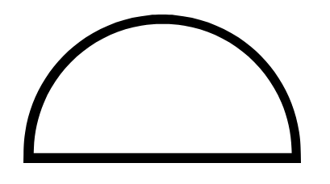

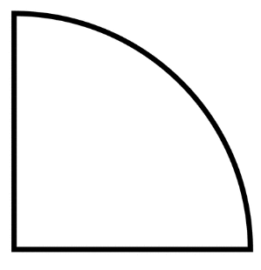
1)
4)
7)
10)
3cm
1.2cm
240cm
24cm
2)
5)
8)
11)
6cm
12cm
120cm
12cm
3)
12)
6)
9)
6cm
12cm
24cm
12cm

Slide 2
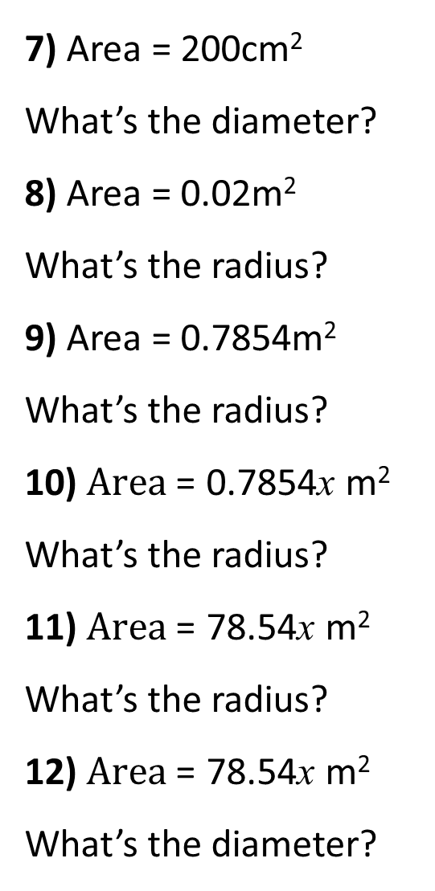
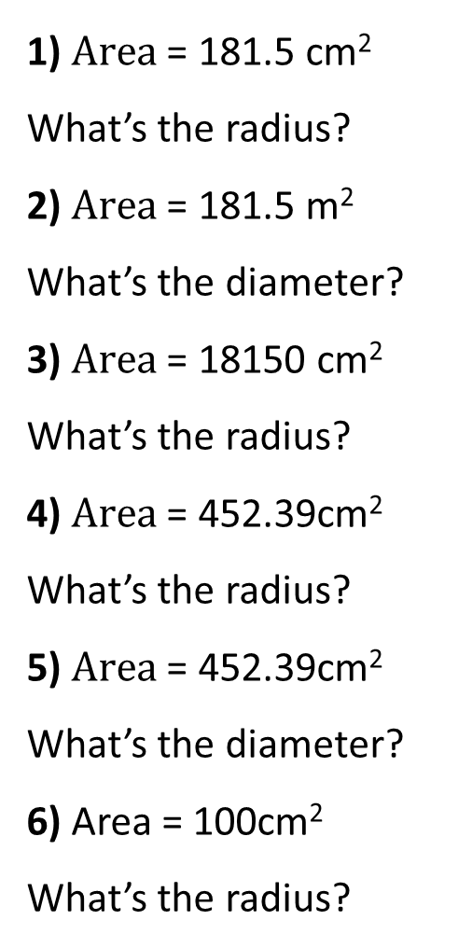
Give your answers to 1 decimal places.
7) Area = 200cm²
What’s the diameter?
8) Area = 0.02m²
What’s the radius?
9) Area = 0.7854m²
What’s the radius?
10) $Area\text{ =}$ 0.7854x m²
What’s the radius?
11) $Area\text{ =}$ 78.54x m²
What’s the radius?
12) $Area\text{ =}$ 78.54x m²
What’s the diameter?
1) $Area\text{ =}$ 181.5 cm²
What’s the radius?
2) $Area\text{ =}$ 181.5 m²
What’s the diameter?
3) $Area\text{ =}$ 18150 cm²
What’s the radius?
4) $Area\text{ =}$ 452.39cm²
What’s the radius?
5) $Area\text{ =}$ 452.39cm²
What’s the diameter?
6) Area = 100cm²
What’s the radius?

Slide 3
ANSWERS

Slide 4
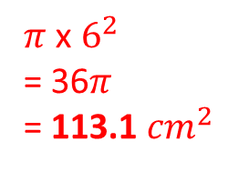
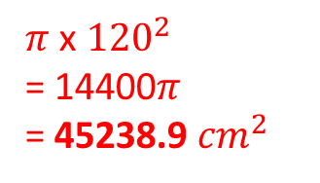
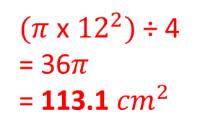
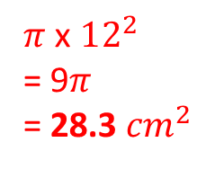
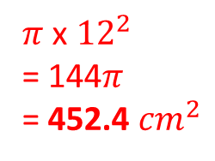
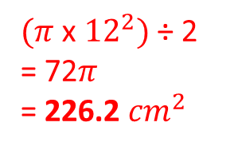
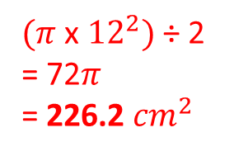
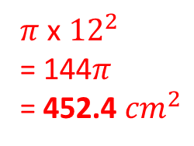
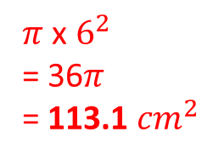
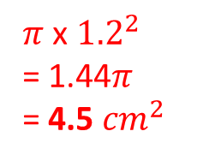

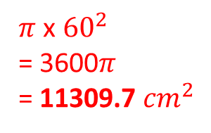
1)
3cm
4)
7)
1.2cm
10)
$(π$ x ${12}^{2})$ ÷ 2
= 72$π$
= 226.2 ${cm}^{2}$
$π$ x $12^{2}$
= 9$π$
= 28.3 ${cm}^{2}$
240cm
$π$ x ${120}^{2}$
= 14400$π$
= 45238.9 ${cm}^{2}$
$π$ x ${1.2}^{2}$
= 1.44$π$
= 4.5 ${cm}^{2}$
24cm
2)
5)
6cm
8)
12cm
120cm
11)
$(π$ x ${12}^{2})$ ÷ 2
= 72$π$
= 226.2 ${cm}^{2}$
$π$ x ${60}^{2}$
= 3600$π$
= 11309.7 ${cm}^{2}$
$π$ x ${12}^{2}$
= 144$π$
= 452.4 ${cm}^{2}$
$π$ x $6^{2}$
= 36$π$
= 113.1 ${cm}^{2}$
12cm
6)
9)
3)
12)
12cm
24cm
6cm
$(π$ x ${12}^{2})$ ÷ 4
= 36$π$
= 113.1 ${cm}^{2}$
$π$ x $6^{2}$
= 36$π$
= 113.1 ${cm}^{2}$
$π$ x $6^{2}$
= 36$π$
= 113.1 ${cm}^{2}$
$π$ x ${12}^{2}$
= 144$π$
= 452.4 ${cm}^{2}$
12cm

Slide 5
Give your answers to 1 decimal places.
7) Area = 200cm²
What’s the diameter?
8) Area = 0.02m²
What’s the radius?
9) Area = 0.7854m²
What’s the radius?
10) $Area\text{ =}$ 0.7854x m²
What’s the radius?
11) $Area\text{ =}$ 78.54x m²
What’s the radius?
12) $Area\text{ =}$ 78.54x m²
What’s the diameter?
16.0cm
1) $Area\text{ =}$ 181.5 cm²
What’s the radius?
2) $Area\text{ =}$ 181.5 m²
What’s the diameter?
3) $Area\text{ =}$ 18150 cm²
What’s the radius?
4) $Area\text{ =}$ 452.39cm²
What’s the radius?
5) $Area\text{ =}$ 452.39cm²
What’s the diameter?
6) Area = 100cm²
What’s the radius?
7.6cm
0.8m
15.2m
0.5m
76.0cm
0.5x m
12.0cm
24.0cm
5x m
10x m
5.6cm

