Slide 1
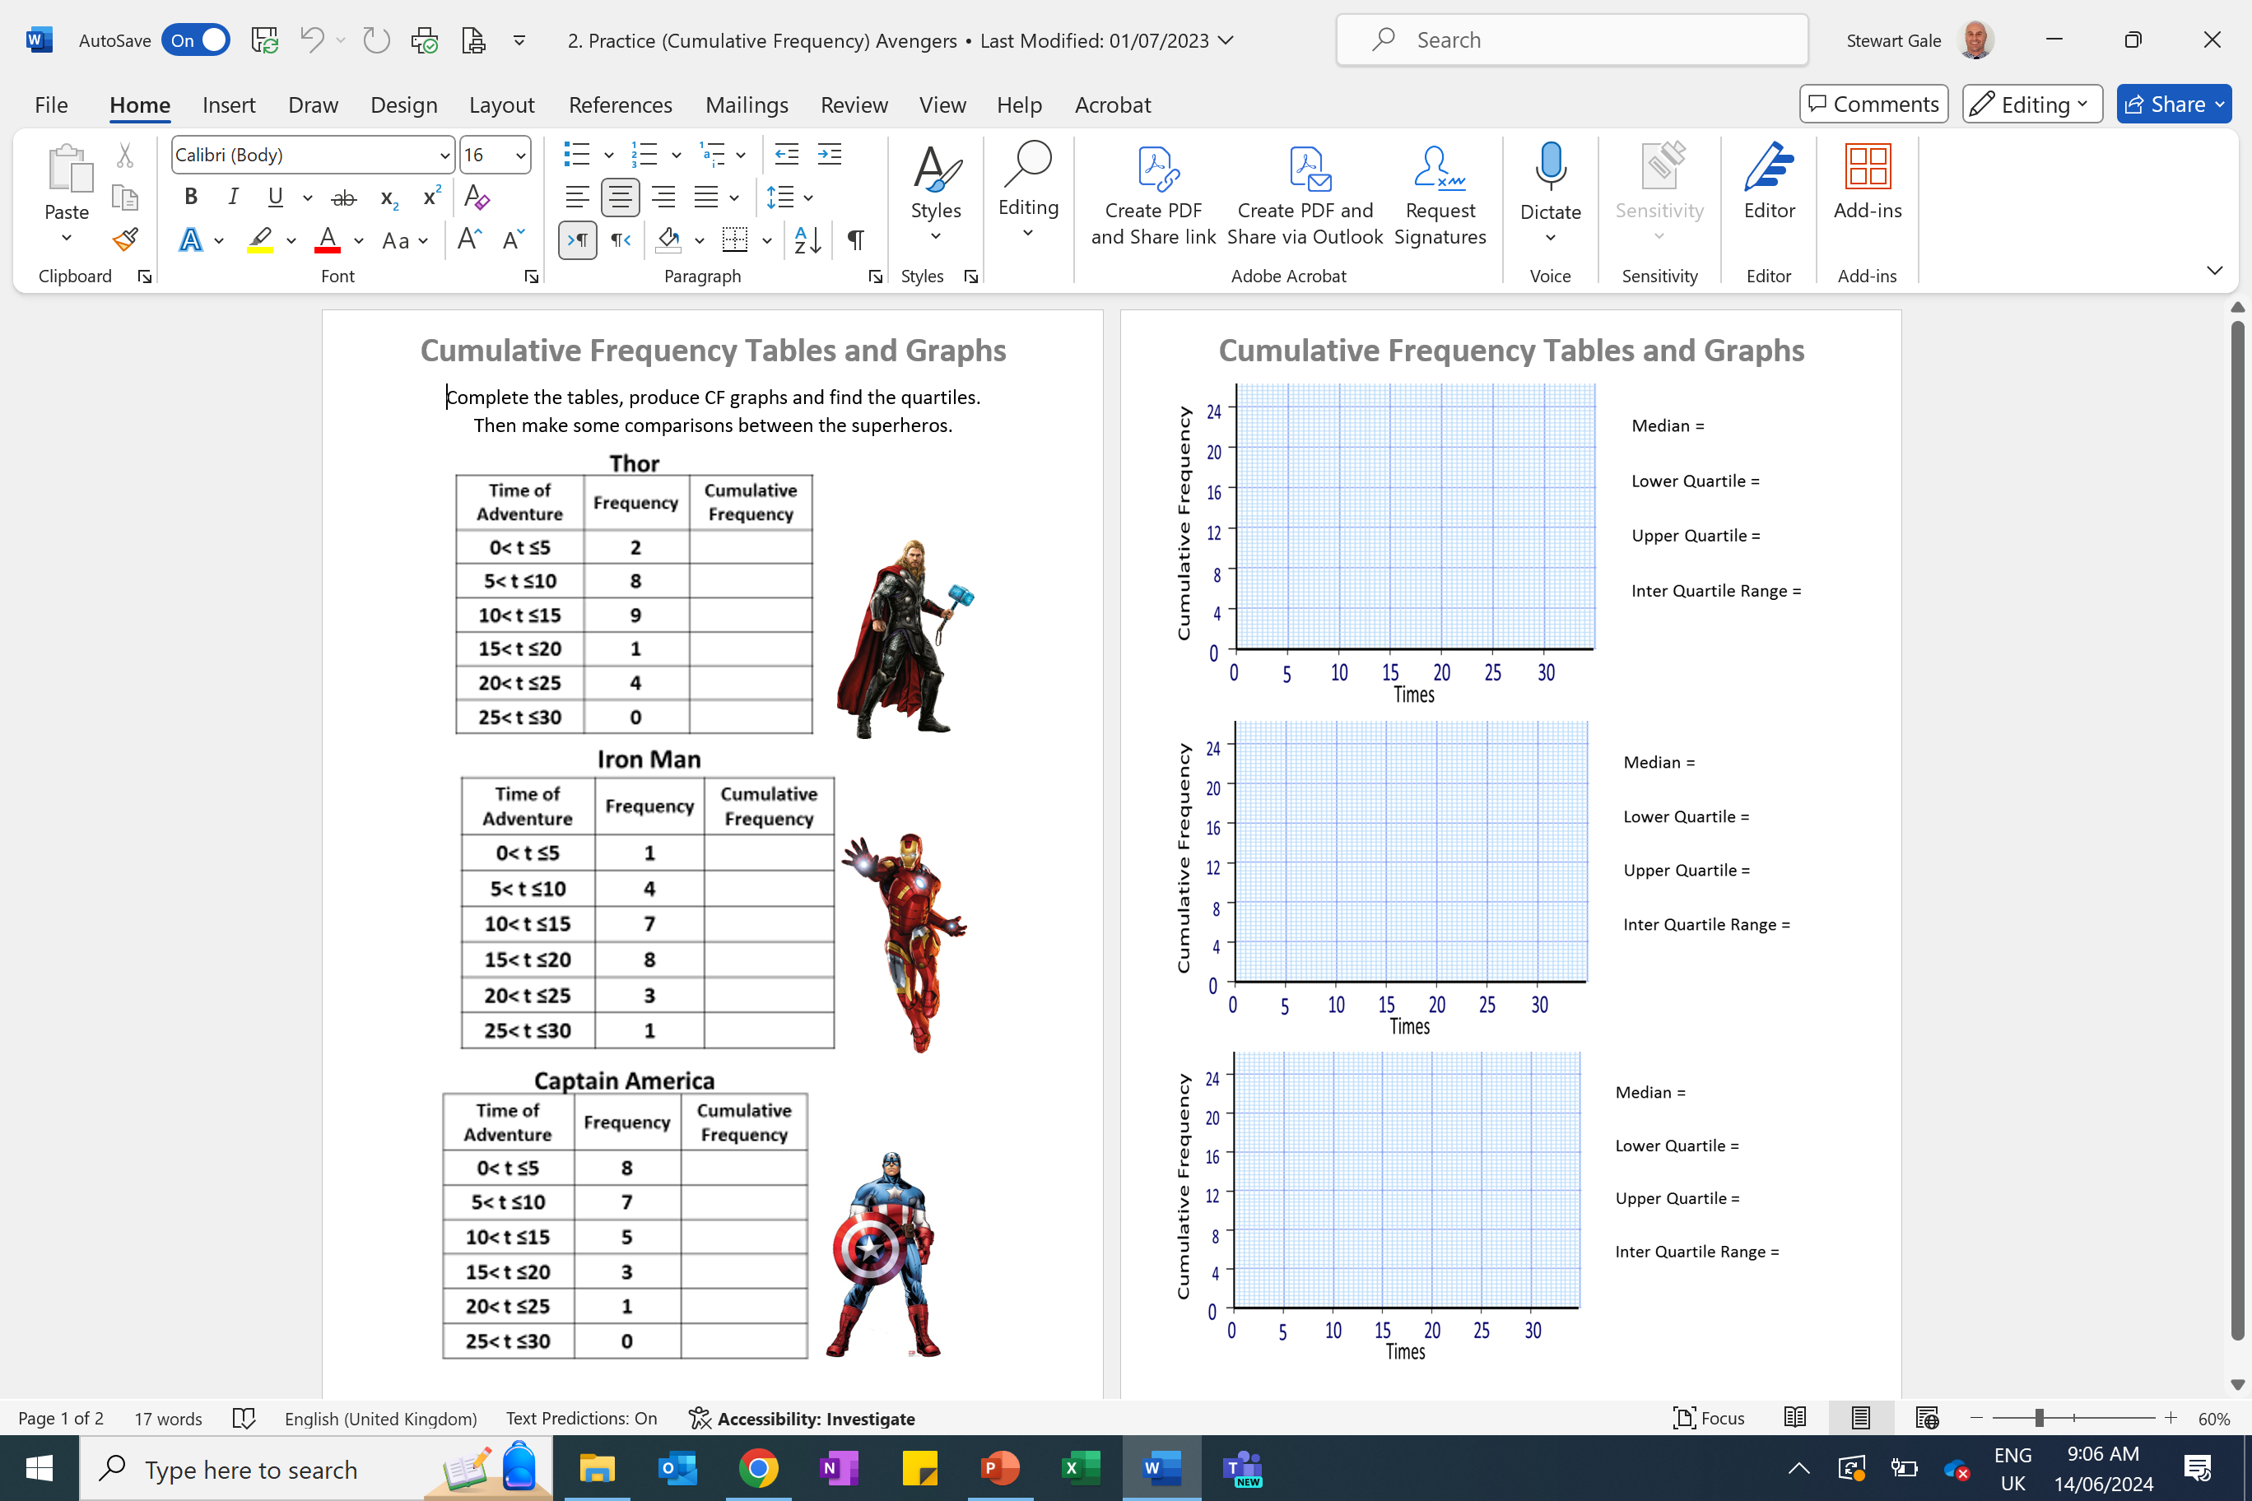

Slide 2
ANSWERS

Slide 3
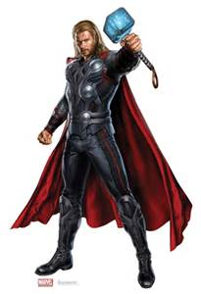
Adventures data
Time of Adventure | Frequency | Cumulative Frequency
0< t ≤5 | 2 | 2
5< t ≤10 | 8 | 10
10< t ≤15 | 9 | 19
15< t ≤20 | 1 | 20
20< t ≤25 | 4 | 24
25< t ≤30 | 0 | 24
30
Thor
25
The median is 11 minutes
20
The lower quartile is 6 minutes
15
Cumulative Frequency
The upper quartile is 14 minutes
10
The interquartile range (IQR) is 14 – 6 = 8
5
0
0
5
10
15
20
25
30
Adventure Time

Slide 4
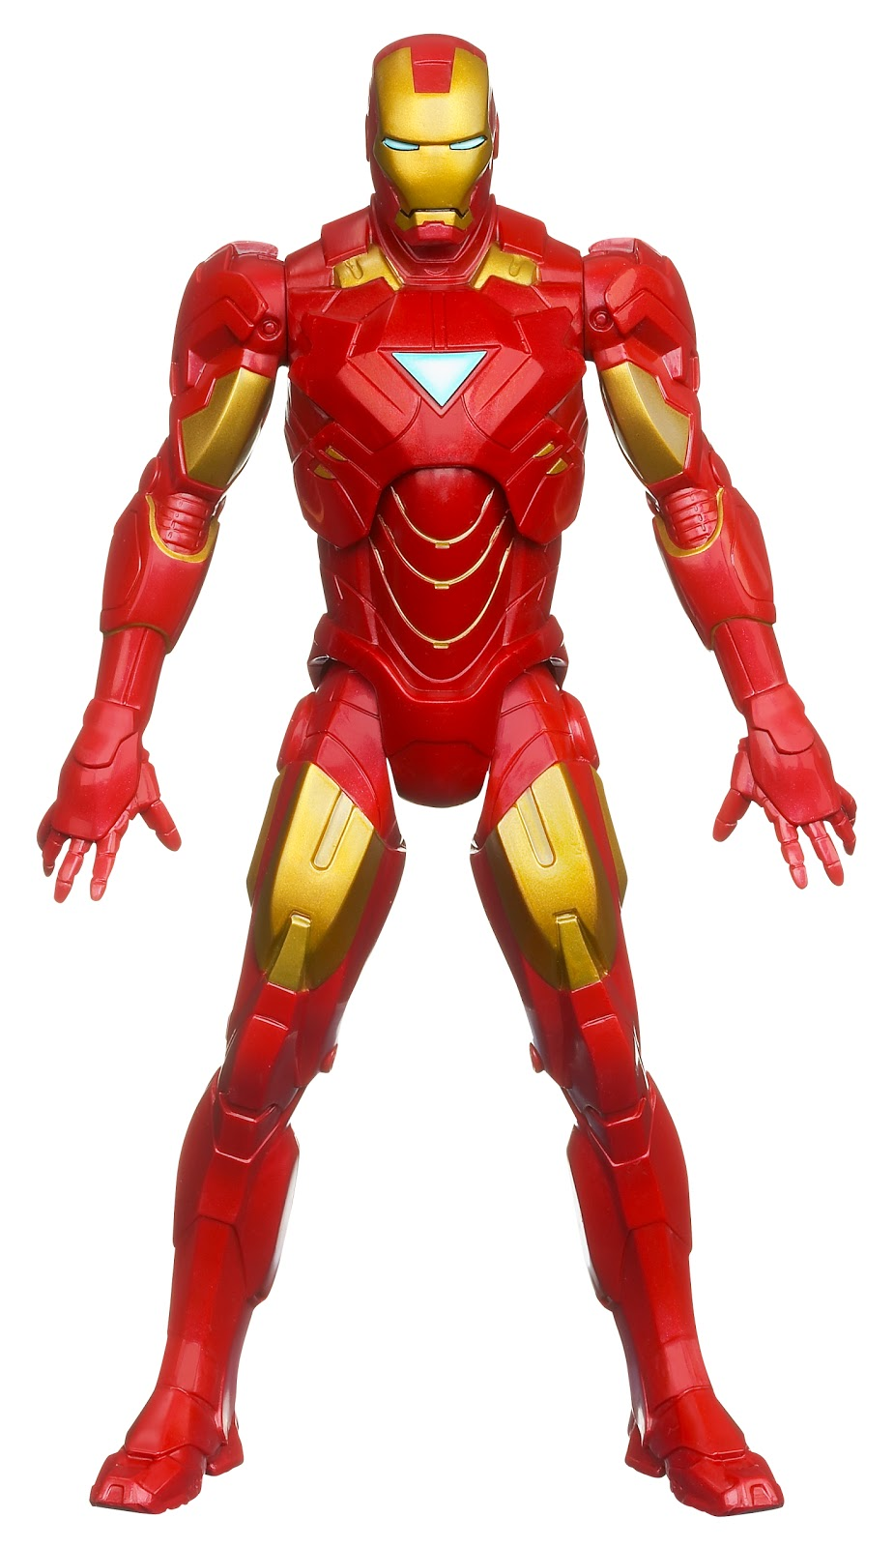
Iron Man’s data
Time of Adventure | Frequency | Cumulative Frequency
0< t ≤5 | 1 | 1
5< t ≤10 | 4 | 5
10< t ≤15 | 7 | 12
15< t ≤20 | 8 | 20
20< t ≤25 | 3 | 23
25< t ≤30 | 1 | 24
30
The median is 16 minutes
25
The lower quartile is 12 minutes
20
18
The upper quartile is 18 minutes
15
Cumulative Frequency
The interquartile range (IQR) is 18-12= 6
10
12
6
5
0
12
18
0
5
10
16
20
25
30
15
Adventure Time

Slide 5
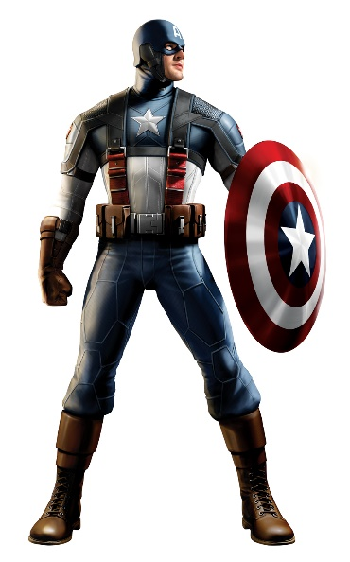
Adventures data
Time of Adventure | Frequency | Cumulative Frequency
0< t ≤5 | 8 | 8
5< t ≤10 | 7 | 15
10< t ≤15 | 5 | 20
15< t ≤20 | 3 | 23
20< t ≤25 | 1 | 24
25< t ≤30 | 0 | 24
30
Captain America
25
The median is 9 minutes
20
The lower quartile is 4 minutes
15
Cumulative Frequency
The upper quartile is 14 minutes
10
The interquartile range (IQR) is 14 – 4 = 10
5
0
0
5
10
15
20
25
30
Adventure Time

Slide 6

The median is 11 minutes
The median is 16 minutes
The median is 9 minutes
The lower quartile is 6 minutes
The lower quartile is 12 minutes
The lower quartile is 4 minutes
The upper quartile is 14 minutes
The upper quartile is 14 minutes
The upper quartile is 18 minutes
The interquartile range (IQR) is 14 – 6 = 8
The interquartile range (IQR) is 14 – 4 = 10
The interquartile range (IQR) is 18-12= 6

