Slide 1
Forces and Motions
F = ma
Chapter 10
(Part 2 of 9)

Slide 2

Forces – Horizontal
What forces could be acting on the particle?
Reaction Force
acceleration
Resistance Force
m
Driving Force
Weight (mg)

Slide 3
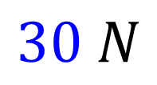


The ‘resultant force’ is the
overall force acting on the object.
$$30 N$$
$$50 N$$
$$20 N$$

Slide 4
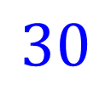
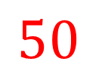
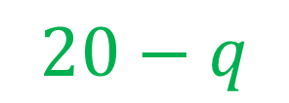
What is the resultant force acting on the object?
q
$$50$$
$$30$$
$$20−q$$

Slide 5
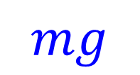
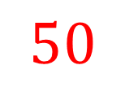

Forces – Vertical
What is the resultant force acting on the object?
$$50$$
$$50 −mg$$
acceleration
m
m
$$mg$$

Slide 6

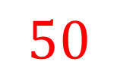
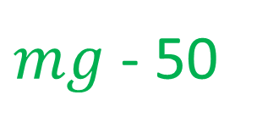
What is the resultant force acting on the object?
$$50$$
acceleration
m
m
$$mg$$
$mg$ - 50

Slide 7
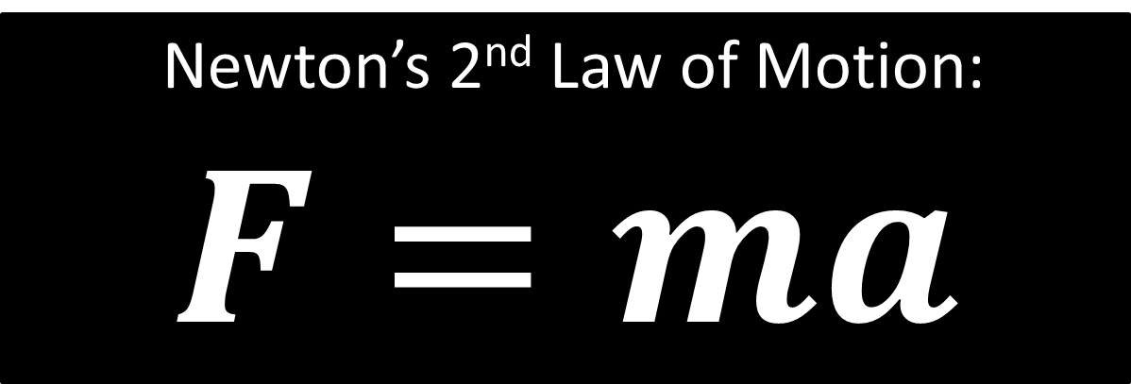
Newton’s 2nd Law of Motion:
$F=ma$
F = resultant force
m = mass
a = acceleration
F = Driving Forces – Resistance Forces

Slide 8
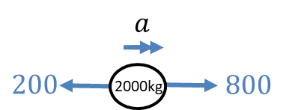
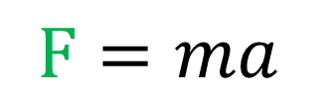

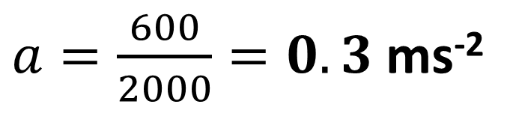
A car of 2000kg has a driving force of 800N
and forces of 200N resisting its motion.
Determine its acceleration.
$$F=ma$$
$$800−200=2000a$$
$a=\frac{600}{2000}=0.3$ms⁻²

Slide 9
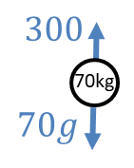
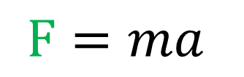

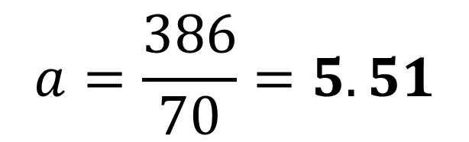
A falling rock of mass 70kg experiences air resistance of 300N. Determine the rocks’s acceleration as it plummets towards the ground.
$$F=ma$$
$$70g−300=70a$$
$$a=\frac{386}{70}=5.51$$

Slide 10
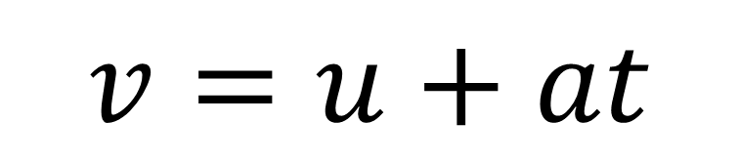
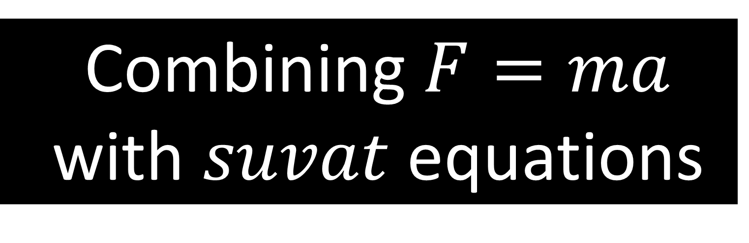
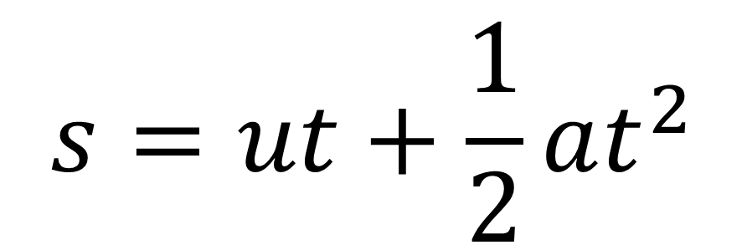
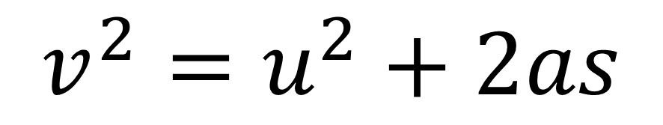
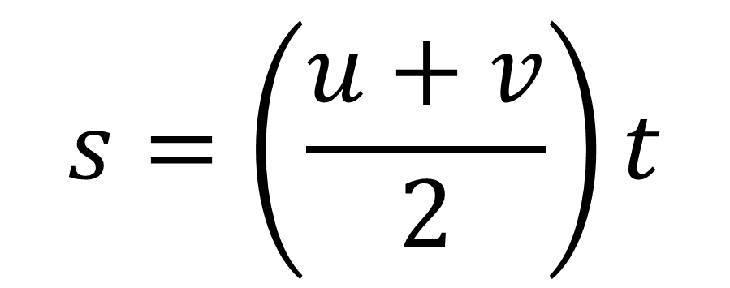
Combining $F=ma$
with $suvat$ equations
$$v=u+at$$
$$v^{2}=u^{2}+2as$$
$$s=\left(\frac{u+v}{2}\right)t$$
$$s=ut+\frac{1}{2}at^{2}$$

Slide 11
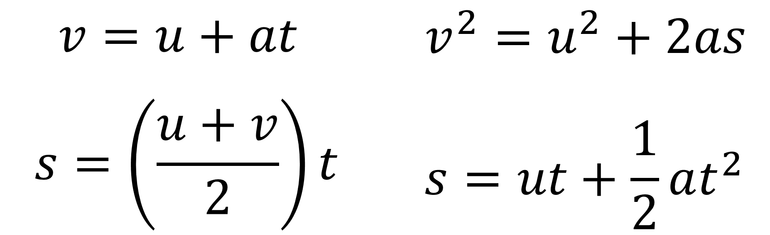
Question A
A body of mass 5kg is pulled along a rough horizontal table by a horizontal force of magnitude 20N against a constant friction force of magnitude 4N.
Given that the body is initially at rest, find:
the magnitude of the normal reaction between the body and ..the table
the acceleration of the body
the distance travelled by the body in the first 4 seconds

Slide 12
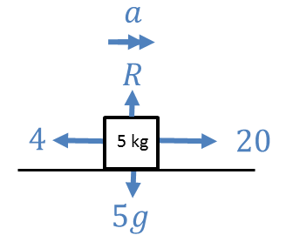
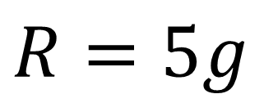
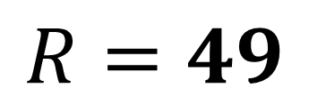
A body of mass 5kg is pulled along a rough horizontal table by a horizontal force of magnitude 20N against a constant friction force of magnitude 4N.
Given that the body is initially at rest, find:
the magnitude of the normal reaction between the body and the table
a.
$$R=5g$$
$$R=49$$

Slide 13
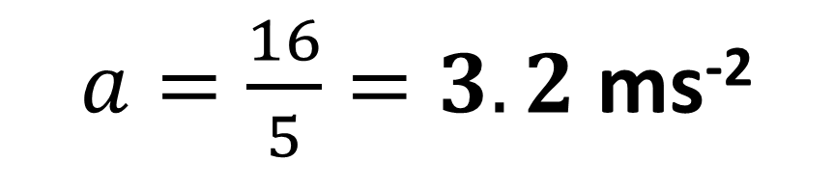
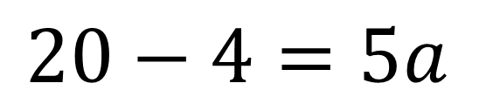
A body of mass 5kg is pulled along a rough horizontal table by a horizontal force of magnitude 20N against a constant friction force of magnitude 4N.
Given that the body is initially at rest, find:
(b) the acceleration of the body
b.
F = ma
$$20−4=5a$$
$a=\frac{16}{5}=3.2$ ms⁻²

Slide 14

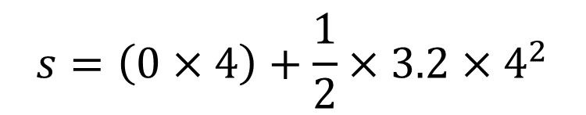

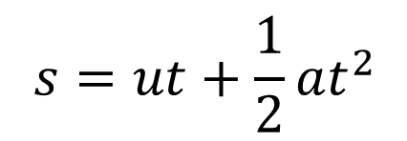
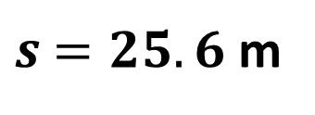
A body of mass 5kg is pulled along a rough horizontal table by a horizontal force of magnitude 20N against a constant friction force of magnitude 4N.
Given that the body is initially at rest, find:
(c) the distance travelled by the body in the first 4 seconds
$$s=$$
$$u=0$$
$$v=$$
$$a=3.2$$
$$t=4$$
c.
$$s=$$
$$u=$$
$$v=$$
$$a=$$
$$t=$$
$$s=ut+\frac{1}{2}at^{2}$$
$$s=\left(0×4\right)+\frac{1}{2}×3.2×4^{2}$$
$s$ $=25.6$ m

