Slide 1
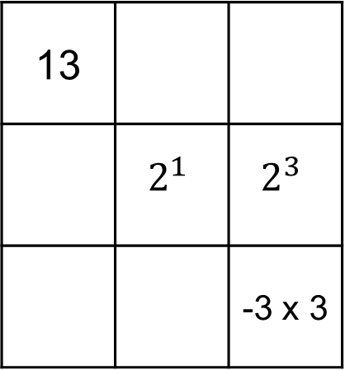
A
B
C
D
 | 1 | 11
8 | -3
13
 | $$2^{1}$$ | $$2^{3}$$
 |  | -3 x 3
42
 | -1 | 7
 |  | -44
8.6
-4.2 | 2.5
 |  | -3.6
Magic Number = 3
Magic Number = ?
Magic Number = ?
Magic Number = ?

Slide 2
ANSWERS

Slide 3
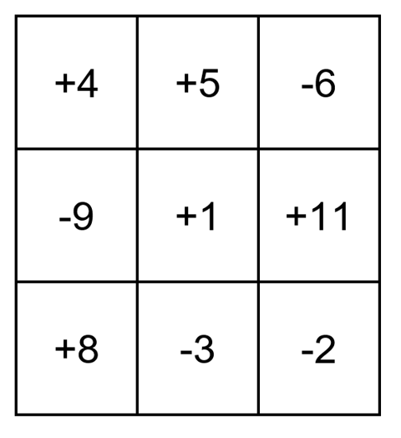
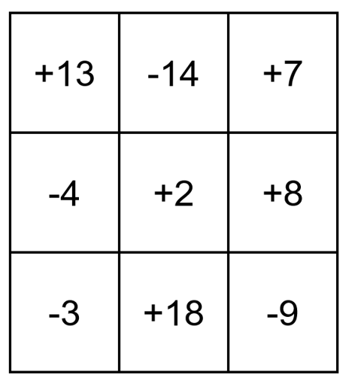
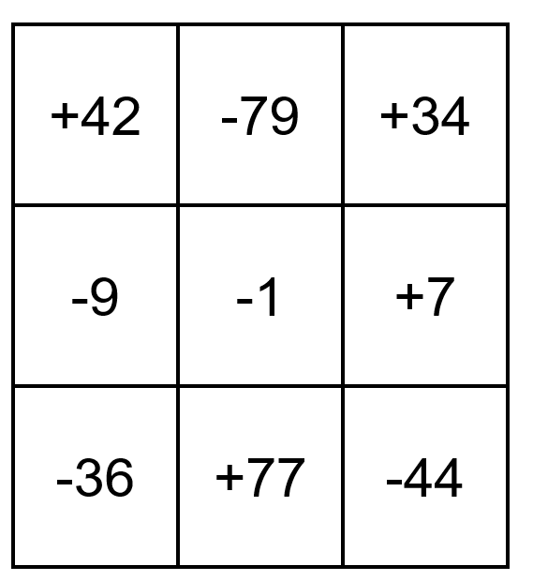
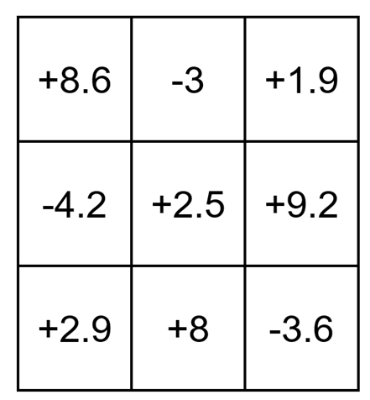
A
B
C
D
 | 1 | 11
8 | -3
13
 | 2 | 8
 |  | -9
42
 | -1 | 7
 |  | -44
8.6
-4.2 | 2.5
 |  | -3.6
Magic Number = 3
Magic Number = ?
Magic Number = ?
Magic Number = ?

