Slide 1
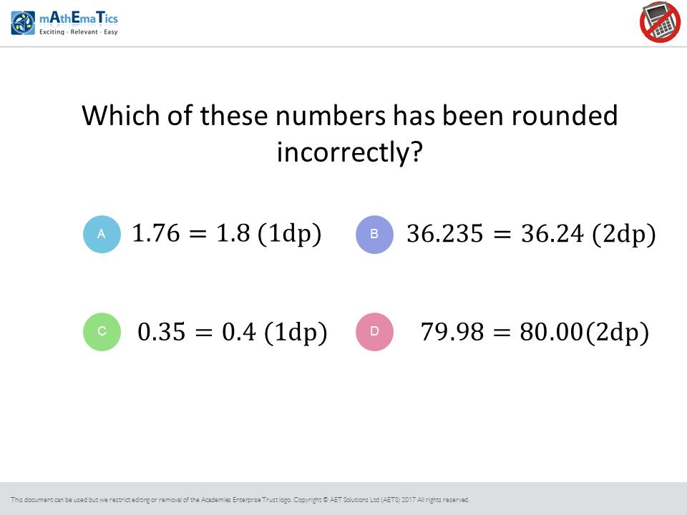
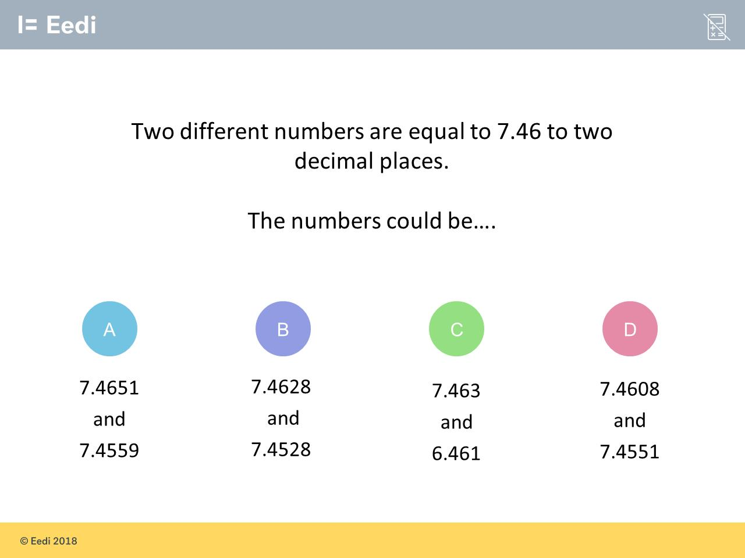
Worst answered question?
Most common wrong answer?

Slide 2
ANSWERS

Slide 3
Worst answered question?
Most common wrong answer?

Slide 4
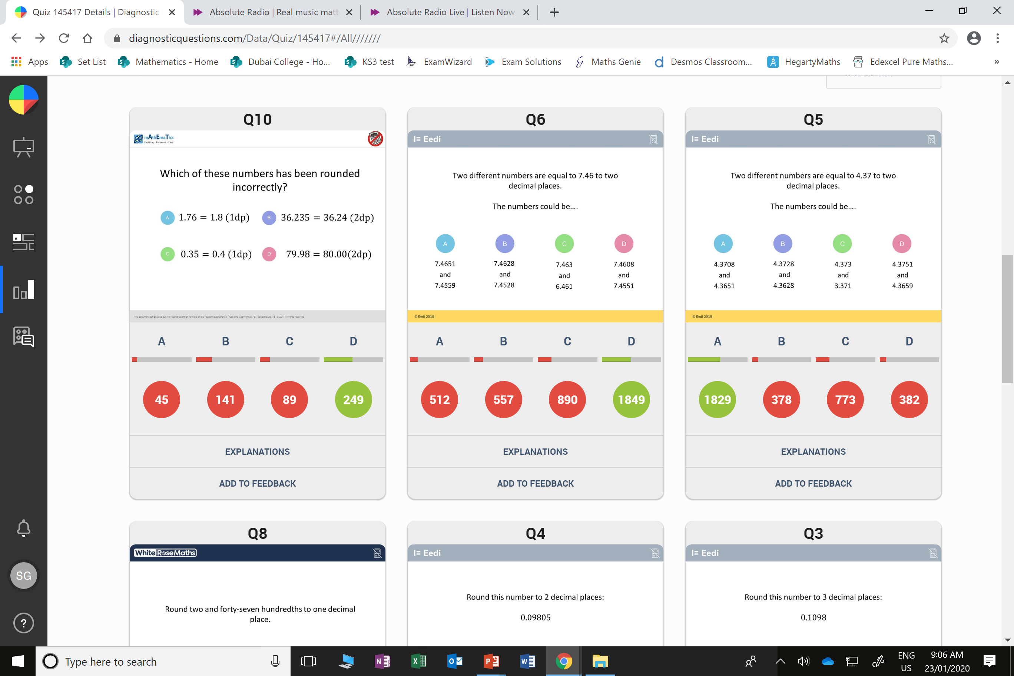
B
They did know if it is 5 you should round up.

Slide 5
C
They forget to look at the units of 6.461

