Slide 1
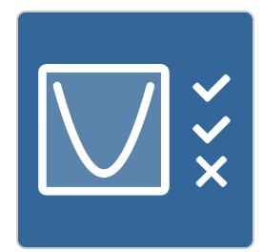
Two Truths and a Lie
Activity: Click on the icon
Student write 3 statements about a parabola.
The other students need to identify the lie.

