Slide 1
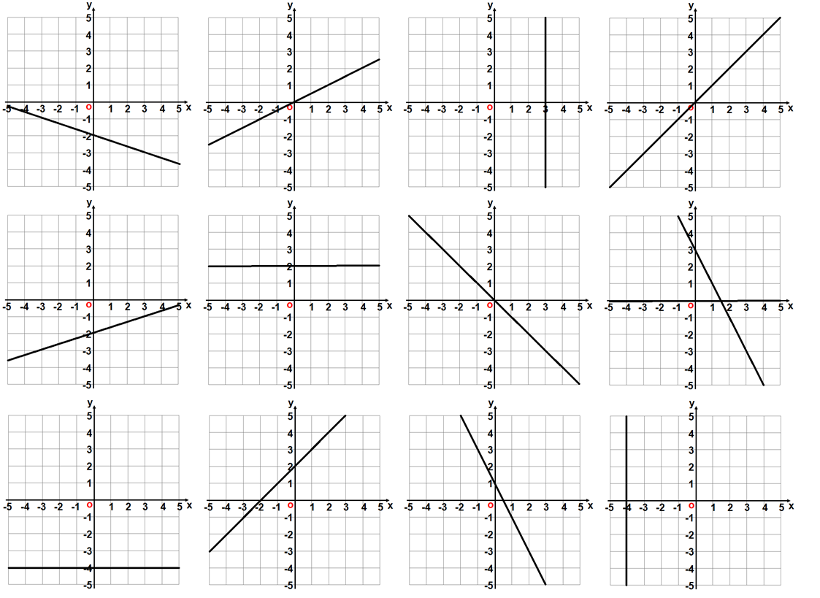
1
2
3
4
5
6
7
8
9
10
11
12

Slide 2
Answers

Slide 3

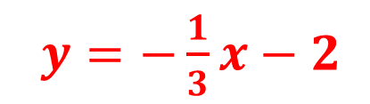
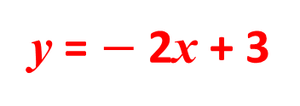
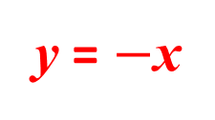
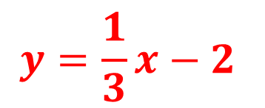

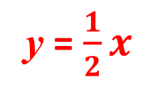
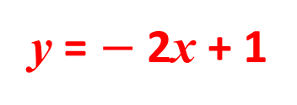
1
$y=−\frac{1}{3}x−2$
2
y = $\frac{1}{2}x$
3
4
x = 3
y = x
5
6
7
8
$$y=\frac{1}{3}x−2$$
y = $−$x
y = 2
y = $−$2x + 3
9
10
11
12
$$y=−4$$
$$x=−4$$
y = x + 2
y = $−$2x + 1

