Slide 1
FM: Stationary Points

Slide 2
Can you identify a stationary point
on the curve?
Local maximum
Local minimum

Slide 3


What can you stay about the
stationary points and their gradients?
$$f^{′}\left(x\right)=0$$
$$f^{′}\left(x\right)=0$$

Slide 4
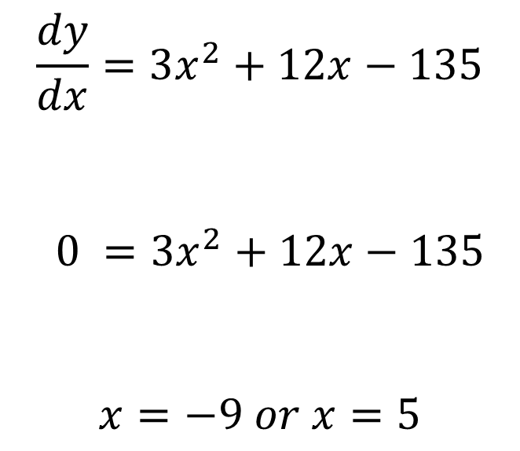
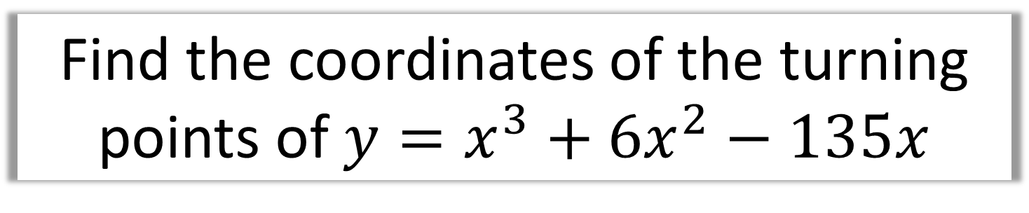


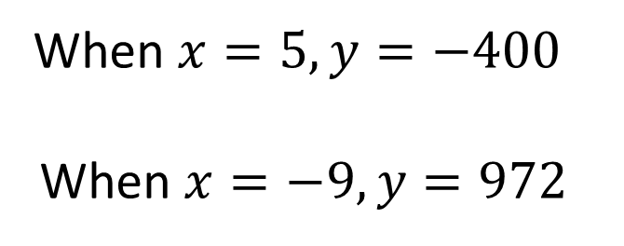
Find the coordinates of the turning points of $y=x^{3}+6x^{2}−135x$
$$\frac{dy}{dx}=3x^{2}+12x−135$$
$$0 =3x^{2}+12x−135$$
$$x=−9 or x=5$$
When $x=5, y=−400$
When $x=−9, y=972$
$$(−9 ,972)$$
$$\left(5 ,−400\right)$$

Slide 5
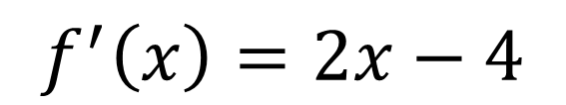



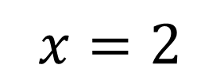
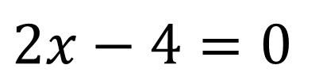
Find the smallest value of
$$f\left(x\right)=x^{2}−4x+9$$
$$f^{′}\left(x\right)=2x−4$$
$$f\left(2\right)=2^{2}−4\left(2\right)+9$$
$$2x−4=0$$
$$f\left(2\right)=5$$
$$x=2$$
5 is the minimum value.

Slide 6
How do you tell what type of stationary point?
Look at gradient just before and just after point.
Local Minimum
Gradient just before | Gradient at minimum | Gradient just after
- gradient | 0 | + gradient

Slide 7
How do you tell what type of stationary point?
Look at gradient just before and just after point.
Local Maximum
Gradient just before | Gradient at maximum | Gradient just after
+ gradient | 0 | - gradient

Slide 8
The second derivative
tells you the rate at which
the gradient is changing.

Slide 9
If the second derivative is positive,
the gradient is increasing.
Local Minimum
Gradient just before | Gradient at minimum | Gradient just after
- gradient | 0 | + gradient

Slide 10
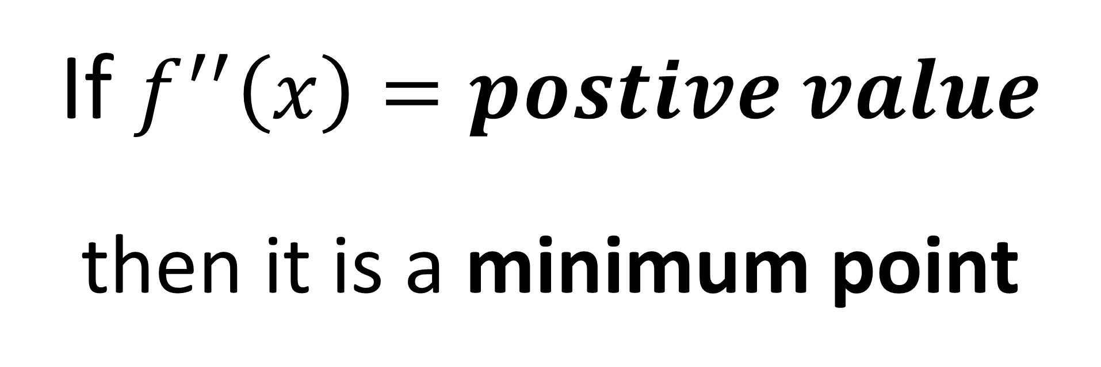
If $f^{′′}\left(x\right)=postive value$
then it is a minimum point

Slide 11
If the second derivative is negative,
the gradient is decreasing.
Local Maximum
Gradient just before | Gradient at maximum | Gradient just after
+ gradient | 0 | - gradient

Slide 12
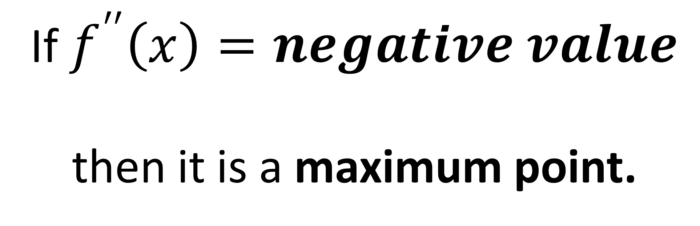
If $f^{′′}\left(x\right)=negative value$
then it is a maximum point.

Slide 13
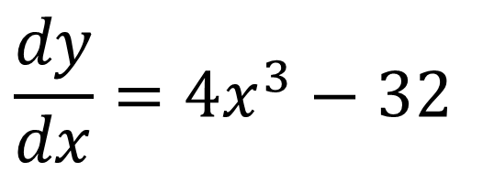

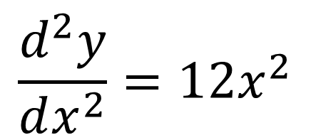
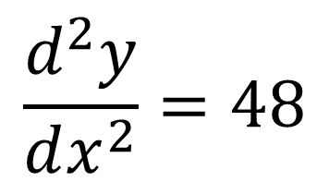
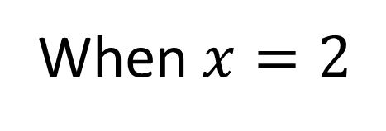
The stationary point of $y=x^{4}−32x$ is $\left(2,−48\right)$.
Use the second derivative to classify this stationary point.
When $x=2$
$$\frac{dy}{dx}=4x^{3}−32$$
$$\frac{d^{2}y}{dx^{2}}=48$$
$$\frac{d^{2}y}{dx^{2}}=12x^{2}$$
48 is positive therefore
minimum point.

Slide 14
