Slide 1
LO: Trial and
Improvement

Slide 2
Evaluate the expressions when x = –2
5x²
= 5(–2)²
= 5 x 4 =
20

Slide 3
Evaluate the expressions when x = –2
2x² – 4
= 2(–2)² – 4
= 8 – 4
= 4

Slide 4
Evaluate the expressions when x = –2
= x² – x
= (–2)² – –2
= 4 + 2 =
6

Slide 5
Evaluate the expressions when x = –2
= 3x² – 2x
= 3(–2)² – 2(–2)
= 12 + 4 =
16

Slide 6
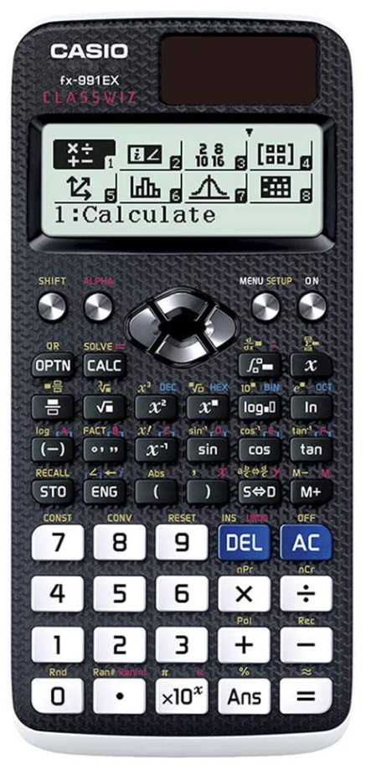
If at first you don’t
succeed then
try, try and
try again.

Slide 7
x | x² = 22
4.0
4.1 | 16.81
4.2 | 17.64
4.3 | 18.49
4.4 | 19.36
4.5 | 20.25
4.6 | 21.16
4.7 | 22.09
4.8 | 23.04
4.9 | 24.01
5.0
Which value of x gets you
closest to 22?

Slide 8
x | x² = 22
4.1 | 16.81 | small
4.2 | 17.64 | small
4.3 | 18.49 | small
4.4 | 19.36 | small
4.5 | 20.25 | small
4.6 | 21.16 | small
4.7 | 22.09 | big
4.8 | 23.04 | big
4.9 | 24.01 | big
4.6
or
4.7
4.6 | 21.16 | small
4.7 | 22.09 | big

Slide 9
x | x² = 22
4.1 | 16.81
4.2 | 17.64
4.3 | 18.49
4.4 | 19.36
4.5 | 20.25
4.6 | 21.16
4.7 | 22.09
4.8 | 23.04
4.9 | 24.01
Which one?
4.6 | 21.16 | Small
4.65 | 21.62 | Small
4.6 | 21.16
4.7 | 22.09
4.7 | 22.09 | Big

Slide 10
x | Equation = 40
6.0 | 37.02 | Small
6.1 | 37.21 | Small
6.2 | 38.44 | Small
6.3 | 39.69 | Small
6.4 | 40.96 | Big
6.5 | 42.25 | Big
6.6 | 43.56 | Big
6.7 | 44.89 | Big
6.8 | 46.24 | Big
6.9 | 47.61 | Big
7.0 | 48.10 | Big
Which one?
6.3 | 39.69 | Small
6.4 | 40.96 | Big
6.3 | 39.69 | Small
6.35 | 40.12 | Big
6.4 | 40.96 | Big

Slide 11
x | Equation = 8
6.0 | 7.10 | Small
6.1 | 7.21 | Small
6.2 | 7.34 | Small
6.3 | 7.55 | Small
6.4 | 7.78 | Small
6.5 | 7.82 | Small
6.6 | 7.88 | Small
6.7 | 7.91 | Small
6.8 | 7.96 | Small
6.9 | 8.01 | Big
7.0 | 8.32 | Big
Which one?
6.8 | 7.96 | Small
6.85 | 7.98 | Small
6.9 | 8.01 | Big
6.8 | 7.96 | Small
6.9 | 8.01 | Big

Slide 12
x | Equation = 27
12.0 | 26.90 | Small
12.1 | 27.21 | Big
12.2 | 27.34 | Big
12.3 | 27.55 | Big
12.4 | 28.78 | Big
12.5 | 28.82 | Big
12.6 | 28.88 | Big
12.7 | 28.91 | Big
12.8 | 29.96 | Big
12.9 | 29.01 | Big
13.0 | 30.32 | Big
12.0 | 26.90 | Small
12.1 | 27.21 | Big
Which one?
12.0 | 26.90 | Small
12.05 | 27.01 | Big
12.1 | 27.21 | Big

Slide 13
Is the best solution 5.2 or 5.3?
5.2 | too small
5.25 | too small
5.3 | too big

Slide 14
Is the best solution 8.0 or 8.1?
8.0 | too small
8.05 | too big
8.1 | too big

Slide 15
Is the best solution 7.5 or 7.6?
7.5 | too small
7.55 | too big
7.6 | too big

Slide 16
Is the best solution 25.2 or 25.3?
25.2 | too small
25.25 | too small
25.3 | too big

Slide 17
Use trial and improvement to
find x to 1 decimal place
x² + 4 = 34
x | x² + 4 = 34
5.4
5.5
33.16
34.25
Small
Big
5.45 | 33.7 | Small
x = 5.5

Slide 18
Use trial and improvement to
find x to 1 decimal place
x² + x = 36
x | x² + x = 36
5.5
5.6
35.75
36.96
Small
Big
5.55 | 36.35 | Big
x = 5.5

Slide 19
Use trial and improvement to
find x to 1 decimal place
x² – 2x = 45
x | x² – 2x = 45
7.7
7.8
43.89
45.24
Small
Big
7.75 | 44.56 | Small
x = 7.8

