Slide 1
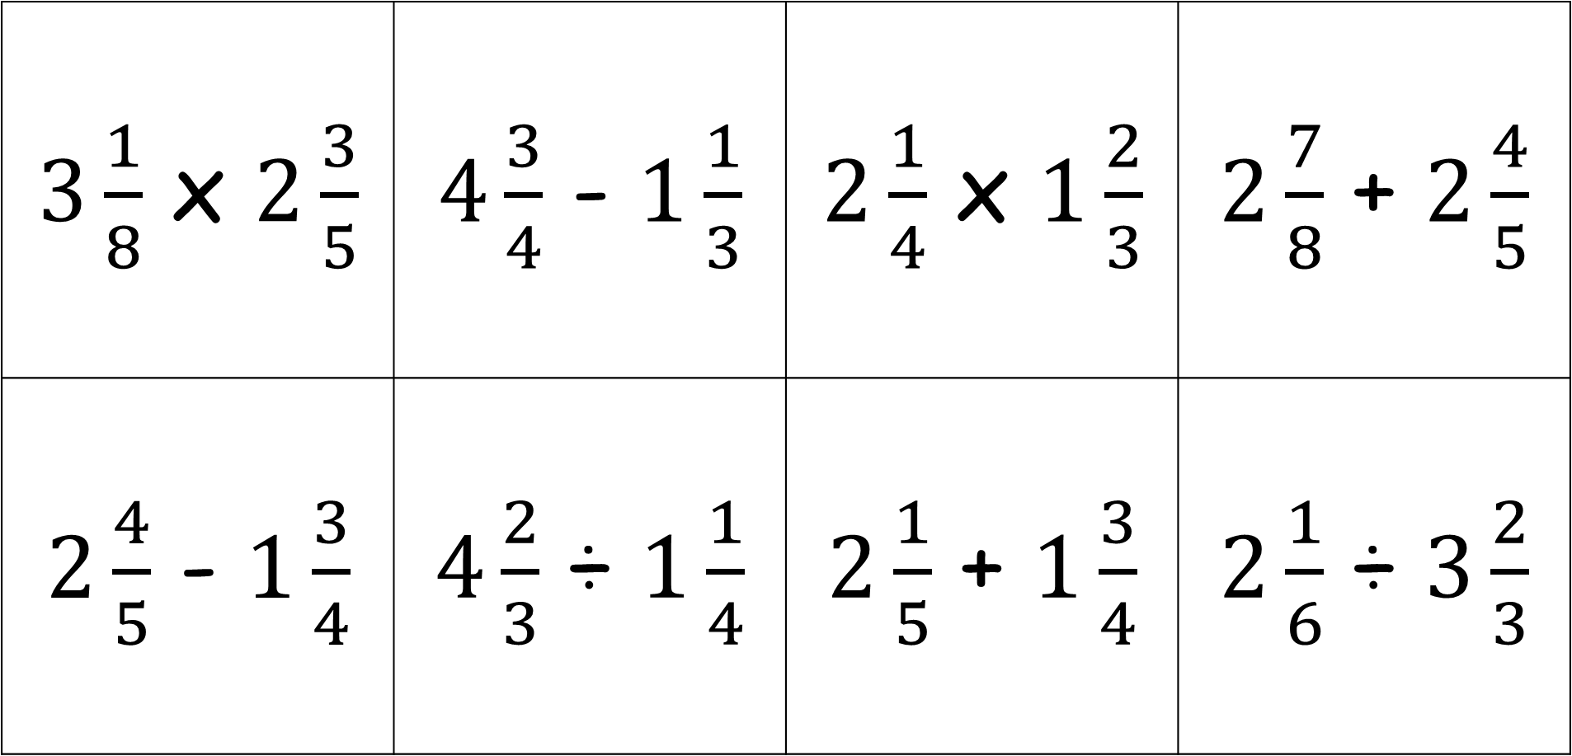
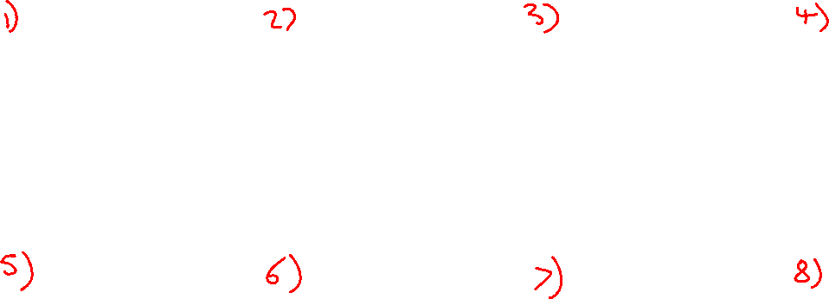
Mixed Numbers Calculations (Give you answers as mixed fractions)
$3\frac{1}{8}$ x $2\frac{3}{5}$ | $4\frac{3}{4}$ - $1\frac{1}{3}$ | $2\frac{1}{4}$ x $1\frac{2}{3}$ | $2\frac{7}{8}$ + $2\frac{4}{5}$
$2\frac{4}{5}$ - $1\frac{3}{4}$ | $4\frac{2}{3}$ ÷ $1\frac{1}{4}$ | $2\frac{1}{5}$ + $1\frac{3}{4}$ | $2\frac{1}{6}$ ÷ $3\frac{2}{3}$

Slide 2
ANSWERS

Slide 3
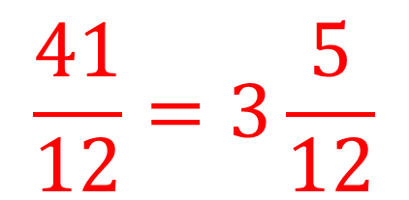
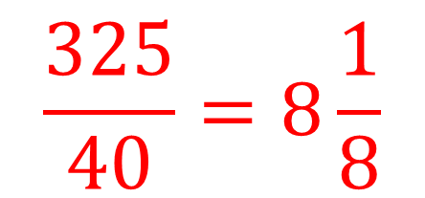
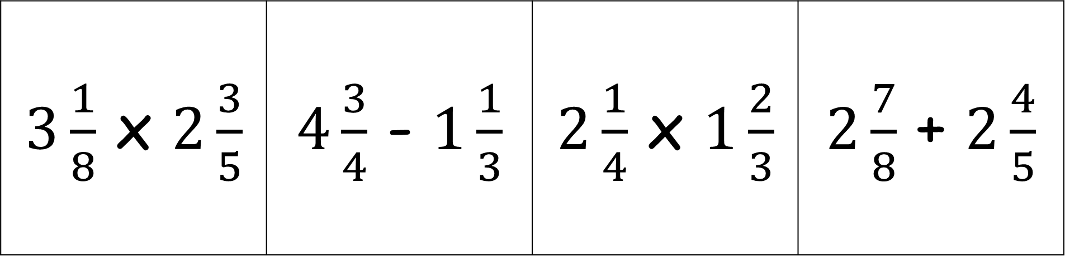
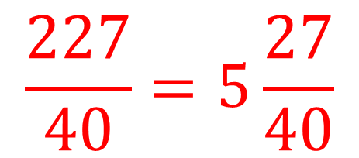
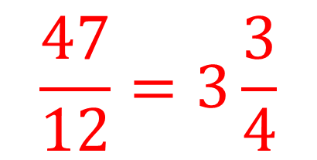
$3\frac{1}{8}$ x $2\frac{3}{5}$ | $4\frac{3}{4}$ - $1\frac{1}{3}$ | $2\frac{1}{4}$ x $1\frac{2}{3}$ | $2\frac{7}{8}$ + $2\frac{4}{5}$
$$\frac{41}{12}=3\frac{5}{12}$$
$$\frac{227}{40}=5\frac{27}{40}$$
$$\frac{325}{40}=8\frac{1}{8}$$
$$\frac{47}{12}=3\frac{3}{4}$$

Slide 4
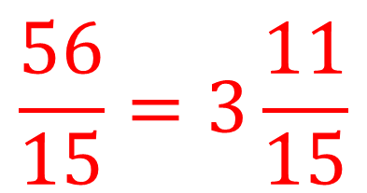
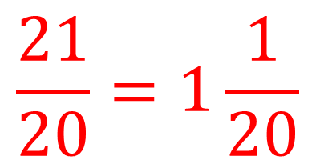
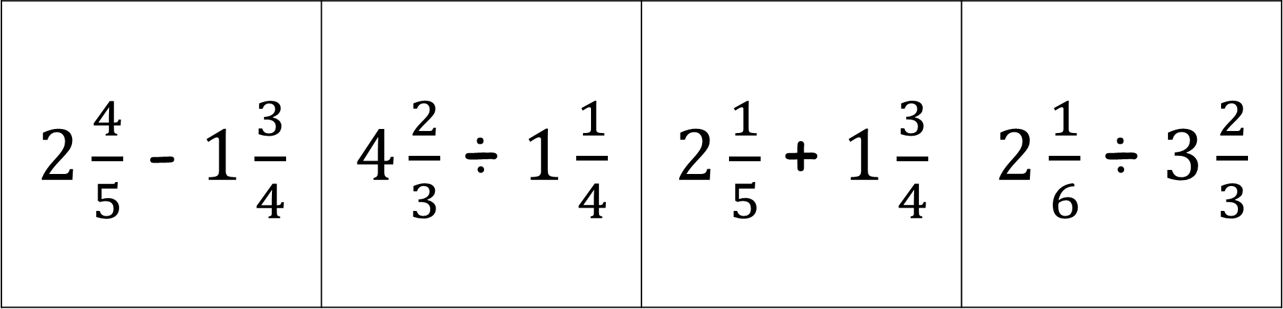
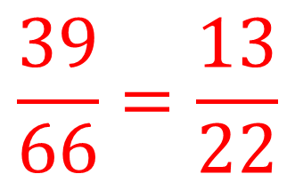
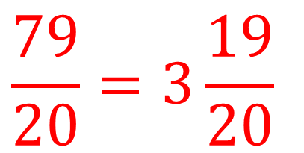
$2\frac{4}{5}$ - $1\frac{3}{4}$ | $4\frac{2}{3}$ ÷ $1\frac{1}{4}$ | $2\frac{1}{5}$ + $1\frac{3}{4}$ | $2\frac{1}{6}$ ÷ $3\frac{2}{3}$
$$\frac{56}{15}=3\frac{11}{15}$$
$$\frac{39}{66}=\frac{13}{22}$$
$$\frac{21}{20}=1\frac{1}{20}$$
$$\frac{79}{20}=3\frac{19}{20}$$

