Slide 1
Integration
Standard Functions
Chapter 11
(Part 1 of 12)

Slide 2
There’s certain results you should be able to integrate straight off.
Think about the opposite of differentiation to help you answer.

Slide 3
Standard Functions
(Know them!)

Slide 4
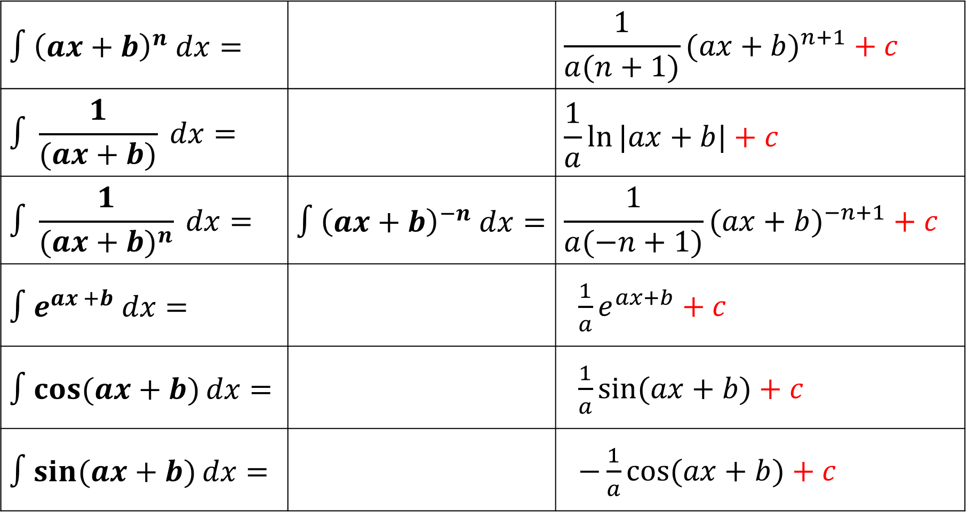

$$∫{\left(ax+b\right)}^{n} dx=$$ |  | $$\frac{1}{a(n+1)}{(ax+b)}^{n+1} + c$$
$$∫\frac{1}{(ax+b)} dx=$$ |  | $$\frac{1}{a}ln{|ax+b|}+c$$
$$∫\frac{1}{{(ax+b)}^{n}} dx=$$ | $$∫{\left(ax+b\right)}^{−n} dx=$$ | $$\frac{1}{a(−n+1)}{(ax+b)}^{−n+1} + c$$
$${∫e}^{ax +b} dx=$$ |  | $\frac{1}{a}e^{ax+b}+c$
$$∫cos{(ax+b)}dx=$$ |  | $\frac{1}{a}\sin{(ax+b)}+c$
$$∫sin{(ax+b)}dx=$$ |  | $−\frac{1}{a}\cos{(ax+b)}+c$
$$n≠1$$

Slide 5
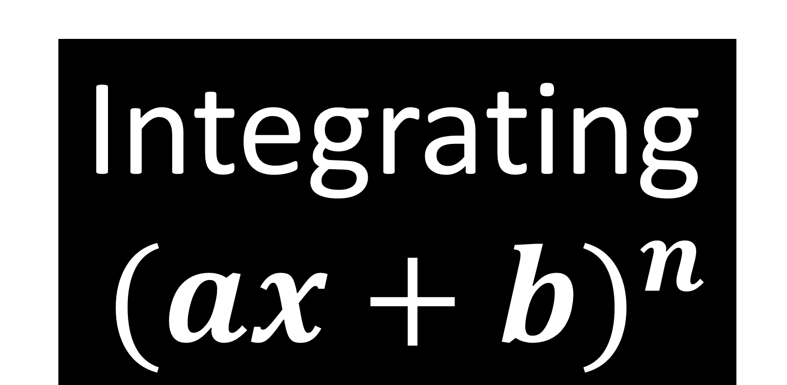
Integrating
${(ax+b)}^{n}$

Slide 6
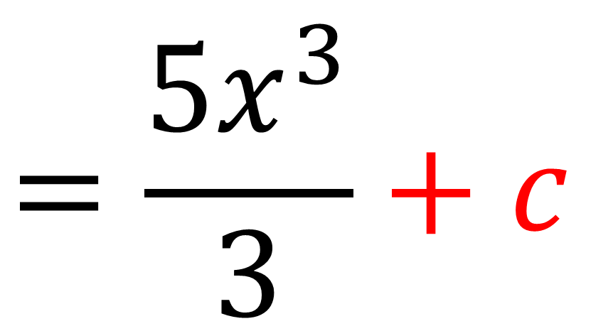
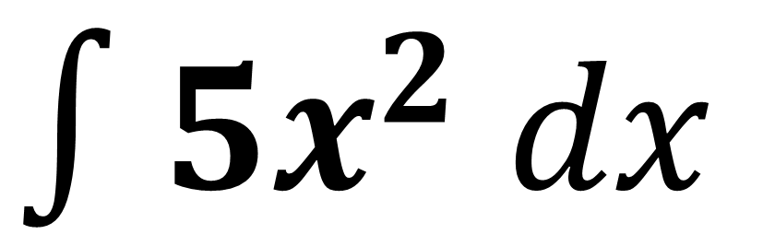
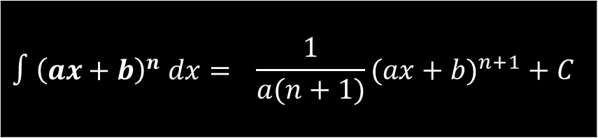
$$∫{\left(ax+b\right)}^{n} dx=$$ | $$\frac{1}{a(n+1)}{(ax+b)}^{n+1} + C$$
$∫{5x}^{2}$ $dx$
$$=\frac{{5x}^{3}}{3}+c$$

Slide 7
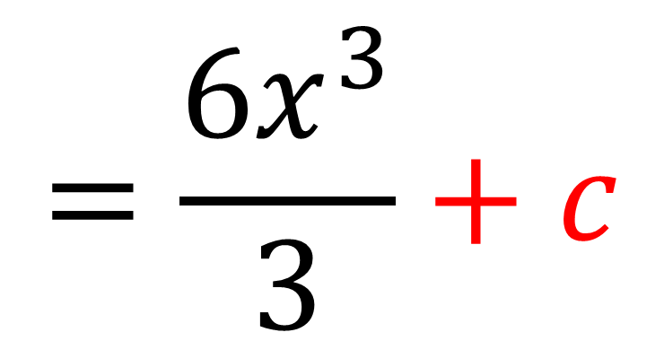
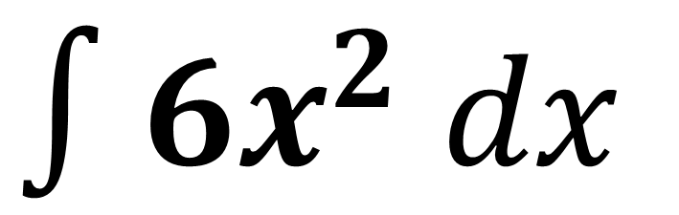

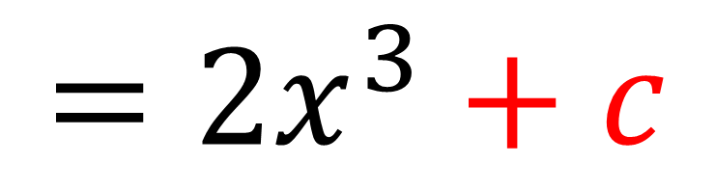
$$∫{\left(ax+b\right)}^{n} dx=$$ | $$\frac{1}{a(n+1)}{(ax+b)}^{n+1} + C$$
$∫{6x}^{2}$ $dx$
$$=\frac{6x^{3}}{3}+c$$
$$=2x^{3}+c$$

Slide 8
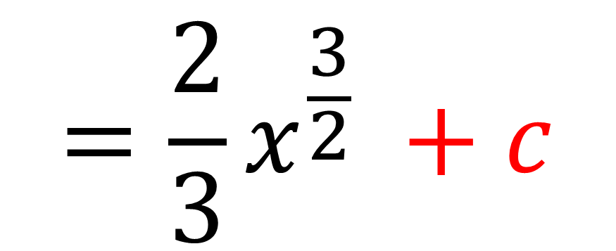
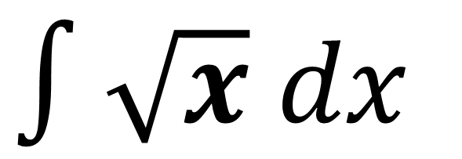
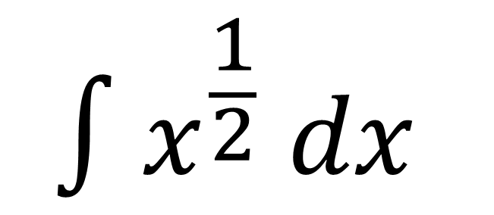
$$∫{\left(ax+b\right)}^{n} dx=$$ | $$\frac{1}{a(n+1)}{(ax+b)}^{n+1} + C$$
$∫\sqrt{x}$ $dx$
$$∫x^{\frac{1}{2}} dx$$
$$=\frac{2}{3}x^{\frac{3}{2}} +c$$

Slide 9
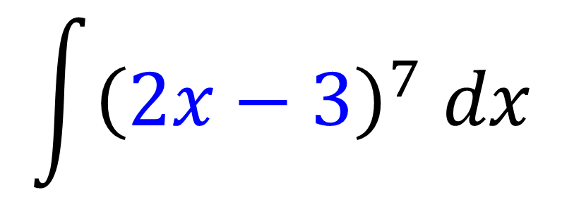
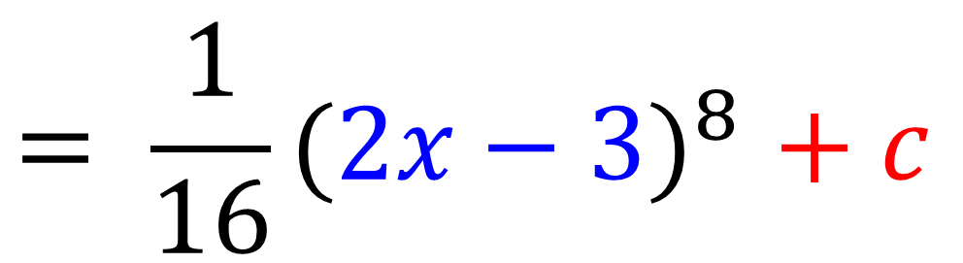

$$∫{\left(ax+b\right)}^{n} dx=$$ | $$\frac{1}{a(n+1)}{(ax+b)}^{n+1} + C$$
$$\int{{\left(2x−3\right)}^{7} dx}$$
$${= \frac{1}{16}(2x−3)}^{8}+ c$$

Slide 10
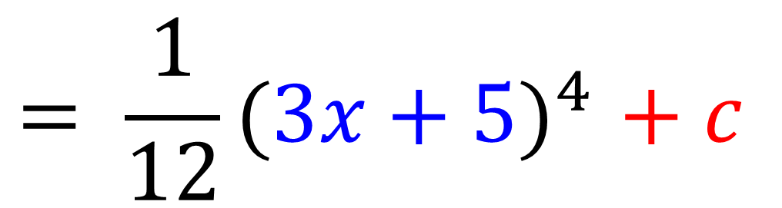
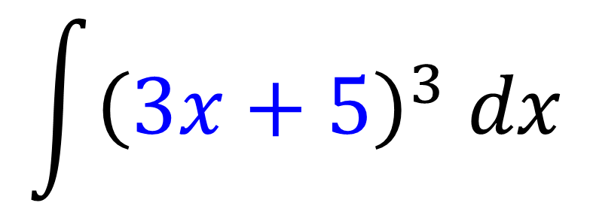
$$∫{\left(ax+b\right)}^{n} dx=$$ | $$\frac{1}{a(n+1)}{(ax+b)}^{n+1} + C$$
$$\int{{\left(3x+5\right)}^{3} dx}$$
$${= \frac{1}{12}(3x+5)}^{4}+ c$$

Slide 11
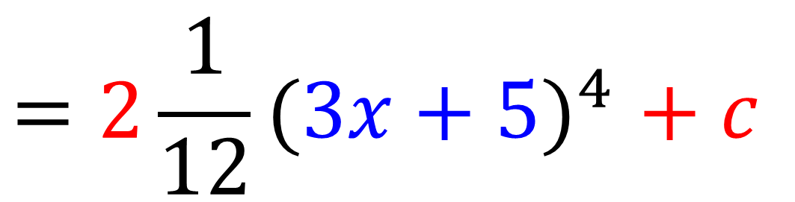
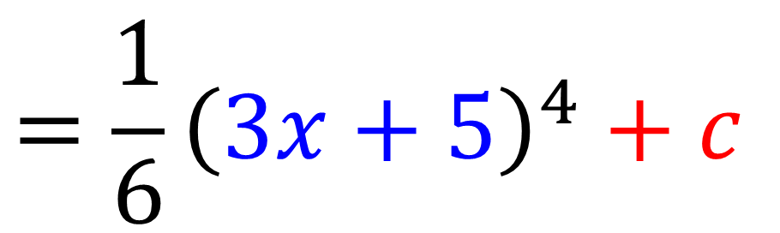
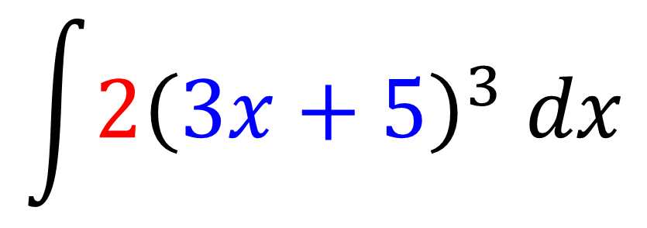
$$∫{\left(ax+b\right)}^{n} dx=$$ | $$\frac{1}{a(n+1)}{(ax+b)}^{n+1} + C$$
$$\int{2{\left(3x+5\right)}^{3} dx}$$
$${=2\frac{1}{12}(3x+5)}^{4}+ c$$
$$={\frac{1}{6}\left(3x+5\right)}^{4}+c$$

Slide 12
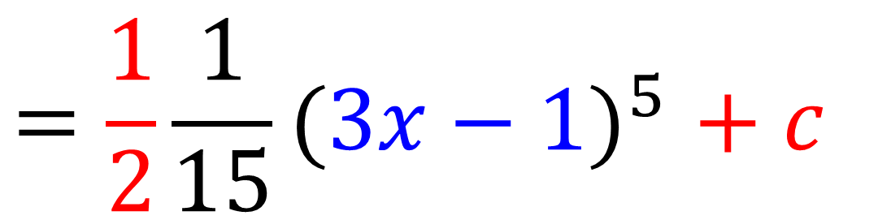
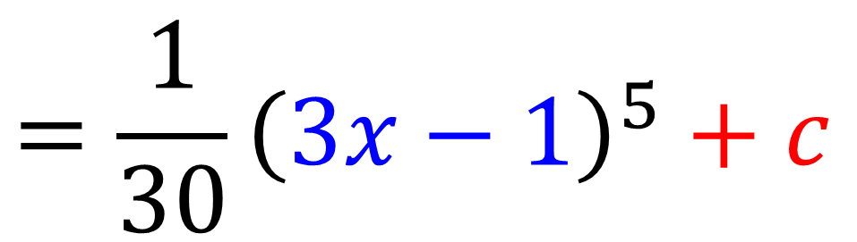
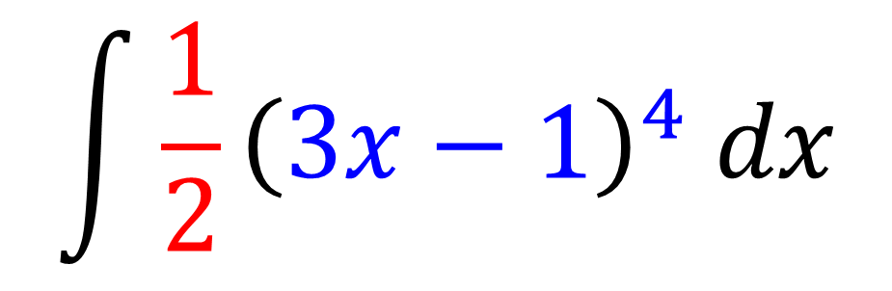
$$∫{\left(ax+b\right)}^{n} dx=$$ | $$\frac{1}{a(n+1)}{(ax+b)}^{n+1} + C$$
$$\int{{\frac{1}{2}\left(3x−1\right)}^{4} dx}$$
$${=\frac{1}{2}\frac{1}{15}(3x−1)}^{5}+ c$$
$$={\frac{1}{30}\left(3x−1\right)}^{5}+c$$

Slide 13
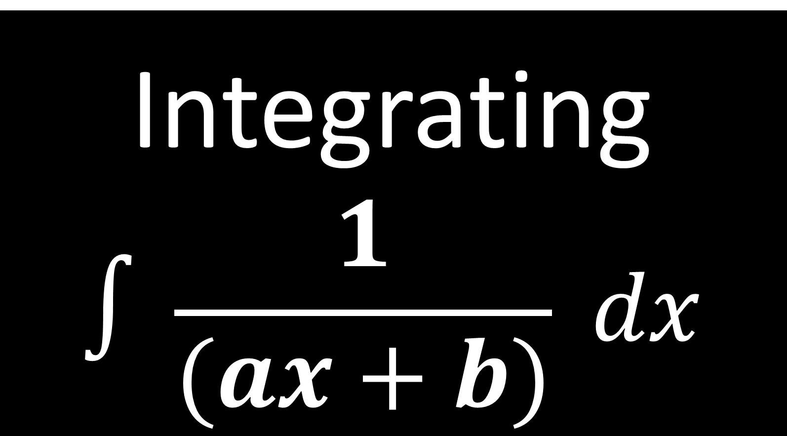
Integrating
$$∫\frac{1}{(ax+b)} dx$$

Slide 14
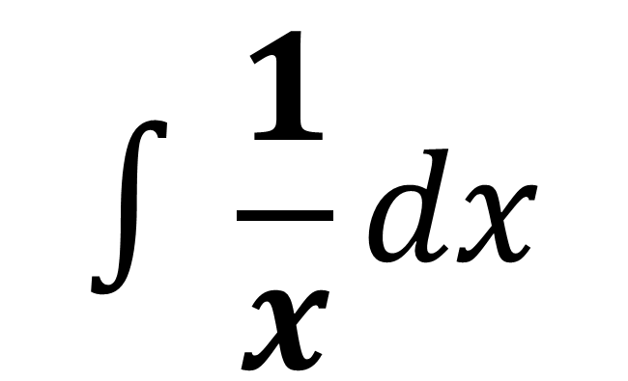
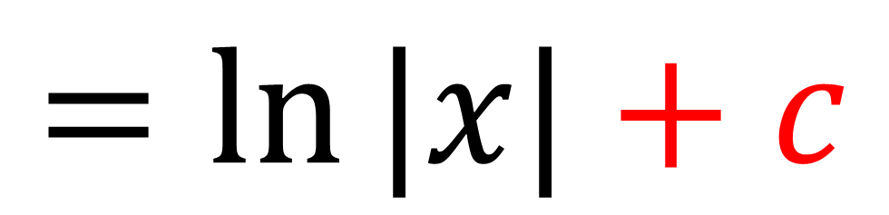
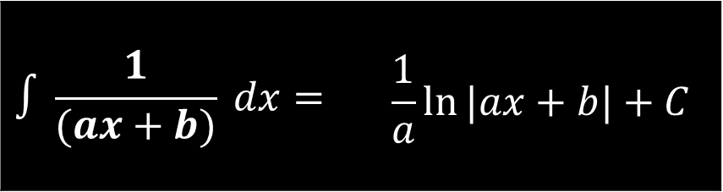
$$∫\frac{1}{(ax+b)} dx=$$ | $$\frac{1}{a}ln{|ax+b|}+C$$
$$∫\frac{1}{x}dx$$
$$=ln{|x|}+c$$

Slide 15
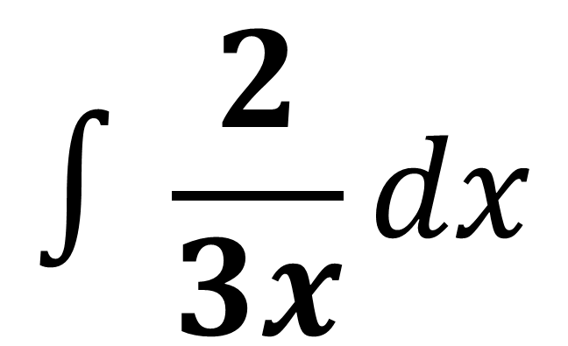
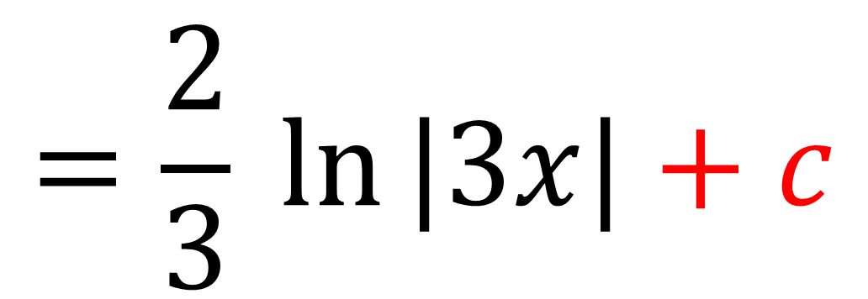
$$∫\frac{1}{(ax+b)} dx=$$ | $$\frac{1}{a}ln{|ax+b|}+C$$
$$∫\frac{2}{3x}dx$$
$$=\frac{2}{3} ln{|3x|}+c$$

Slide 16

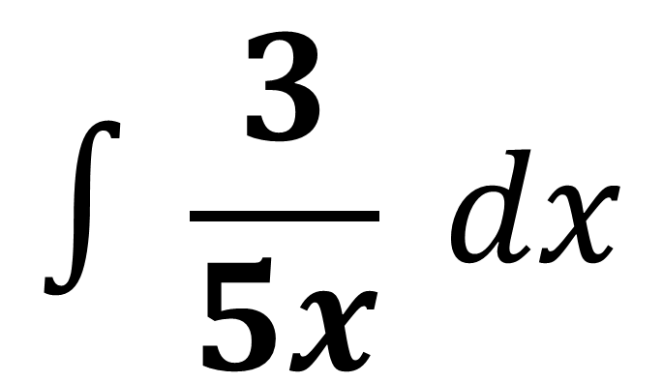
$$∫\frac{1}{(ax+b)} dx=$$ | $$\frac{1}{a}ln{|ax+b|}+C$$
$$∫\frac{3}{5x} dx$$
$$=\frac{3}{5} ln{|5x|}+c$$

Slide 17
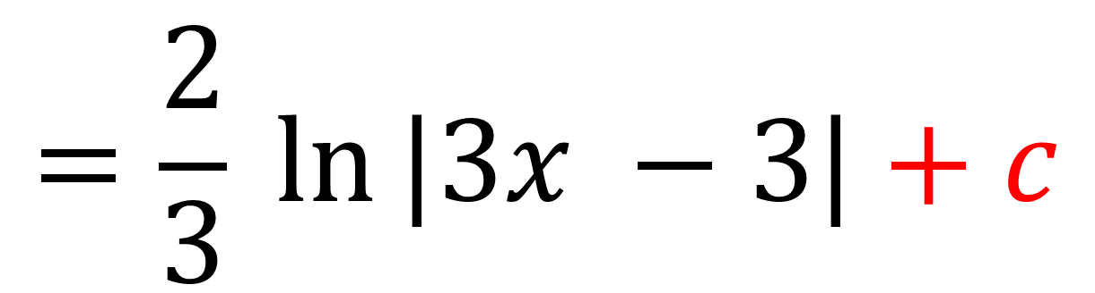
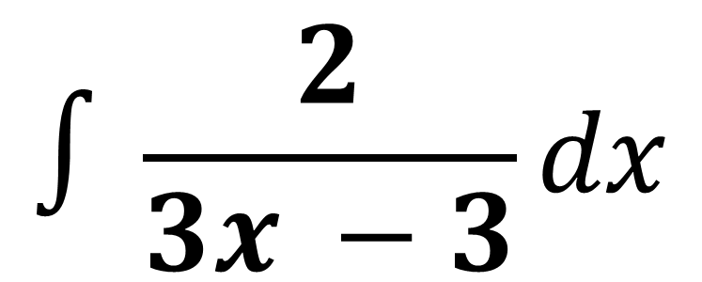
$$∫\frac{1}{(ax+b)} dx=$$ | $$\frac{1}{a}ln{|ax+b|}+C$$
$$∫\frac{2}{3x −3}dx$$
$$=\frac{2}{3} ln{|3x −3|}+c$$

Slide 18
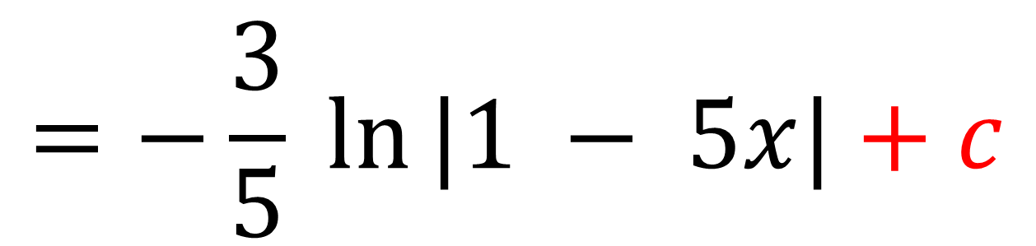
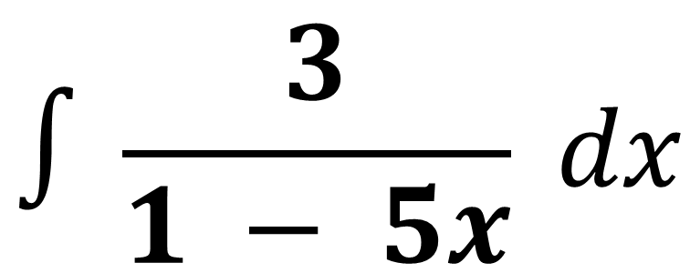
$$∫\frac{1}{(ax+b)} dx=$$ | $$\frac{1}{a}ln{|ax+b|}+C$$
$$∫\frac{3}{1 − 5x} dx$$
$$=−\frac{3}{5} ln{|1 − 5x|}+c$$

Slide 19
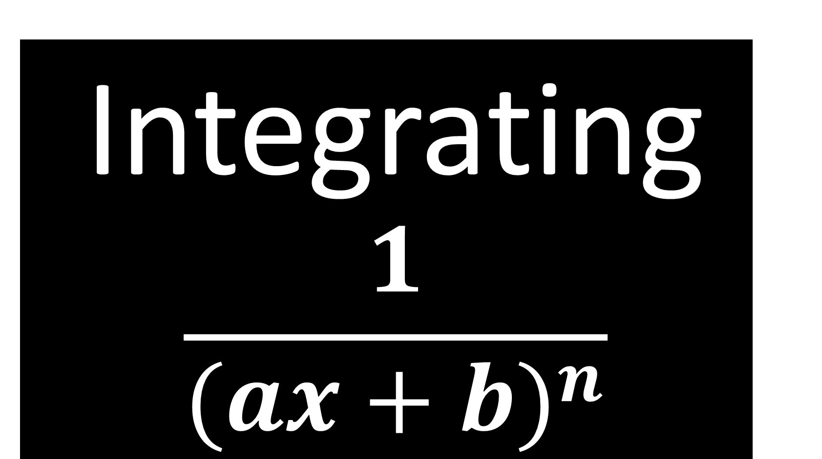
Integrating
$$\frac{1}{{(ax+b)}^{n}}$$

Slide 20
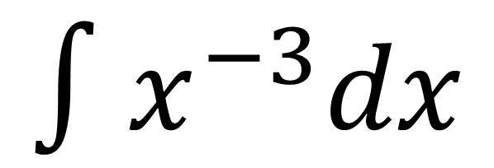
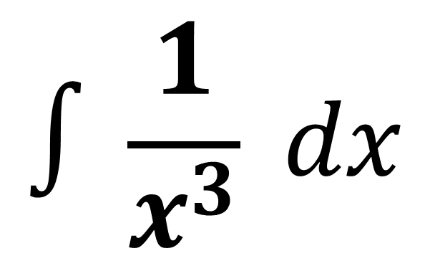
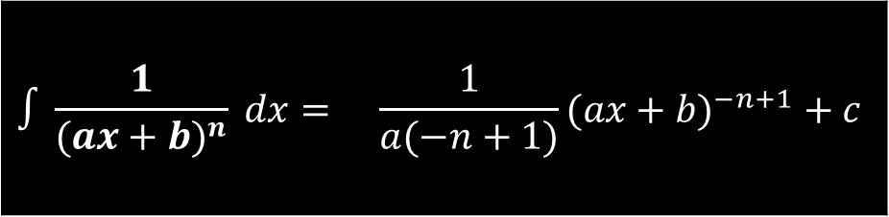
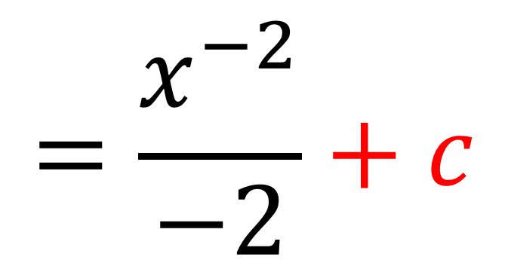
$$∫\frac{1}{x^{3}} dx$$
$$∫\frac{1}{{(ax+b)}^{n}} dx=$$ | $$\frac{1}{a(−n+1)}{(ax+b)}^{−n+1} + c$$
$$∫x^{−3}dx$$
$$=\frac{x^{−2}}{−2}+c$$

Slide 21
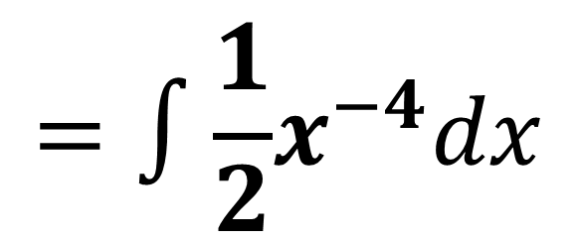
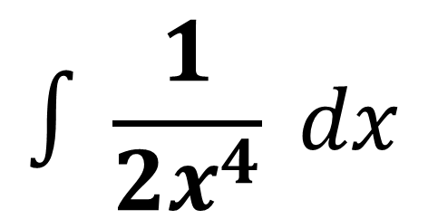
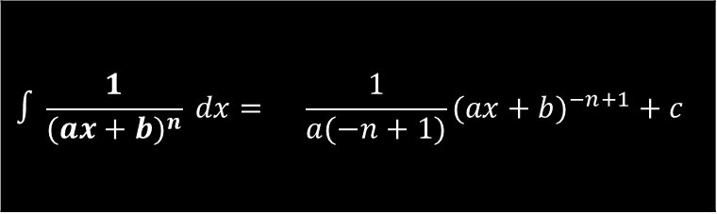
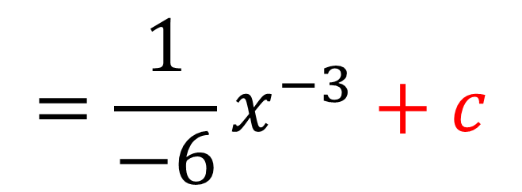
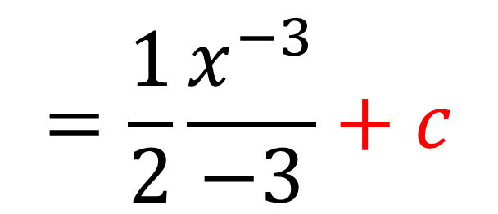
$$∫\frac{1}{{(ax+b)}^{n}} dx=$$ | $$\frac{1}{a(−n+1)}{(ax+b)}^{−n+1} + c$$
$$∫\frac{1}{2x^{4}} dx$$
$$=∫\frac{1}{2}x^{−4}dx$$
$$=\frac{1}{2}\frac{x^{−3}}{−3}+c$$
$$=\frac{1}{−6}x^{−3}+c$$

Slide 22
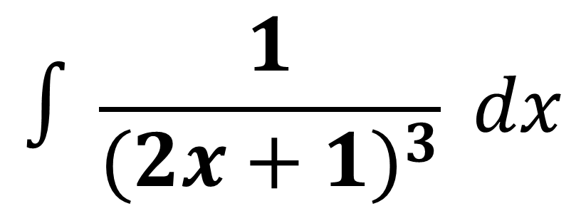
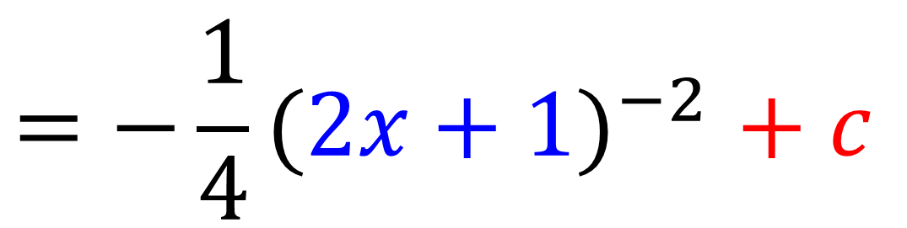
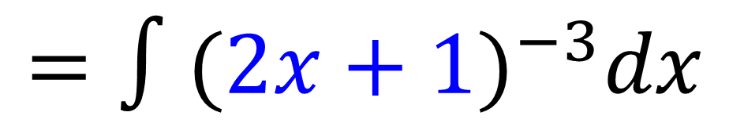
$$∫\frac{1}{{(ax+b)}^{n}} dx=$$ | $$\frac{1}{a(−n+1)}{(ax+b)}^{−n+1} + c$$
$$∫\frac{1}{{(2x+1)}^{3}} dx$$
$$=∫{(2x+1)}^{−3}dx$$
$${=−\frac{1}{4}(2x+1)}^{−2}+ c$$

Slide 23
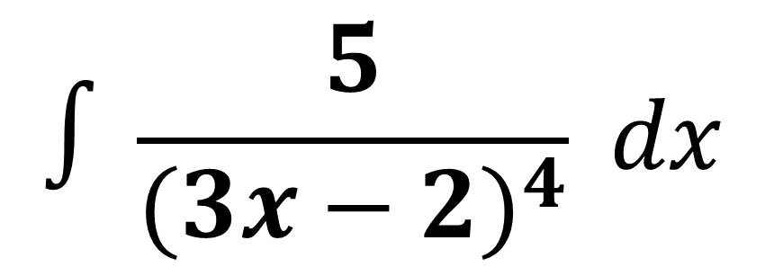
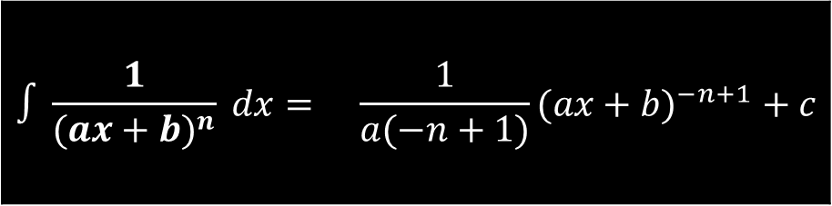
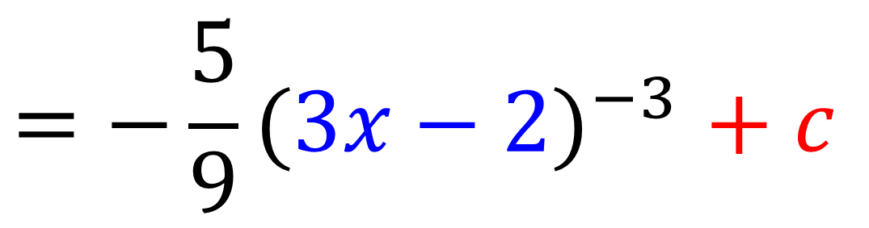
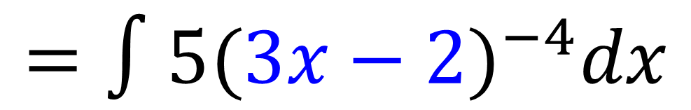
$$∫\frac{1}{{(ax+b)}^{n}} dx=$$ | $$\frac{1}{a(−n+1)}{(ax+b)}^{−n+1} + c$$
$$∫\frac{5}{{(3x−2)}^{4}} dx$$
$$=∫{5(3x−2)}^{−4}dx$$
$${=−\frac{5}{9}(3x−2)}^{−3}+ c$$

Slide 24

Integrating
$e^{ax + b }$

Slide 25
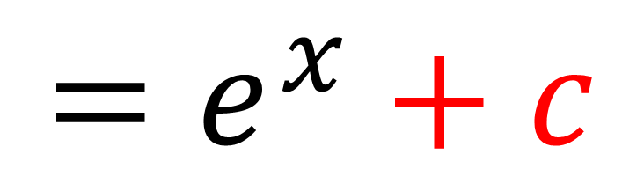


$${∫e}^{ax +b} dx=$$ | $\frac{1}{a}e^{ax+b}+c$
$∫e^{x}$ $dx$
$$=e^{x}+c$$

Slide 26


$${∫e}^{ax +b} dx=$$ | $\frac{1}{a}e^{ax+b}+c$
$∫e^{2x}$ $dx$
$$={\frac{1}{2}e}^{2x}+c$$

Slide 27


$${∫e}^{ax +b} dx=$$ | $\frac{1}{a}e^{ax+b}+c$
$${∫e}^{3x + 5} dx$$
$$=\frac{1}{3}e^{3x + 5}+c$$

Slide 28


$${∫e}^{ax +b} dx=$$ | $\frac{1}{a}e^{ax+b}+c$
$${∫e}^{5 − \frac{1}{2}x} dx$$
$$=−2e^{5 − \frac{1}{2}x}+c$$

Slide 29

Integrating
$$\cos{(ax+b)}$$

Slide 30



$$∫cos{(ax+b)}dx=$$ | $\frac{1}{a}\sin{(ax+b)}+c$
$$∫cos x dx$$
$$= sin{x}+c$$

Slide 31



$$∫cos{(ax+b)}dx=$$ | $\frac{1}{a}\sin{(ax+b)}+c$
$$∫cos{(5x−3)}dx$$
$$=\frac{1}{5}\sin{(5x−3)}+c$$

Slide 32


$$∫cos{(ax+b)}dx=$$ | $\frac{1}{a}\sin{(ax+b)}+c$
$$∫2cos{(5x−3)}dx$$
$$=\frac{2}{5}\sin{(5x−3)}+c$$

Slide 33

Integrating
$$\sin{(ax+b)}$$

Slide 34



$$∫sin{(ax+b)}dx=$$ | $−\frac{1}{a}\cos{(ax+b)}+c$
$$∫sin 2x dx$$
$$=−\frac{1}{2}\cos{2x}+c$$

Slide 35



$$∫sin{(ax+b)}dx=$$ | $−\frac{1}{a}\cos{(ax+b)}+c$
$$∫sin{(4x−2)}dx$$
$$=−\frac{1}{4}\cos{(4x−2)}+c$$

Slide 36


$$∫sin{(ax+b)}dx=$$ | $−\frac{1}{a}\cos{(ax+b)}+c$
$$∫sin{(2−4x)}dx$$
$$=\frac{1}{4}\cos{(2−4x)}+c$$

Slide 37
$$∫{\left(ax+b\right)}^{n} dx=$$ |  | $$\frac{1}{a(n+1)}{(ax+b)}^{n+1} + c$$
$$∫\frac{1}{(ax+b)} dx=$$ |  | $$\frac{1}{a}ln{|ax+b|}+c$$
$$∫\frac{1}{{(ax+b)}^{n}} dx=$$ | $$∫{\left(ax+b\right)}^{−n} dx=$$ | $$\frac{1}{a(−n+1)}{(ax+b)}^{−n+1} + c$$
$${∫e}^{ax +b} dx=$$ |  | $\frac{1}{a}e^{ax+b}+c$
$$∫cos{(ax+b)}dx=$$ |  | $\frac{1}{a}\sin{(ax+b)}+c$
$$∫sin{(ax+b)}dx=$$ |  | $−\frac{1}{a}\cos{(ax+b)}+c$
$$n≠1$$

Slide 38


$$\int{2\cos{x}+\frac{3}{x}−\sqrt{x} dx}$$
$$=2\sin{x}+3\ln{|x|}−\frac{2}{3}x^{\frac{3}{2}}+C$$

Slide 39


$$\int{3\sin\left(2x+1\right)+{2e}^{5x} dx}$$
$$=−\frac{3}{2}\cos\left(2x+1\right)+{\frac{2}{5}e}^{5x}+c$$

Slide 40



$$\int{\frac{1}{{(3x+1)}^{2}}+\frac{1}{2x+1} dx}$$
$$=\int{{(3x+1)}^{−2} + \frac{1}{2x+1} dx}$$
$$=−\frac{1}{3}{\left(3x+1\right)}^{−1}+\frac{1}{2}\ln\left|2x+1\right|+c$$

Slide 41












Given that $\int_{a}^{3a}{ 2+\frac{1}{x} dx}=\ln{12}$
find the exact value of $a$.
$$\int_{a}^{3a}{2+\frac{1}{x} dx}=$$
$${\left[2x+\ln{x}\right]}_{a}^{3a}$$
$$4a+\ln{3}=\ln{12}$$
$$4a=\ln{12}−\ln{3}$$
$$=\left(6a+\ln{3a}\right)−\left(2a+\ln{a}\right)$$
$$4a=\ln{4}$$
$$=6a+\ln{3a}−2a−\ln{a}$$
$$=6a−2a+\ln{3a}−\ln{a}$$
$$a=\frac{1}{4}\ln{4}$$
$$=4a+\ln\left(\frac{3a}{a}\right)$$
$$=4a+\ln{3}$$

Slide 42
Integrating
other trig functions
Use the formula booklet.

Slide 43


Slide 44





Integration
$$\frac{1}{k}$$
+ C
$$\frac{1}{k}$$
+ C
$$\frac{1}{k}$$
+ C
$$\frac{1}{k}$$
+ C

Slide 45


$$\int{\sec{x}\tan{x} dx}$$
$$=sec{x}+c$$

Slide 46


$$\int{cosec^{2} x dx}$$
$$=−\cot{x}+c$$

Slide 47


$$\int{\sec^{2}{3x} dx}$$
$$= \frac{1}{3}tan{3x}+c$$

Slide 48


$$\int{cosec 2x\cot{2x} dx}$$
$$=−\frac{1}{2}cosec 2x+c$$

Slide 49


$$\int{cosec^{2} 2x dx}$$
$$=−\frac{1}{2}\cot{2x}+c$$

Slide 50


$$\int{\sec{(\frac{1}{3}x)}\tan{(\frac{1}{3}x)} dx}$$
$$=3sec{\frac{1}{3}x}+c$$

Slide 51



$$\int{\frac{\cos{x}}{\sin^{2}{x}} dx}=$$
Hint: Rewrite using trig identities
$$\int{cosec x cot{x} dx}=$$
$$−cosec x+c$$

