Slide 1
Further Kinematics
Vectors and Projectiles
Chapter 8
(Part 2 of 5)

Slide 2
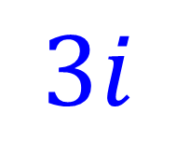


Vectors and Projectiles
$$3i+5j$$
$$5j$$
$$3i$$

Slide 3
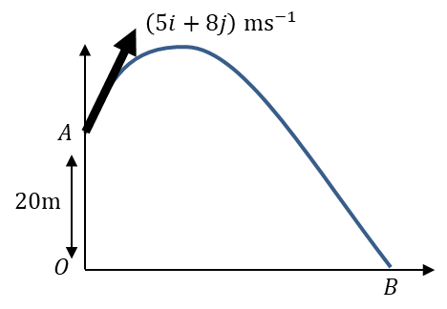


Horizontal Velocity $=$ 5 ms⁻¹
Vertical Velocity $=$ 8 ms⁻¹

Slide 4
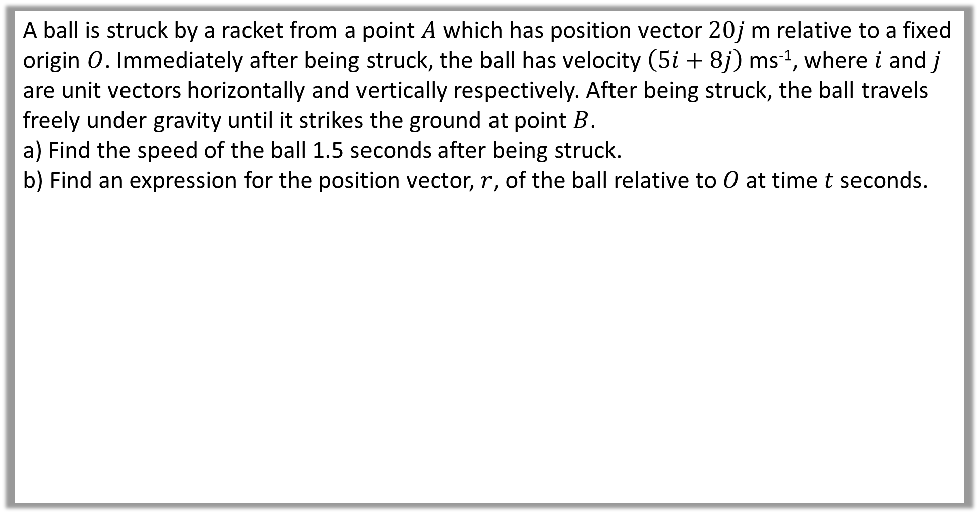
A ball is struck by a racket from a point $A$ which has position vector $20j$ m relative to a fixed origin $O$. Immediately after being struck, the ball has velocity $\left(5i+8j\right)$ ms⁻¹, where $i$ and $j$ are unit vectors horizontally and vertically respectively. After being struck, the ball travels freely under gravity until it strikes the ground at point $B$.
a) Find the speed of the ball 1.5 seconds after being struck.
b) Find an expression for the position vector, $r$, of the ball relative to $O$ at time $t$ seconds.

Slide 5





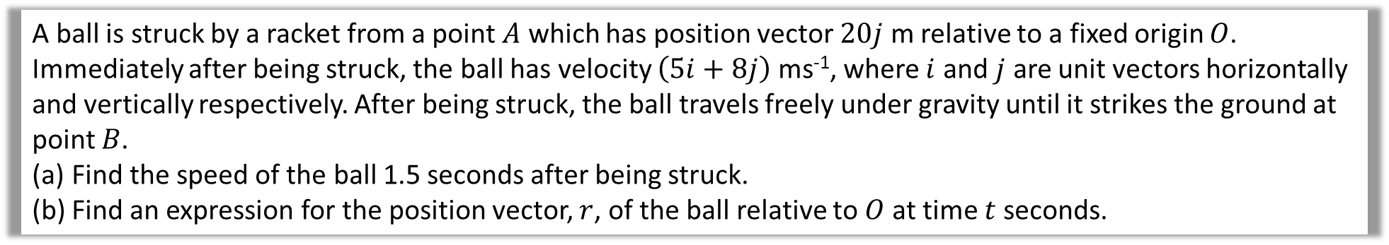
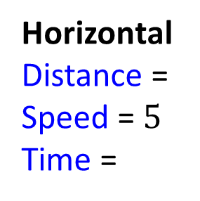

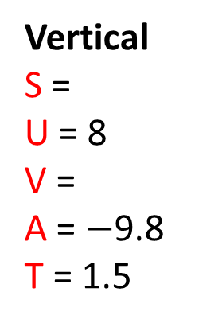


A ball is struck by a racket from a point $A$ which has position vector $20j$ m relative to a fixed origin $O$. Immediately after being struck, the ball has velocity $\left(5i+8j\right)$ ms⁻¹, where $i$ and $j$ are unit vectors horizontally and vertically respectively. After being struck, the ball travels freely under gravity until it strikes the ground at point $B$.
Find the speed of the ball 1.5 seconds after being struck.
Find an expression for the position vector, $r$, of the ball relative to $O$ at time $t$ seconds.
a
Vertical
S =
U = 8
V =
A = $−$9.8
T = 1.5
$$v=u+at$$
$$v=8+(−9.8)(1.5)$$
$$v=−6.7$$
$$5i$$
Horizontal
Distance =
Speed = $5$
Time =
$$−6.7j$$
$$5i−6.7j$$
Speed $=\left|v\right|=\sqrt{5^{2}+{6.7}^{2}}=8.4$ms⁻¹

Slide 6
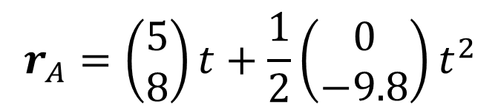

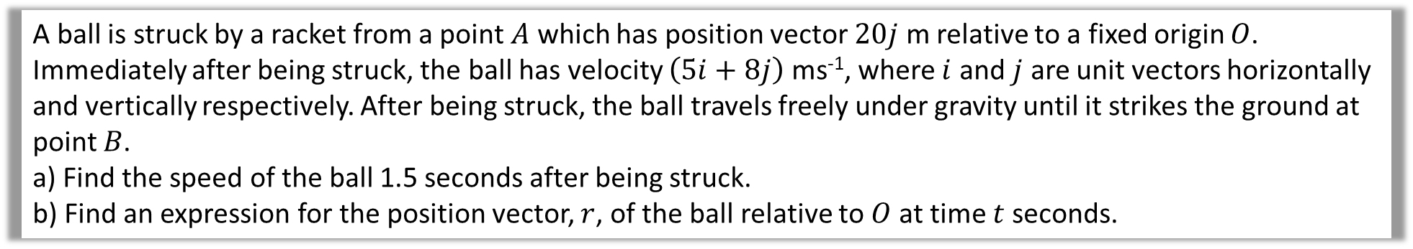
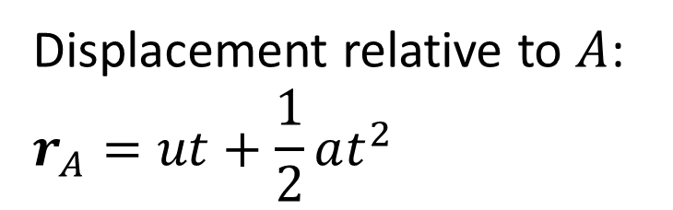
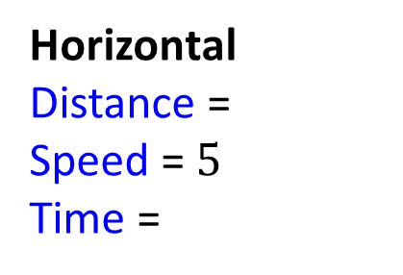
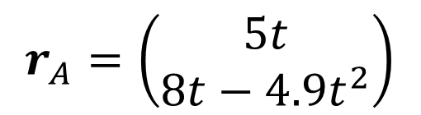
A ball is struck by a racket from a point $A$ which has position vector $20j$ m relative to a fixed origin $O$. Immediately after being struck, the ball has velocity $\left(5i+8j\right)$ ms⁻¹, where $i$ and $j$ are unit vectors horizontally and vertically respectively. After being struck, the ball travels freely under gravity until it strikes the ground at point $B$.
a) Find the speed of the ball 1.5 seconds after being struck.
b) Find an expression for the position vector, $r$, of the ball relative to $O$ at time $t$ seconds.
b
Vertical
S =
U = 8
V =
A = $−$9.8
T = 1.5
Displacement relative to $A$:
$$r_{A}=ut+\frac{1}{2}at^{2}$$
$$r_{A}=\left(\begin{matrix}5 \\ 8\end{matrix}\right)t+\frac{1}{2}\left(\begin{matrix}0 \\ −9.8\end{matrix}\right)t^{2}$$
Horizontal
Distance =
Speed = $5$
Time =
$$r_{A}=\left(\begin{matrix}5t \\ 8t−4.9t^{2}\end{matrix}\right)$$
$$r_{A}=\left(5t\right)i+\left(8t−4.9t^{2}\right)j$$

Slide 7
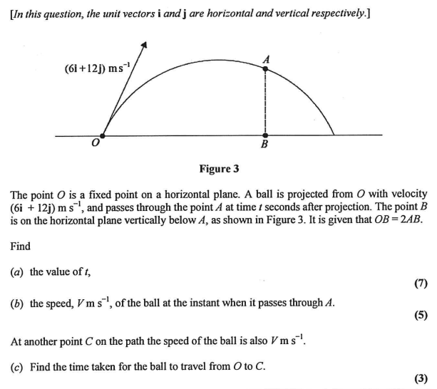

Slide 8
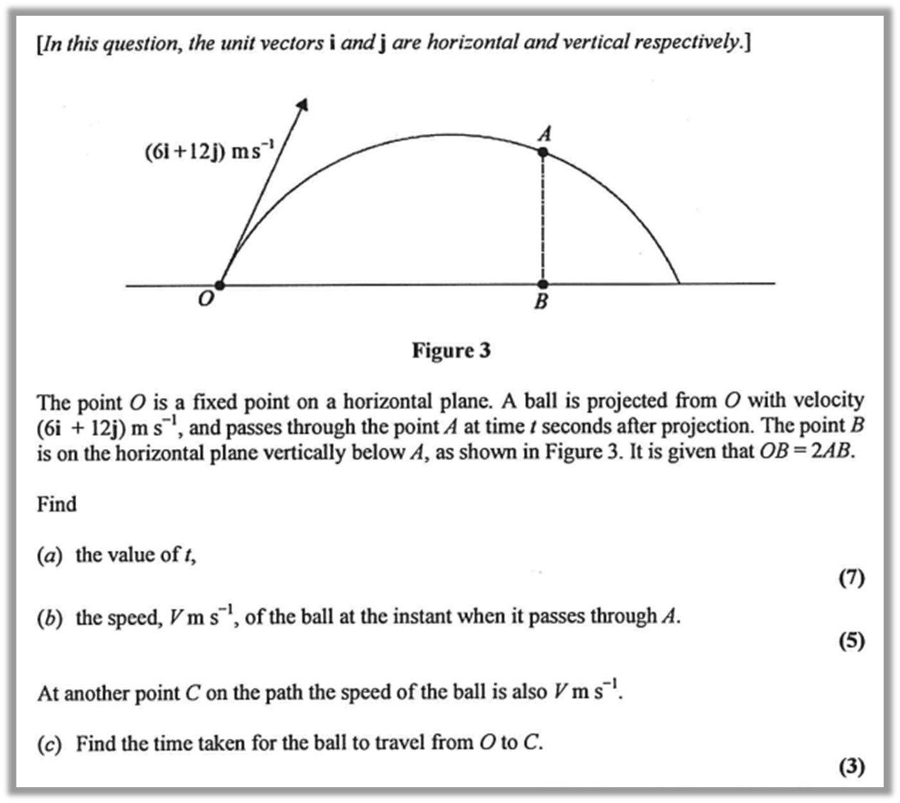
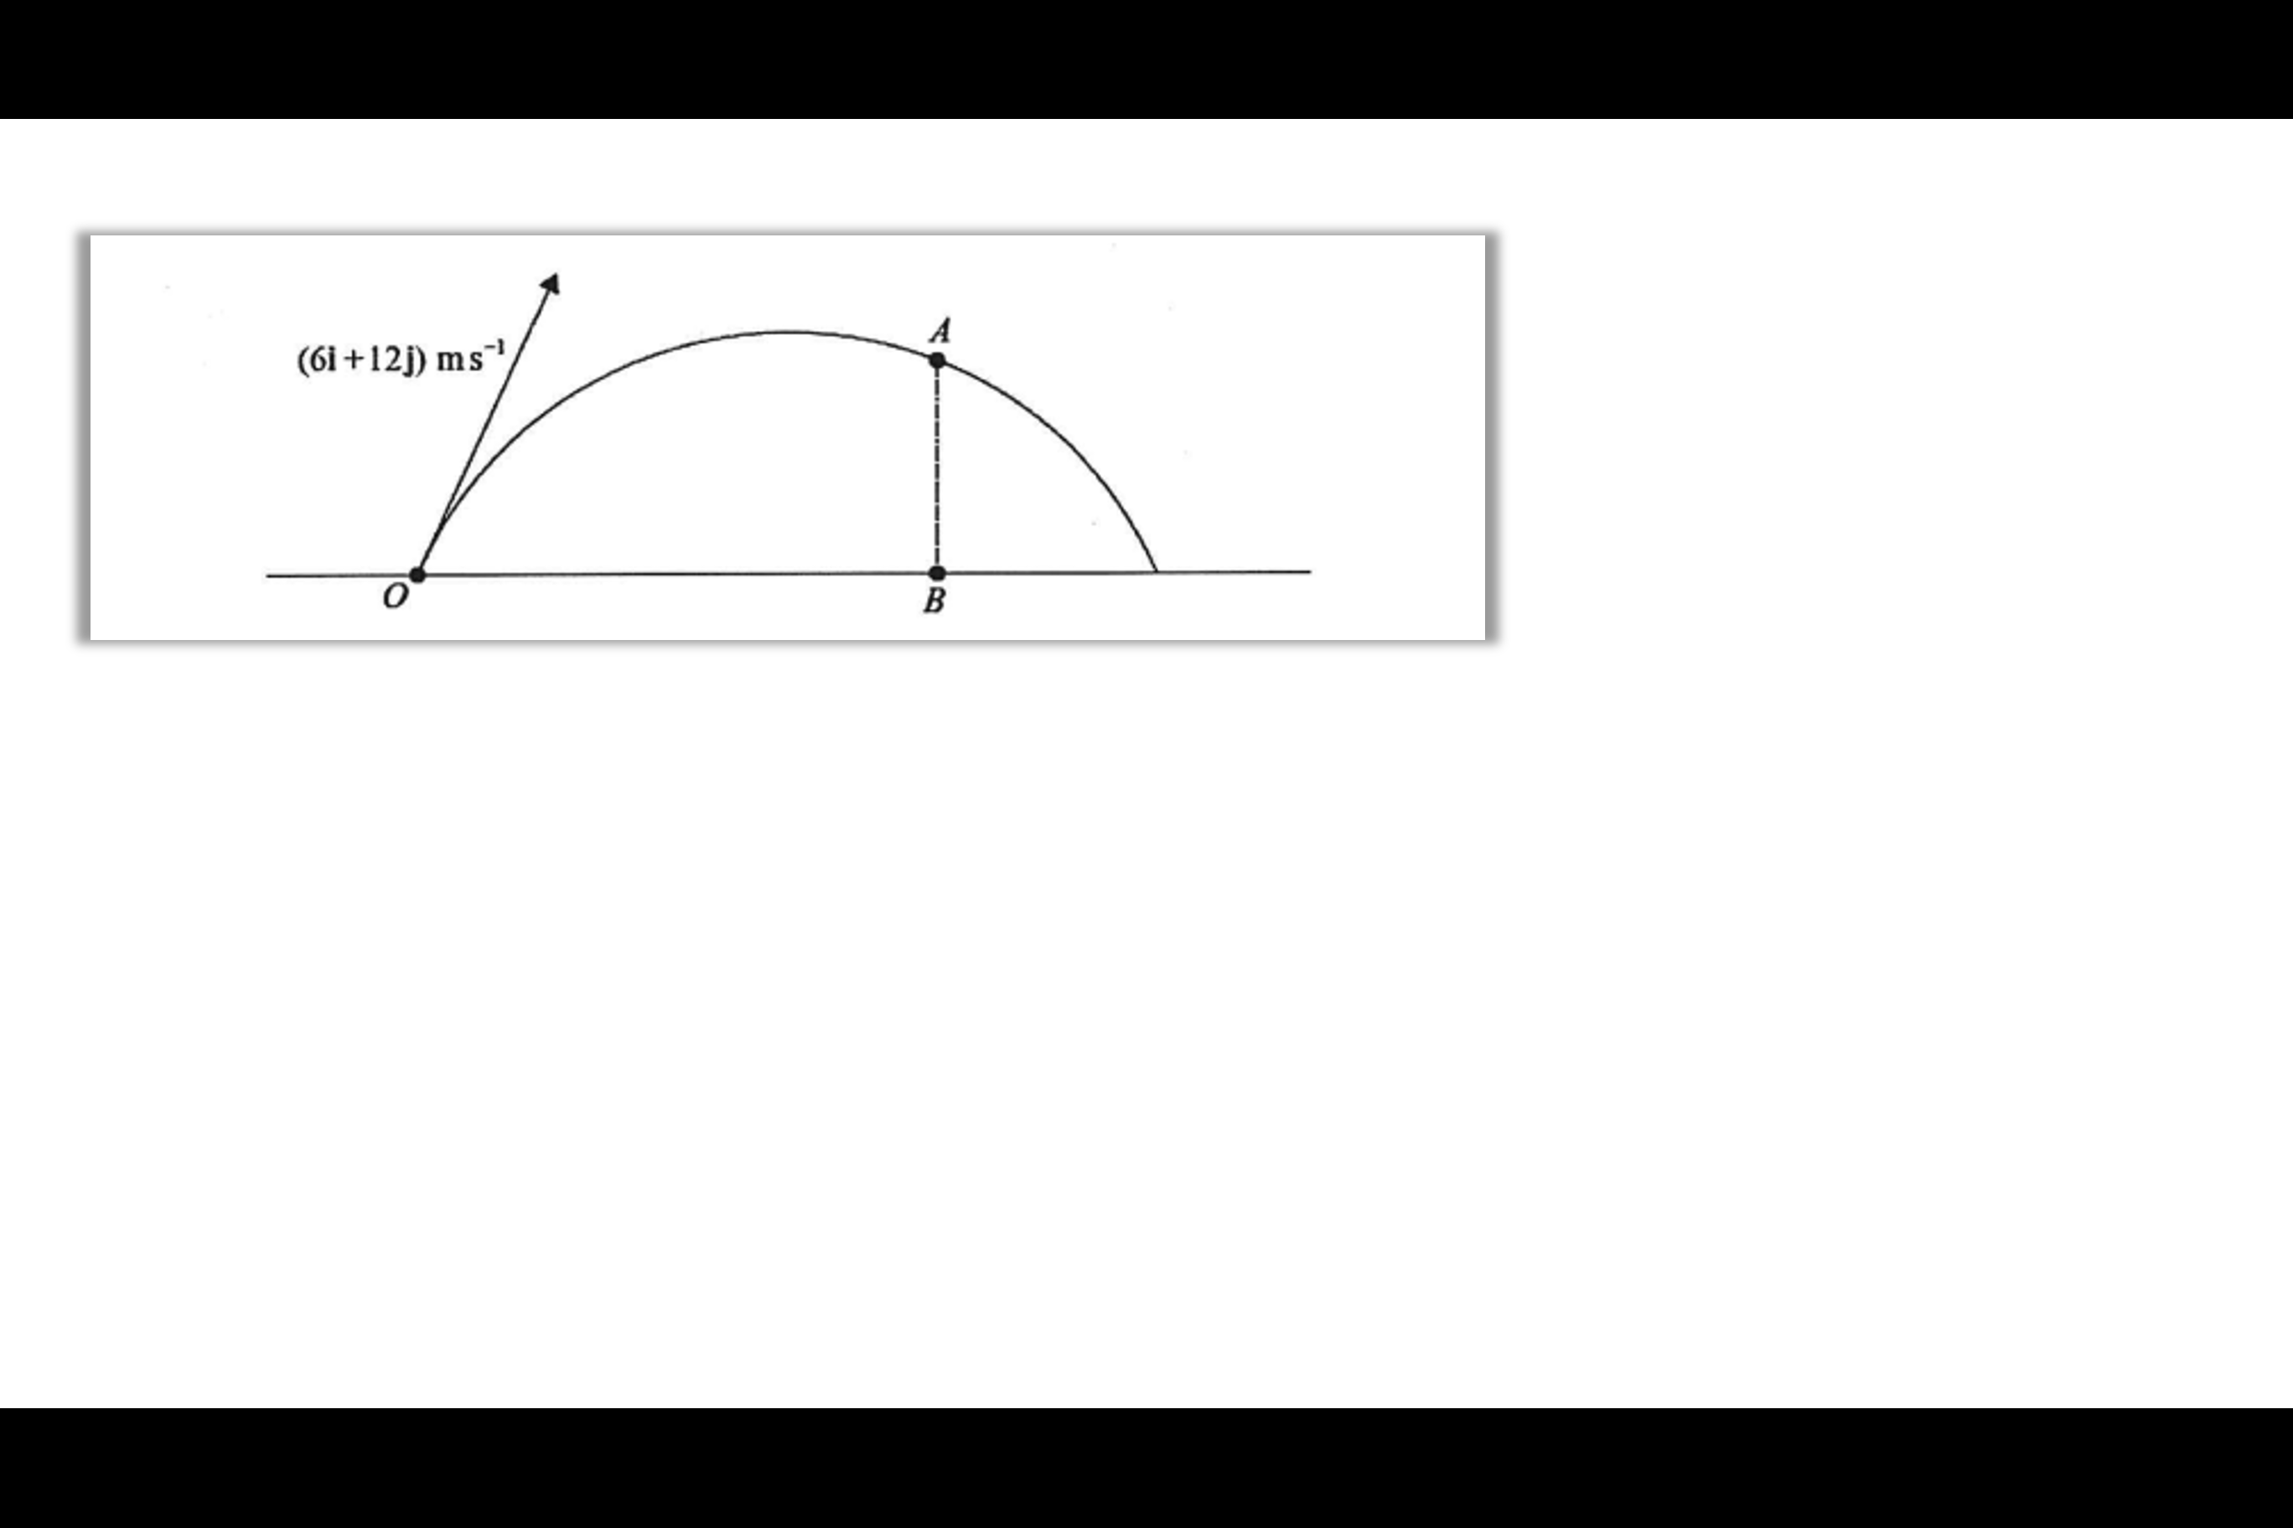

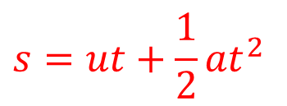


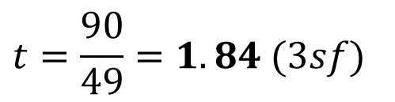
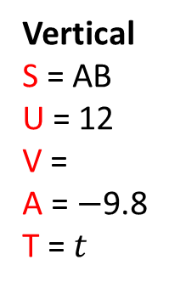

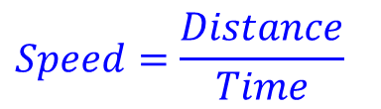

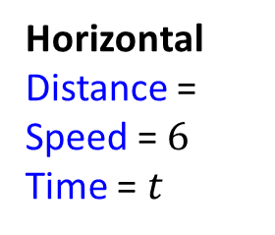

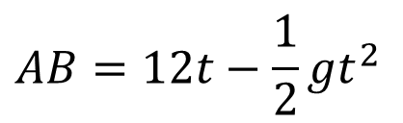
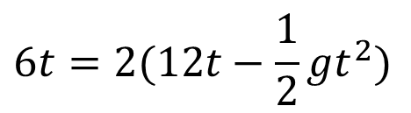

$$6i$$
$$12i$$
$$6i$$
a
$$OB=2AB$$
Vertical
S = AB
U = 12
V =
A = $−$9.8
T = $t$
Horizontal
Distance =
Speed = $6$
Time = $t$
$$6t=2(12t−\frac{1}{2}{gt}^{2})$$
$$s=ut+\frac{1}{2}{at}^{2}$$
$$6t=24t−{gt}^{2}$$
$$Speed=\frac{Distance}{Time}$$
$$AB=12t−\frac{1}{2}{gt}^{2}$$
$${9.8t}^{2}−18t=0$$
$$Distance=OB=6t$$
$$t=\frac{90}{49}=1.84 (3sf)$$

Slide 9
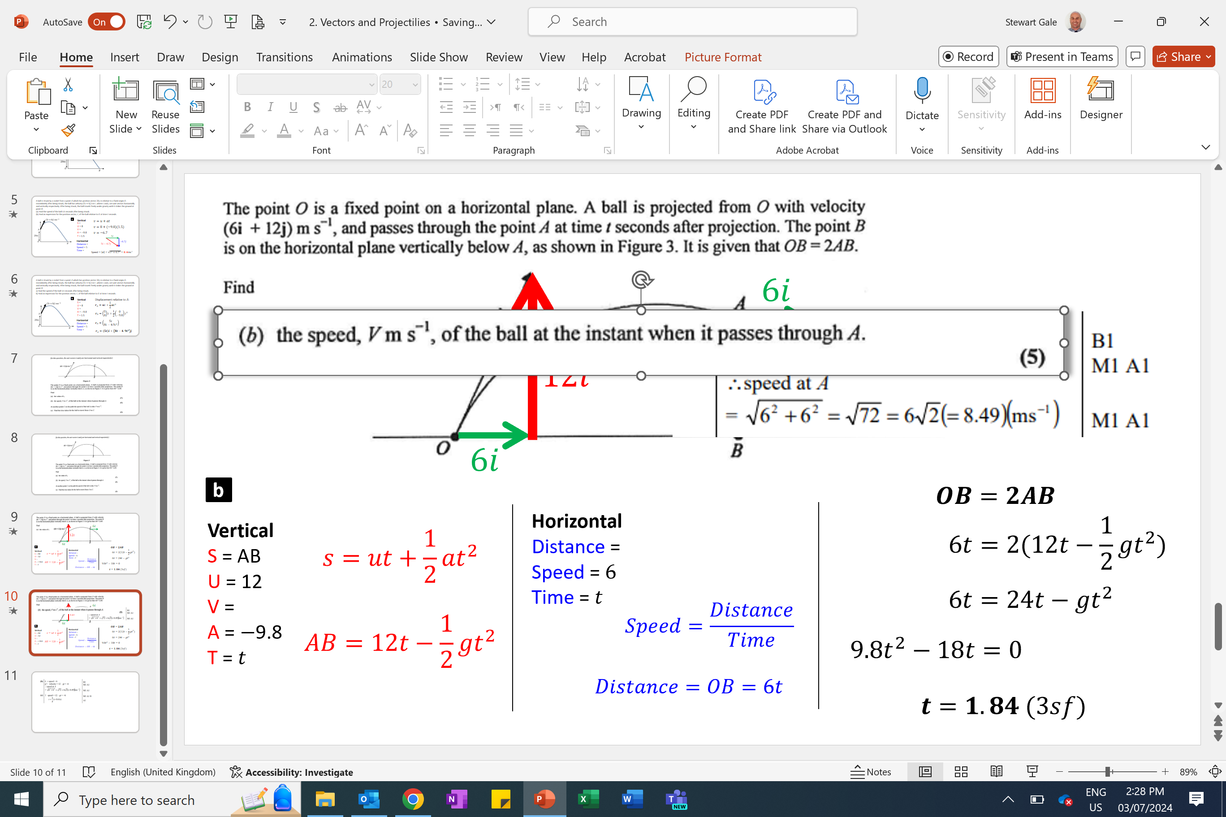
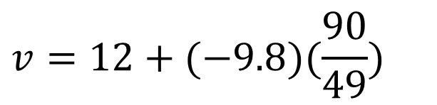

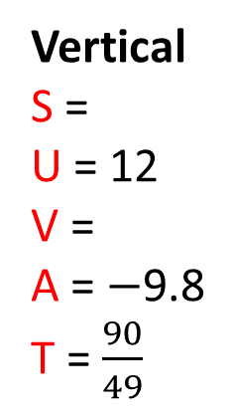







$$6i$$
$$−6j$$
b
Vertical
S =
U = 12
V =
A = $−$9.8
T = $\frac{90}{49}$
$$v=u+at$$
$$6i$$
$$v=12+(−9.8)(\frac{90}{49})$$
$$−6j$$
$$6i−6j$$
$$v=−6$$
Speed $=\left|v\right|=\sqrt{6^{2}+6^{2}}=8.49$ms⁻¹

Slide 10
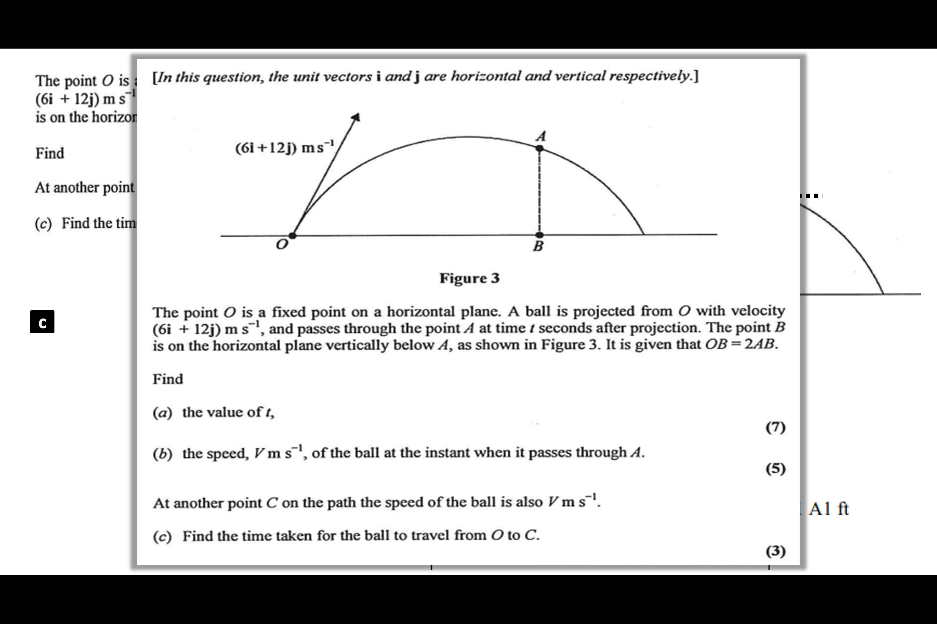
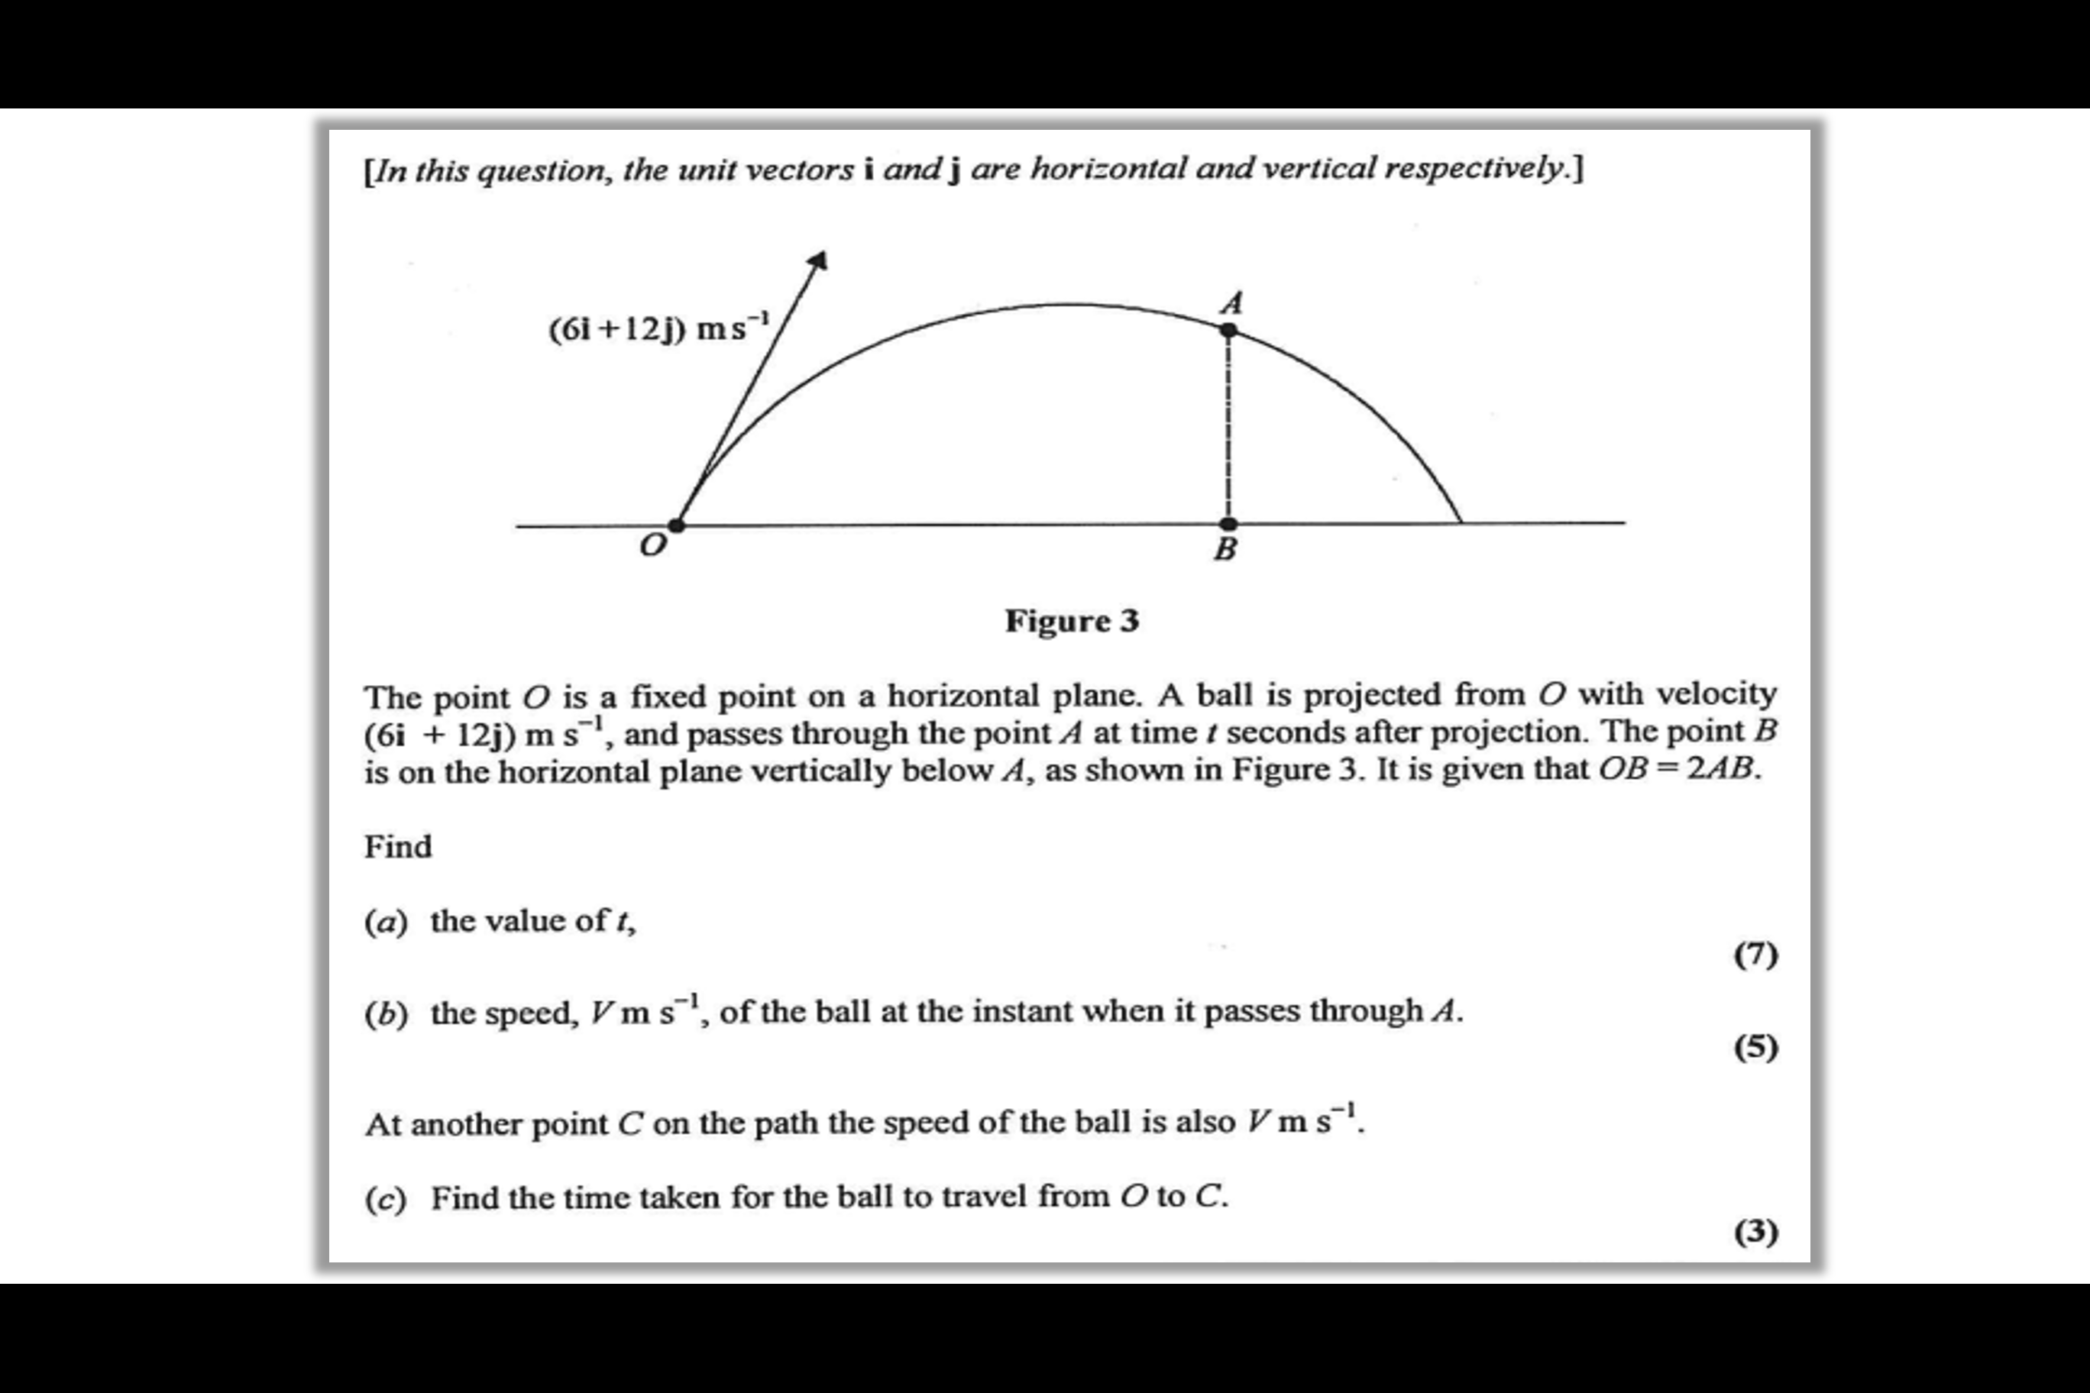
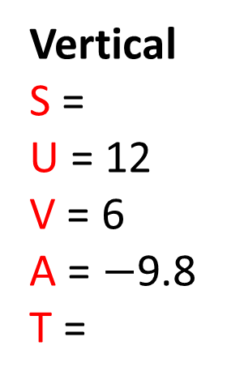





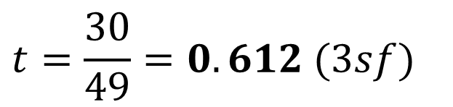

$$6j$$
$$12i$$
$$−6j$$
$$6i$$
Vertical
S =
U = 12
V = 6
A = $−$9.8
T =
c
$$v=u+at$$
$$6=12+(−9.8)t$$
$$t=\frac{30}{49}=0.612 (3sf)$$

