Slide 1
Vectors
Modelling
Chapter 11
(Part 4 of 4)

Slide 2
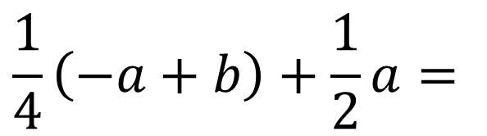

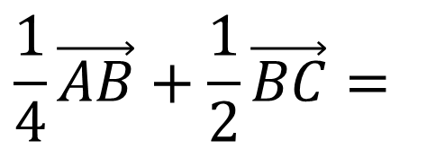
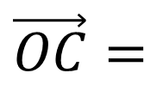
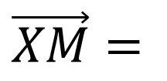


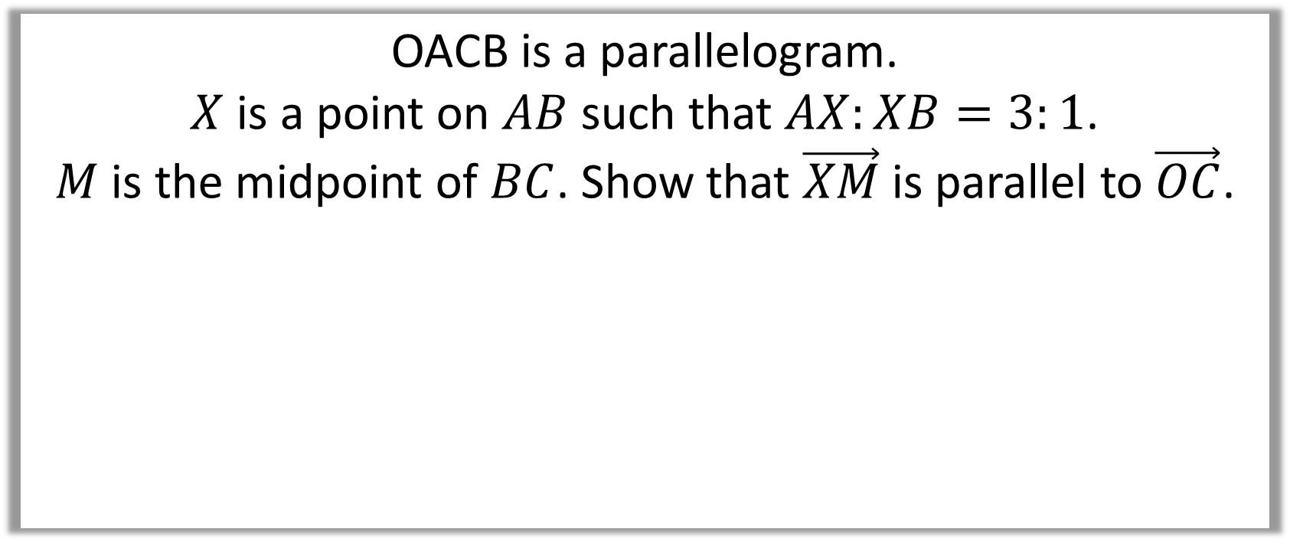

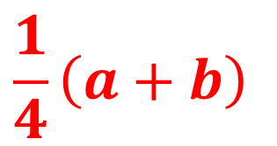

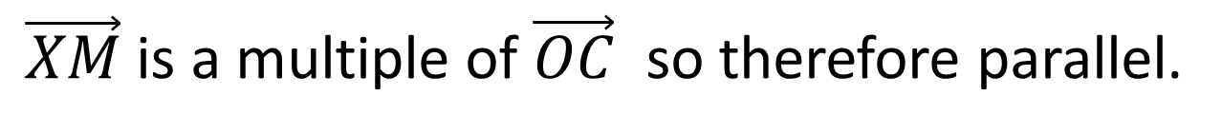


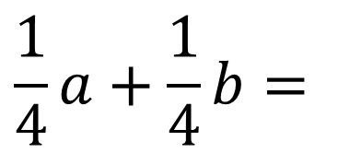


OACB is a parallelogram.
$X$ is a point on $AB$ such that $AX:XB=3:1$.
$M$ is the midpoint of $BC$. Show that $\vec{XM}$ is parallel to $\vec{OC}$.
$$A$$
$$C$$
$$a$$
$$X$$
$$M$$
$$O$$
$$b$$
$$B$$
$$\vec{OC}=$$
$$a+b$$
$$\frac{1}{4}\vec{AB}+\frac{1}{2}\vec{BC}=$$
$$\frac{1}{4}\left(−a+b\right)+\frac{1}{2}a=$$
$$\frac{1}{4}a+\frac{1}{4}b=$$
$$\frac{1}{4}\left(a+b\right)$$
$$\vec{XM}=$$
$\vec{XM}$ is a multiple of $\vec{OC}$ so therefore parallel.

Slide 3



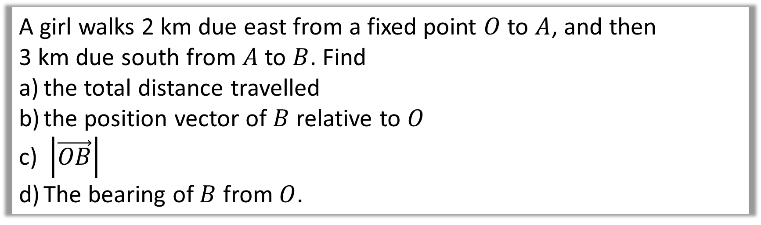

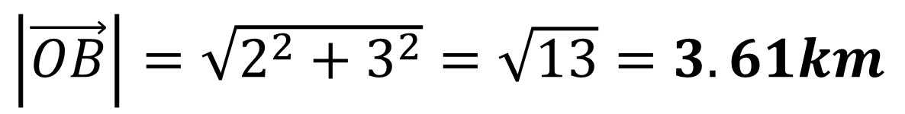

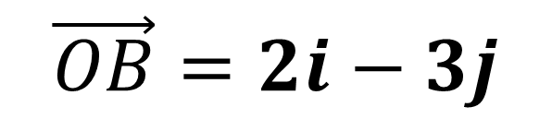

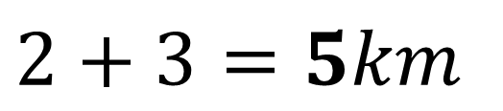
A girl walks 2 km due east from a fixed point $O$ to $A$, and then
3 km due south from $A$ to $B$. Find
the total distance travelled
the position vector of $B$ relative to $O$
$\left|\vec{OB}\right|$
The bearing of $B$ from $O$.
N
$$2+3=5km$$
a)
$$2$$
$$A$$
$$O$$
$$\vec{OB}=2i−3j$$
$$θ$$
b)
$$3$$
$\left|\vec{OB}\right|=\sqrt{2^{2}+3^{2}}=\sqrt{13}=3.61km$
c)
$$B$$

Slide 4
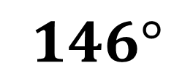
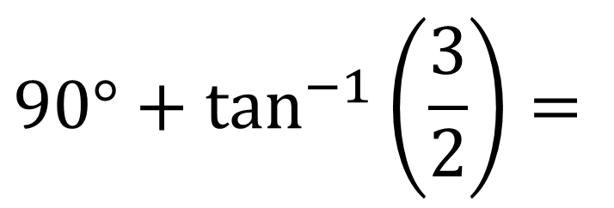
A girl walks 2 km due east from a fixed point $O$ to $A$, and then
3 km due south from $A$ to $B$. Find
the total distance travelled
the position vector of $B$ relative to $O$
$\left|\vec{OB}\right|$
The bearing of $B$ from $O$.
N
$$90°+\tan^{−1}\left(\frac{3}{2}\right)=$$
d)
$$146°$$
$$2$$
$$A$$
$$O$$
$$θ$$
$$3$$
$$B$$

Slide 5
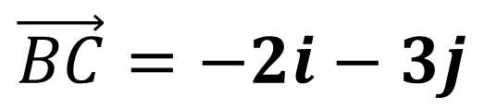
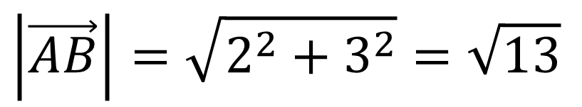
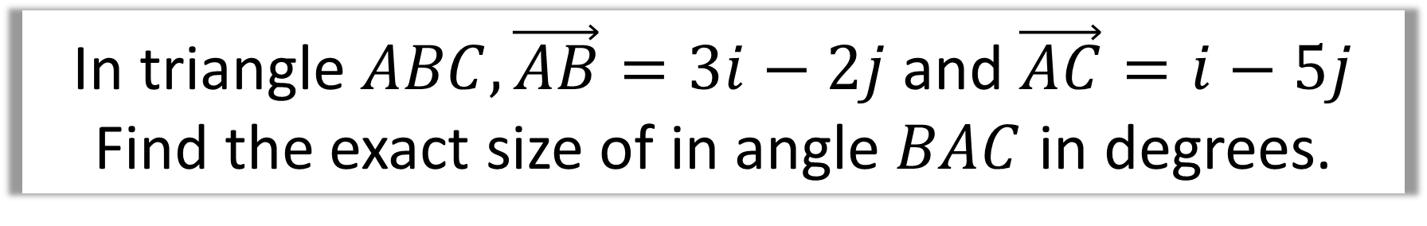
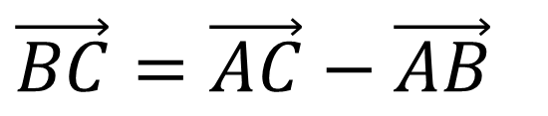
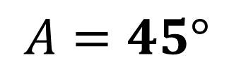
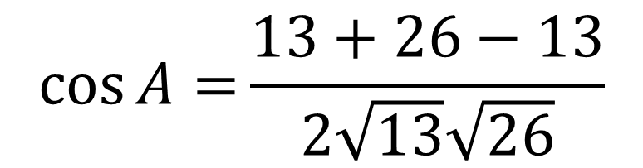
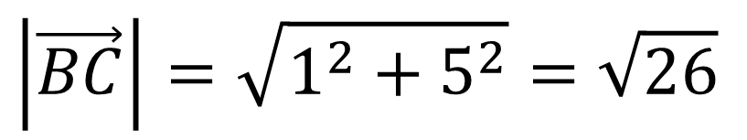
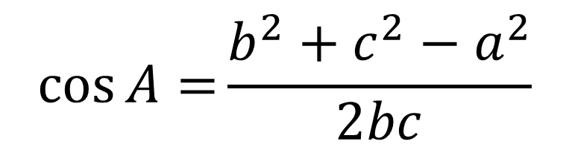
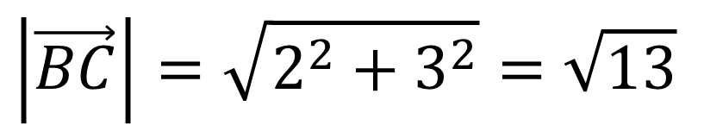
In triangle $ABC,\vec{AB}=3i−2j$ and $\vec{AC}=i−5j$
Find the exact size of in angle $BAC$ in degrees.
$$\vec{BC}=\vec{AC}−\vec{AB}$$
$$\cos{A=}\frac{b^{2}+c^{2}−a^{2}}{2bc}$$
$$\vec{BC}=−2i−3j$$
$$\left|\vec{AB}\right|=\sqrt{2^{2}+3^{2}}=\sqrt{13}$$
$$\cos{A=}\frac{13+26−13}{2\sqrt{13}\sqrt{26}}$$
$$\left|\vec{BC}\right|=\sqrt{2^{2}+3^{2}}=\sqrt{13}$$
$$\left|\vec{BC}\right|=\sqrt{1^{2}+5^{2}}=\sqrt{26}$$
$$A=45°$$

Slide 6

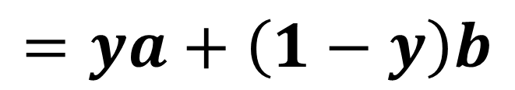


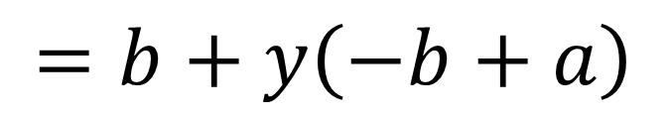
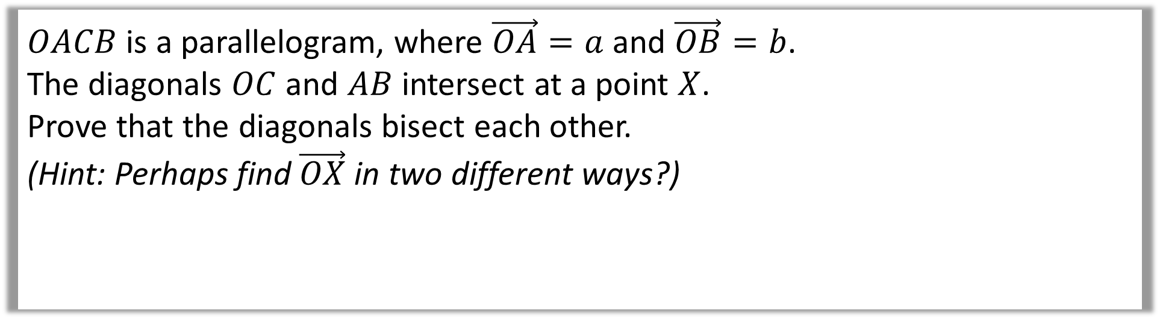

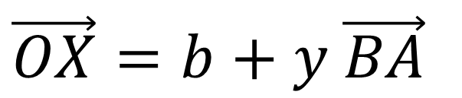

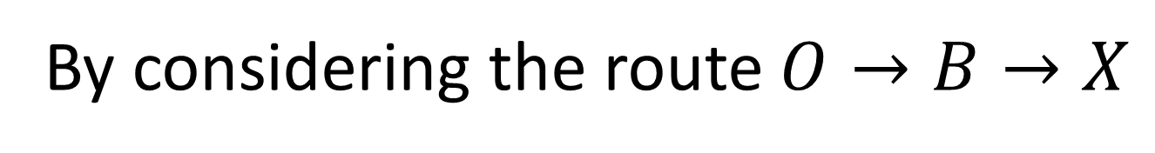


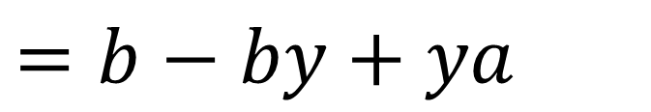
$OACB$ is a parallelogram, where $\vec{OA}=a$ and $\vec{OB}=b$.
The diagonals $OC$ and $AB$ intersect at a point $X$.
Prove that the diagonals bisect each other.
(Hint: Perhaps find $\vec{OX}$ in two different ways?)
$$O$$
$$a$$
$$A$$
$$X$$
$$b$$
$$B$$
$$C$$
By considering the route $O→B→X$
$$\vec{OX}=b+y \vec{BA}$$
$$=b+y\left(−b+a\right)$$
$$=b−by+ya$$
$$=ya+\left(1−y\right)b$$

Slide 7
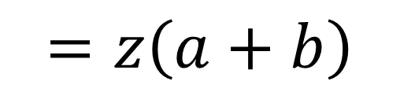


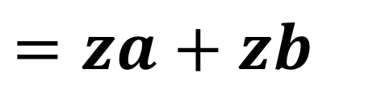

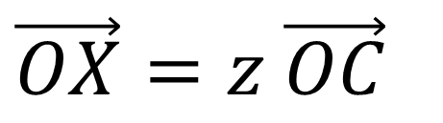


$OACB$ is a parallelogram, where $\vec{OA}=a$ and $\vec{OB}=b$.
The diagonals $OC$ and $AB$ intersect at a point $X$.
Prove that the diagonals bisect each other.
(Hint: Perhaps find $\vec{OX}$ in two different ways?)
$$O$$
$$a$$
$$A$$
$$X$$
$$b$$
$$B$$
$$C$$
Similarly, considering the line $OC$:
$$\vec{OX}=z \vec{OC}$$
$$=z\left(a+b\right)$$
$$=za+zb$$

Slide 8

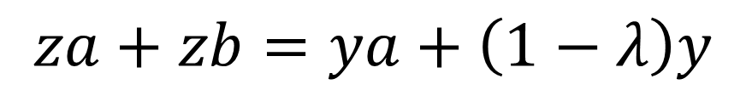
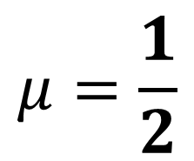

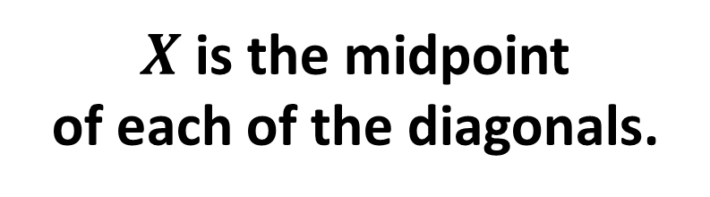
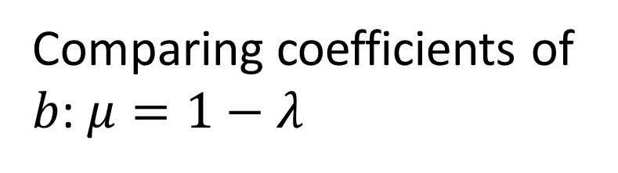
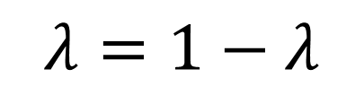
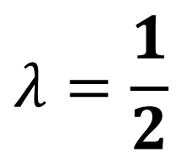
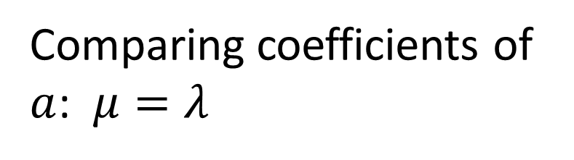

$OACB$ is a parallelogram, where $\vec{OA}=a$ and $\vec{OB}=b$.
The diagonals $OC$ and $AB$ intersect at a point $X$.
Prove that the diagonals bisect each other.
(Hint: Perhaps find $\vec{OX}$ in two different ways?)
$$O$$
$$a$$
$$A$$
$$X$$
$$b$$
$$B$$
$$C$$
$$za+zb=ya+\left(1−λ\right)y$$
$$λ=1−λ$$
Comparing coefficients of
$a$: $μ=λ$
$$λ=\frac{1}{2}$$
$$μ=\frac{1}{2}$$
Comparing coefficients of
$b$: $μ=1−λ$
$X$ is the midpoint
of each of the diagonals.

