Slide 1
Probability
Conditional Probability
Chapter 2
(Part 2 of 4)

Slide 2
Conditional Probability
Probability of an event
can change dependent
on the outcome of
a previous event.

Slide 3


Conditional Probability
The chance of winning a 2nd football match
is dependent on how you get on in your 1st match.

Slide 4

Notation
$$\left(B | A\right)$$
The ‘|’ symbol reads:
“given that”

Slide 5

$$P\left(B | A\right)$$
Probability of B given that
A has already occurred.

Slide 6

$$P\left(A | B\right)$$
Probability of A given that
B has already occurred.

Slide 7
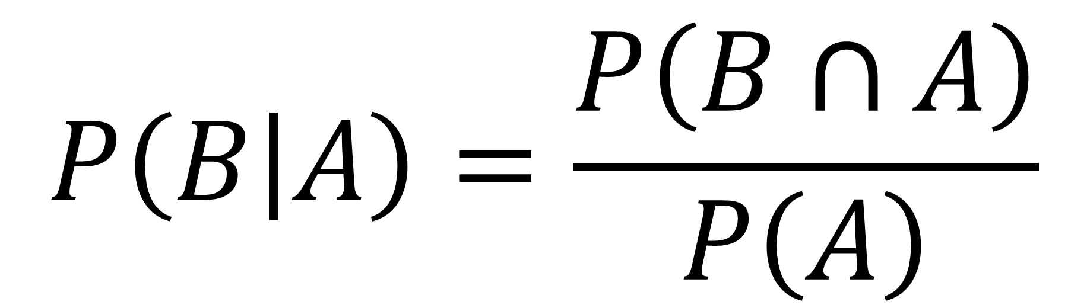
$$P\left(B | A\right)=\frac{P\left(B∩A\right)}{P\left(A\right)}$$

Slide 8
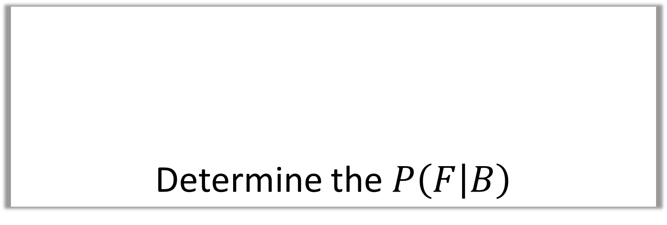
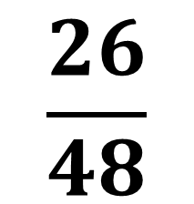

Determine the $P\left(F | B\right)$
 | French | Spanish
Girls | 14 | 38
Boys | 26 | 22
$$\frac{}{48}$$
Step 1: Highlight Boys
Step 2: Highlight French
of what you have highlighted.
$$\frac{26}{48}$$

Slide 9

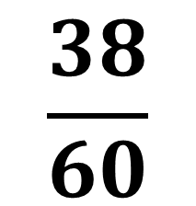

Determine the $P\left(G | S\right)$
 | French | Spanish
Girls | 14 | 38
Boys | 26 | 22
$$\frac{}{60}$$
Step 1: Highlight Spanish
Step 2: Highlight Girls
of what you have highlighted.
$$\frac{38}{60}$$

Slide 10


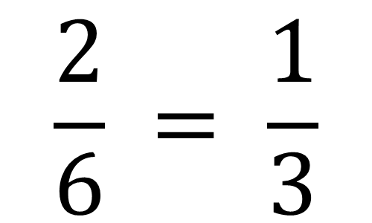



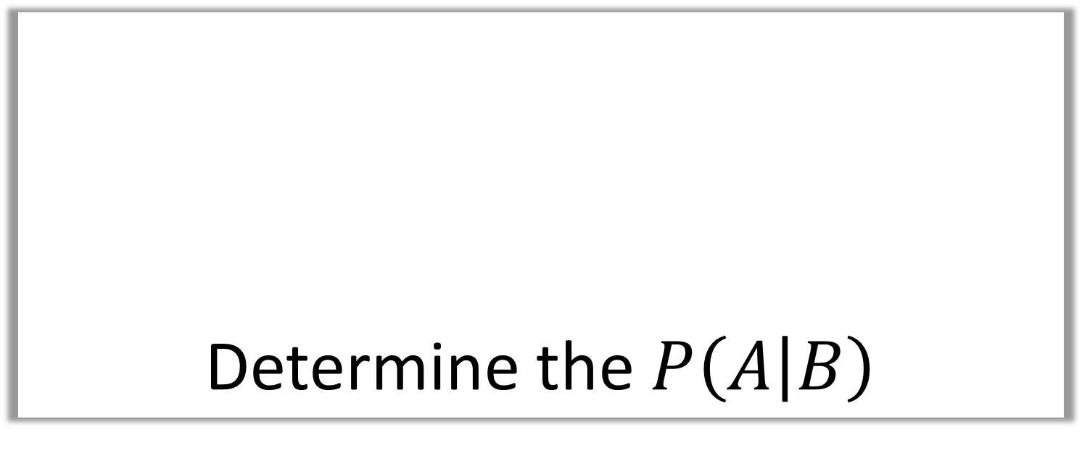
Determine the $P\left(A | B\right)$
$$A$$
$$B$$
2
3
6
4
$$2$$
$$\frac{}{2+4}=$$
$$\frac{2}{6} = \frac{1}{3}$$
$$P\left(A | B\right)=$$

Slide 11



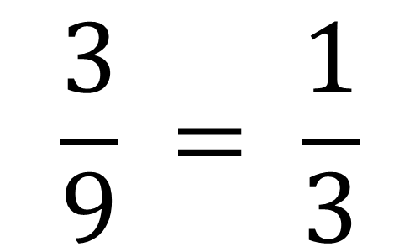
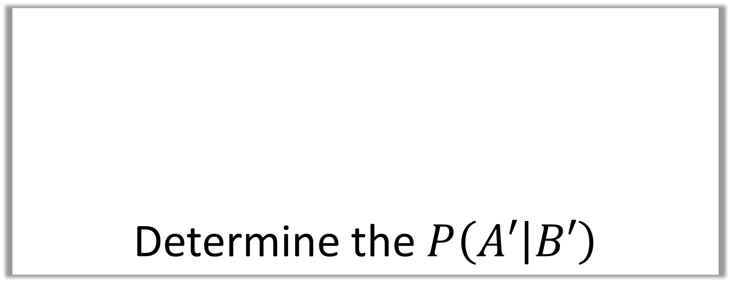
Determine the $P\left(A′ | B′\right)$
$$A$$
$$B$$
2
3
2
6
4
$$3$$
$$\frac{}{6+3}=$$
$$\frac{3}{9} = \frac{1}{3}$$
$P\left(A′ | B′\right)=$

Slide 12



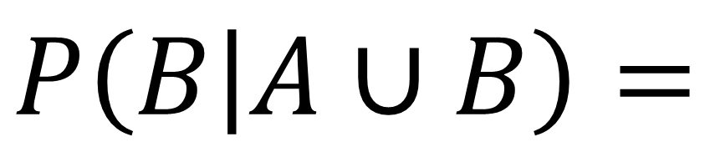
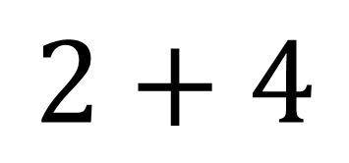
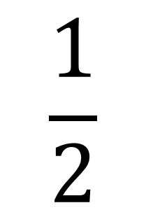
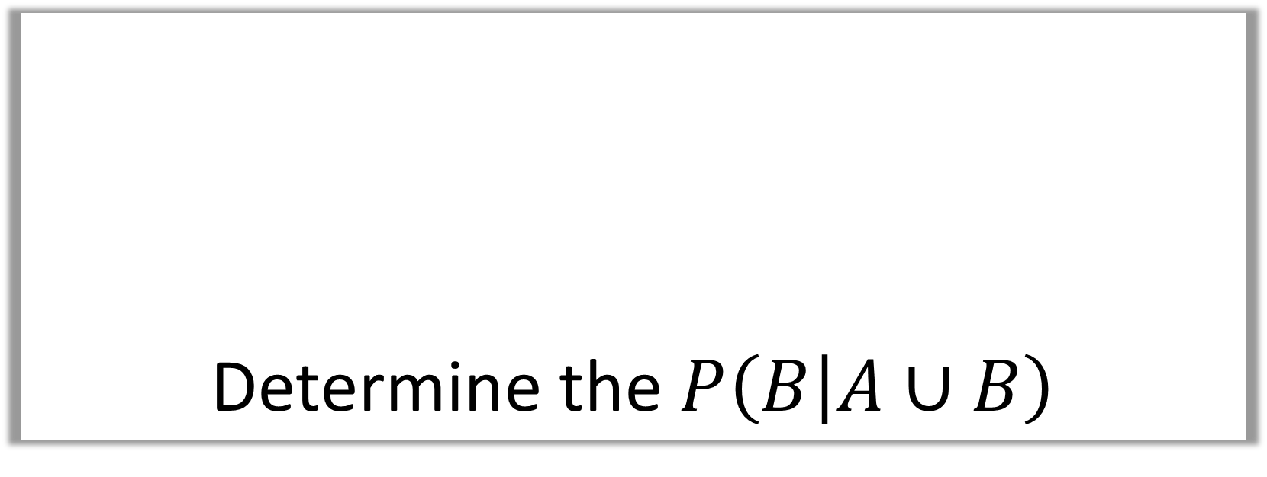
Determine the $P\left(B | A∪B\right)$
$$A$$
$$B$$
2
3
6
4
$$2+4$$
$$\frac{}{6+4+2}=$$
$$\frac{1}{2}$$
$P\left(B | A∪B\right)=$

Slide 13
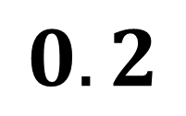
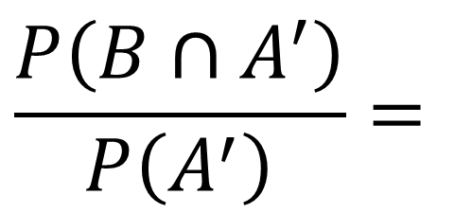
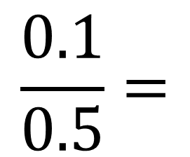
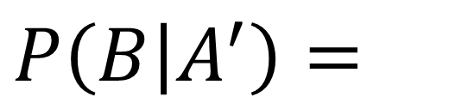


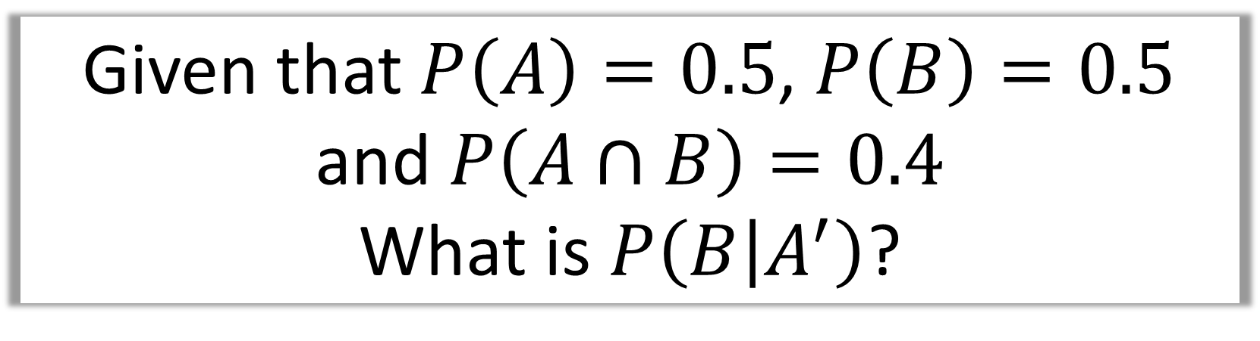
Given that $P\left(A\right)=0.5$, $P\left(B\right)=0.5$
and $P\left(A∩B\right)=0.4$
What is $P\left(B | A^{′}\right)$?
$$A$$
$$B$$
$$P\left(B | A^{′}\right)=$$
0.1
0.4
0.1
$$\frac{P\left(B∩A^{′}\right)}{P\left(A^{′}\right)}=$$
$$\frac{0.1}{0.5}=$$
$$0.2$$
0.4

Slide 14
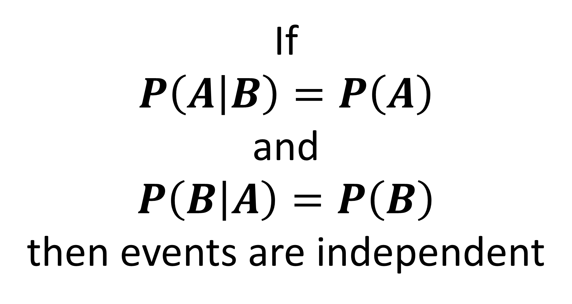
If
$$P\left(A | B\right)=P\left(A\right)$$
and
$$P\left(B | A\right)=P\left(B\right)$$
then events are independent

