Slide 1
LO: Listing
Outcomes

Slide 2

Sally Spinner Bingo
I will spin both spinners and add the two numbers.
If you have that total on your Bingo card, cross it out.
The winner is the first to cross out all their numbers.
Design the perfect bingo card.

Slide 3
+ | 1 | 2 | 3 | 4 | 5 | 6 | 7 | 8
1
2
3
4
5
6
7
8
+ | 1 | 2 | 3 | 4 | 5 | 6 | 7 | 8
1 | 2 | 3 | 4 | 5 | 6 | 7 | 8 | 9
2 | 3 | 4 | 5 | 6 | 7 | 8 | 9 | 10
3 | 4 | 5 | 6 | 7 | 8 | 9 | 10 | 11
4 | 5 | 6 | 7 | 8 | 9 | 10 | 11 | 12
5 | 6 | 7 | 8 | 9 | 10 | 11 | 12 | 13
6 | 7 | 8 | 9 | 10 | 11 | 12 | 13 | 14
7 | 8 | 9 | 10 | 11 | 12 | 13 | 14 | 15
8 | 9 | 10 | 11 | 12 | 13 | 14 | 15 | 16
The perfect
bingo card.
10 | 5 | 11
6 | 9 | 12
7 | 13 | 8

Slide 4
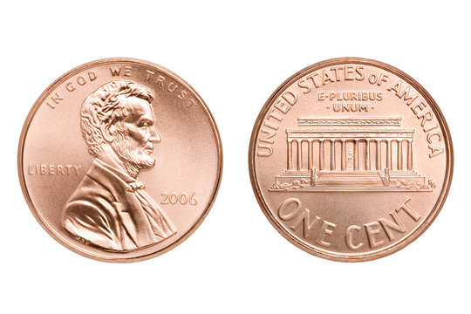
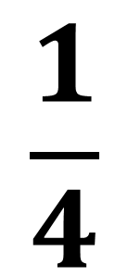
You flip two coin.
What is the probability of getting Head Head?
$$\frac{1}{4}$$

Slide 5
You flip two coin.
What are all the
possible outcomes?

Slide 6
 | H | T
H | HH | HT
T | TH | TT

Slide 7
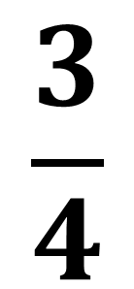
 | H | T
H | HH | HT
T | TH | TT
$$\frac{3}{4}$$
P(at least one H) =

Slide 8
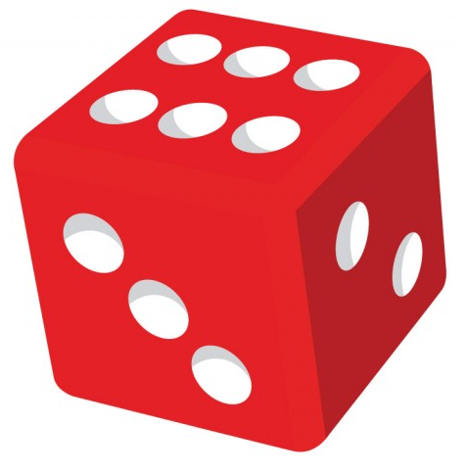
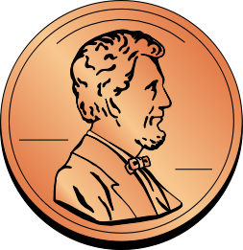
You roll a dice and then you flip a coin.
How many outcomes are there?

Slide 9

 | 1 | 2 | 3 | 4 | 5 | 6
H | 1,H | 2,H | 3,H | 4,H | 5,H | 6,H
T | 1,T | 2,T | 3,T | 4,T | 5,T | 6,T
How many outcomes are there?
12
Notes:
The game could be something like “Win a point if you get a head and a square number, lose a point if you get a prime number and a tail” or something similar.

Slide 10
List all the outcomes.
 | 1 | 2 | 3 | 4 | 5 | 6
G
B
1,G | 2,G | 3,G | 4,G | 5,G | 6,G
1,B | 2,B | 3,B | 4,B | 5,B | 6,B

Slide 11
List all the outcomes.
 | 1 | 2 | 3 | 4 | 5 | 6
G
B
R
R
1,G | 2,G | 3,G | 4,G | 5,G | 6,G
1,B | 2,B | 3,B | 4,B | 5,B | 6,B
1,R | 2,R | 3,R | 4,R | 5,R | 6,R
1,R | 2,R | 3,R | 4,R | 5,R | 6,R

