Slide 1
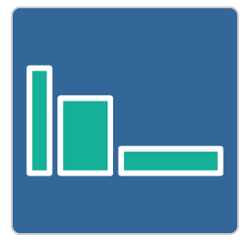
Build a Bigger Field
Activity: Click on the icon
Investigation into
area and perimeter of rectangles.

