Slide 1
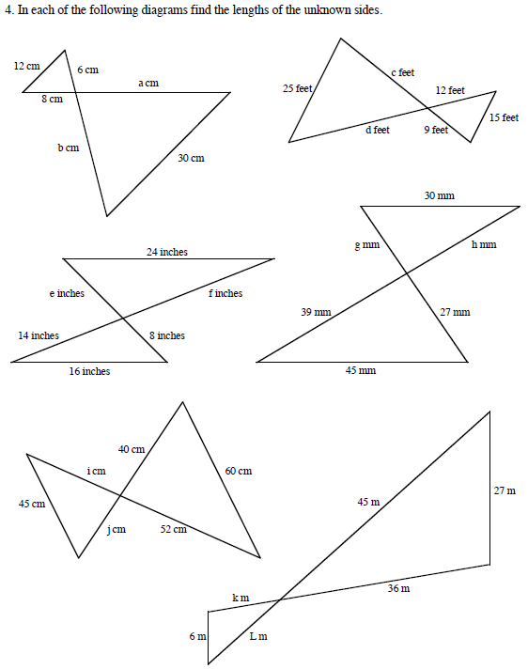
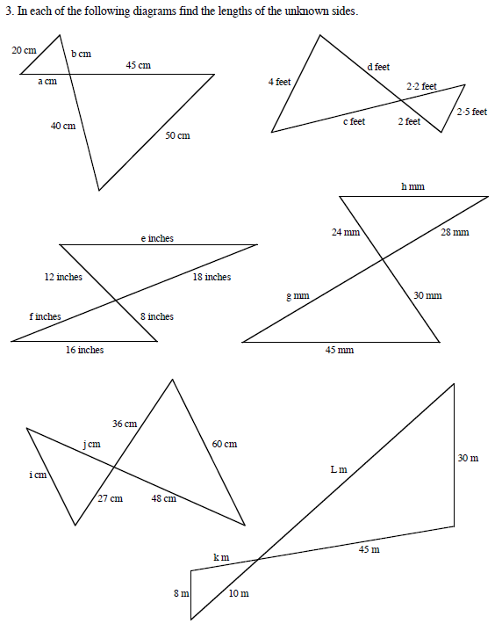
1)
2)

Slide 2
ANSWERS

Slide 3
1)
2)
15
16
3.2
20
18
20
3.52
15
36
24
18
26
12
35
21
12
39
36
37.5
45
30
8
12
10
10

