Slide 1
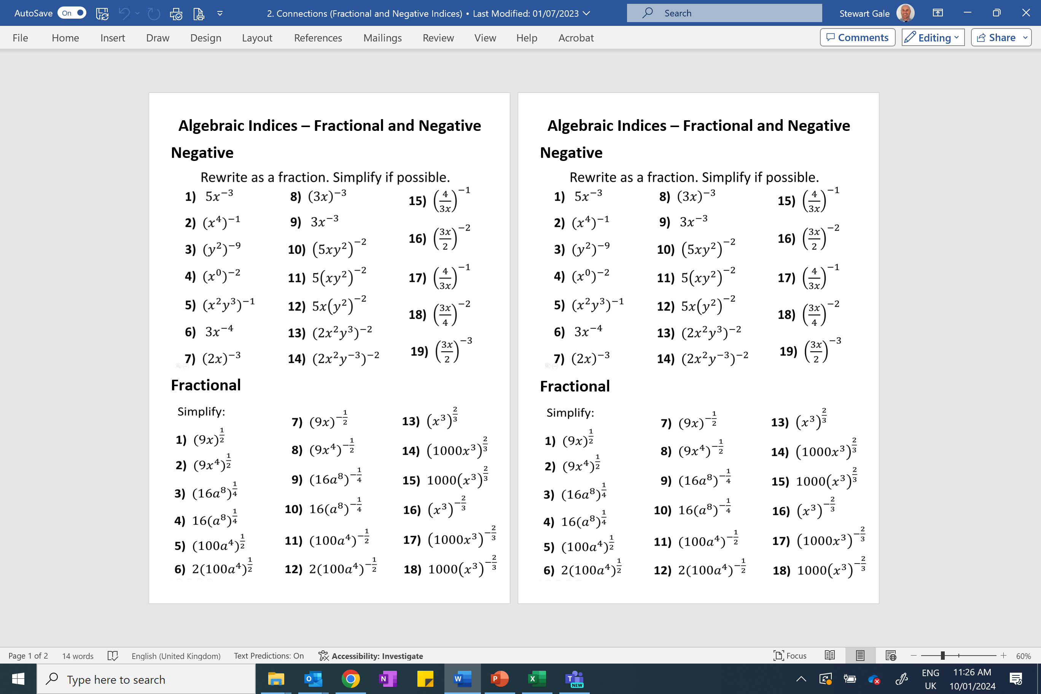

Slide 2
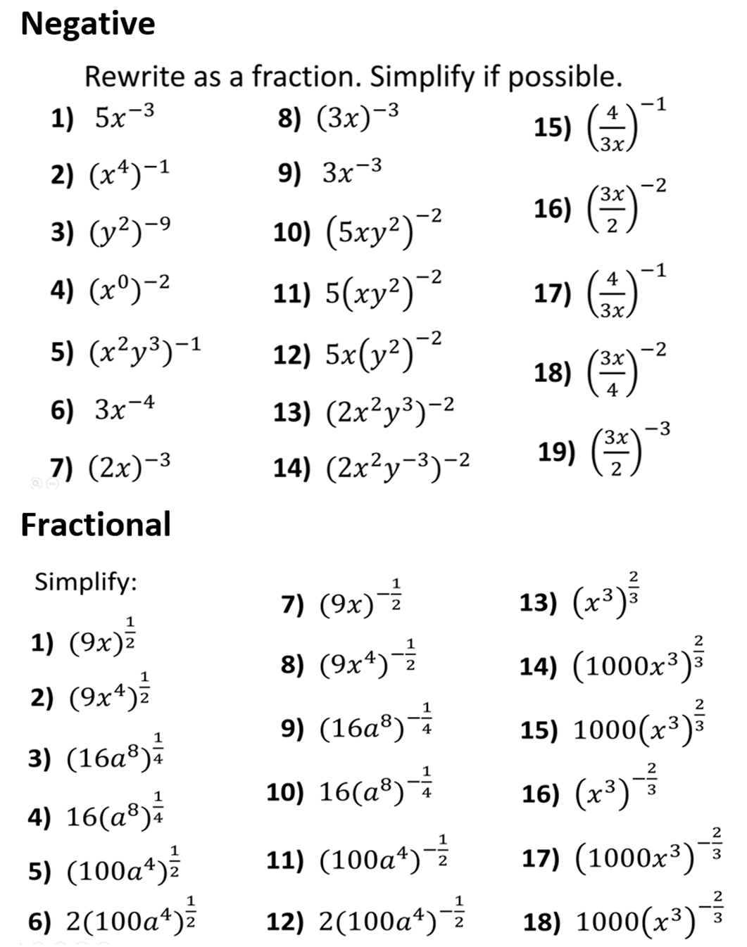

Slide 3
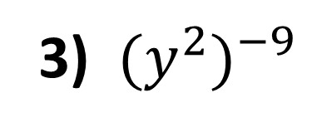
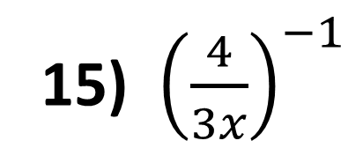
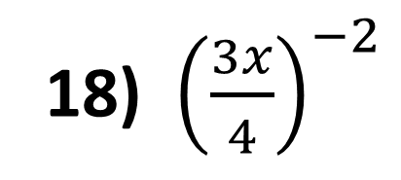
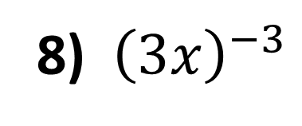
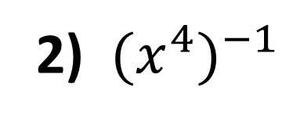
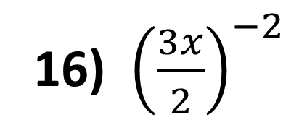
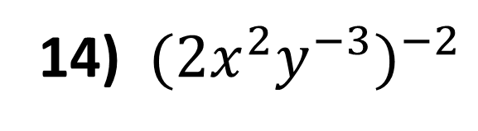
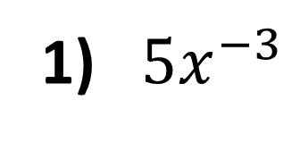
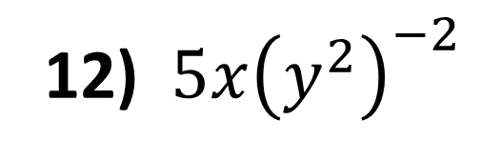
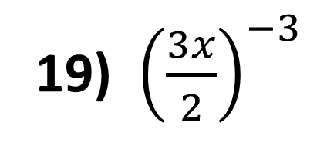
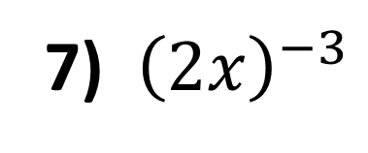
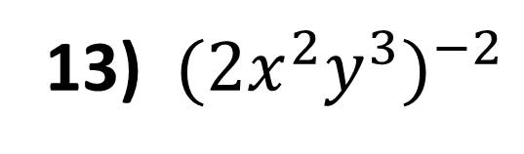
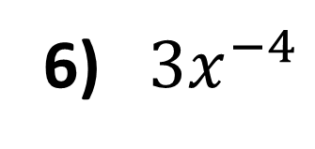
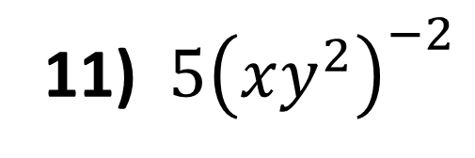
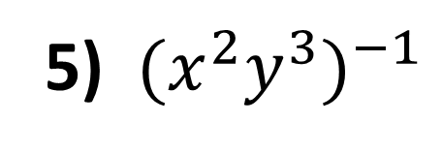
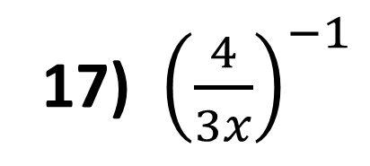
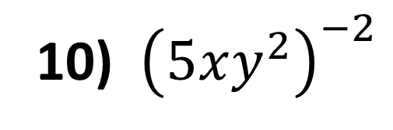
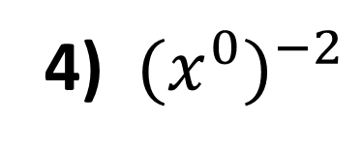
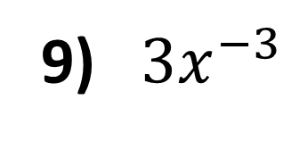
Rewrite as a fraction. Simplify if possible.
1) ${5x}^{−3}$
8) ${\left(3x\right)}^{−3}$
15) ${\left(\frac{4}{3x}\right)}^{−1}$
2) ${{(x}^{4})}^{−1}$
9) $3x^{−3}$
16) ${\left(\frac{3x}{2}\right)}^{−2}$
3) ${{(y}^{2})}^{−9}$
10) ${\left(5xy^{2}\right)}^{−2}$
4) ${{(x}^{0})}^{−2}$
11) ${5\left(xy^{2}\right)}^{−2}$
17) ${\left(\frac{4}{3x}\right)}^{−1}$
5) ${{(x}^{2}y^{3})}^{−1}$
12) ${5x\left(y^{2}\right)}^{−2}$
18) ${\left(\frac{3x}{4}\right)}^{−2}$
6) ${ 3x}^{−4}$
13) ${{(2x}^{2}y^{3})}^{−2}$
19) ${\left(\frac{3x}{2}\right)}^{−3}$
7) ${\left(2x\right)}^{−3}$
14) ${{(2x}^{2}y^{−3})}^{−2}$

Slide 4
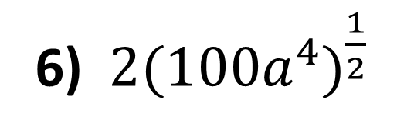
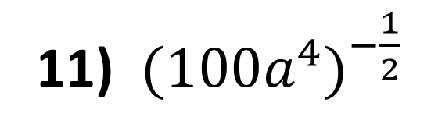
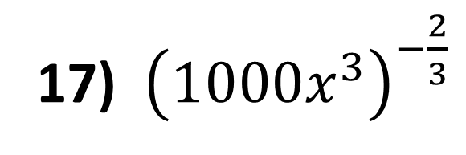
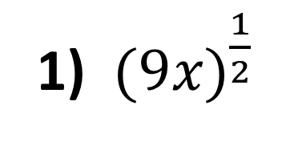
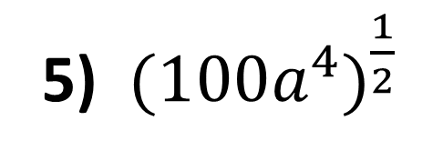
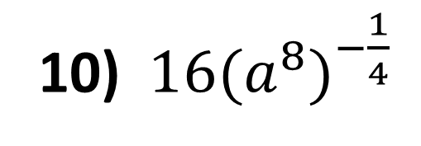
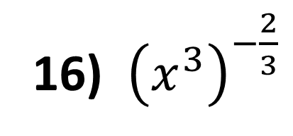
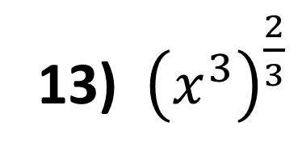
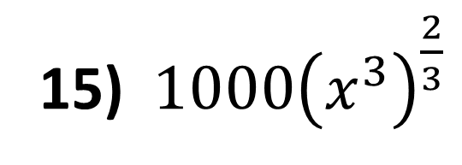
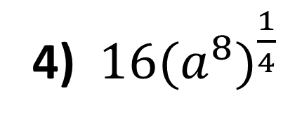
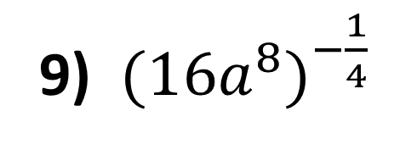
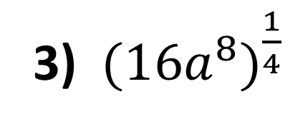
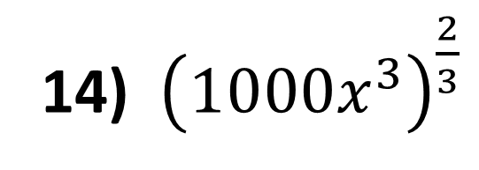
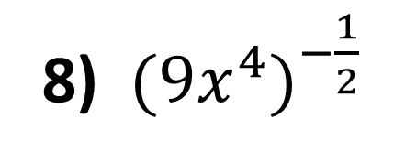
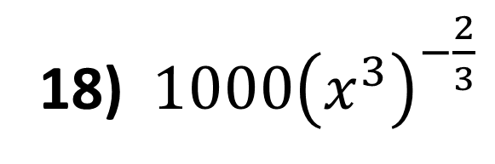
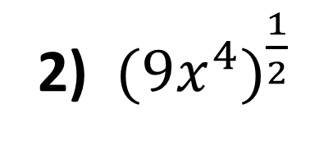
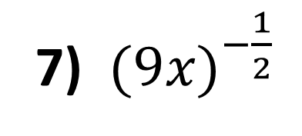
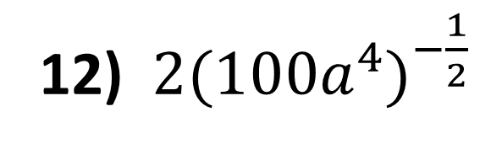
Simplify:
13) ${\left(x^{3}\right)}^{\frac{2}{3}}$
7) ${(9x)}^{−\frac{1}{2} }$
1) ${(9x)}^{\frac{1}{2} }$
8) ${(9x^{4})}^{−\frac{1}{2} }$
14) ${\left(1000x^{3}\right)}^{\frac{2}{3}}$
2) ${(9x^{4})}^{\frac{1}{2} }$
9) ${(16a^{8})}^{−\frac{1}{4} }$
15) ${1000\left(x^{3}\right)}^{\frac{2}{3}}$
3) ${(16a^{8})}^{\frac{1}{4} }$
10) ${16(a^{8})}^{−\frac{1}{4} }$
16) ${\left(x^{3}\right)}^{−\frac{2}{3}}$
4) ${16(a^{8})}^{\frac{1}{4} }$
11) ${({100a}^{4})}^{−\frac{1}{2} }$
17) ${\left(1000x^{3}\right)}^{−\frac{2}{3}}$
5) ${({100a}^{4})}^{\frac{1}{2} }$
6) ${2({100a}^{4})}^{\frac{1}{2} }$
12) ${2({100a}^{4})}^{−\frac{1}{2} }$
18) ${1000\left(x^{3}\right)}^{−\frac{2}{3}}$

Slide 5
ANSWERS

Slide 6

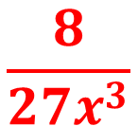

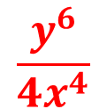
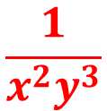
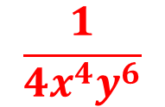
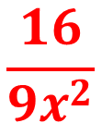





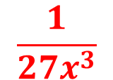
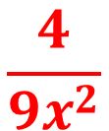
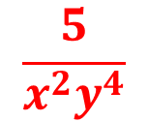


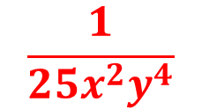

Rewrite as a fraction. Simplify if possible.
1) ${5x}^{−3}$
$$\frac{5}{x^{3}}$$
8) ${\left(3x\right)}^{−3}$
$$\frac{1}{{27x}^{3}}$$
15) ${\left(\frac{4}{3x}\right)}^{−1}$
$$\frac{3x}{4}$$
2) ${{(x}^{4})}^{−1}$
$$\frac{1}{x^{4}}$$
9) $3x^{−3}$
$$\frac{3}{x^{3}}$$
16) ${\left(\frac{3x}{2}\right)}^{−2}$
$$\frac{4}{{9x}^{2}}$$
3) ${{(y}^{2})}^{−9}$
$$\frac{1}{y^{18}}$$
10) ${\left(5xy^{2}\right)}^{−2}$
$$\frac{1}{{25x}^{2}y^{4}}$$
4) ${{(x}^{0})}^{−2}$
$$\frac{1}{1}$$
11) ${5\left(xy^{2}\right)}^{−2}$
$$\frac{5}{x^{2}y^{4}}$$
17) ${\left(\frac{4}{3x}\right)}^{−1}$
$$\frac{3x}{4}$$
5) ${{(x}^{2}y^{3})}^{−1}$
$$\frac{1}{x^{2}y^{3}}$$
12) ${5x\left(y^{2}\right)}^{−2}$
$$\frac{5x}{y^{4}}$$
18) ${\left(\frac{3x}{4}\right)}^{−2}$
$$\frac{16}{{9x}^{2}}$$
6) ${ 3x}^{−4}$
$$\frac{3}{x^{4}}$$
$$\frac{1}{{4x}^{4}y^{6}}$$
13) ${{(2x}^{2}y^{3})}^{−2}$
19) ${\left(\frac{3x}{2}\right)}^{−3}$
$$\frac{8}{{27x}^{3}}$$
7) ${\left(2x\right)}^{−3}$
$$\frac{1}{{8x}^{3}}$$
14) ${{(2x}^{2}y^{−3})}^{−2}$
$$\frac{y^{6}}{{4x}^{4}}$$

Slide 7
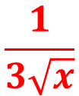
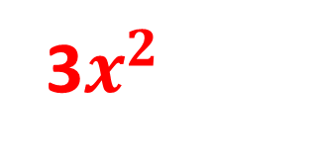
















Simplify:
13) ${\left(x^{3}\right)}^{\frac{2}{3}}$
7) ${(9x)}^{−\frac{1}{2} }$
$$\frac{1}{3\sqrt{x}}$$
$$x^{2}$$
1) ${(9x)}^{\frac{1}{2} }$
3$\sqrt{x}$
8) ${(9x^{4})}^{−\frac{1}{2} }$
$$\frac{1}{{3x}^{2}}$$
14) ${\left(1000x^{3}\right)}^{\frac{2}{3}}$
$${100x}^{2}$$
2) ${(9x^{4})}^{\frac{1}{2} }$
3$x^{2}$
9) ${(16a^{8})}^{−\frac{1}{4} }$
$$\frac{1}{2a^{2}}$$
15) ${1000\left(x^{3}\right)}^{\frac{2}{3}}$
$${1000x}^{2}$$
3) ${(16a^{8})}^{\frac{1}{4} }$
2$a^{2}$
10) ${16(a^{8})}^{−\frac{1}{4} }$
16) ${\left(x^{3}\right)}^{−\frac{2}{3}}$
$$\frac{16}{a^{2}}$$
$$\frac{1}{x^{2}}$$
4) ${16(a^{8})}^{\frac{1}{4} }$
1$6a^{2}$
11) ${({100a}^{4})}^{−\frac{1}{2} }$
$$\frac{1}{{10a}^{2}}$$
17) ${\left(1000x^{3}\right)}^{−\frac{2}{3}}$
$$\frac{1}{{100x}^{2}}$$
5) ${({100a}^{4})}^{\frac{1}{2} }$
1$0a^{2}$
6) ${2({100a}^{4})}^{\frac{1}{2} }$
12) ${2({100a}^{4})}^{−\frac{1}{2} }$
$$\frac{2}{{10x}^{2}}$$
18) ${1000\left(x^{3}\right)}^{−\frac{2}{3}}$
20$a^{2}$
$$\frac{1000}{x^{2}}$$

