Slide 1
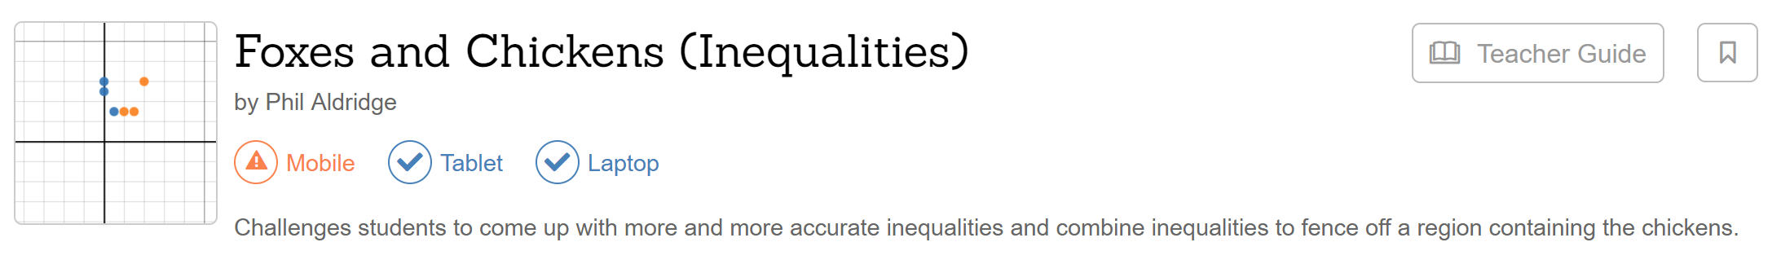
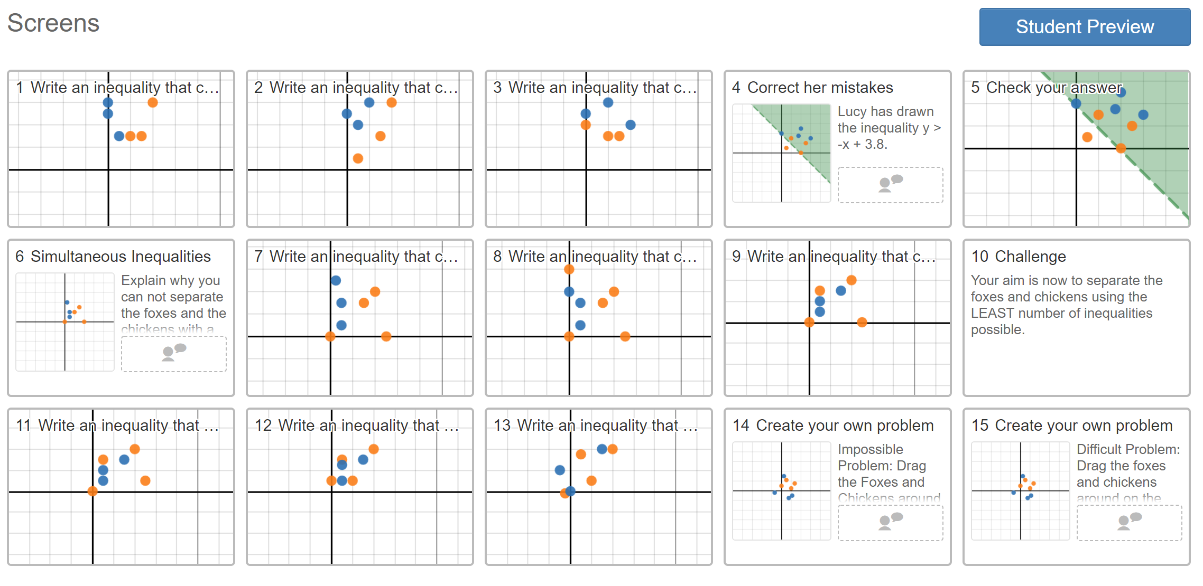
https://teacher.desmos.com/activitybuilder/custom/577a59253dd9ccb342f8d40f

