Slide 1
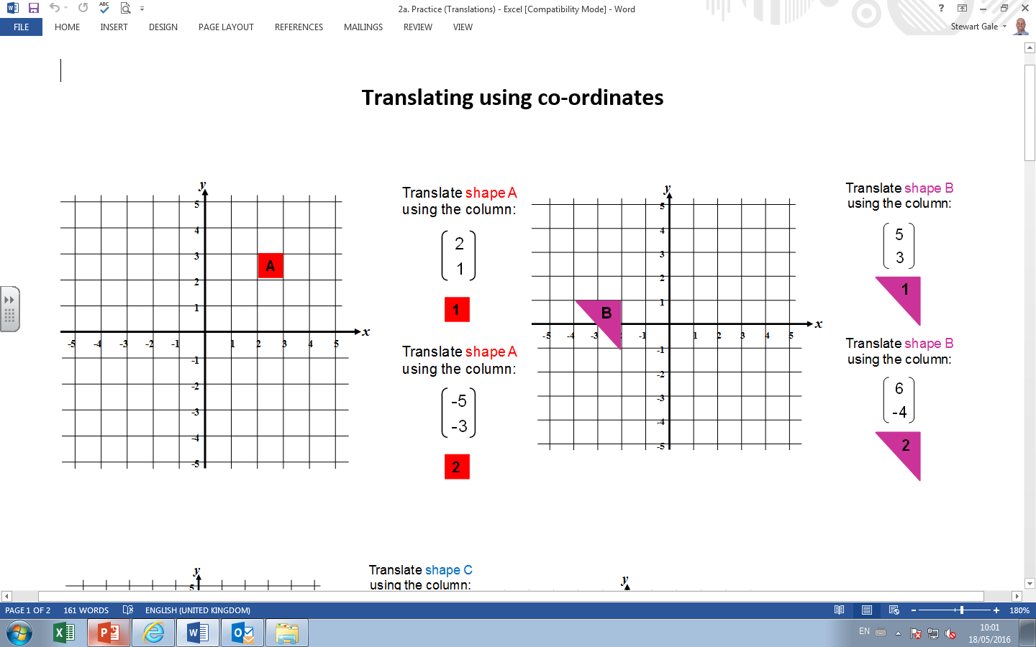

Slide 2
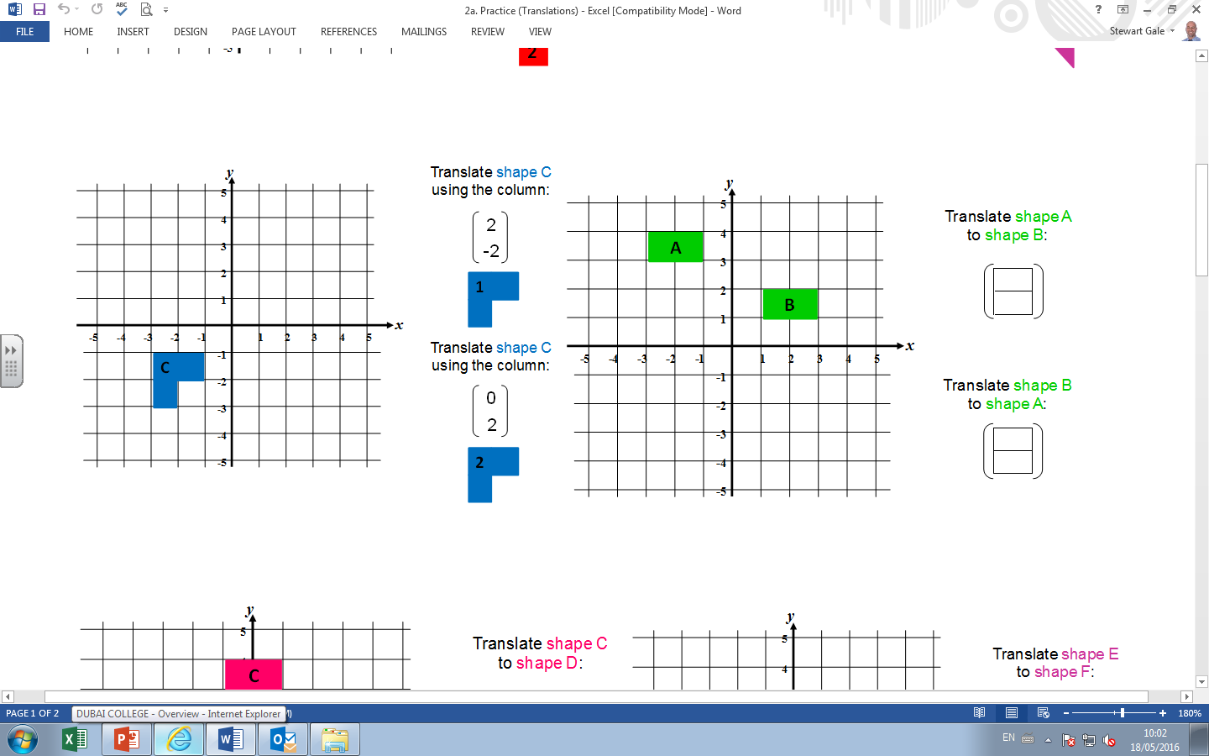

Slide 3
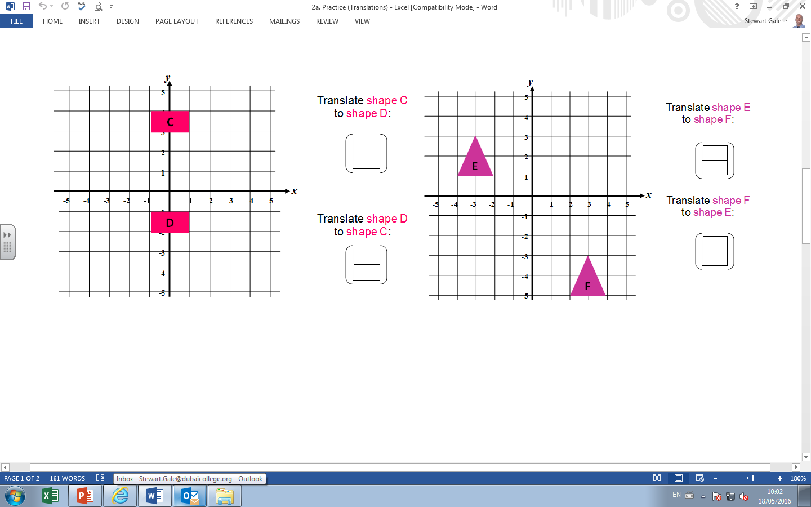

Slide 4
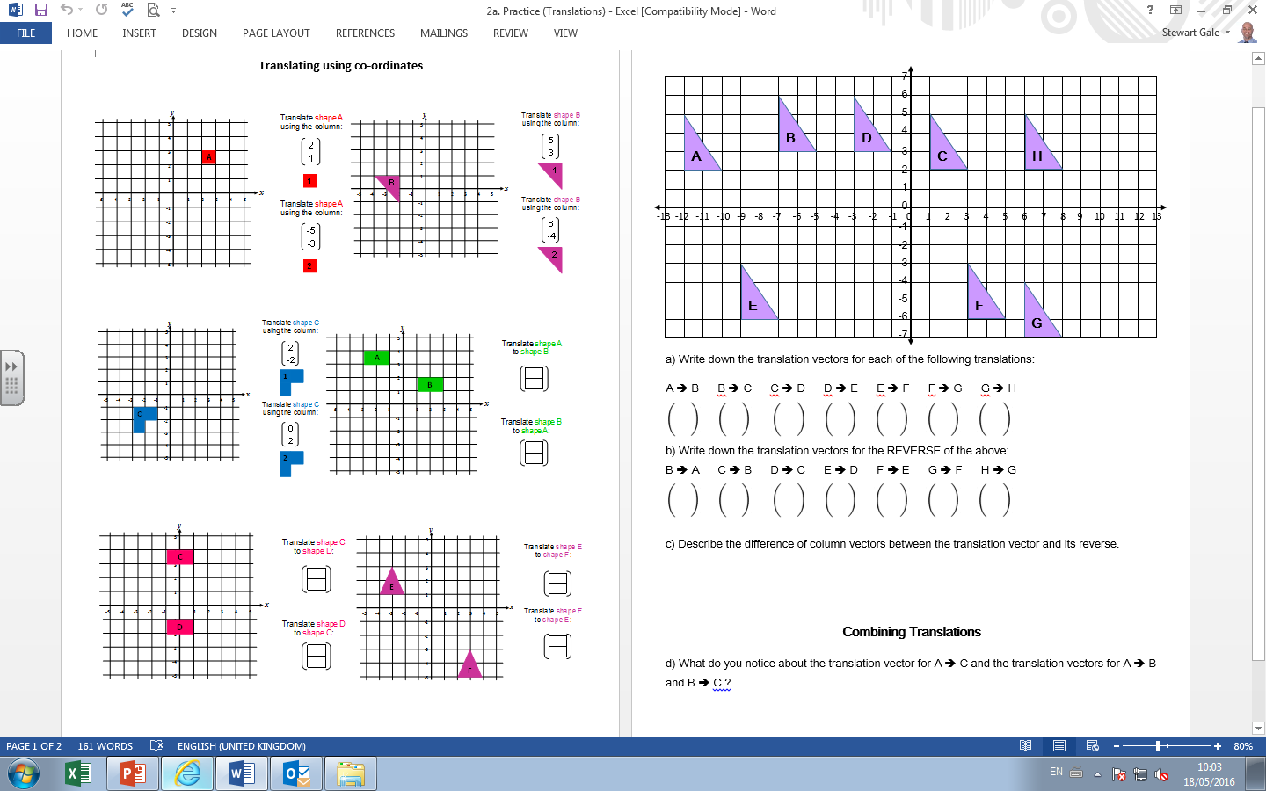

Slide 5
ANSWERS

Slide 6
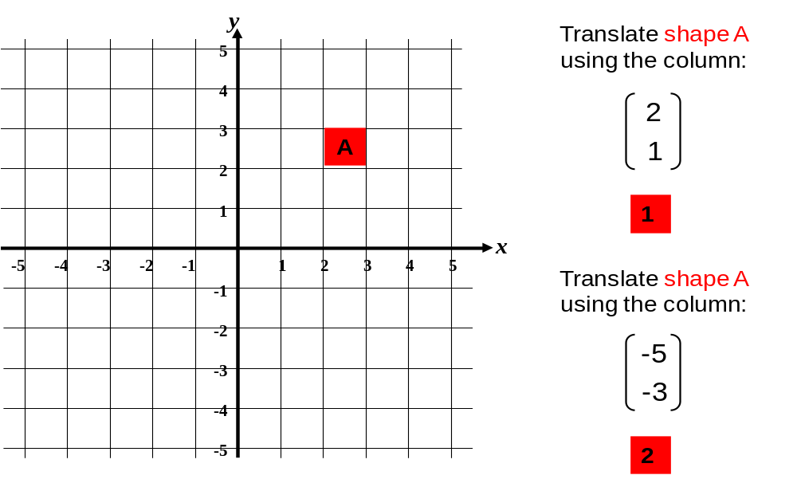
1
2

Slide 7
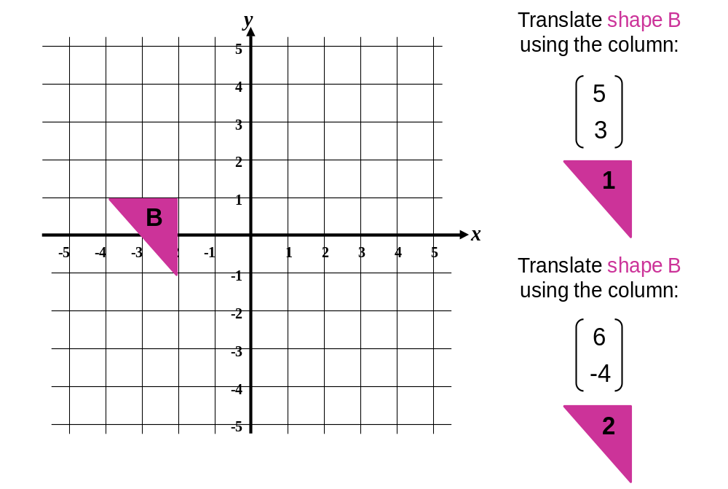
1
2

Slide 8
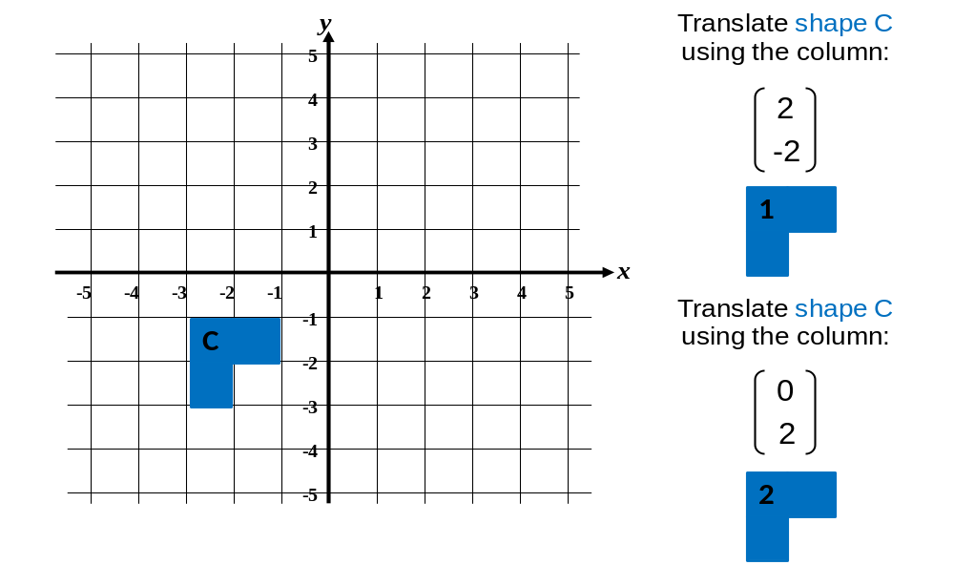
2
1

Slide 9
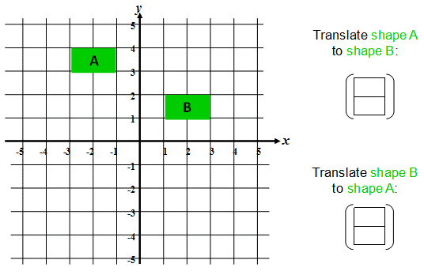
4
-2
-4
2

Slide 10
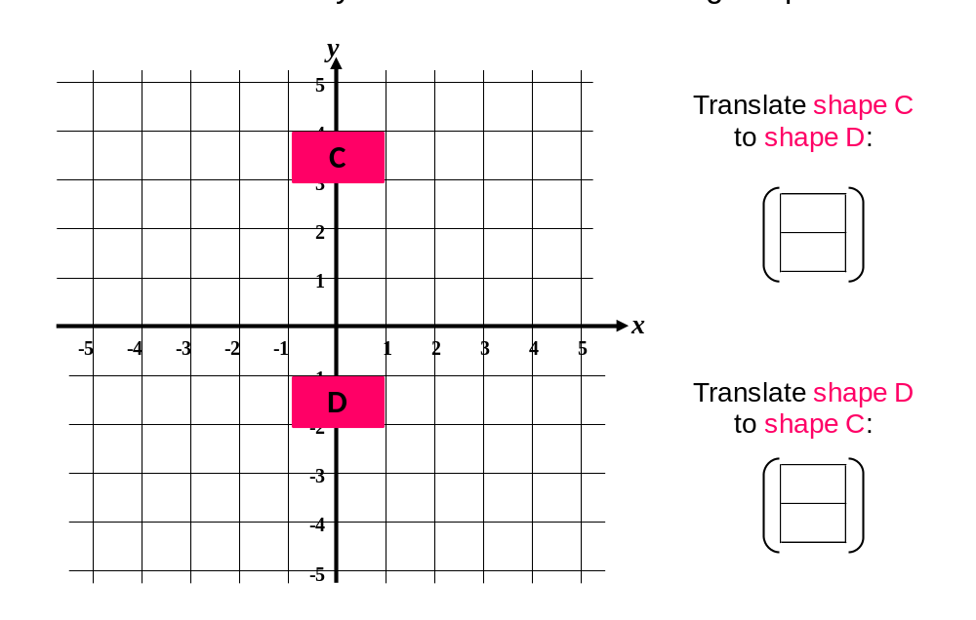
0
-5
0
5

Slide 11
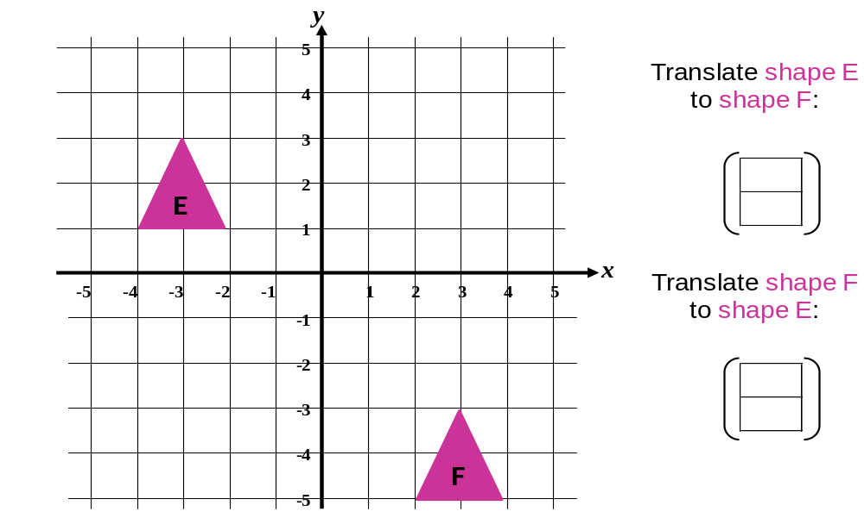
6
-6
-6
6

Slide 12
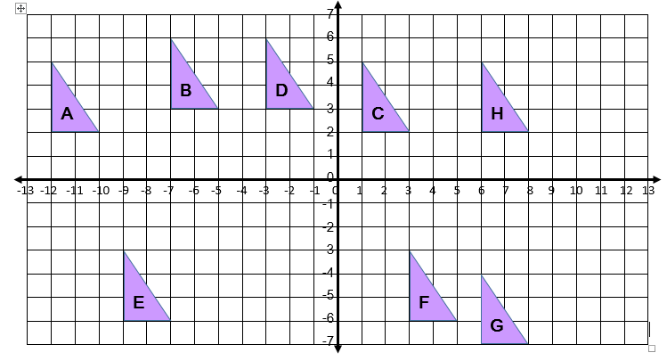
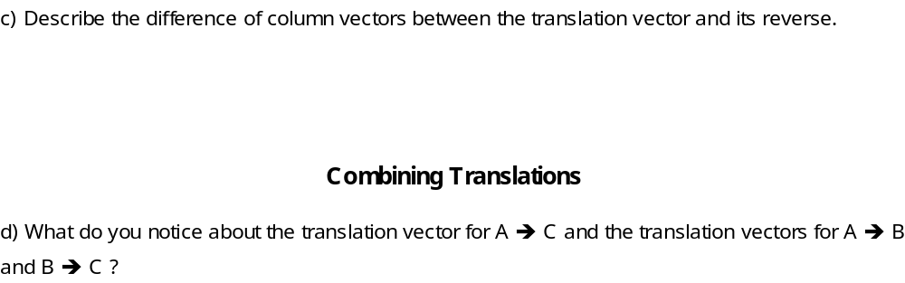
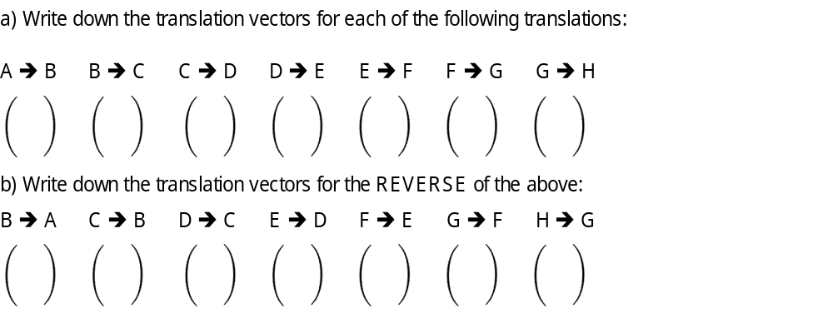
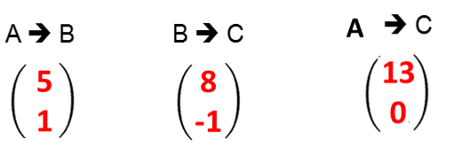
Negatives change to positives
and positives change to negatives.
5
1
8
-1
-4
1
-6
-9
12
0
3
-1
0
9
+
=
-5
-1
-8
1
4
-1
6
9
-12
0
-3
1
0
-9

