Slide 1

Senior Challenge 1
SILVER

Slide 2
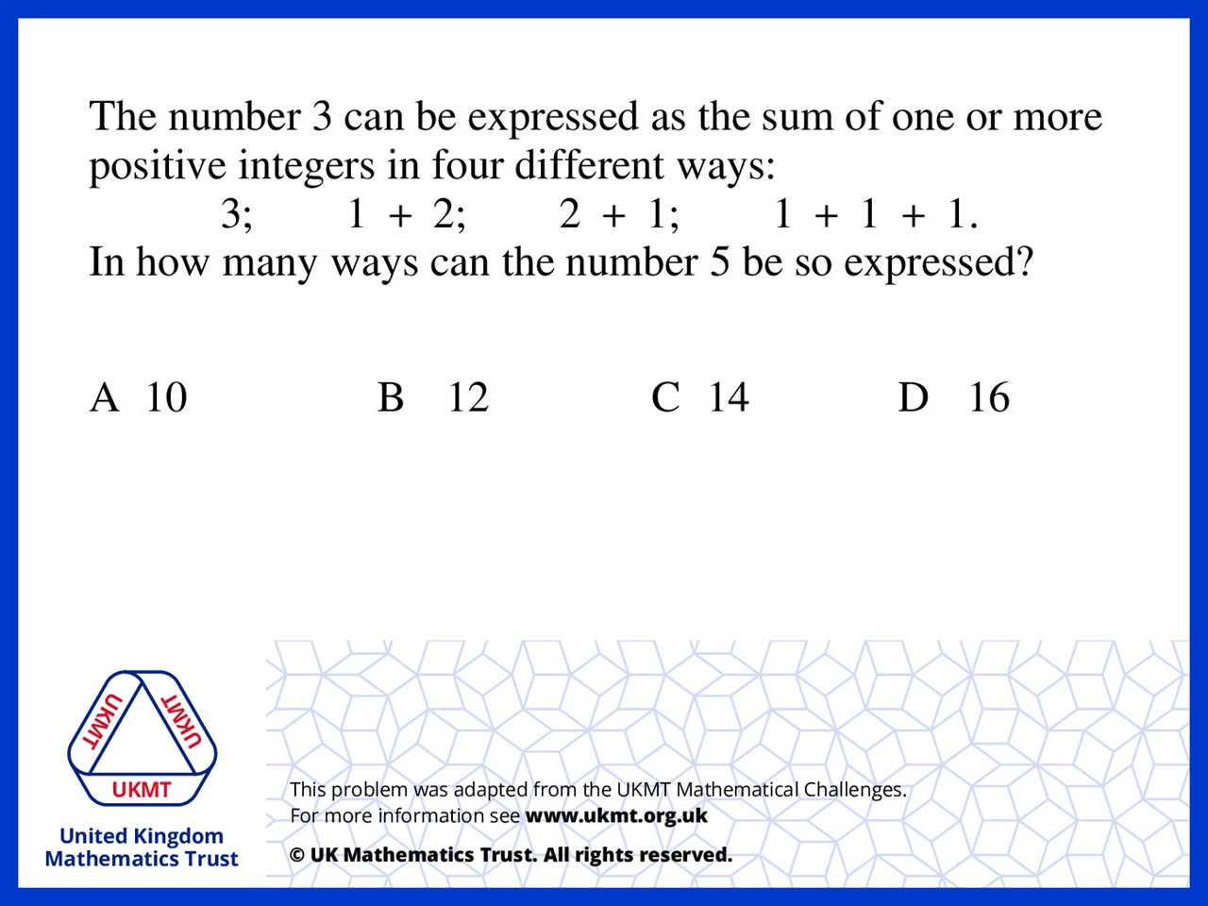
Q1.
(5) 1 way
(1,4) 2 ways
(2,3) 2 ways
(1,1,3) 3 ways
(1,2,2) 3 ways
(1,1,1,2) 4 ways
(1,1,1,1,1) 1 ways

Slide 3
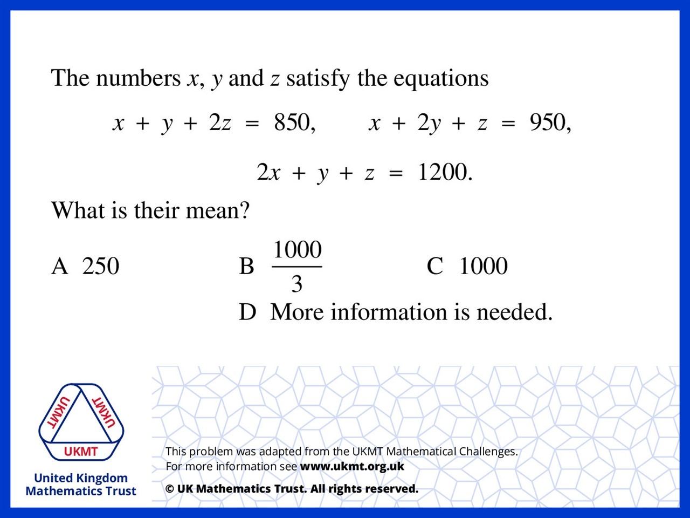
Q2.
Add all the equations together,
4x + 4y + 4z = 3000
x + y + z = 750
mean: 750/3 = 250

Slide 4
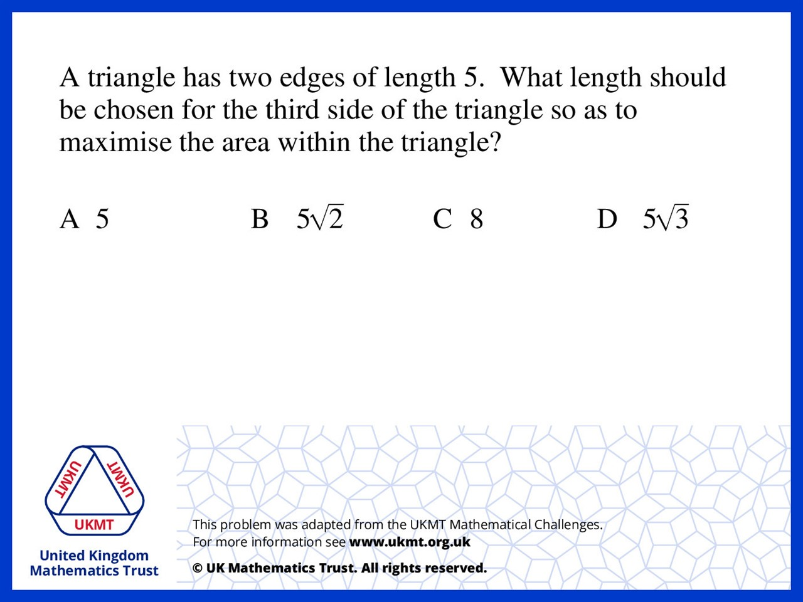
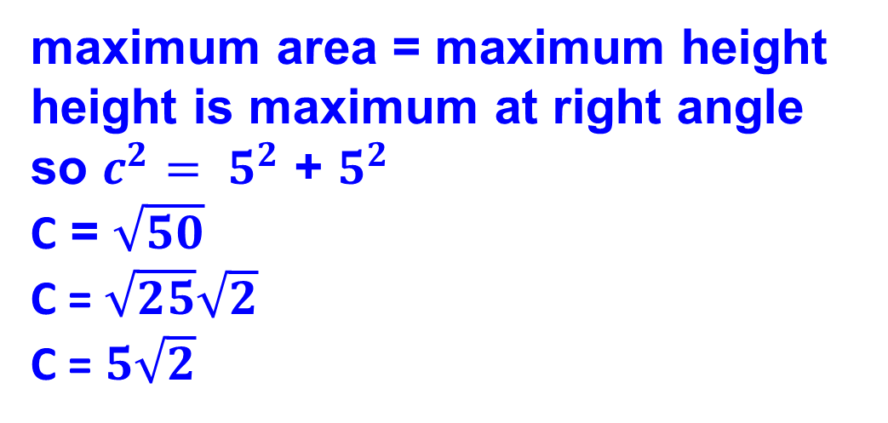
Q3.
maximum area = maximum height
height is maximum at right angle
so ${c^{2}= 5}^{2}$ + $5^{2}$
C = $\sqrt{50}$
C = $\sqrt{25}\sqrt{2}$
C = $5\sqrt{2}$

Slide 5
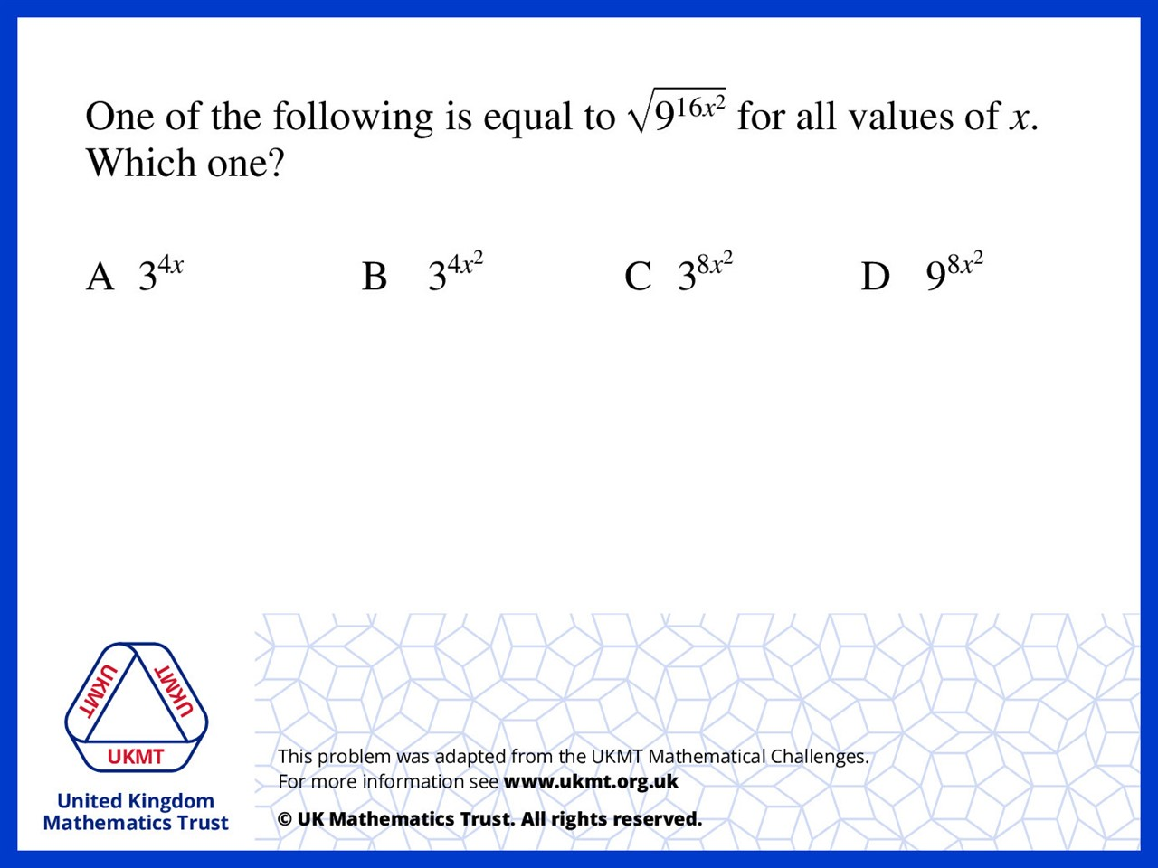
Q4.
Let x = 1
square root of 9 to power of 16
equals
9 to the power of 8

Slide 6
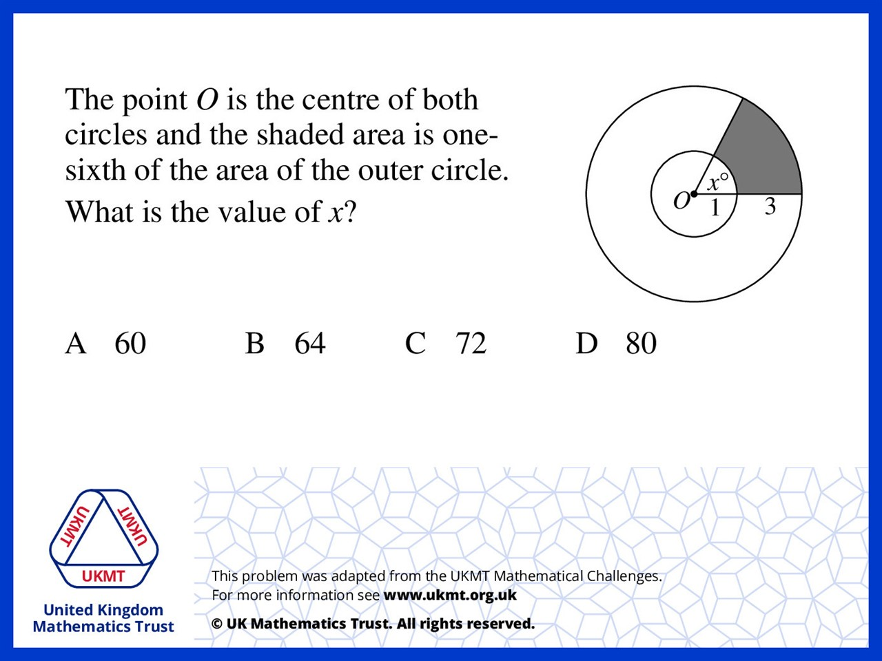
Q5.
Area of outer circle: 4 x 4 x π = 16π
Area of shaded area: [4 x 4 x x π x (x/360)] – [1 x 1 x π x (x/360)] = 1/24xπ
In addition, 16π x 1/6 = 1/24xπ
8/3 = 1/24x
x = 64

