Slide 1
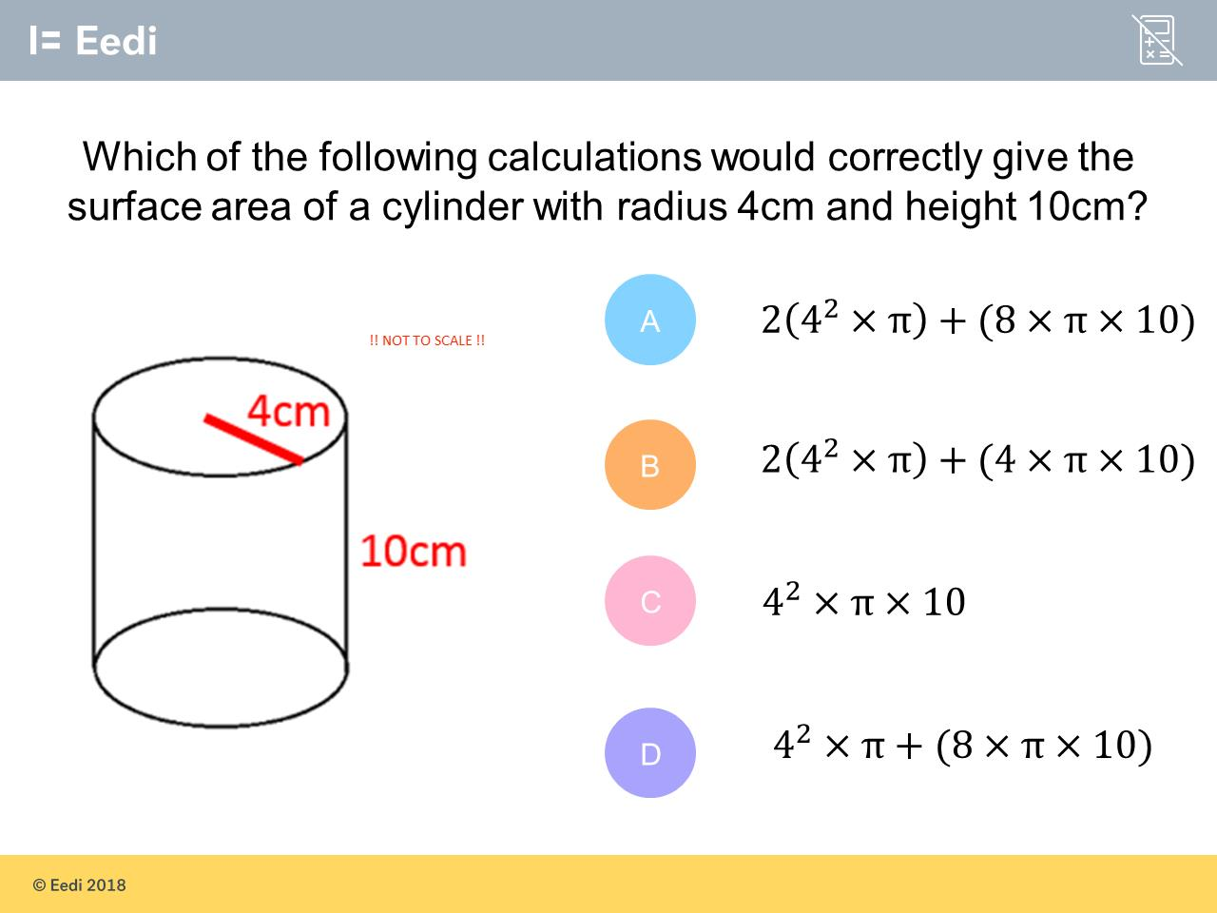
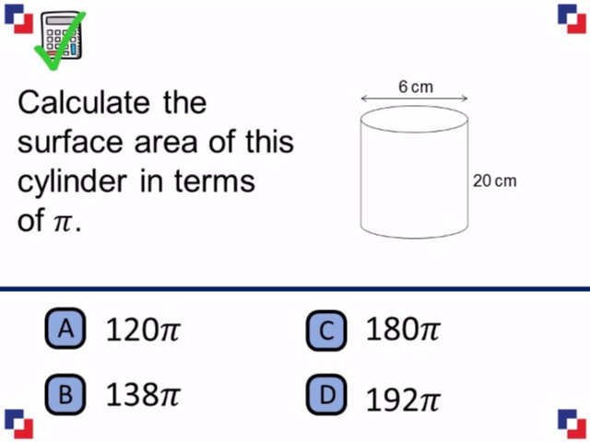
Worst answered question?
Most common wrong answer?

Slide 2
ANSWERS

Slide 3
Worst answered question?

Slide 4
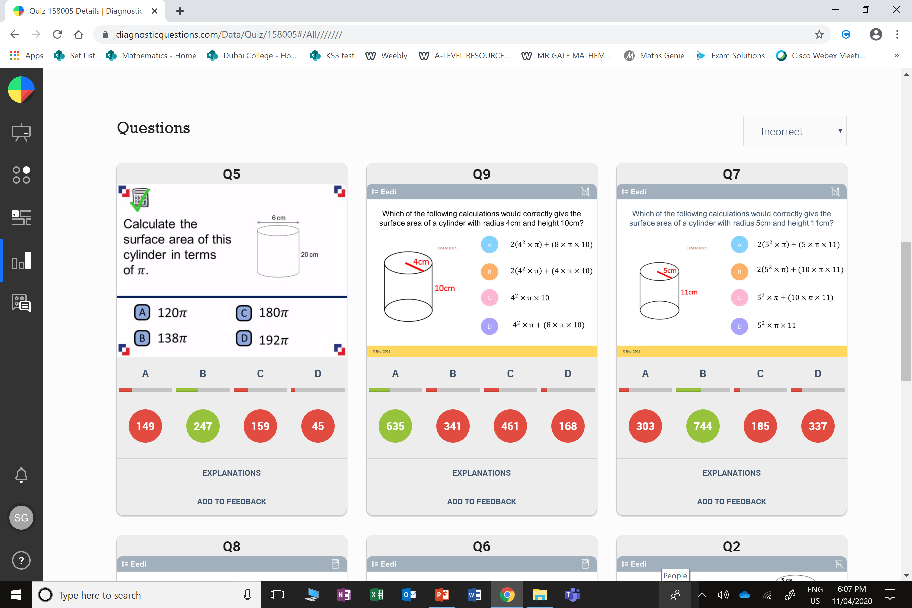
C
They did
9π x 20 = 180π
which is the volume.

Slide 5
C
The students have calculated the volume.

