Slide 1
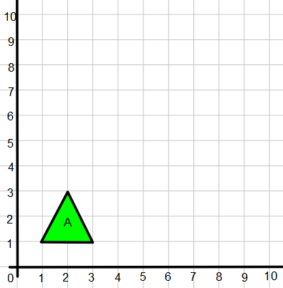
1) Enlarge using
a scale factor of 2
from centre (0,0)
2) Enlarge using
a scale factor of 2
from centre (1,1)
3) Enlarge using
a scale factor of 2
from centre (0,2)
4) Enlarge using
a scale factor of 2
from centre (2,0)

Slide 2
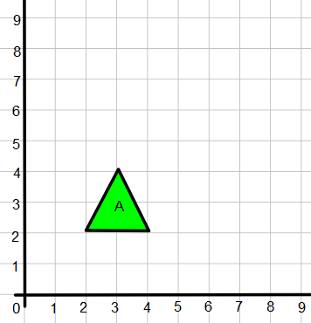
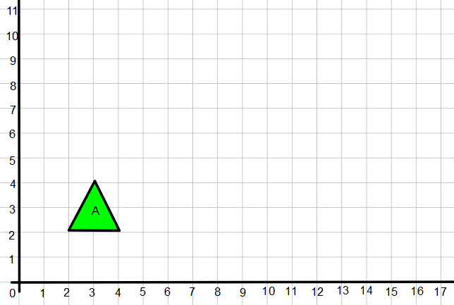
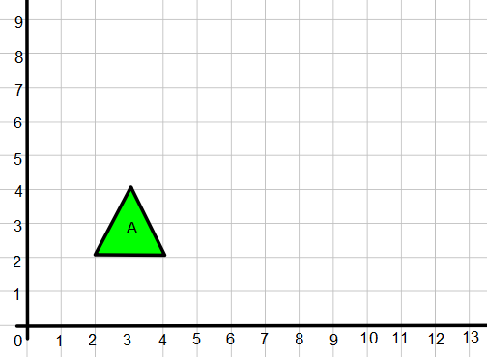
5) Enlarge using a scale factor of 2
from centre (0,2)
6) Enlarge using a scale factor of 4 from centre (0,2)
7) Enlarge using a scale factor of 3 from centre (0,2)
8) Enlarge using a scale factor of 1.5 from centre (0,2)

Slide 3
ANSWERS

Slide 4
1) Enlarge using
a scale factor of 2
from centre (0,0)

Slide 5
2) Enlarge using
a scale factor of 2
from centre (1,1)

Slide 6
3) Enlarge using
a scale factor of 2
from centre (0,2)

Slide 7
4) Enlarge using
a scale factor of 2
from centre (2,0)

Slide 8
5) Enlarge using a scale factor of 2
from centre (0,2)

Slide 9
6) Enlarge using a scale factor of 4 from centre (0,2)

Slide 10
7) Enlarge using a scale factor of 3 from centre (0,2)

Slide 11
8) Enlarge using a scale factor of 1.5 from centre (0,2)

