Slide 1
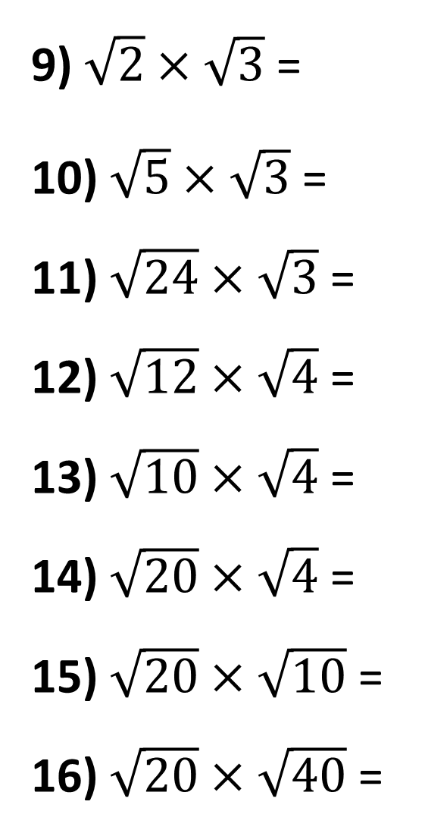
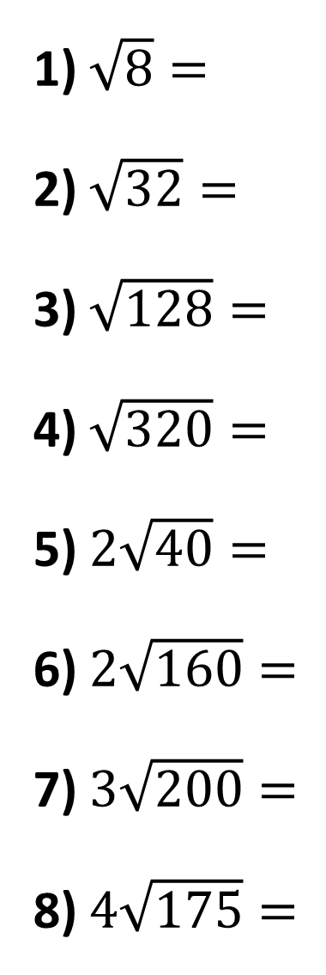
1) $\sqrt{8}=$
2) $\sqrt{32}=$
3) $\sqrt{128}=$
4) $\sqrt{320}=$
5) $2\sqrt{40}=$
6) $2\sqrt{160}=$
7) $3\sqrt{200}=$
8) $4\sqrt{175}=$
9) $\sqrt{2}×\sqrt{3}$ =
10) $\sqrt{5}×\sqrt{3}$ =
11) $\sqrt{24}×\sqrt{3}$ =
12) $\sqrt{12}×\sqrt{4}$ =
13) $\sqrt{10}×\sqrt{4}$ =
14) $\sqrt{20}×\sqrt{4}$ =
15) $\sqrt{20}×\sqrt{10}$ =
16) $\sqrt{20}×\sqrt{40}$ =

Slide 2
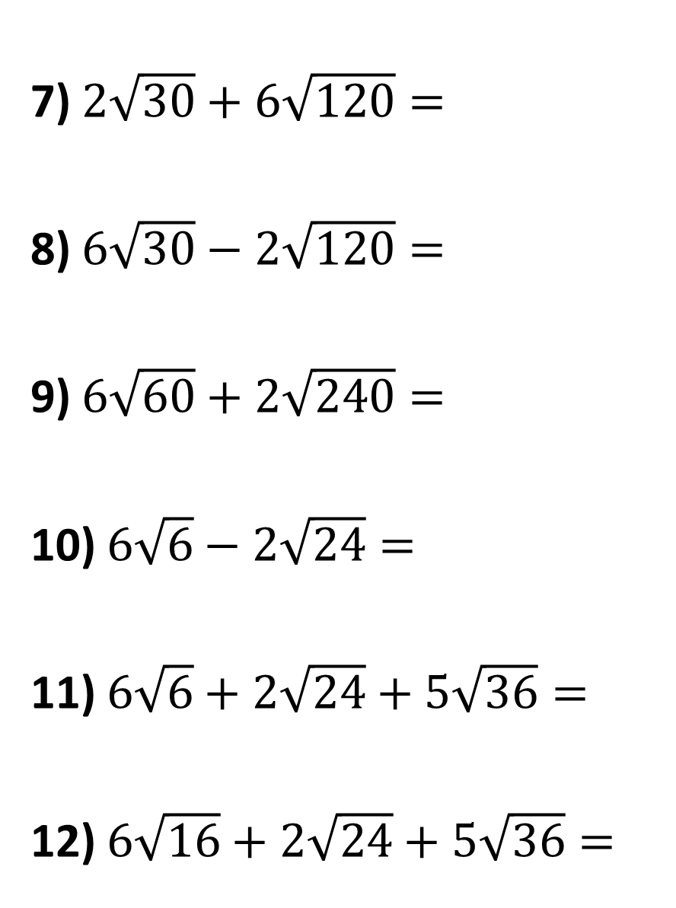
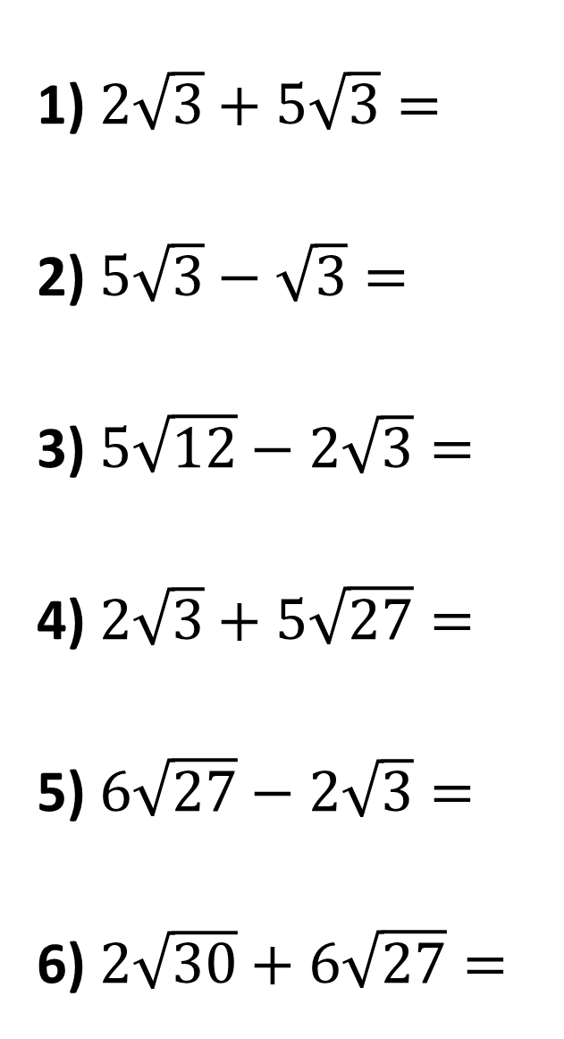
7) $2\sqrt{30}+6\sqrt{120}=$
8) $6\sqrt{30}−2\sqrt{120}=$
9) $6\sqrt{60}+2\sqrt{240}=$
10) $6\sqrt{6}−2\sqrt{24}=$
11) $6\sqrt{6}+2\sqrt{24}+5\sqrt{36}=$
12) $6\sqrt{16}+2\sqrt{24}+5\sqrt{36}=$
1) $2\sqrt{3}+5\sqrt{3}=$
2) $5\sqrt{3}−\sqrt{3}=$
3) $5\sqrt{12}−2\sqrt{3}=$
4) $2\sqrt{3}+5\sqrt{27}=$
5) $6\sqrt{27}−2\sqrt{3}=$
6) $2\sqrt{30}+6\sqrt{27}=$

Slide 3
ANSWERS

Slide 4
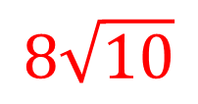
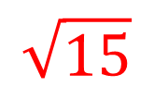
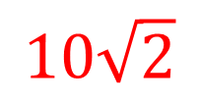
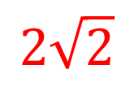
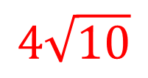
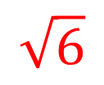
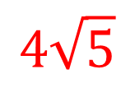
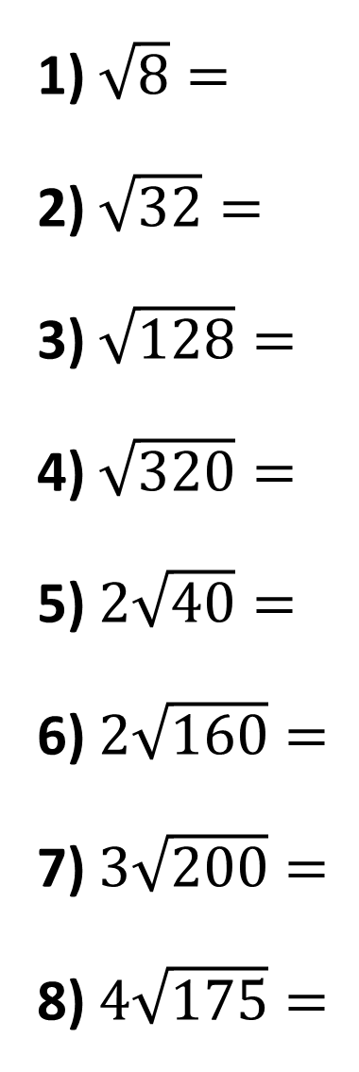
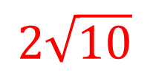
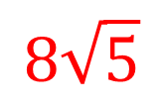
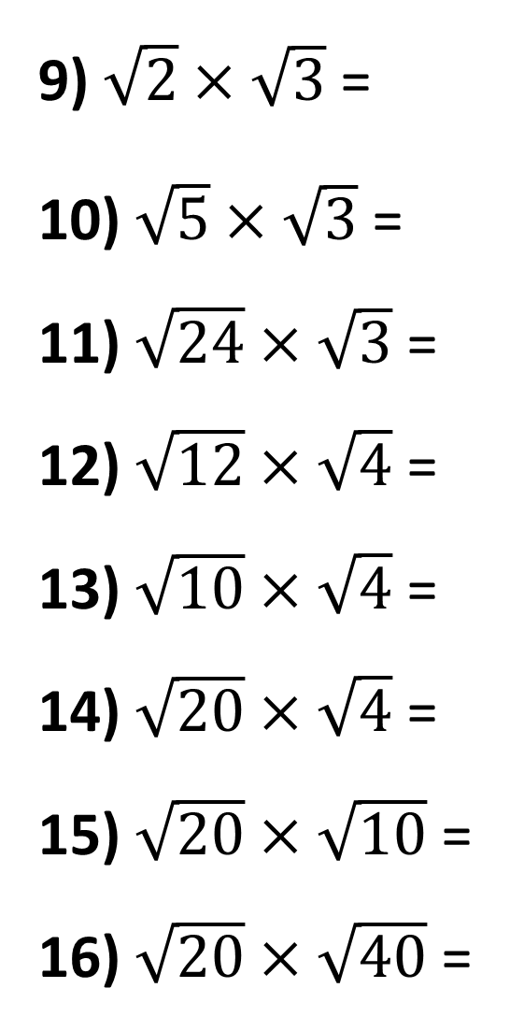
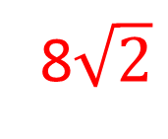
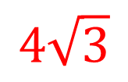
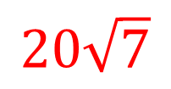
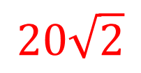
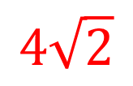
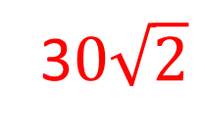
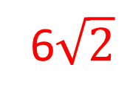
1) $\sqrt{8}=$
2) $\sqrt{32}=$
3) $\sqrt{128}=$
4) $\sqrt{320}=$
5) $2\sqrt{40}=$
6) $2\sqrt{160}=$
7) $3\sqrt{200}=$
8) $4\sqrt{175}=$
$$2\sqrt{2}$$
9) $\sqrt{2}×\sqrt{3}$ =
10) $\sqrt{5}×\sqrt{3}$ =
11) $\sqrt{24}×\sqrt{3}$ =
12) $\sqrt{12}×\sqrt{4}$ =
13) $\sqrt{10}×\sqrt{4}$ =
14) $\sqrt{20}×\sqrt{4}$ =
15) $\sqrt{20}×\sqrt{10}$ =
16) $\sqrt{20}×\sqrt{40}$ =
$$\sqrt{6}$$
$$4\sqrt{2}$$
$$\sqrt{15}$$
8$\sqrt{2}$
6$\sqrt{2}$
$$8\sqrt{5}$$
$$4\sqrt{3}$$
$$4\sqrt{10}$$
$$2\sqrt{10}$$
$$8\sqrt{10}$$
$$4\sqrt{5}$$
3$0\sqrt{2}$
$$10\sqrt{2}$$
$$20\sqrt{7}$$
$$20\sqrt{2}$$

Slide 5
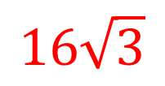
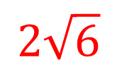
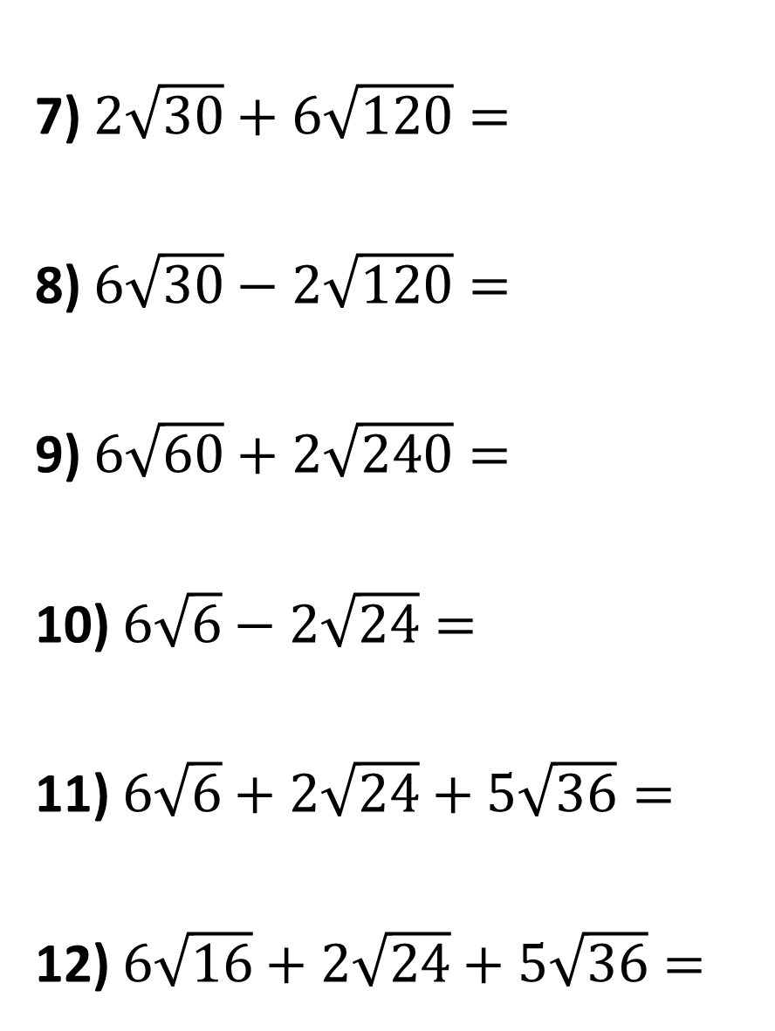
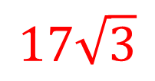
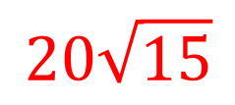
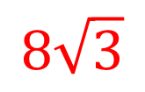
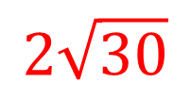
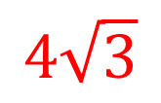

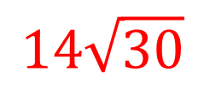
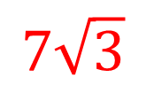


7) $2\sqrt{30}+6\sqrt{120}=$
8) $6\sqrt{30}−2\sqrt{120}=$
9) $6\sqrt{60}+2\sqrt{240}=$
10) $6\sqrt{6}−2\sqrt{24}=$
11) $6\sqrt{6}+2\sqrt{24}+5\sqrt{36}=$
12) $6\sqrt{16}+2\sqrt{24}+5\sqrt{36}=$
1) $2\sqrt{3}+5\sqrt{3}=$
2) $5\sqrt{3}−\sqrt{3}=$
3) $5\sqrt{12}−2\sqrt{3}=$
4) $2\sqrt{3}+5\sqrt{27}=$
5) $6\sqrt{27}−2\sqrt{3}=$
6) $2\sqrt{30}+6\sqrt{27}=$
$$7\sqrt{3}$$
$$14\sqrt{30}$$
$$4\sqrt{3}$$
$$2\sqrt{30}$$
$$8\sqrt{3}$$
$$20\sqrt{15}$$
$$17\sqrt{3}$$
$$2\sqrt{6}$$
$$16\sqrt{3}$$
$$30+10\sqrt{6}$$
$$2\sqrt{30}+18\sqrt{3}$$
$$54+4\sqrt{6}$$

