Slide 1
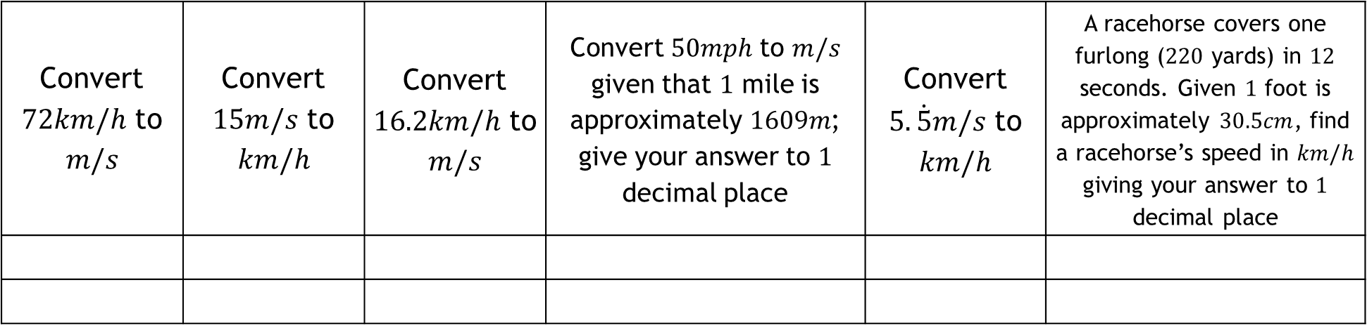
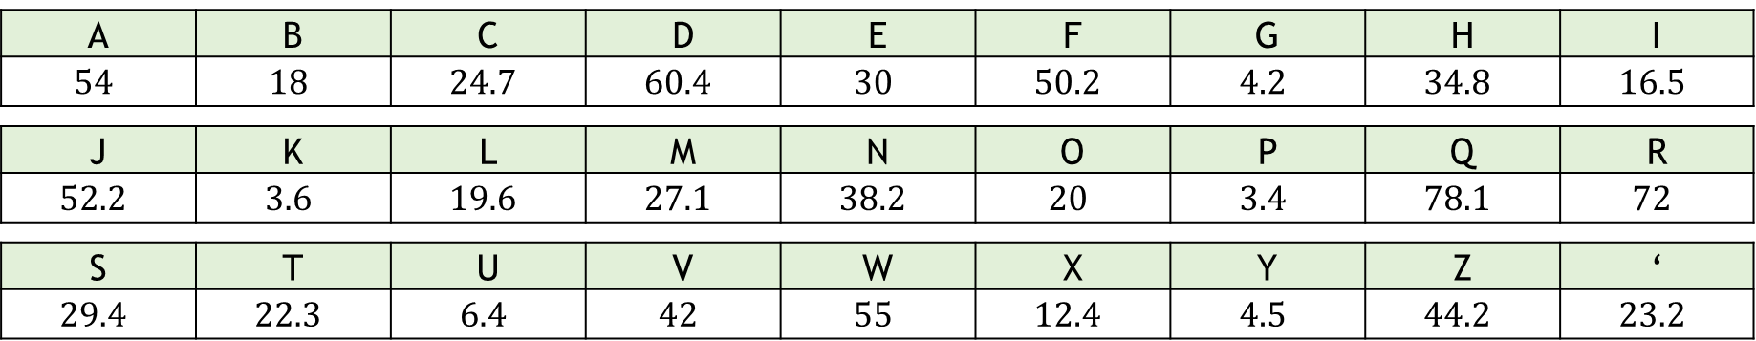
Converting Compound Measures Codebreaker
Link your answers to the table and unjumble the letters
to reveal which brand of car a Jedi prefers:
A | B | C | D | E | F | G | H | I
$$54$$ | $$18$$ | $$24.7$$ | $$60.4$$ | $$30$$ | $$50.2$$ | $$4.2$$ | $$34.8$$ | $$16.5$$
J | K | L | M | N | O | P | Q | R
$$52.2$$ | $$3.6$$ | $$19.6$$ | $$27.1$$ | $$38.2$$ | $$20$$ | $$3.4$$ | $$78.1$$ | $$72$$
S | T | U | V | W | X | Y | Z | ‘
$$29.4$$ | $$22.3$$ | $$6.4$$ | $$42$$ | $$55$$ | $$12.4$$ | $$4.5$$ | $$44.2$$ | $$23.2$$
Convert $72km/h$ to $$m/s$$ | Convert $15m/s$ to $$km/h$$ | Convert $16.2km/h$ to $m/s$ | Convert $50mph$ to $m/s$ given that $1$ mile is approximately $1609m$; give your answer to $1$ decimal place | Convert $5.\dot{5}m/s$ to $km/h$ | A racehorse covers one furlong ($220$ yards) in $12$ seconds. Given $1$ foot is approximately $30.5cm$, find a racehorse’s speed in $km/h$ giving your answer to $1$ decimal place

Slide 2
ANSWERS

Slide 3
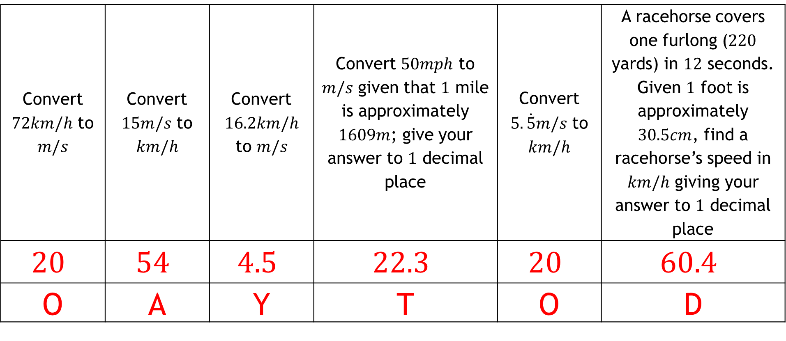
Convert $72km/h$ to $$m/s$$ | Convert $15m/s$ to $$km/h$$ | Convert $16.2km/h$ to $m/s$ | Convert $50mph$ to $m/s$ given that $1$ mile is approximately $1609m$; give your answer to $1$ decimal place | Convert $5.\dot{5}m/s$ to $km/h$ | A racehorse covers one furlong ($220$ yards) in $12$ seconds. Given $1$ foot is approximately $30.5cm$, find a racehorse’s speed in $km/h$ giving your answer to $1$ decimal place
$$20$$ | $$54$$ | $$4.5$$ | $$22.3$$ | $$20$$ | $$60.4$$
O | A | Y | T | O | D
Toyoda

