Slide 1
Momentum and Impulse
Conservation of Momentum
Chapter 1
(Part 2 of 3)

Slide 2
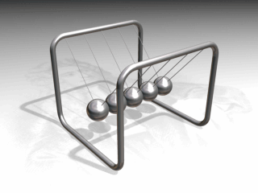

Slide 3













$$u_{1}$$
$$u_{2}$$
Proof
Before
$$−I$$
$$I$$
$$m_{1}$$
$$m_{2}$$
$$v_{1}$$
$$v_{2}$$
After
By Newton’s 3rd law the magnitude of $I$is equal on both bodies
(equal and opposite forces acting for equal time).
$−I=m_{1}v_{1}−m_{1}u_{1}$
1
2
$I=m_{2}v_{2}−m_{2}u_{2}$
$0=m_{1}v_{1}−m_{1}u_{1}+m_{2}v_{2}−m_{2}u_{2}$
$$+$$
1
2
$${m_{1}u}_{1}+m_{2}u_{2}=m_{1}v_{1}+m_{2}v_{2}$$
Total momentum before impact $=$ Total momentum after impact

Slide 4

The law of Conservation of Momentum
30km/h
Total momentum
before impact
Total momentum after impact
$$=$$

Slide 5








Calculated the value of $b$
$3$
$$1$$
CoM
2kg
1kg
$$3\left(2\right)+1\left(1\right)=2\left(1\right)+b(1)$$
A
B
$$7=2+b$$
$$b={5 ms}^{−1}$$
$$1$$
$$b$$

Slide 6

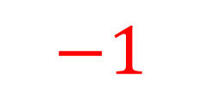





Calculated the value of $b$
3
$$1$$
CoM
2kg
1kg
$$3\left(2\right)+1\left(1\right)=−1\left(2\right)+b(1)$$
A
B
$$7=−2+b$$
$$b={9 ms}^{−1}$$
$$−1$$
$$b$$

Slide 7







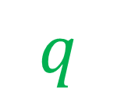

Calculated the value of $q$
3
$$0$$
CoM
2kg
1kg
$$P$$
$$Q$$
$$3\left(2\right)+0\left(1\right)=2\left(−1\right)+q(1)$$
$$6=−2+q$$
$$q$$
$$q ={8 ms}^{−1}$$
$$−1$$

Slide 8








Calculated the value of $q$
3
$$−1$$
CoM
$$3\left(2\right)−1\left(1\right)=−1\left(2\right)+q(1)$$
2kg
1kg
$$P$$
$$Q$$
$$5=−2+q$$
$$q ={7 ms}^{−1}$$
$$−1$$
$$b$$

Slide 9
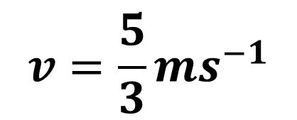


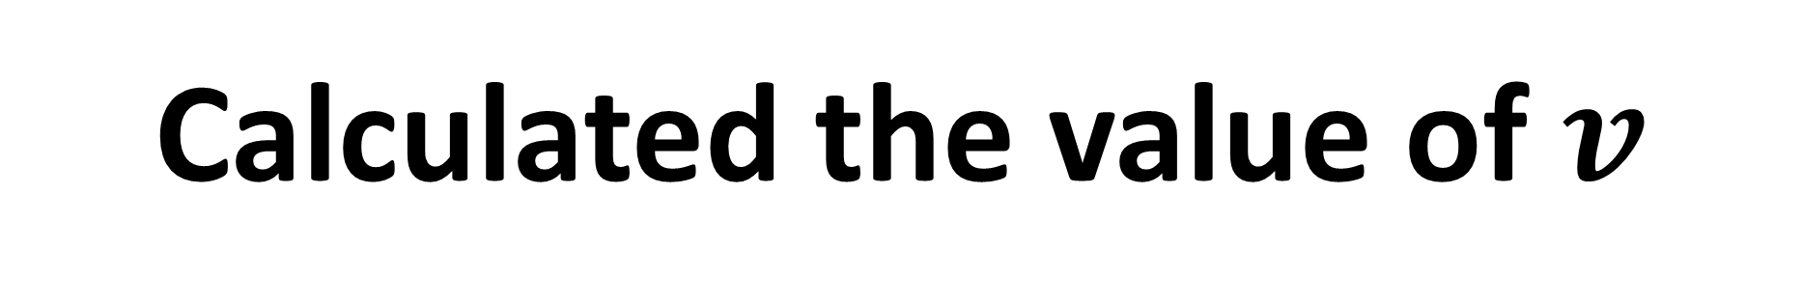





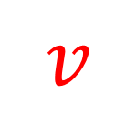
Calculated the value of $v$
$3$
$$−1$$
CoM
$$3\left(2\right)−1\left(1\right)=2v+v$$
2kg
1kg
$$P$$
$$Q$$
$$5=3v$$
$$v={\frac{5}{3}ms}^{−1}$$
$$v$$
$$v$$

Slide 10
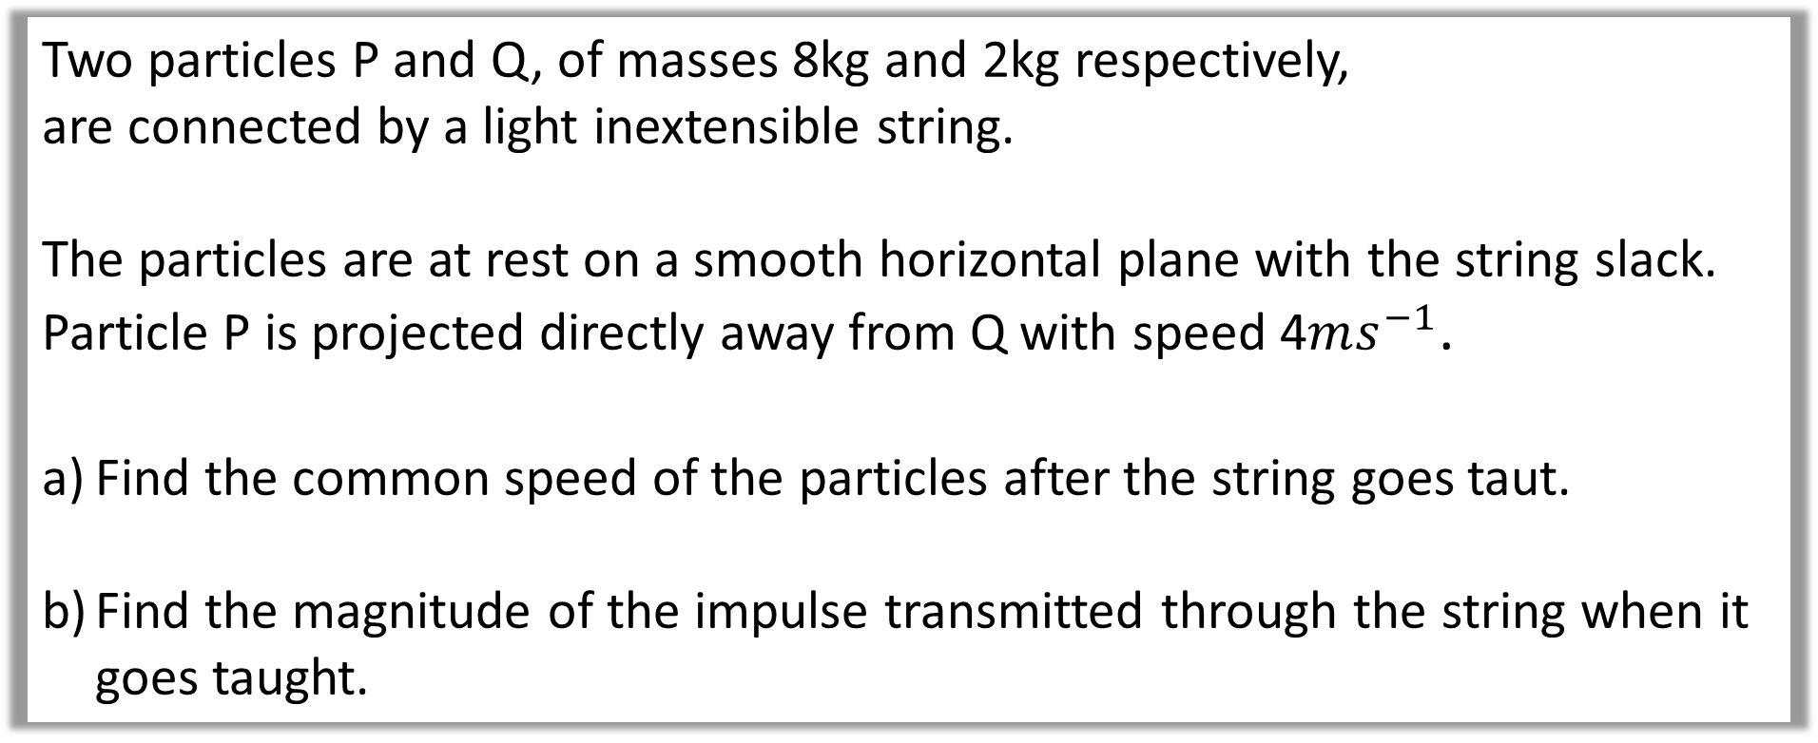
Question A
Two particles P and Q, of masses 8kg and 2kg respectively,
are connected by a light inextensible string.
The particles are at rest on a smooth horizontal plane with the string slack.
Particle P is projected directly away from Q with speed 4$ms^{−1}$.
Find the common speed of the particles after the string goes taut.
Find the magnitude of the impulse transmitted through the string when it goes taught.

Slide 11
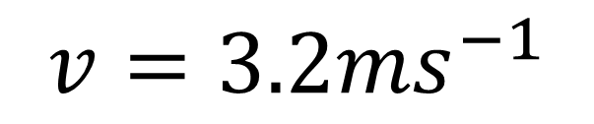
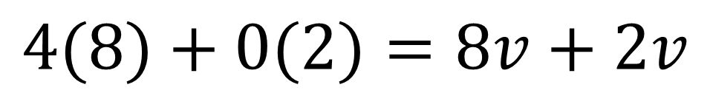
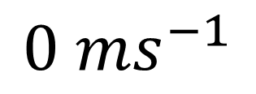
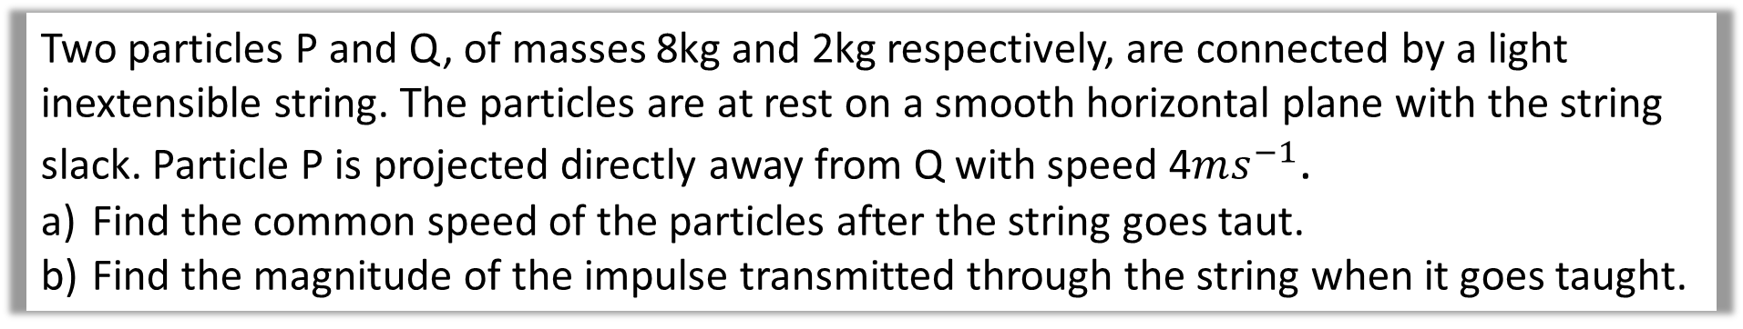
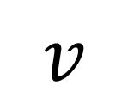
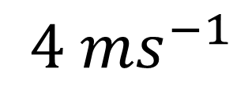

Two particles P and Q, of masses 8kg and 2kg respectively, are connected by a light inextensible string. The particles are at rest on a smooth horizontal plane with the string slack. Particle P is projected directly away from Q with speed 4$ms^{−1}$.
Find the common speed of the particles after the string goes taut.
Find the magnitude of the impulse transmitted through the string when it goes taught.
a
${4 ms}^{−1}$
$${0 ms}^{−1}$$
CoM
$$4(8)+0(2)=8v+2v$$
8kg
2kg
$$v=3.2ms^{−1}$$
$$v$$
$$v$$

Slide 12

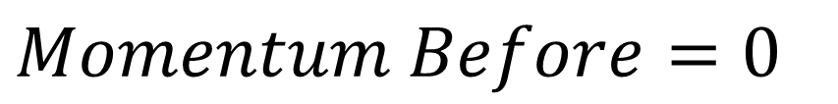
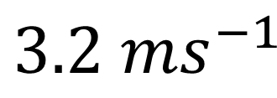
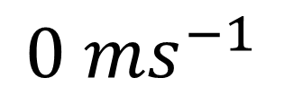
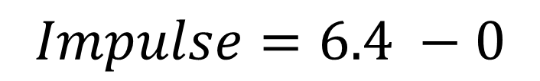
Two particles P and Q, of masses 8kg and 2kg respectively, are connected by a light inextensible string. The particles are at rest on a smooth horizontal plane with the string slack. Particle P is projected directly away from Q with speed 4$ms^{−1}$.
Find the common speed of the particles after the string goes taut.
Find the magnitude of the impulse transmitted through the string when it goes taught.
b
$${0 ms}^{−1}$$
$$Momentum Before=0$$
2kg
$$Momentum After=2\left(3.2\right)=6.4$$
$$Impulse=6.4 −0$$
$${3.2 ms}^{−1}$$
$$=6.4Ns$$

Slide 13
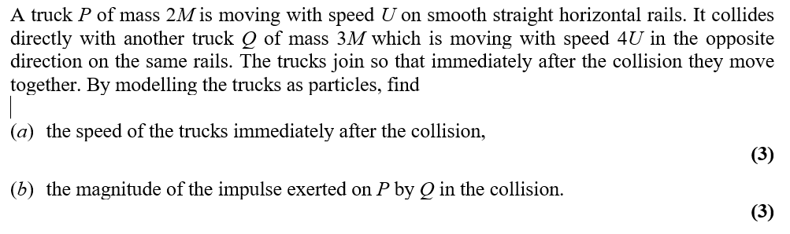
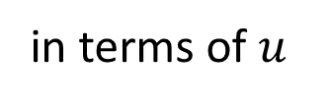
Question B
in terms of $u$

Slide 14
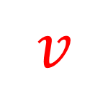










$u$
CoM
$$−4u$$
$$u\left(2m\right)−4u(3m)=v(2m)+v(3m)$$
$$2m$$
$$3m$$
$$P$$
$$Q$$
$$2u−12u=2v+3v$$
$$−10u=5v$$
$$v=−2u$$
$$v$$
$$v$$
$$v=2u ms^{−1}$$

Slide 15
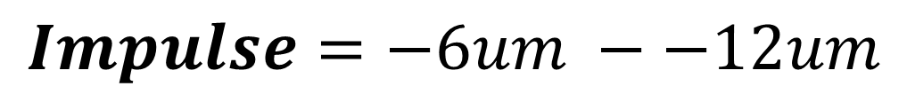

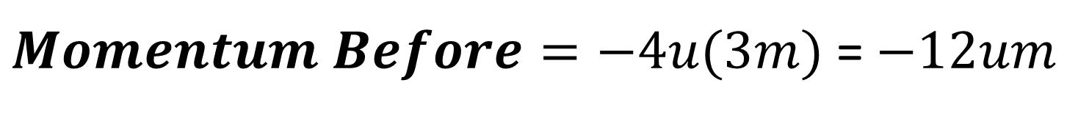


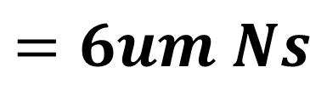
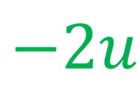
$$−4u$$
$Momentum Before=−4u(3m)$ = $−12um$
$$3m$$
$$Momentum After=−2u\left(3m\right)=−6um$$
$$Q$$
$$Impulse=−6um −−12um$$
$$−2u$$
$$=6um Ns$$

