Slide 1
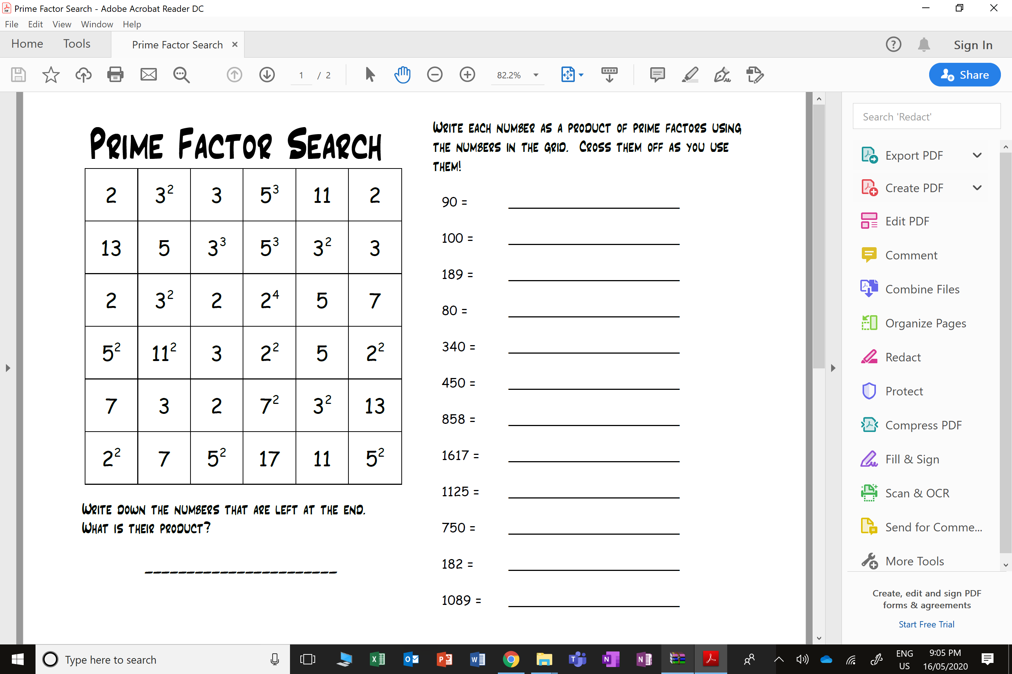

Product of Prime Factors
Write each numbers below as a product of prime factors.
Cross off the numbers in the grid that were used.
Write down the numbers that are left
at the end. What is their product?

Slide 2
ANSWERS

Slide 3
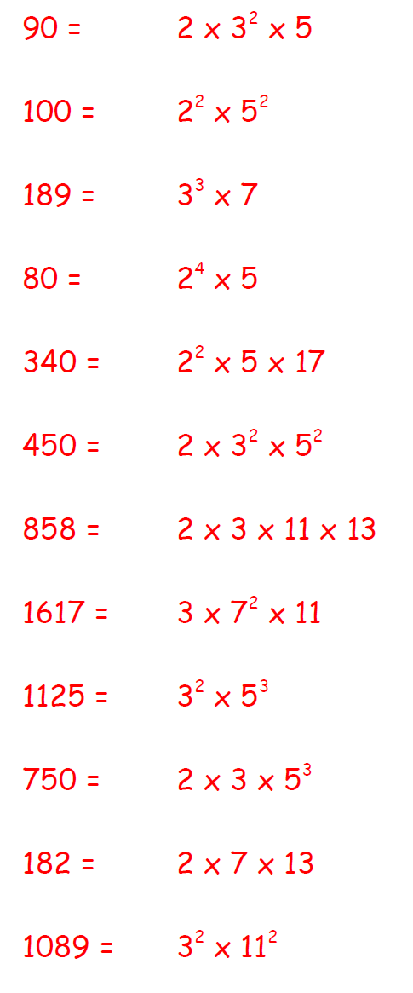

Write down the numbers that are left
at the end. What is their product?

