Slide 1
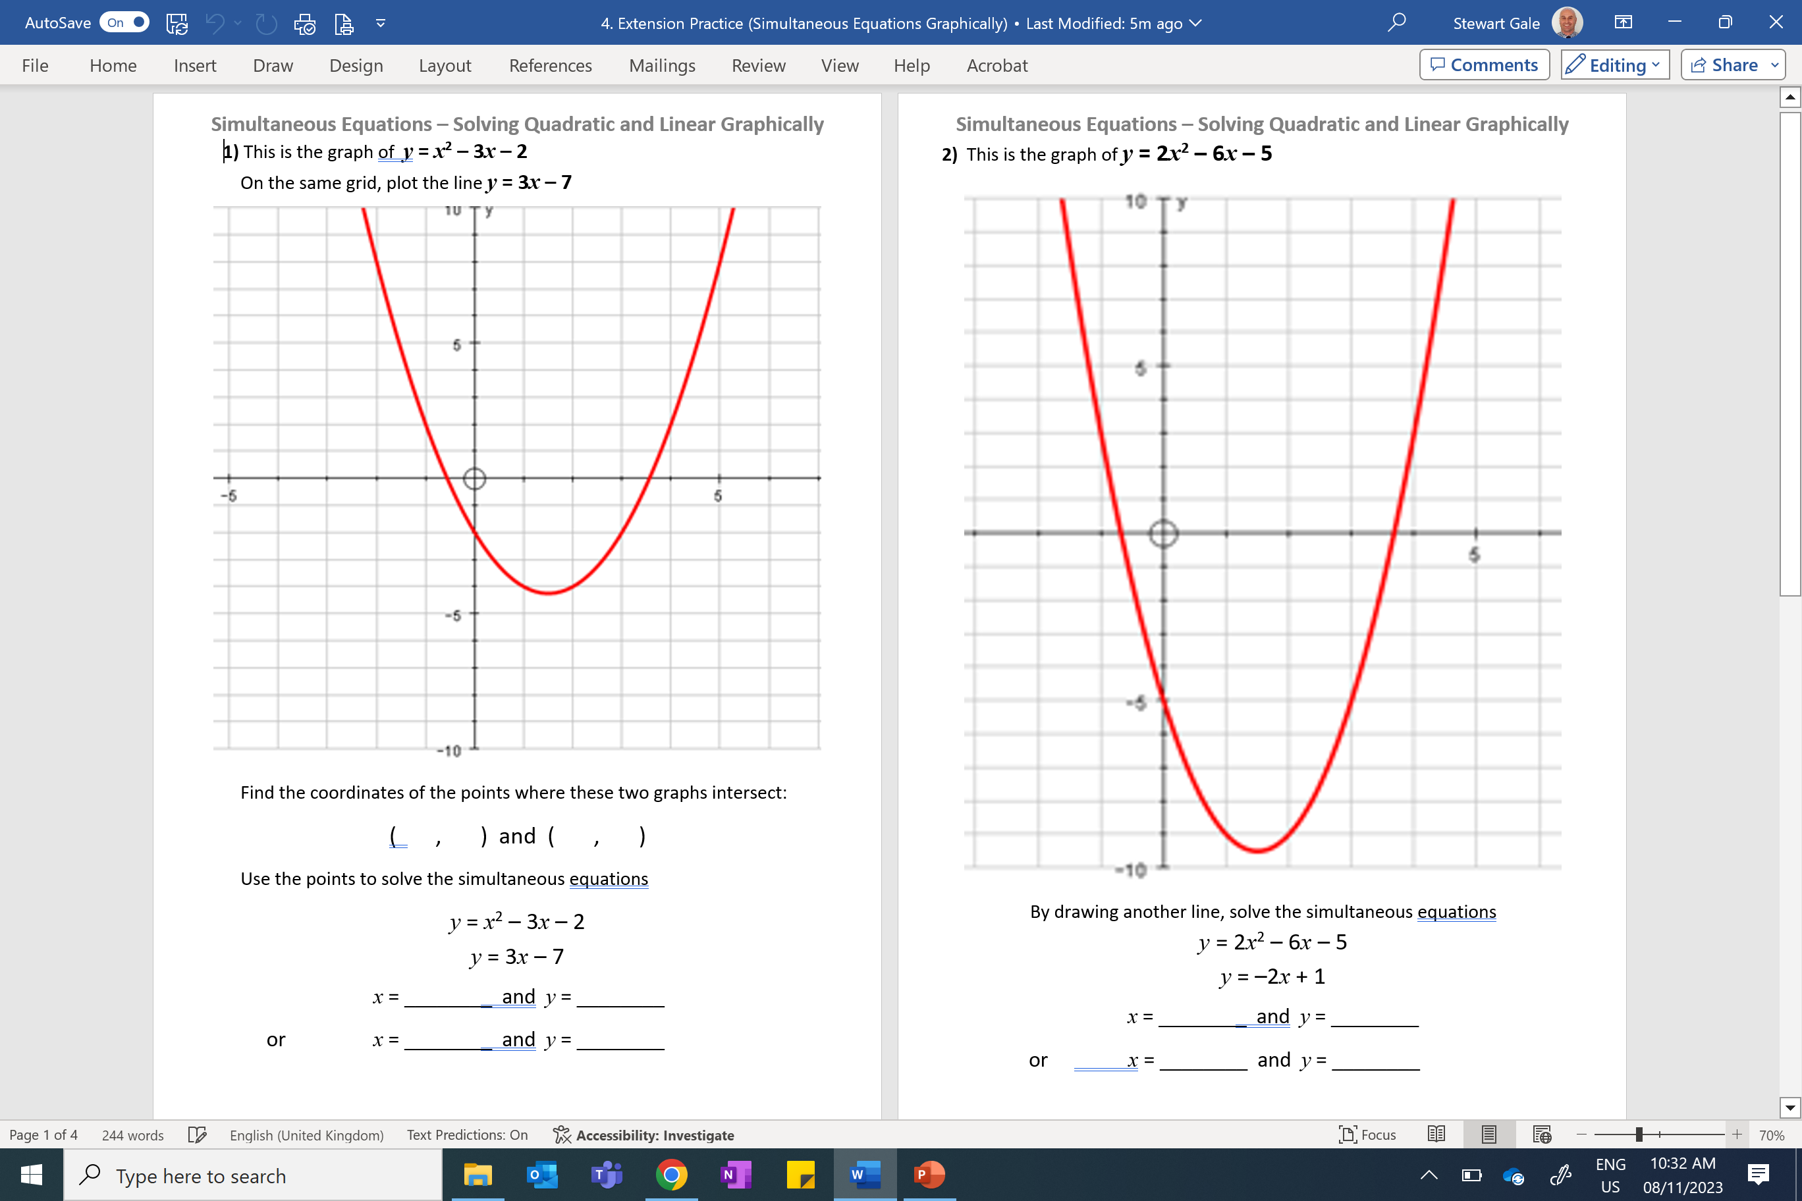

Slide 2
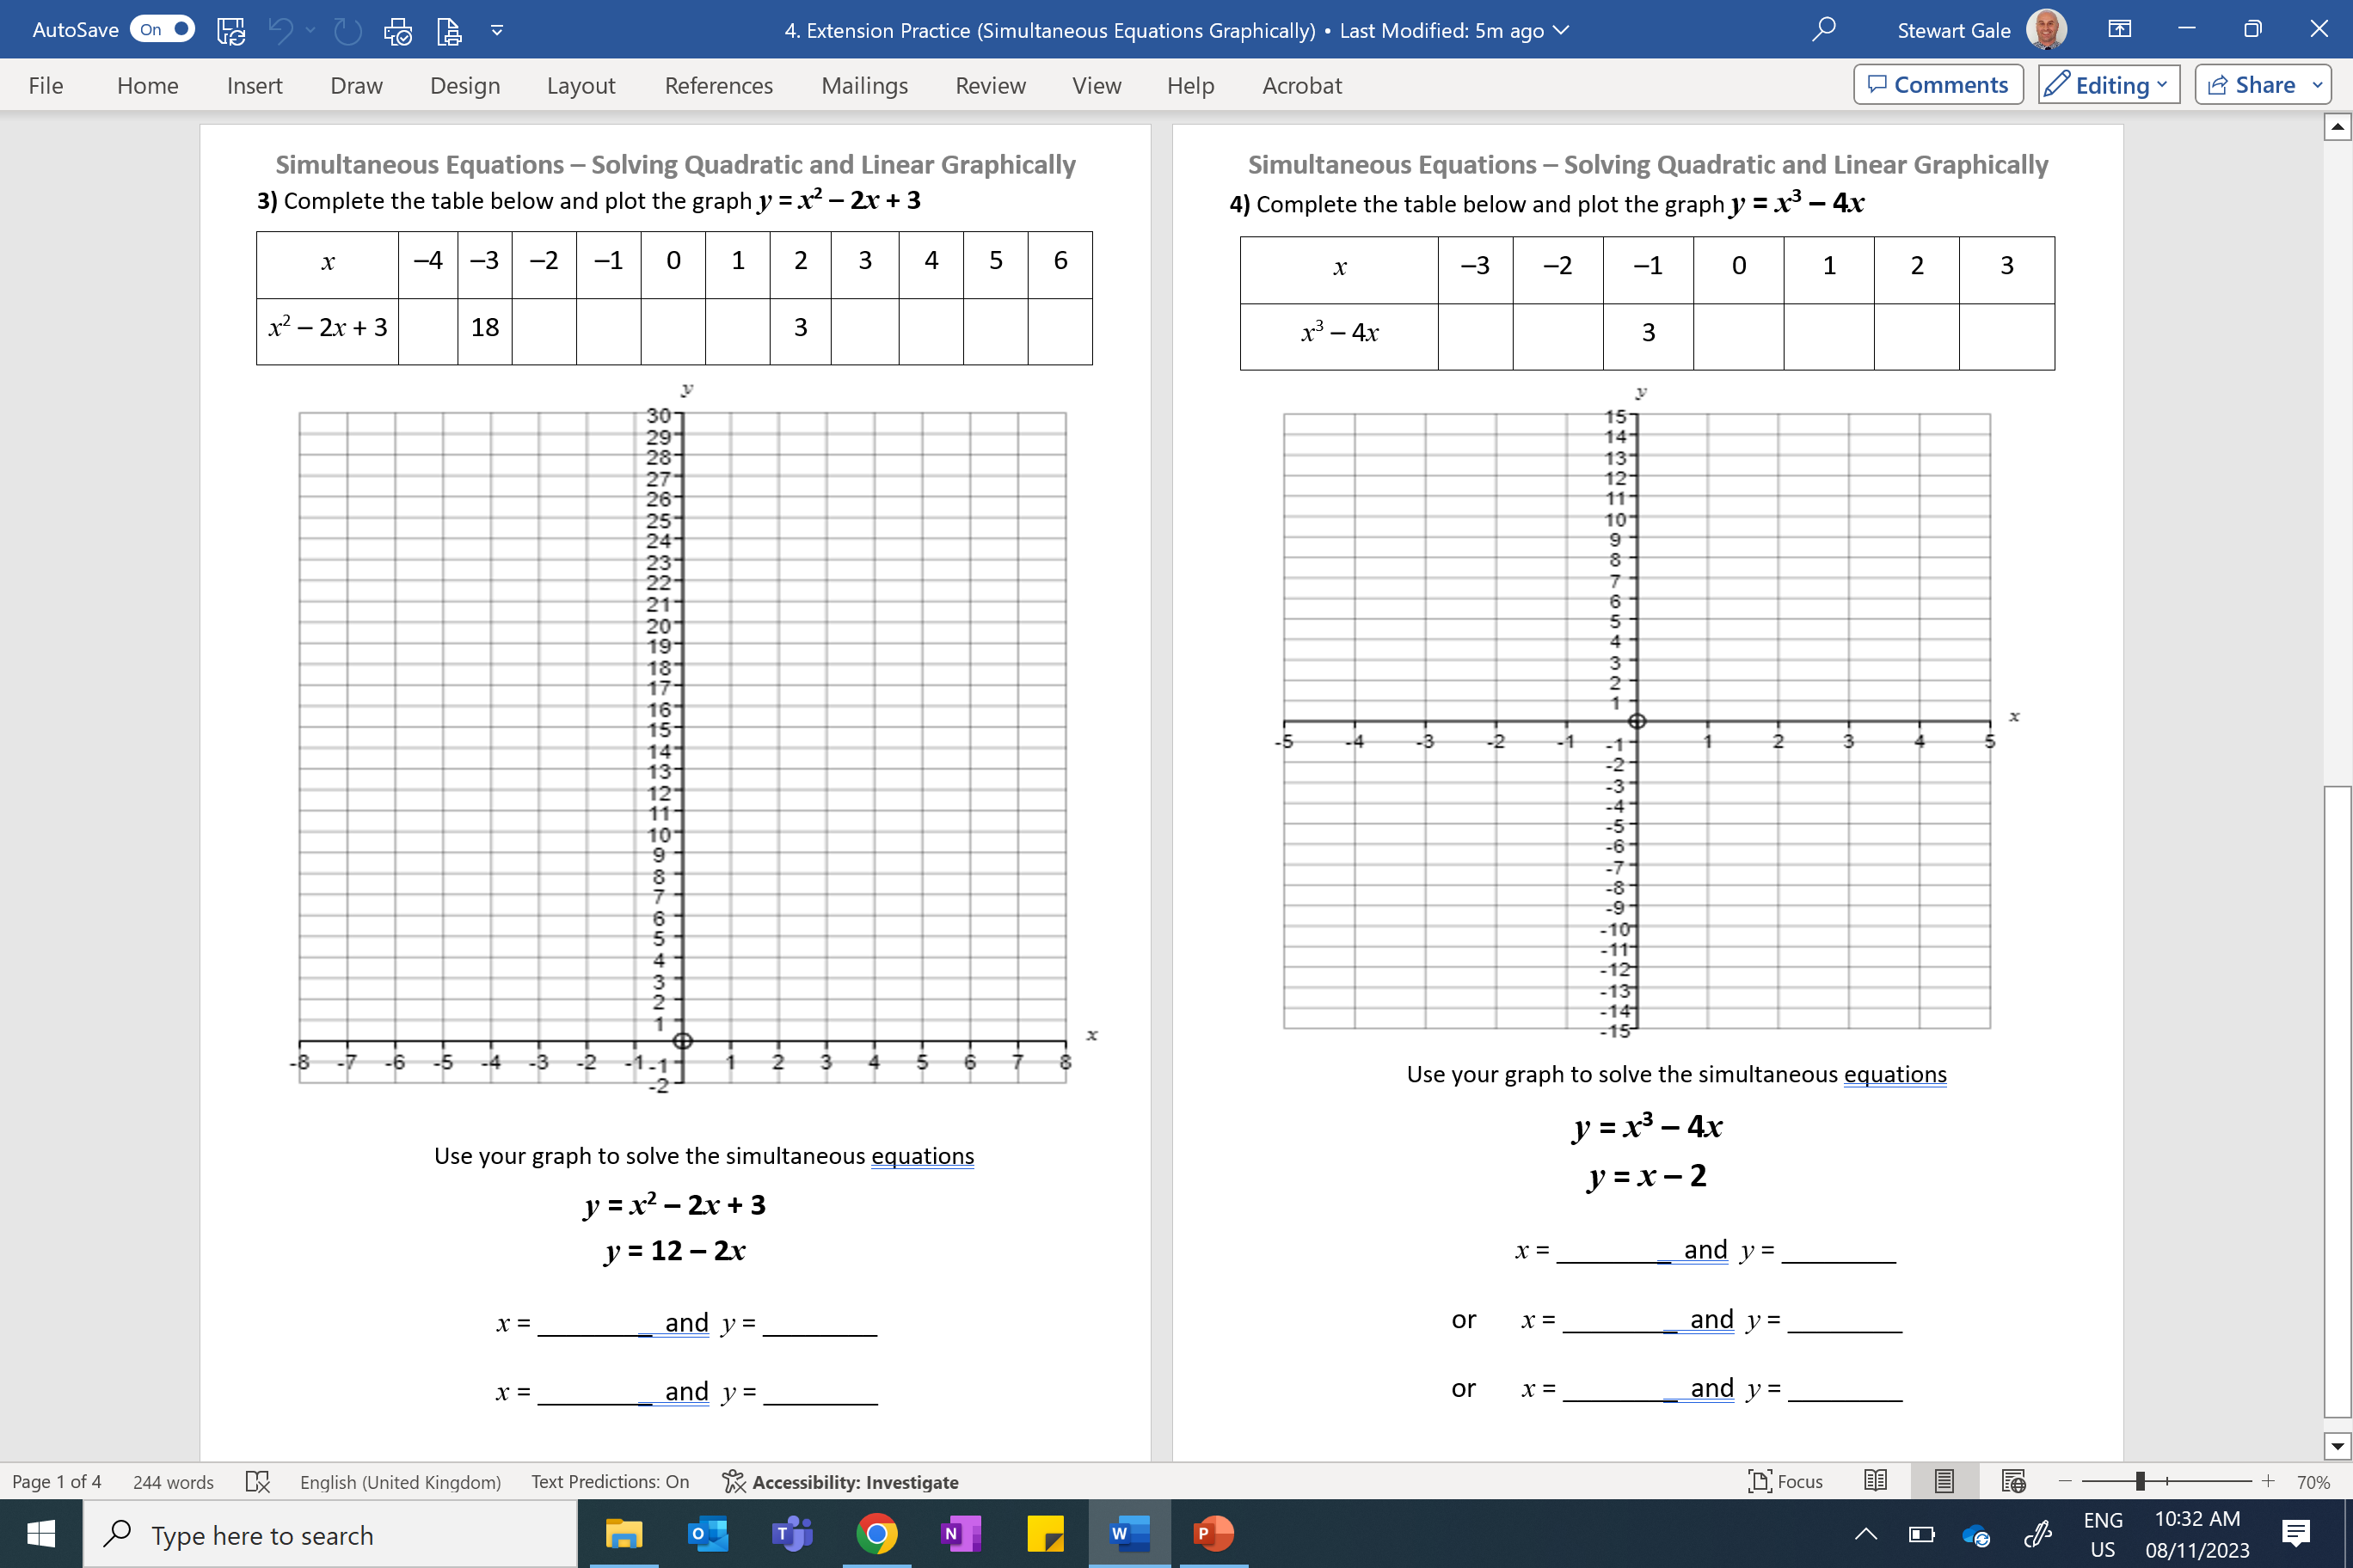

Slide 3
ANSWERS

Slide 4
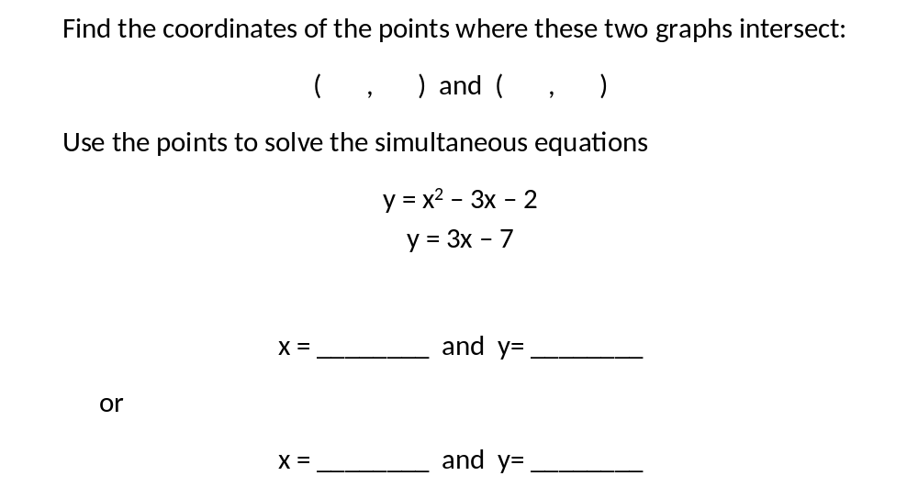
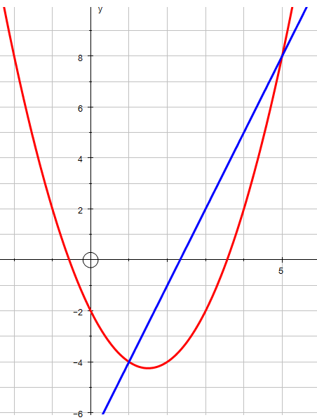
1) This is the graph of y = x² – 3x – 2.
On the same grid, plot the line y = 3x – 7.
5
8
1
- 4

Slide 5
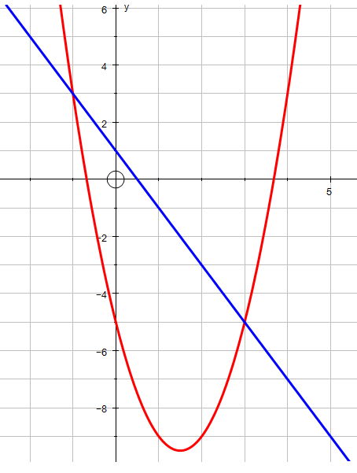
2) This is the graph of y = 2x² – 6x – 5.
By drawing another line, solve the simultaneous equations
y = 2x² – 6x – 5
y = -2x + 1
x = ________ and y= ________
or
x = ________ and y= ________
3
-5
-1
3

Slide 6
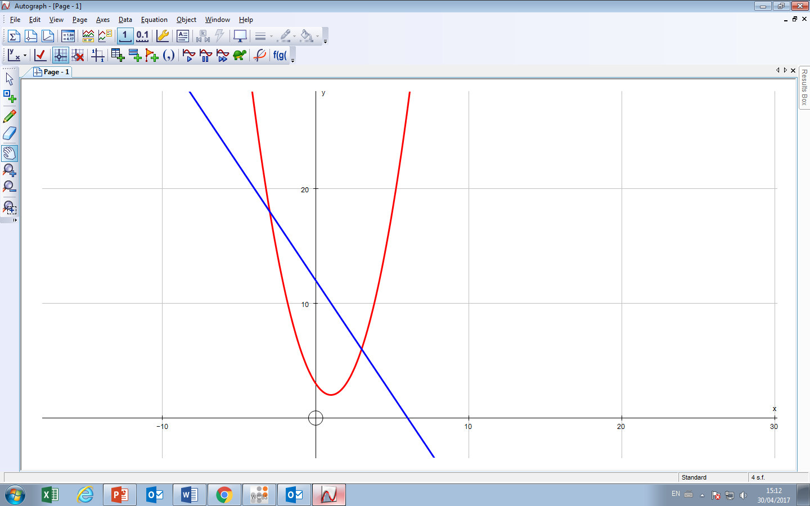
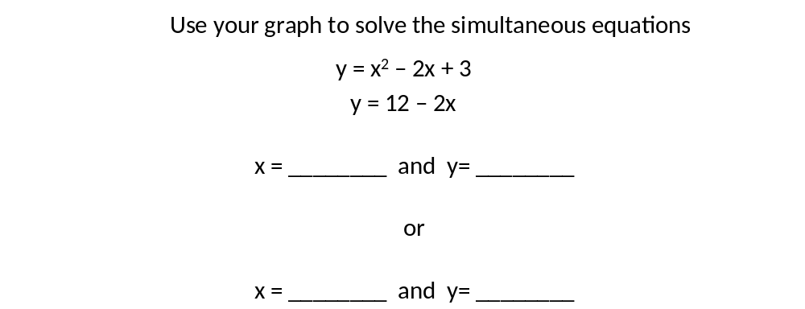
3) Complete the table below and plot the graph y = x² – 2x + 3
x | -4 | -3 | -2 | -1 | 0 | 1 | 2 | 3 | 4 | 5 | 6
x² – 2x + 3 | 27 | 18 | 11 | 6 | 3 | 2 | 3 | 6 | 11 | 18 | 27
3
6
-3
18

Slide 7
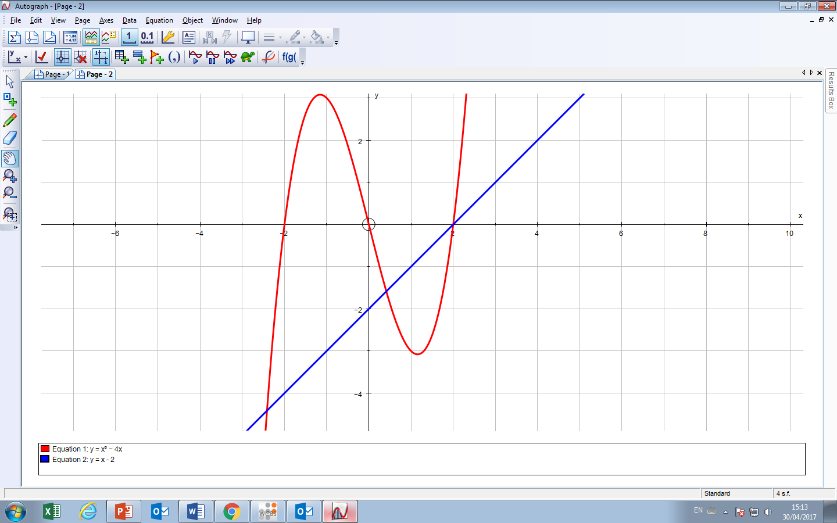
4) Complete the table below and plot the graph y = x³ – 4x
x | -3 | -2 | -1 | 0 | 1 | 2 | 3
x³ – 4x | -15 | 0 | 3 | 0 | -3 | 0 | 15
Use your graph to solve the simultaneous equations
y = x³ – 4x
y = x - 2
x = ________ and y= ________
or x = ________ and y= ________
or x = ________ and y= ________
2
0
0.5
-1.5
-2.5
-4.5

