Slide 1
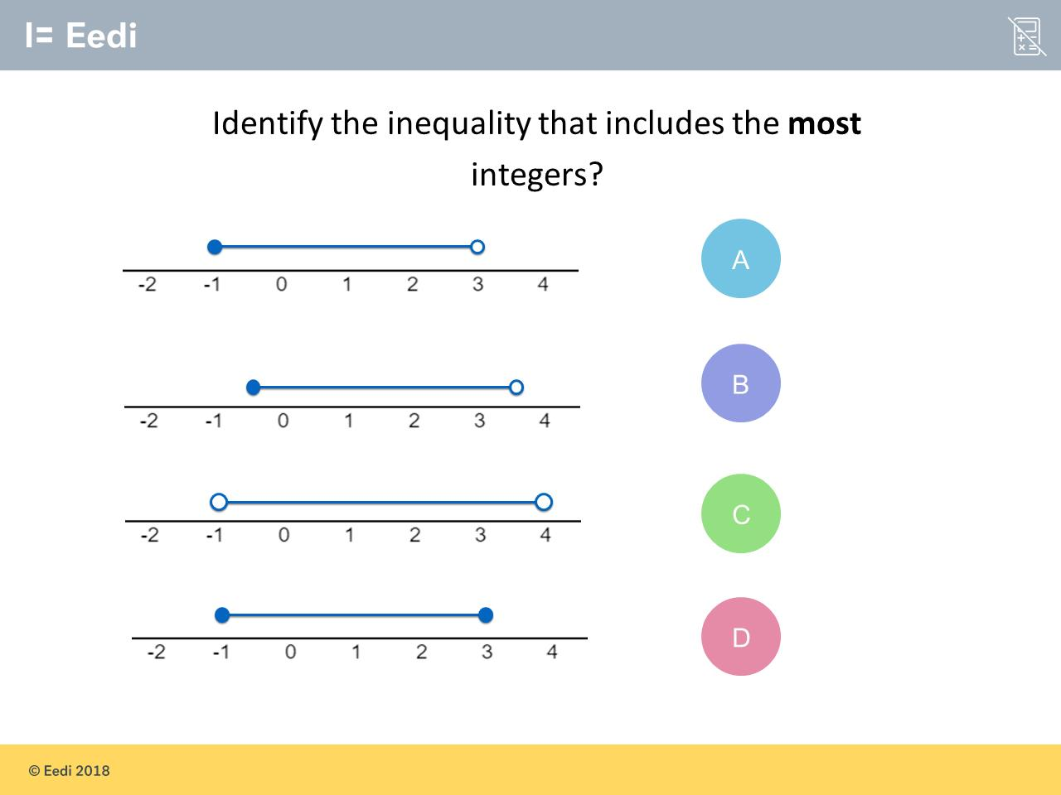
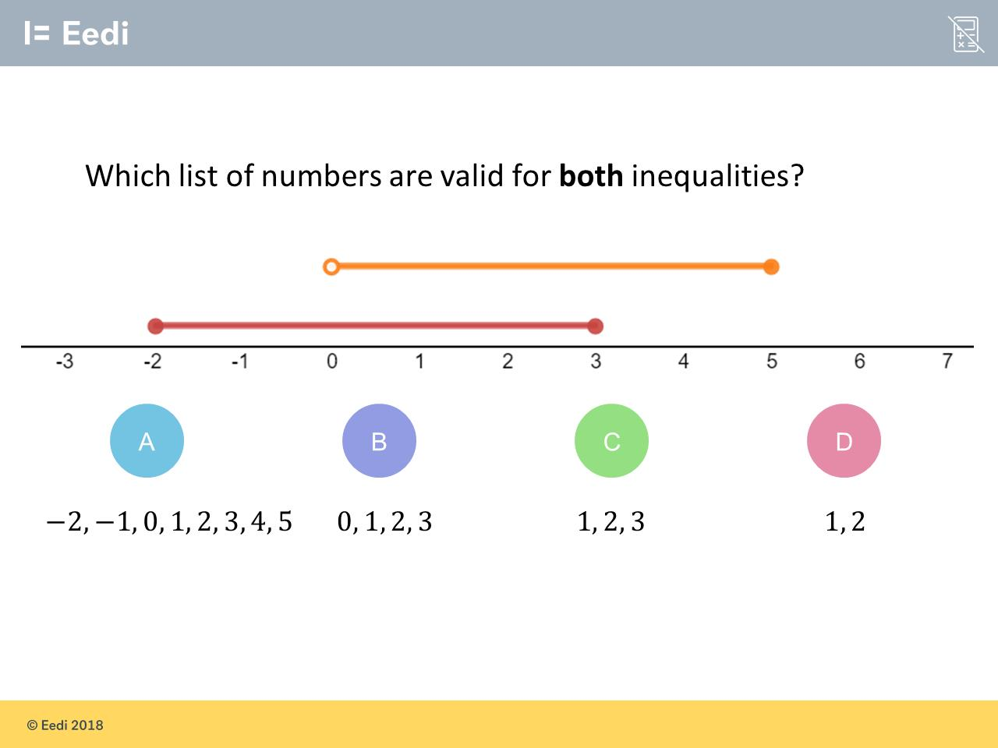
Worst answered question?
Most common wrong answer?

Slide 2
ANSWERS

Slide 3
Worst answered question?

Slide 4

B
They did not notice the circle is not shaded over the zero.

Slide 5
C
They went for the longest line.

