Slide 1
FM: Algebraic Proofs

Slide 2
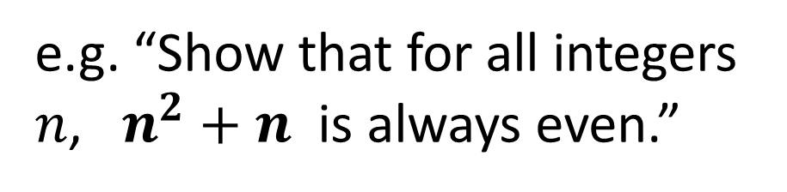
Types of Proofs
Multiples of a Number
Numbers are Always Positive
“Show that 8x + 12 is a multiple of 4.”
“Prove that 2(x + 7) –2(5 + x) is always a positive integer.”
Consecutive Numbers
Even/Odd
“Prove that the sum of any three consecutive integers is a multiple of 3.”
e.g. “Show that for all integers $n$, $n^{2}+n$ is always even.”
Identities
Show that the RHS is identical to the LHS.

Slide 3

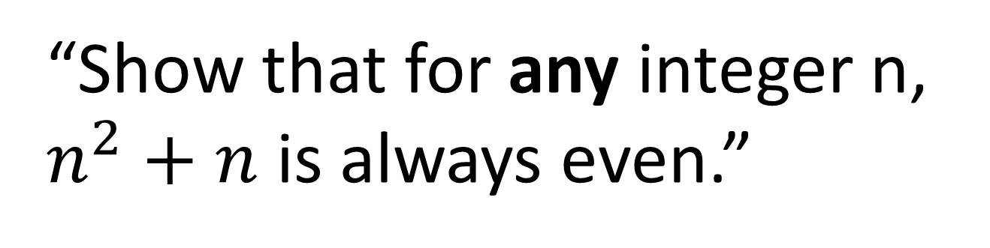
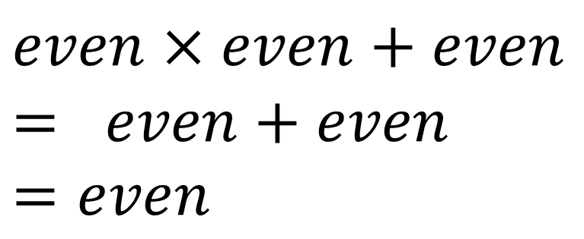
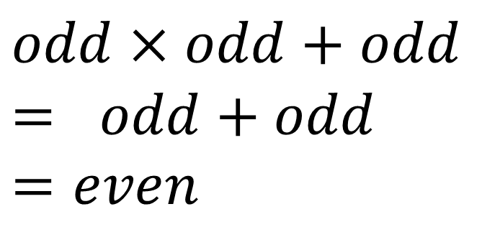
Even/Odd Proofs
“Show that for any integer n,
$n^{2}+n$ is always even.”
If n is odd:
If n is even:
$$odd×odd+odd= odd+odd$$
$$=even$$
$$even×even+even= even+even$$
$$=even$$
Therefore $n^{2}+n$ is even for all integers.

Slide 4
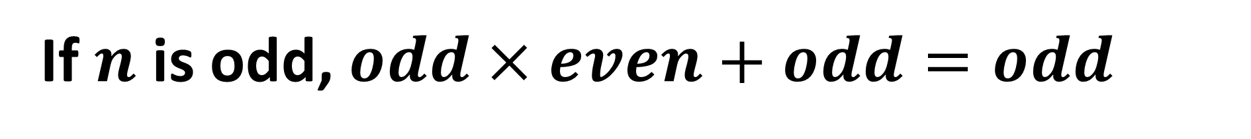
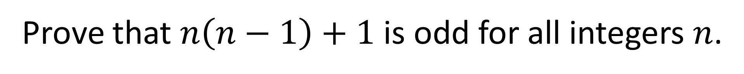

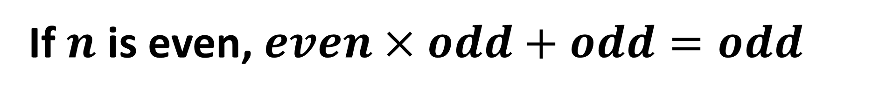
Even/Odd Proofs
Prove that $n\left(n−1\right)+1$ is odd for all integers $n$.
If $n$ is odd, $odd×even+odd=odd$
If $n$ is even, $even×odd+odd=odd$
Thus $n\left(n−1\right)+1$ is odd for all integers $n$.

Slide 5
Multiples of a Number and Consecutive Numbers
Prove the sum of three consecutive integers
are a multiple of 3.
x + x + 1 + x + 2 =
3x + 3
= 3(x + 1)
Hence a multiple of 3

Slide 6
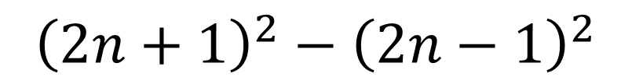
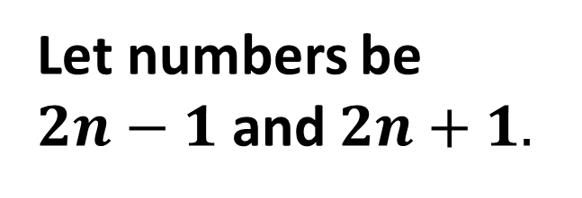
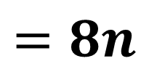
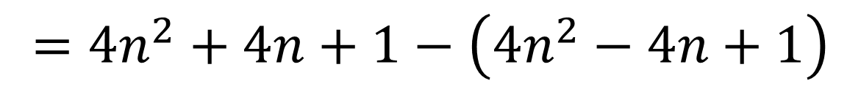
Multiples of a Number and Consecutive Numbers
Prove that the difference between the squares of two consecutive odd numbers is a multiple of 8.
Let numbers be
$2n−1$ and $2n+1.$
$${\left(2n+1\right)}^{2}−{\left(2n−1\right)}^{2}$$
$$=4n^{2}+4n+1−\left(4n^{2}−4n+1\right)$$
$$=4n^{2}+4n+1−4n^{2}+4n−1$$
$$=8n$$
which is divisible by 8.

Slide 7
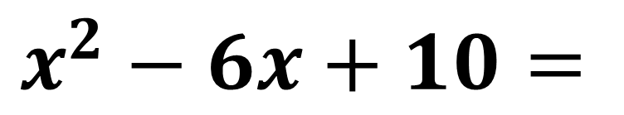

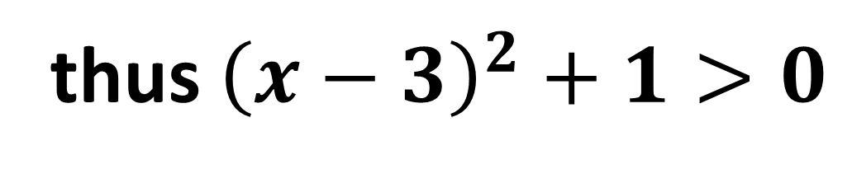
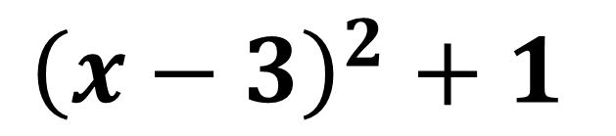
Numbers are Always Positive
Prove that for all values of $x$,
$$x^{2}−6x+10>0$$
$$x^{2}−6x+10=$$
$${\left(x−3\right)}^{2}+1$$
${\left(x−3\right)}^{2}≥0$ because any number square is positive
thus ${\left(x−3\right)}^{2}+1>0$

Slide 8
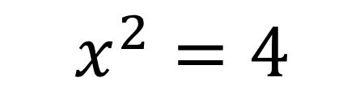
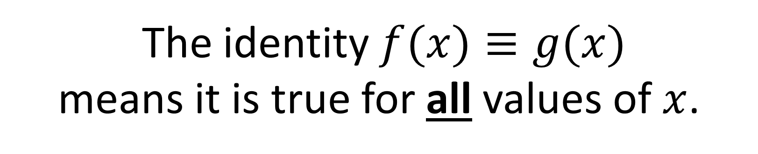
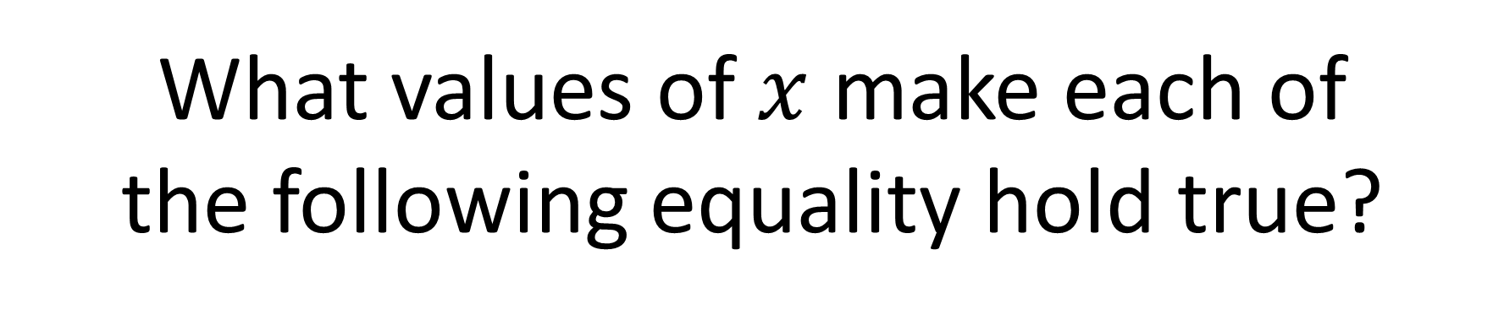
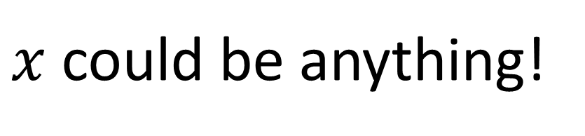
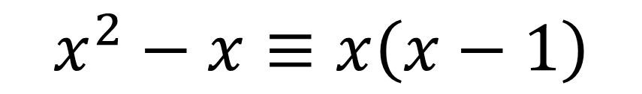
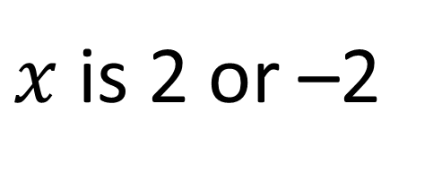
Identities
What values of $x$ make each of
the following equality hold true?
$$x^{2}=4$$
$x$ is 2 or –2
$$x^{2}−x≡x\left(x−1\right)$$
$x$ could be anything!
The identity $f(x)≡g(x)$
means it is true for all values of $x$.

Slide 9
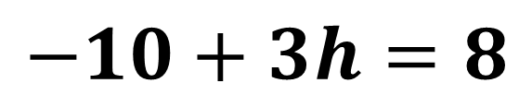
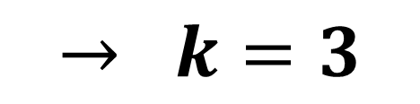
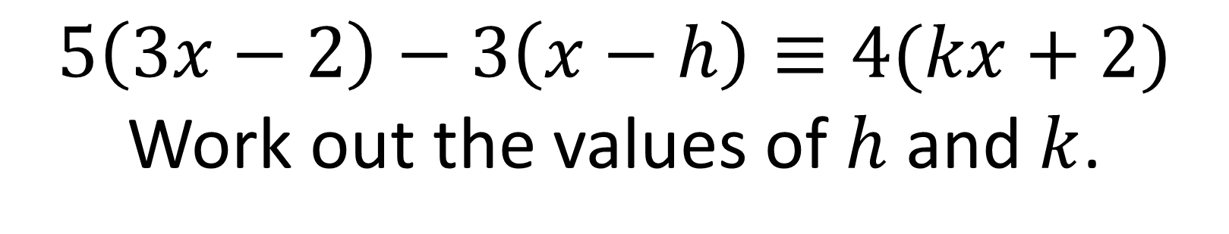
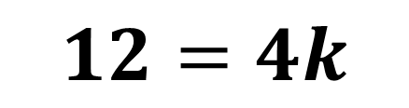

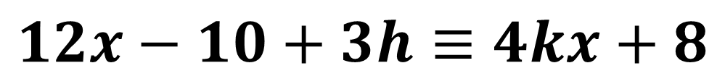
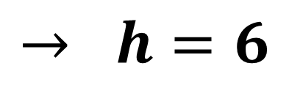
Identities
$$5\left(3x−2\right)−3\left(x−h\right)≡4(kx+2)$$
Work out the values of $h$ and $k$.
$$15x−10−3x+3h≡4kx+8$$
$$12x−10+3h≡4kx+8$$
Comparing $x$ terms:
$$12=4k$$
$$→ k=3$$
Comparing constant terms:
$$−10+3h=8$$
$$→ h=6$$

Slide 10
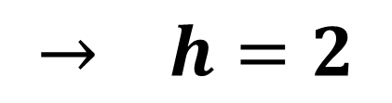

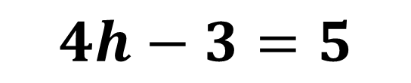
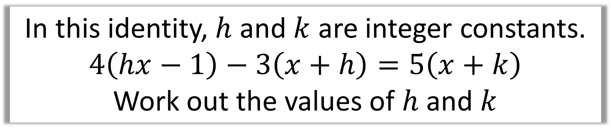
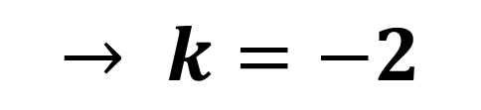
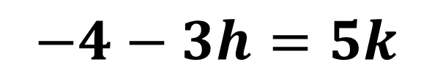
Identities
In this identity, $h$ and $k$ are integer constants.
$$4\left(hx−1\right)−3\left(x+h\right)=5\left(x+k\right)$$
Work out the values of $h$ and $k$
$$4hx−4−3x−3h=5x+5k$$
Comparing $x$ terms:
$$4h−3=5$$
$$→ h=2$$
Comparing constant terms:
$$−4−3h=5k$$
$$→ k=−2$$

