Slide 1
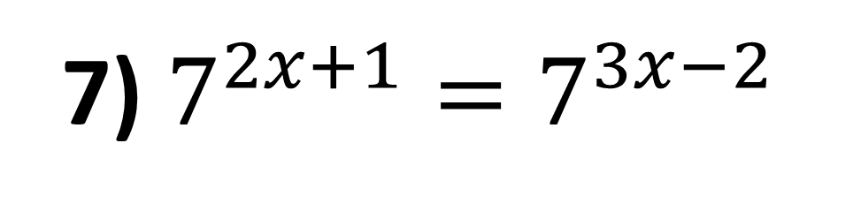
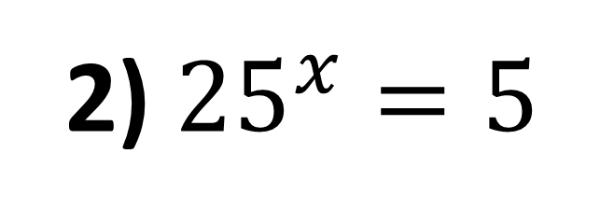
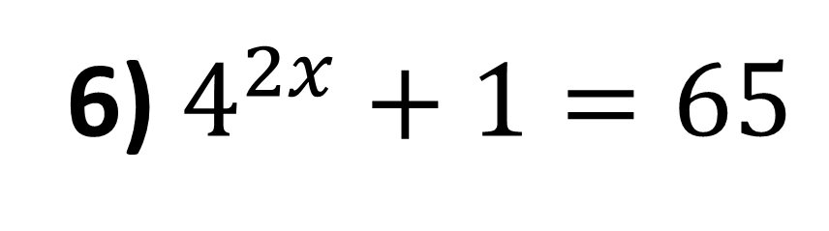
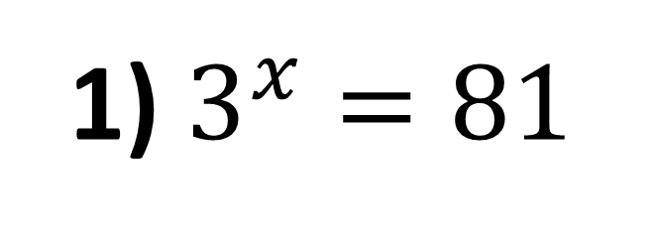
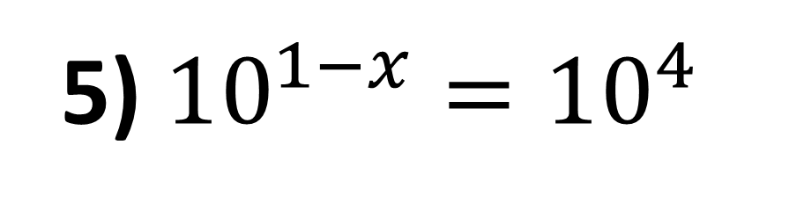
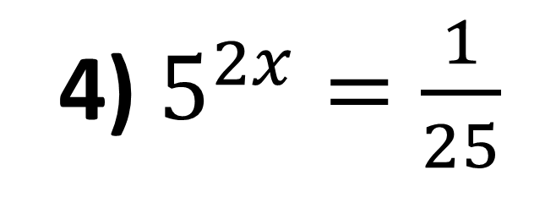
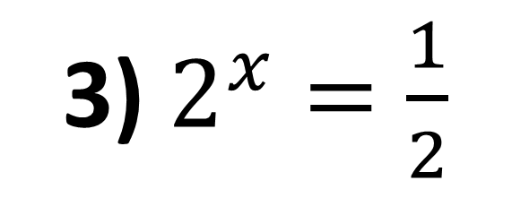
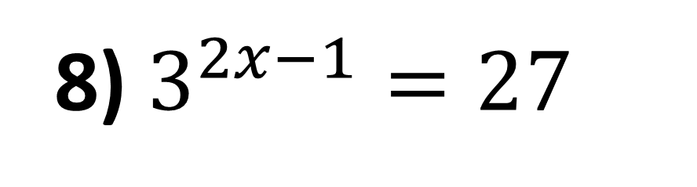
1) $3^{x}=81$
5) ${10}^{1−x}={10}^{4}$
2) ${25}^{x}=5$
6) $4^{2x}+1=65$
3) $2^{x}=\frac{1}{2}$
7) $7^{2x+1}=7^{3x−2}$
4) $5^{2x}=\frac{1}{25}$
8) $3^{2x−1}=27$

Slide 2
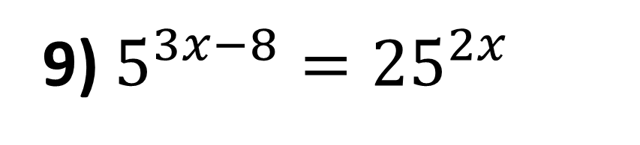
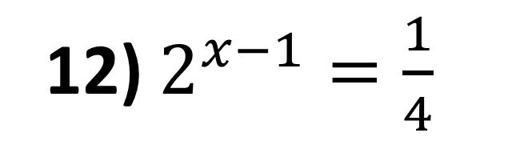
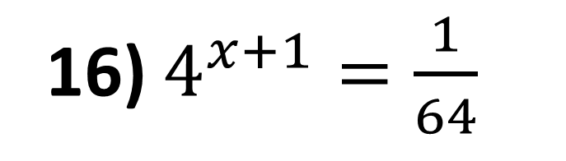
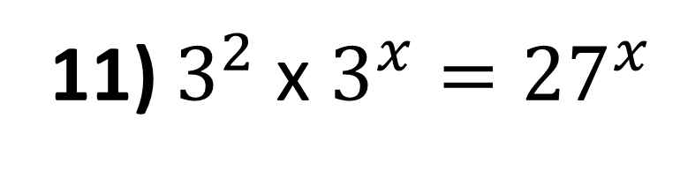
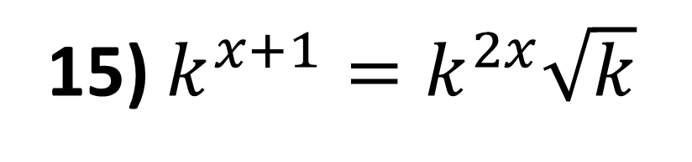
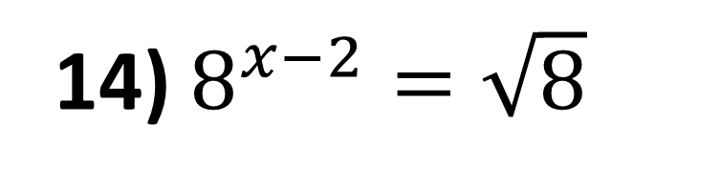
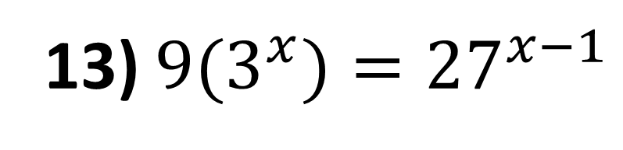
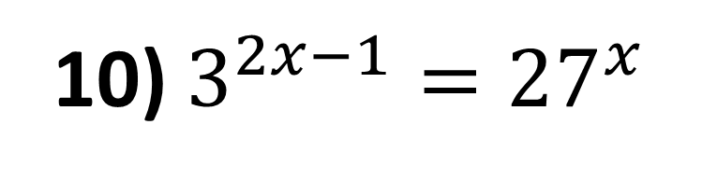
9) $5^{3x−8}={25}^{2x}$
13) ${9(3}^{x})={27}^{x−1}$
10) $3^{2x−1}={27}^{x}$
14) $8^{x−2}=\sqrt{8}$
11) $3^{2} \text{x} 3^{x}={27}^{x}$
15) $k^{x+1}=k^{2x}\sqrt{k}$
12) $2^{x−1}=\frac{1}{4}$
16) $4^{x+1}=\frac{1}{64}$

Slide 3
ANSWERS

Slide 4
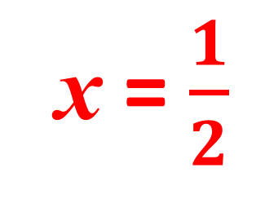
1) $3^{x}=81$
x = 4
x = $\frac{1}{2}$
2) ${25}^{x}=5$
3) $2^{x}=\frac{1}{2}$
x = -1
4) $5^{2x}=\frac{1}{25}$
x = -1

Slide 5
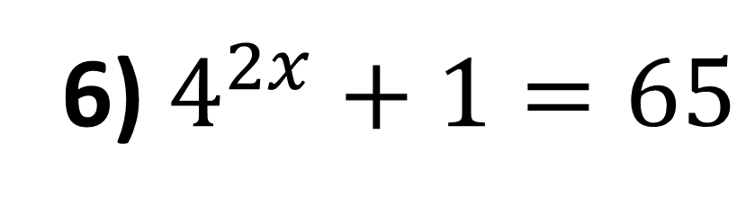
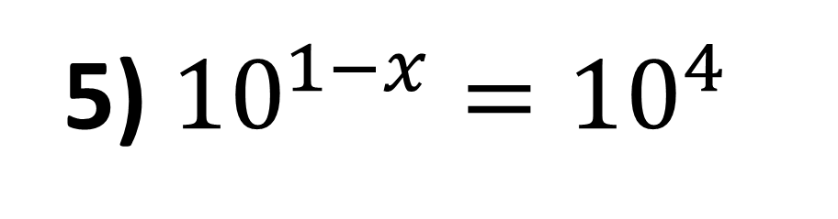
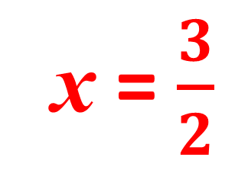
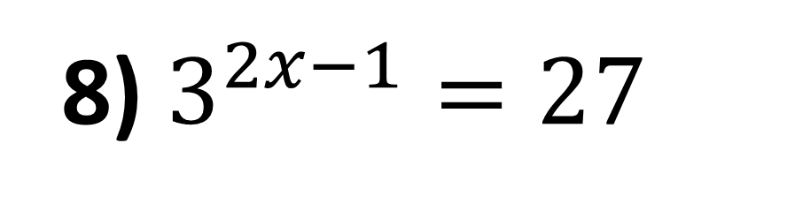
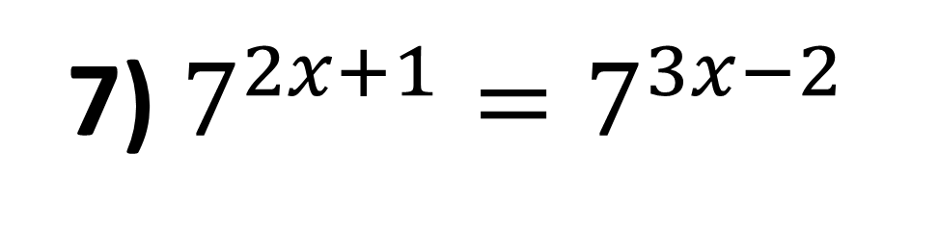
5) ${10}^{1−x}={10}^{4}$
x = -3
x = $\frac{3}{2}$
6) $4^{2x}+1=65$
x = 3
7) $7^{2x+1}=7^{3x−2}$
8) $3^{2x−1}=27$
x = 2

Slide 6
x = -8
9) $5^{3x−8}={25}^{2x}$
x = -1
10) $3^{2x−1}={27}^{x}$
x = 1
11) $3^{2} \text{x} 3^{x}={27}^{x}$
12) $2^{x−1}=\frac{1}{4}$
x = -1

Slide 7
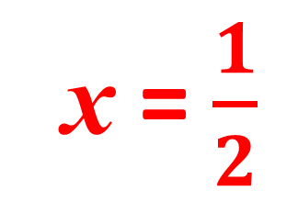
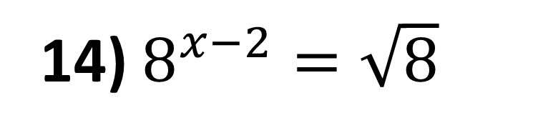
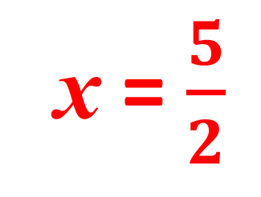
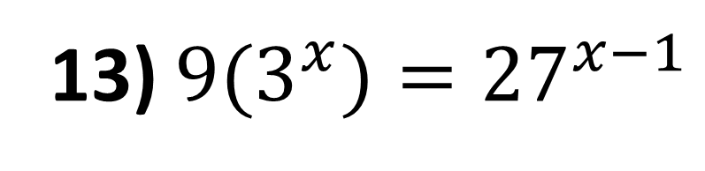
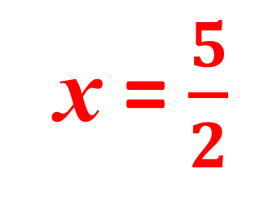
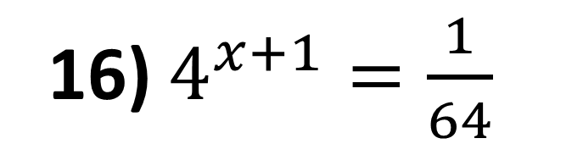
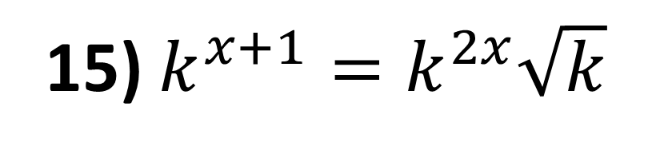
x = $\frac{5}{2}$
13) ${9(3}^{x})={27}^{x−1}$
x = $\frac{5}{2}$
14) $8^{x−2}=\sqrt{8}$
x = $\frac{1}{2}$
15) $k^{x+1}=k^{2x}\sqrt{k}$
16) $4^{x+1}=\frac{1}{64}$
x = -4

