Slide 1
Elastic, Strings and Springs
Hooke’s Law - Dynamics
Chapter 3
(Part 4 of 5)

Slide 2
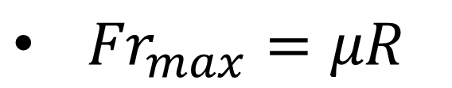
Dynamics Problems
Key ideas to Remember:
F = ma
Maximum displacement occurs when velocity = 0
Maximum velocity occurs when acceleration = 0
${Fr}_{max}=μR$

Slide 3

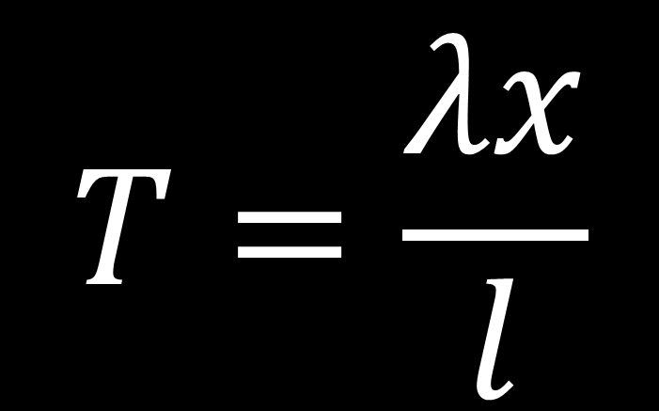
Game Plan:
$$T=\frac{λx}{l}$$
$$F=ma$$

Slide 4
Example A: Vertical
One end of a light elastic string, of natural length 0.5m and modulus of elasticity 20N, is attached to a fixed point A.
The other end is attached to a particle of mass 2kg.
The particle is held at a point which is 1.5m below A and released from rest.
Find:
The initial acceleration of the particle
The length of the string when the particle reaches its maximum speed.

Slide 5
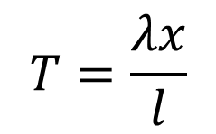
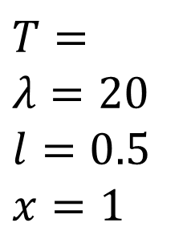


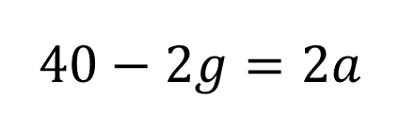



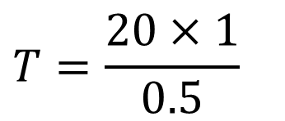
One end of a light elastic string, of natural length 0.5m and modulus of elasticity 20N, is attached to a fixed point A. The other end is attached to a particle of mass 2kg.
The particle is held at a point which is 1.5m below A and released from rest.
Find:
The initial acceleration of the particle
The length of the string when the particle reaches its maximum speed.
a)
A
$$T=$$
$$λ=20 \\ l=0.5$$
$$x=1$$
$$F=ma$$
$$T=\frac{λx}{l}$$
$$T−2g=2a$$
1.5
T
$$T=\frac{20×1}{0.5}$$
$$40−2g=2a$$
a
2
$$a=10.2ms^{−2}$$
$$T=40$$
$$2g$$

Slide 6


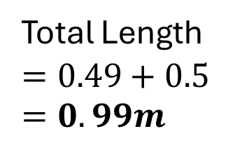


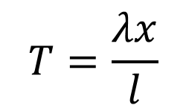
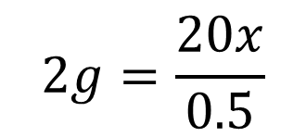
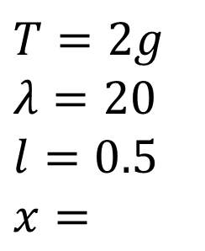
One end of a light elastic string, of natural length 0.5m and modulus of elasticity 20N, is attached to a fixed point A. The other end is attached to a particle of mass 2kg.
The particle is held at a point which is 1.5m below A and released from rest.
Find:
The initial acceleration of the particle
The length of the string when the particle reaches its maximum speed.
b)
$$T=2g$$
$$λ=20 \\ l=0.5$$
$$x=$$
$$T=\frac{λx}{l}$$
A
Max velocity when a = 0
T
$$F=ma$$
$$2g=\frac{20x}{0.5}$$
$$T−2g=0$$
a
2
$$x=0.49$$
Total Length
$$=0.49+0.5$$
$$=0.99m$$
$$2g$$

Slide 7
Example B: Mid Point
A particle P of mass 1.5 kg is attached to the mid-point of a light elastic string of natural length 0.30 m and modulus of elasticity λ newtons.
The ends of the string are attached to two fixed points A and B, where AB is horizontal and AB = 0.48 m.
Initially P is held at rest at the mid-point, M, of the line AB and the tension in the string is 240 N.
The particle is now held at rest at the point C, where C is 0.07m vertically below M.
The particle is released from rest at C.
Given that λ = 400.
Find the magnitude of the initial acceleration of P.

Slide 8


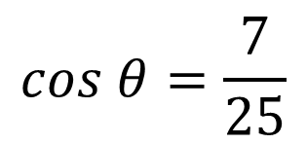



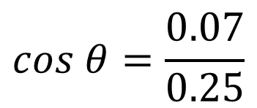









A particle P of mass 1.5 kg is attached to the mid-point of a light elastic string of natural length 0.30 m and modulus of elasticity λ newtons. The ends of the string are attached to two fixed points A and B, where AB is horizontal and AB = 0.48 m. Initially P is held at rest at the mid-point, M, of the line AB and the tension in the string is 240 N. The particle is now held at rest at the point C, where C is 0.07m vertically below M. The particle is released from rest at C.
Given that λ = 400. Find the magnitude of the initial acceleration of P.
$$0.24m$$
$$0.24$$
A
B
$$30°$$
$$30°$$
$$0.07m$$
$$0.07$$
$$T$$
$$T$$
$$\sqrt{{0.24}^{2}+{0.07}^{2}}$$
$$θ$$
$$θ$$
$$cos θ=\frac{0.07}{0.25}$$
$$AP=0.25$$
P
$$x=0.24−0.25=0.1$$
$$cos θ=\frac{7}{25}$$
$$1.5g$$

Slide 9

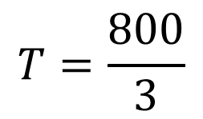
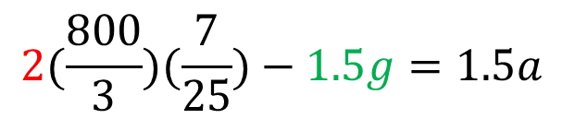


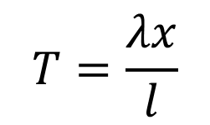




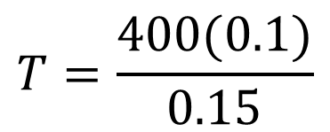



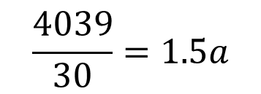



A particle P of mass 1.5 kg is attached to the mid-point of a light elastic string of natural length 0.30 m and modulus of elasticity λ newtons. The ends of the string are attached to two fixed points A and B, where AB is horizontal and AB = 0.48 m. Initially P is held at rest at the mid-point, M, of the line AB and the tension in the string is 240 N. The particle is now held at rest at the point C, where C is 0.07m vertically below M. The particle is released from rest at C.
Given that λ = 400. Find the magnitude of the initial acceleration of P.
$$T=\frac{λx}{l}$$
$$F=ma$$
$$0.24m$$
A
B
$$30°$$
$$30°$$
$$2Tcos θ−1.5g=1.5a$$
$$0.07m$$
$$2(\frac{800}{3})(\frac{7}{25})−1.5g=1.5a$$
$$T$$
$$T$$
$$T=\frac{400(0.1)}{0.15}$$
$$θ$$
$$Tcos θ$$
$$Tcos θ$$
$$\frac{4039}{30}=1.5a$$
P
$$T=\frac{800}{3}$$
$$1.5g$$
$$a=89.8$$

Slide 10
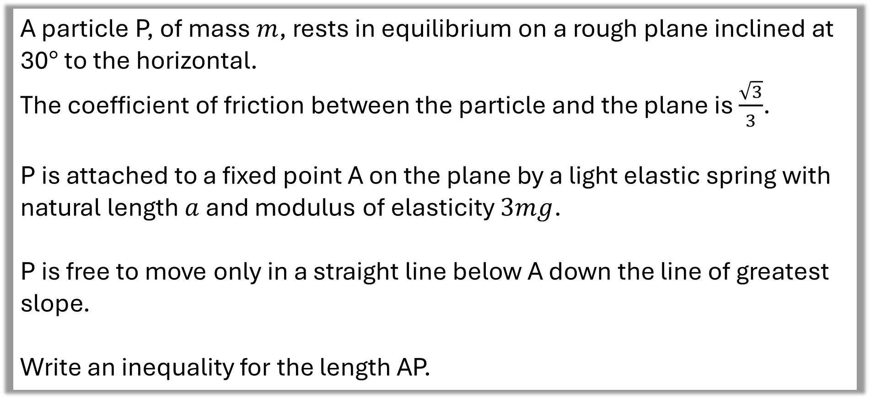
Example C: Slope
A particle P, of mass $m$, rests in equilibrium on a rough plane inclined at 30$°$ to the horizontal.
The coefficient of friction between the particle and the plane is $\frac{\sqrt{3}}{3}$.
P is attached to a fixed point A on the plane by a light elastic spring with
natural length $a$ and modulus of elasticity $3mg$.
P is free to move only in a straight line below A down the line of greatest slope.
Write an inequality for the length AP.

Slide 11


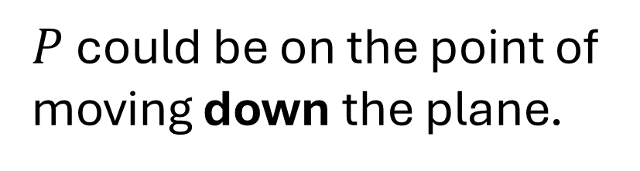
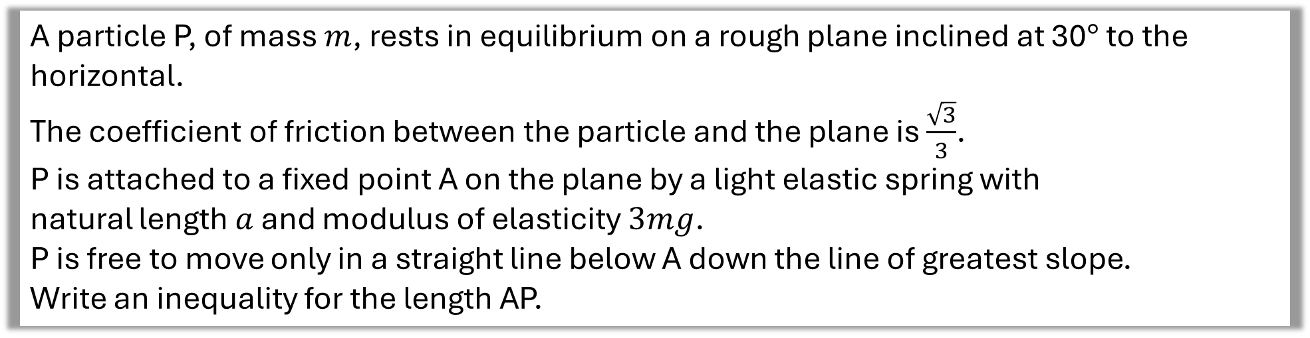
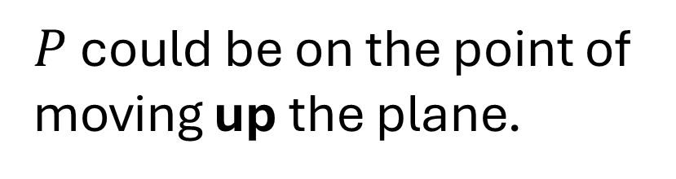


A particle P, of mass $m$, rests in equilibrium on a rough plane inclined at 30$°$ to the horizontal.
The coefficient of friction between the particle and the plane is $\frac{\sqrt{3}}{3}$.
P is attached to a fixed point A on the plane by a light elastic spring with
natural length $a$ and modulus of elasticity $3mg$.
P is free to move only in a straight line below A down the line of greatest slope.
Write an inequality for the length AP.
$P$ could be on the point of moving up the plane.
$$A$$
$$P$$
OR
$$a$$
$P$ could be on the point of moving down the plane.
$$30°$$

Slide 12


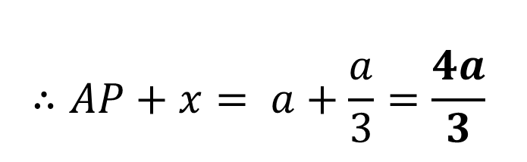

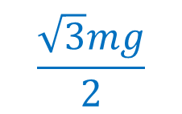
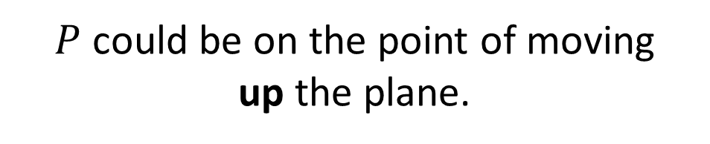


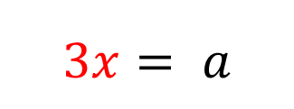




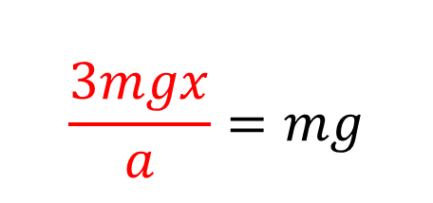
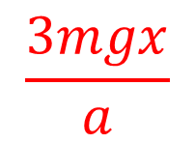



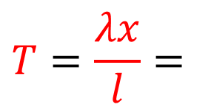

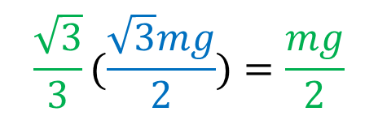
$$A$$
$P$ could be on the point of moving
up the plane.
$$R$$
$$T$$
$$T=μR+mg\sin{30}$$
$$a$$
$$μR$$
$$\frac{3mgx}{a}=\frac{mg}{2}+\frac{mg}{2}$$
$$mg cos 30$$
$$30°$$
$$mg sin 30$$
$$\frac{3mgx}{a}=mg$$
$$\frac{\sqrt{3}mg}{2}$$
$$R =$$
$$3x= a$$
$$\frac{\sqrt{3}}{3}(\frac{\sqrt{3}mg}{2})=\frac{mg}{2}$$
$$μR=$$
$$x=\frac{a}{3}$$
$$∴AP+x= a+\frac{a}{3}=\frac{4a}{3}$$
$$T=\frac{λx}{l}=$$
$$\frac{3mgx}{a}$$

Slide 13

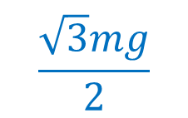
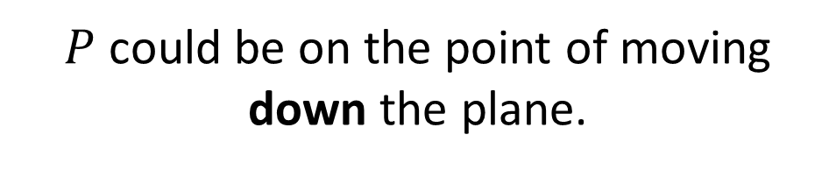
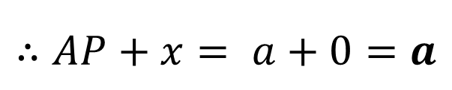

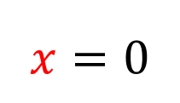



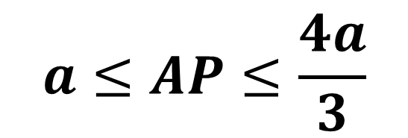

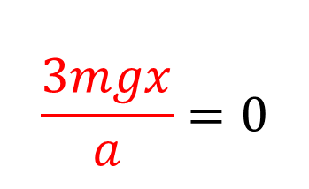

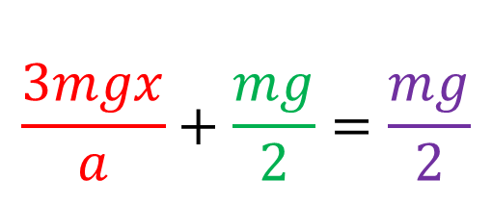
$$A$$
$P$ could be on the point of moving
down the plane.
$$R$$
$$T$$
$$μR$$
$$T+μR=mg\sin{30}$$
$$P$$
$$a$$
$$\frac{3mgx}{a}+\frac{mg}{2}=\frac{mg}{2}$$
$$mg cos 30$$
$$30°$$
$$mg sin 30$$
$$\frac{3mgx}{a}=0$$
$$\frac{\sqrt{3}mg}{2}$$
$$R =$$
$$x=0$$
$$\frac{\sqrt{3}}{3}(\frac{\sqrt{3}mg}{2})=\frac{mg}{2}$$
$$μR=$$
$$∴AP+x= a+0=a$$
$$T=\frac{λx}{l}=$$
$$\frac{3mgx}{a}$$
$$a≤AP≤\frac{4a}{3}$$

