Slide 1
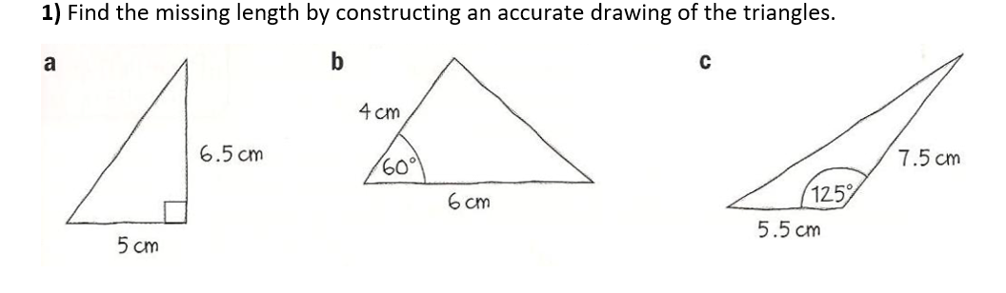
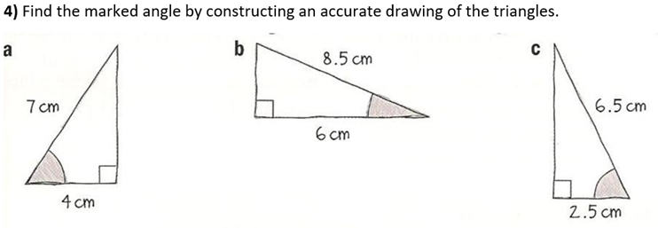
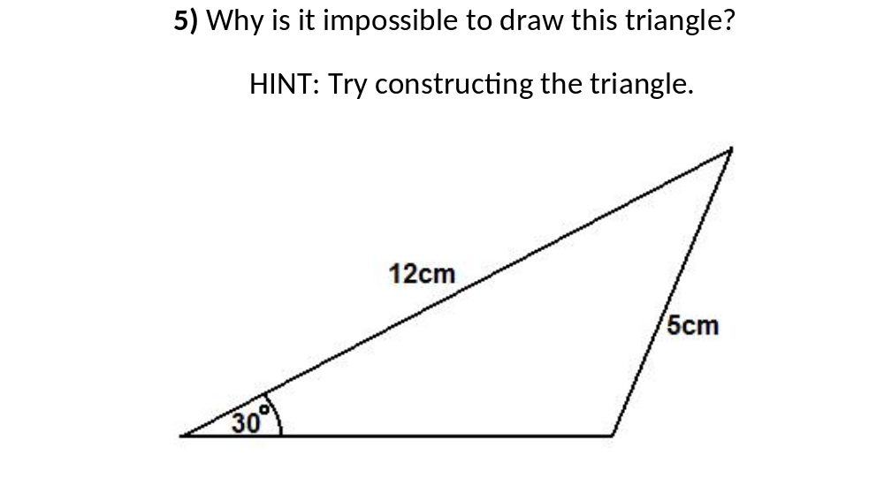
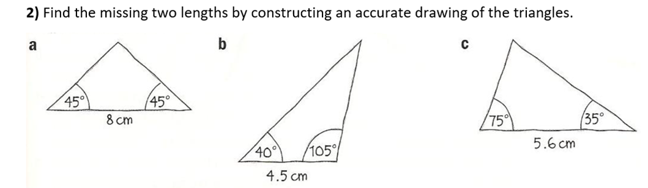
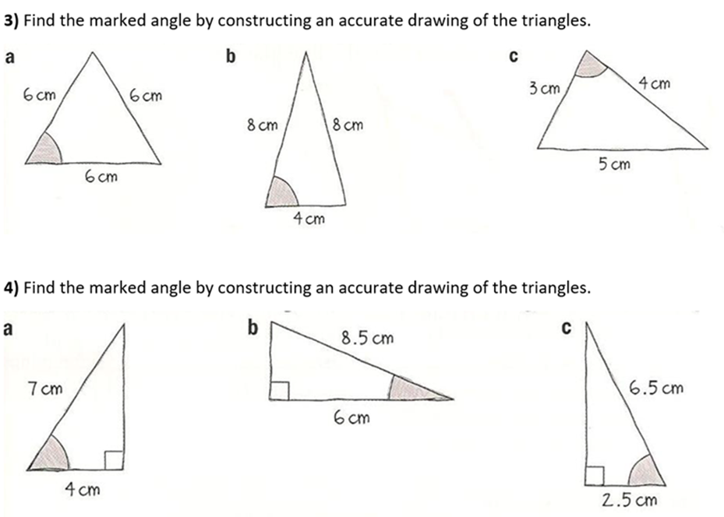

Slide 2
ANSWERS

Slide 3
8.2 cm
5.2 cm
11.5 cm
45˚
55˚
67˚
5.7 cm
5.7cm
3.5 cm
5.8 cm
7.8 cm
5.3 cm
90˚
60˚
76˚

