Slide 1
LO: Area of Parallelograms
and Trapeziums

Slide 2

How would you describe a
parallelogram
to someone?

Slide 3
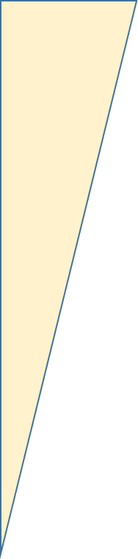

Slide 4
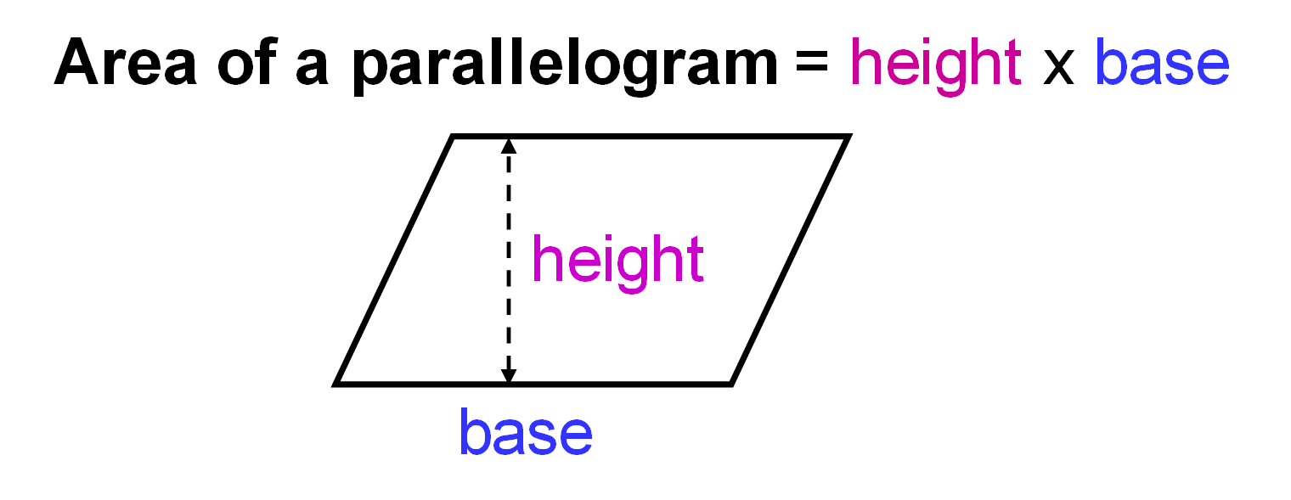
Area of a Parallelogram
= Height x Base

Slide 5
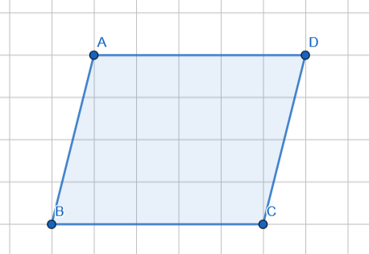
What is the area of the parallelogram?
20 squares

Slide 6

What is the area of the parallelogram?
20 squares

Slide 7
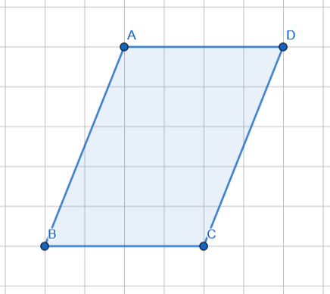
What is the area of the parallelogram?
20 squares

Slide 8
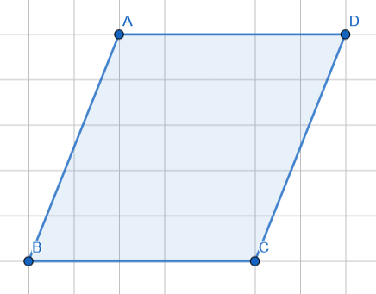
What is the area of the parallelogram?
25 squares

Slide 9
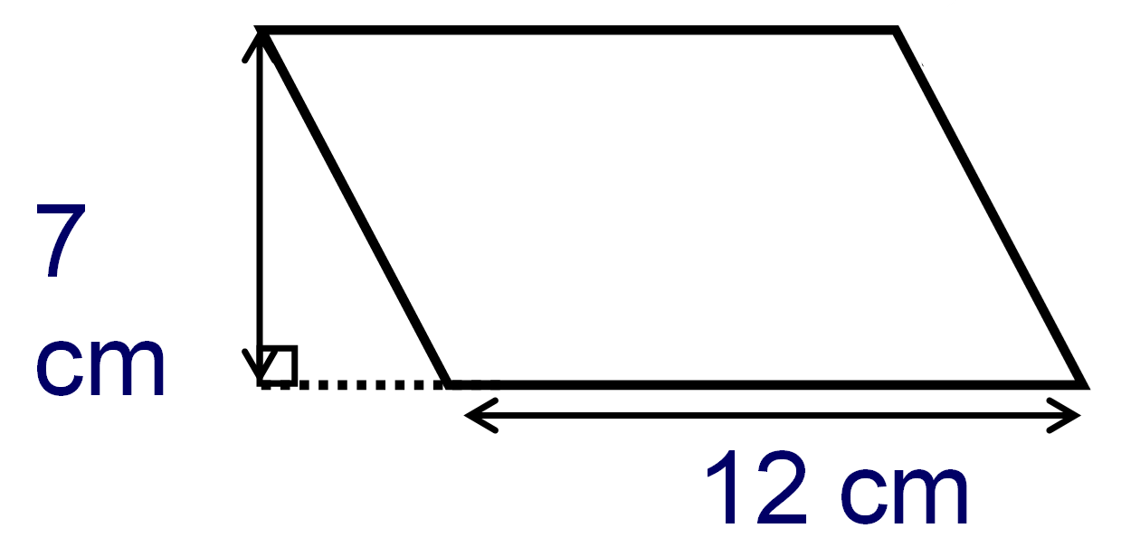
What is the area of the parallelogram?
12 x 7 = 84 cm²

Slide 10
What is the area of the parallelogram?
12 x 7 = 84 cm²

Slide 11
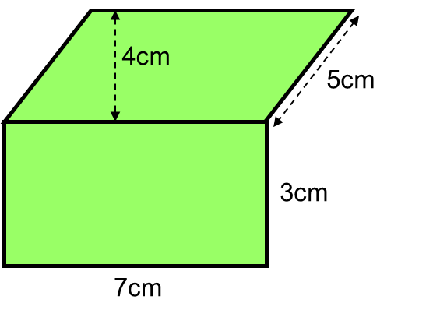
What is the total area of the shape?
28 cm²
49cm²
21 cm²

Slide 12

How would you describe a trapezium
to someone?

Slide 13
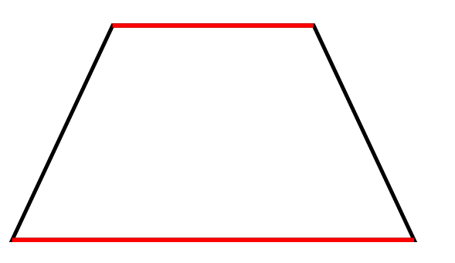
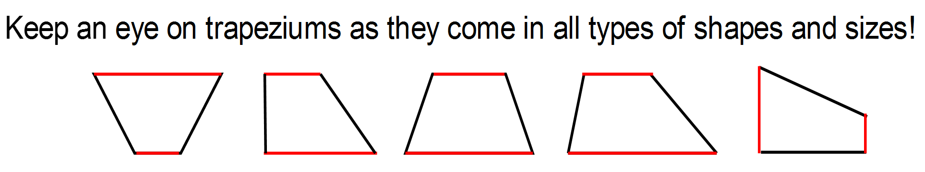

Slide 14

Area of a Trapezium = $\frac{1}{2}$ (a + b)h
a and b are the parallel sides
h is the distance between a and b

Slide 15
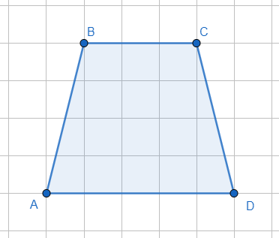
What is the area of the trapezium?
16 square units

Slide 16
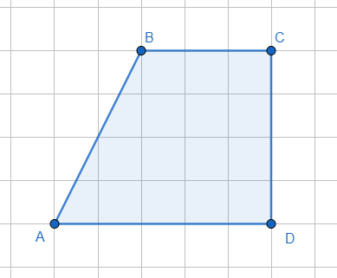
What is the area of the trapezium?
16 square units

Slide 17
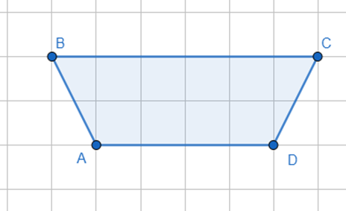
What is the area of the trapezium?
10 square units

Slide 18
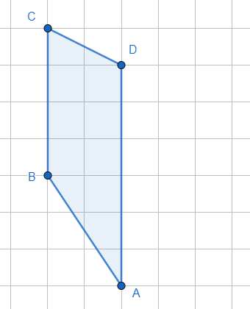
What is the area of the trapezium?
10 square units

Slide 19
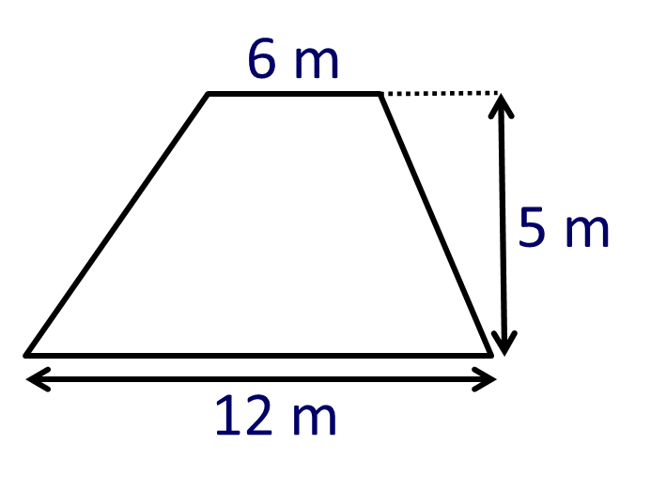
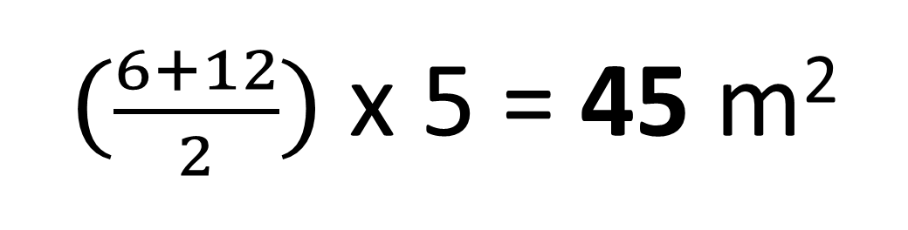
What is the area of the Trapezium?
$(\frac{6+12}{2})$ x 5 = 45 m²

Slide 20
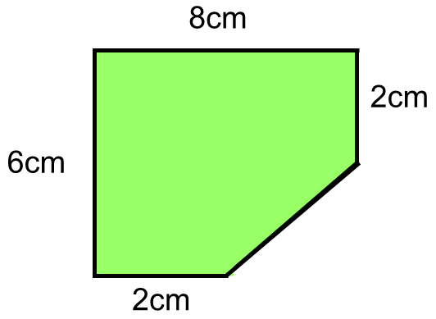
What is the area of the shape?
16cm²
36 cm²
20cm²

