Slide 1
Quadratics
Sketching Quadratics
Chapter 2
(Part 3 of 4)

Slide 2
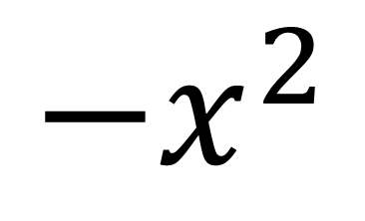
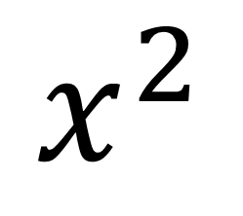
What is the general shape of a quadratic graph?
$$x^{2}$$
$${−x}^{2}$$

Slide 3


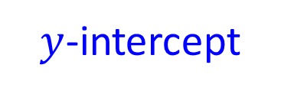
Features needed in sketch of quadratic
$$y$$
Roots
$$x$$
General shape: Happy or Sad?
$y$-intercept
Turning point

Slide 4
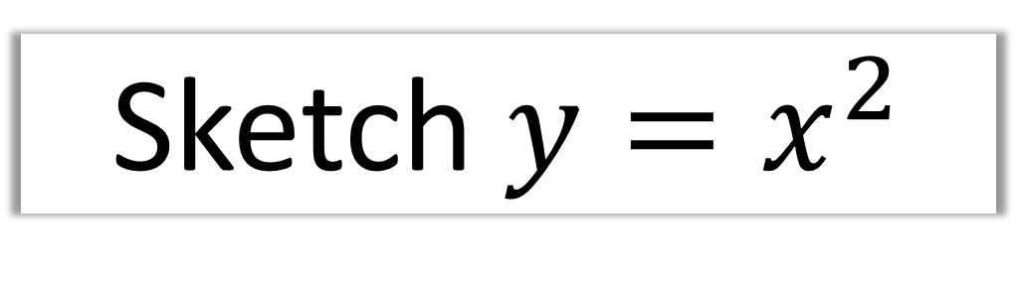
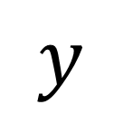
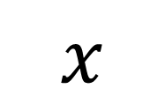
Sketch $y=x^{2}$
$$y$$
$$x$$

Slide 5




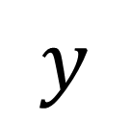
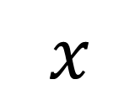
Sketch $y=x^{2}−4$
indicating any intercepts with the axis.
$$y$$
$$x$$
$$−2$$
$$2$$
$$−4$$

Slide 6


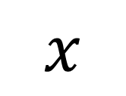
Sketch $y=x^{2}+4$
indicating any intercepts with the axis.
$$y$$
$$4$$
$$x$$

Slide 7

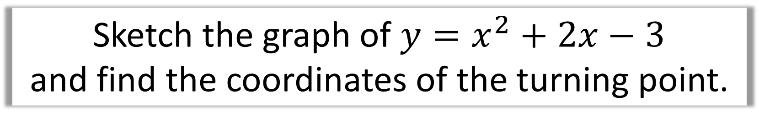


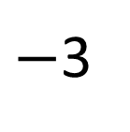
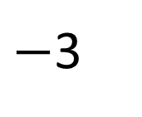
Sketch the graph of $y=x^{2}+2x−3$
and find the coordinates of the turning point.
$$y$$
$$x$$
$−$3
1
$−$3
$$\left(−1,−4\right)$$

Slide 8
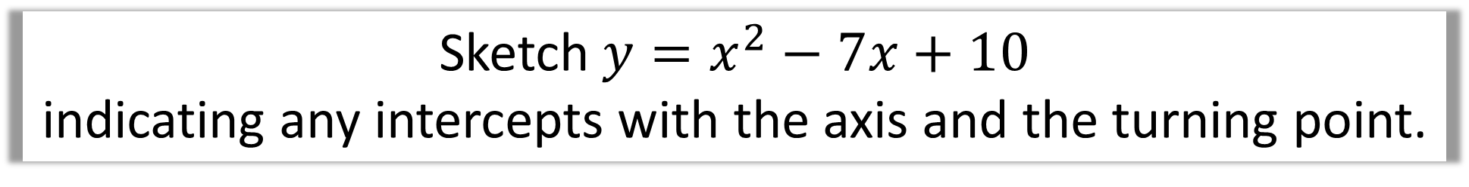



Sketch $y=x^{2}−7x+10$
indicating any intercepts with the axis and the turning point.
$$y$$
10
2
5
$$x$$
$$\left(3.5, −2.25\right)$$

Slide 9

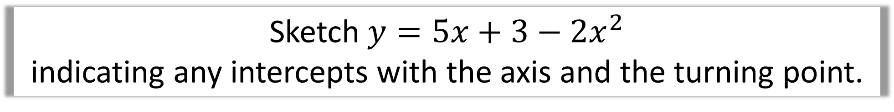



Sketch $y=5x+3−2x^{2}$
indicating any intercepts with the axis and the turning point.
$$y$$
$$\left(1.75, 5.625\right)$$
3
$$x$$
$$−\frac{1}{2}$$
3

Slide 10
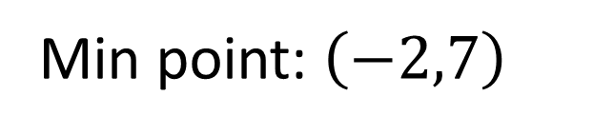
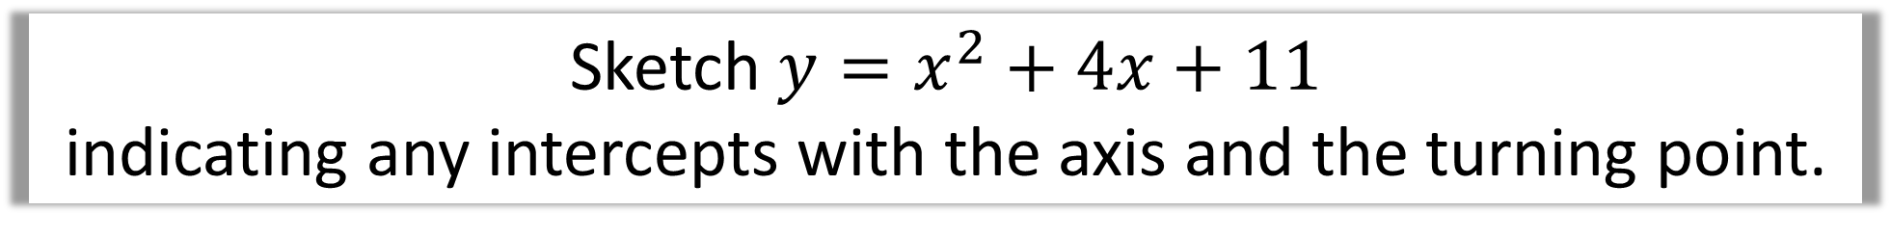
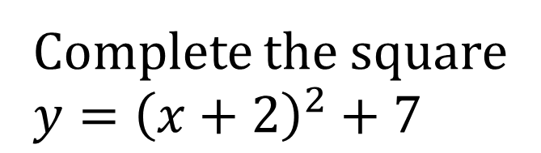



Sketch $y=x^{2}+4x+11$
indicating any intercepts with the axis and the turning point.
$$y$$
Turning Point
Complete the square
$$y={\left(x+2\right)}^{2}+7$$
11
Min point: $\left(−2,7\right)$
$$\left(−2,7\right)$$
$$x$$

Slide 11



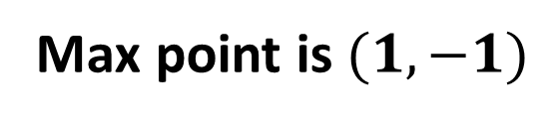
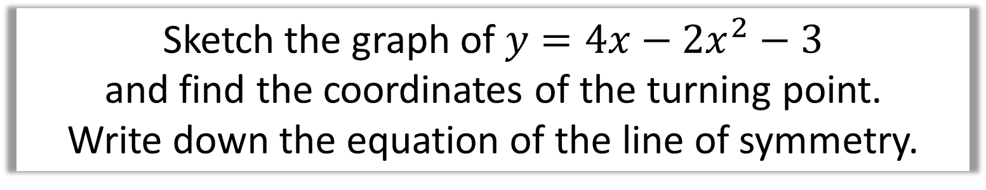






Sketch the graph of $y=4x−2x^{2}−3$
and find the coordinates of the turning point.
Write down the equation of the line of symmetry.
$$y$$
Turning point
$$y=−2x^{2}+4x−3$$
$$y=−2\left(x^{2}−2x\right)−3$$
$$x$$
$$y=−2{[\left(x−1\right)}^{2}−1]−3$$
$$−3$$
$$\left(1,−1\right)$$
$$y=−2{\left(x−1\right)}^{2}+2−3$$
$$y=−2{\left(x−1\right)}^{2}−1$$
Max point is $(1,−1)$

