Slide 1
LO: Quadratic Graphs
(Sketching)

Slide 2
When sketching quadratic graphs
you need to ask yourself:
Is it happy or sad?
What is the y axis intercept?
What are the x axis intercepts?
What is the turning point?

Slide 3
Is it happy or sad?

Slide 4
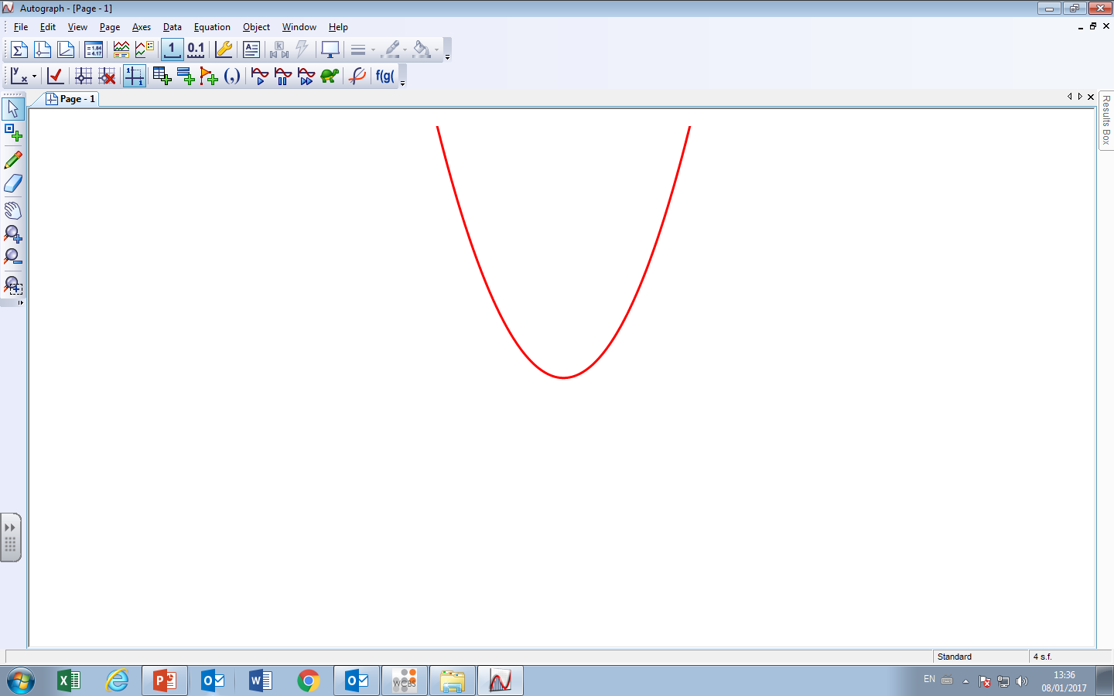
y = x² + 2x + 4
Happy or Sad?

Slide 5
y = 4x – x² + 6
Happy or Sad?

Slide 6
y = 6 – 2x + x²
Happy or Sad?

Slide 7
y = (x – 5)(x – 6)
Happy or Sad?

Slide 8
y = (6 – x)(x + 2)
Happy or Sad?

Slide 9
y = (3 – x)(4 – x)
Happy or Sad?

Slide 10
y intercept

Slide 11
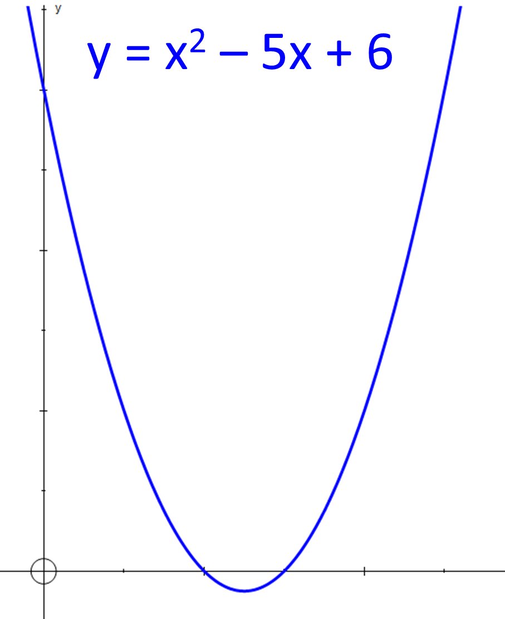
What is the co-ordinate of the graph where it crosses the y axis?
(0 , 6)

Slide 12
y = 2x² – 8x + 4
What is the co-ordinate of the graph where it crosses the y axis?
(0 , 4)

Slide 13
y = 6x – 2x² – 4
What is the co-ordinate of the graph where it crosses the y axis?
(0 , -4)

Slide 14
y = x² + 7x
What is the co-ordinate of the graph where it crosses the y axis?
(0 , 0)

Slide 15
x intercept

Slide 16
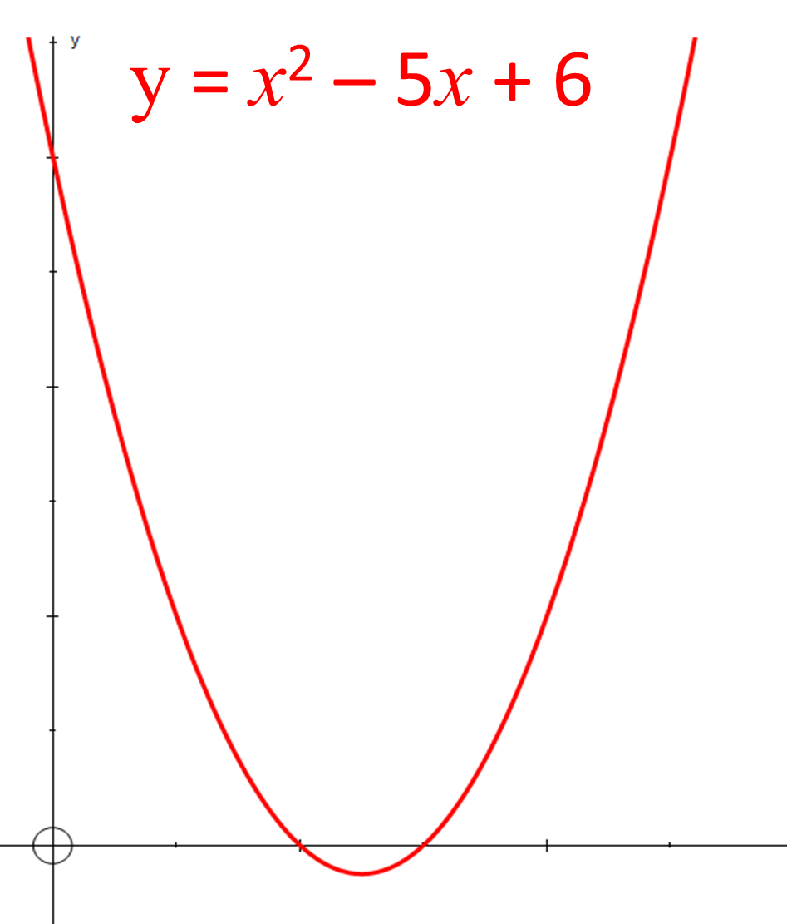
What are the co-ordinates of the graph
where it crosses the x axis?
y = (x – 2)(x – 3)
(2 , 0)
and
(3 , 0)
2
3

Slide 17
What are the co-ordinates of the graph
where it crosses the x axis?
y = (x – 2)(x – 3)
(2 , 0)
and
(3 , 0)

Slide 18
y = (x – 6)(x + 5)
What are the co-ordinates of the graph where it crosses the x axis?
(6 , 0) and (-5 , 0)

Slide 19
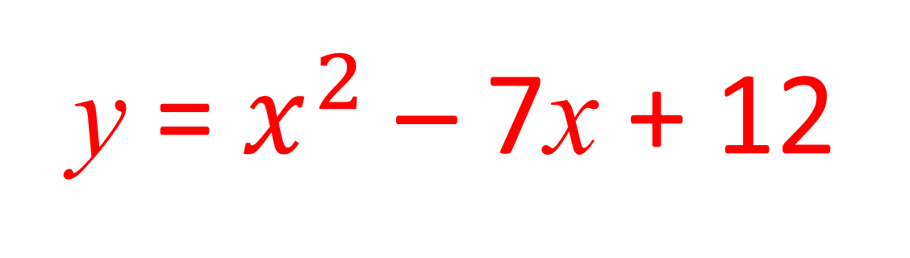
y = $x^{2}$ – 7x + 12
y = (x – 4)(x – 3)
What are the co-ordinates of the graph where it crosses the x axis?
(4 , 0) and (3 , 0)

Slide 20
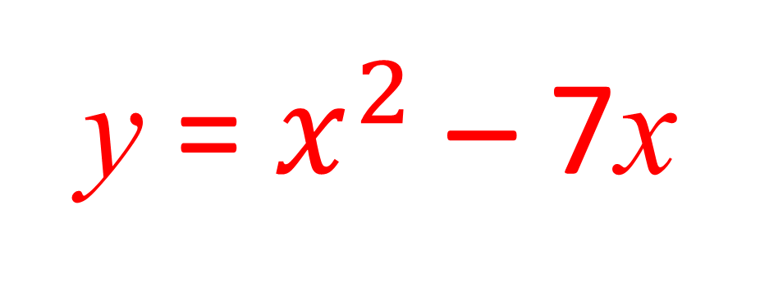
y = $x^{2}$ – 7x
y = (x + 0)(x – 7)
What are the co-ordinates of the graph where it crosses the x axis?
(0 , 0) and (7 , 0)

Slide 21
Turning Point

Slide 22
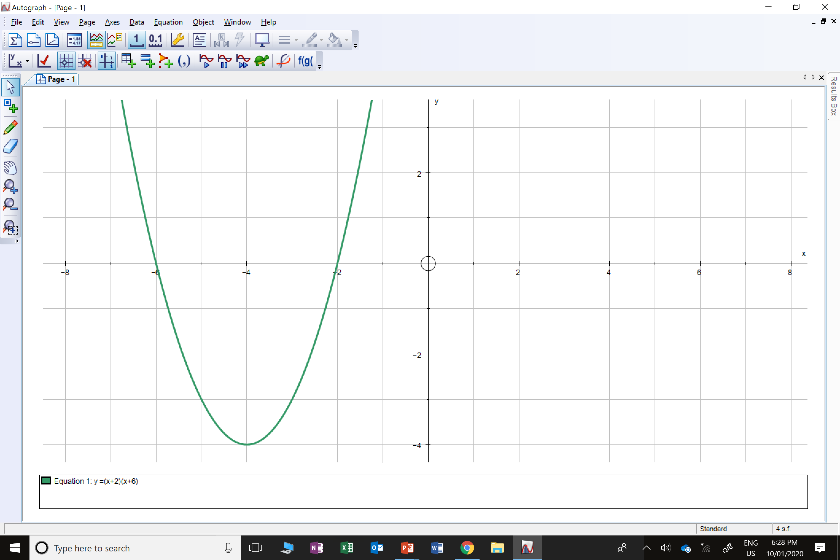
What is the co-ordinate of
the turning point?
(-4, -4)
x

Slide 23
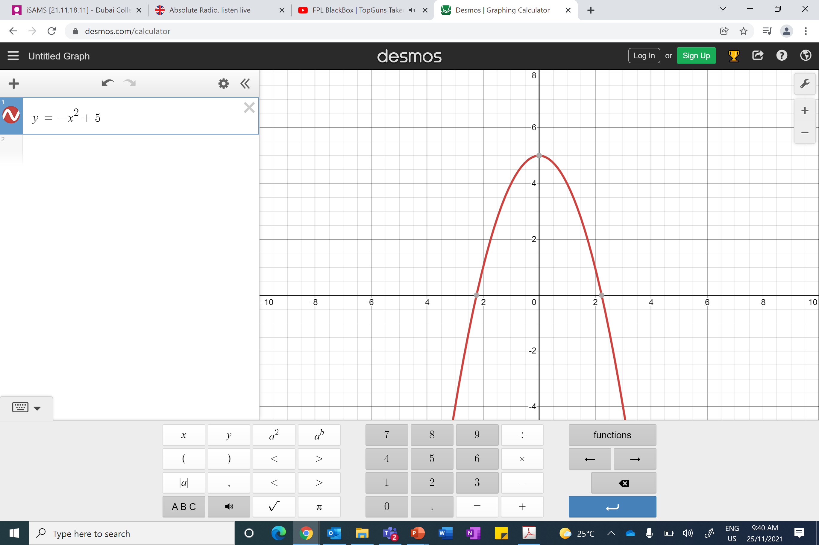
What is the co-ordinate of
the turning point?
(0, 5)
x

Slide 24
What are the co-ordinates of
the turning point?
(-4 ,-4)
y = (x + 6)(x + 2)
-4
-6
-2

Slide 25
y = (x – 5)(x – 9)
What is the co-ordinate of
the turning point?
(7 , -4)

Slide 26
y = (x + 2)(x – 6)
What is the co-ordinate of
the turning point?
(2 , -16)

Slide 27

y = $x^{2}−x –20$
What is the co-ordinate of
the turning point?
y = (x + 1)(x – 7)
(3 , -15)

Slide 28
Sketching

Slide 29
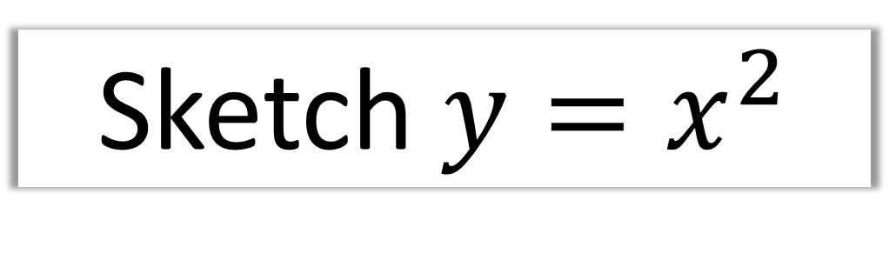
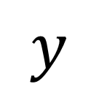
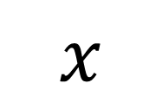
Sketch $y=x^{2}$
$$y$$
$$x$$

Slide 30




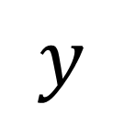
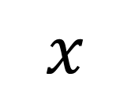
Sketch $y=x^{2}−4$
indicating any intercepts with the axis.
$$y$$
$$x$$
$$−2$$
$$2$$
$$−4$$

Slide 31


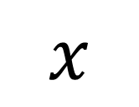
Sketch $y=x^{2}+4$
indicating any intercepts with the axis.
$$y$$
$$4$$
$$x$$

Slide 32

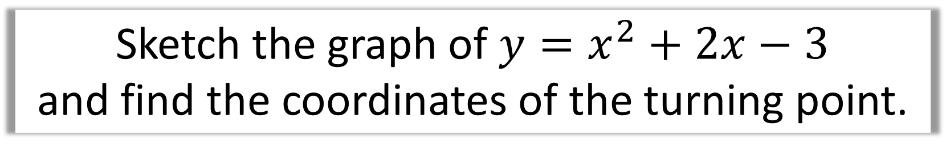


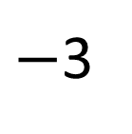
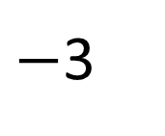
Sketch the graph of $y=x^{2}+2x−3$
and find the coordinates of the turning point.
$$y$$
$$x$$
$−$3
1
$−$3
$$\left(−1,−4\right)$$

Slide 33




Sketch $y=x^{2}−7x+10$
indicating any intercepts with the axis and the turning point.
$$y$$
10
2
5
$$x$$
$$\left(3.5, −2.25\right)$$

