Slide 1
Work, Energy and Power
Work
Chapter 2
(Part 1 of 4)

Slide 2
Work is done by
a force when
it moves an object.

Slide 3

Work = Force $×$ Distance
The force must be in the same direction as the movement.

Slide 4
Units:
Force = Newtons (N)
Distance = meters (m)
Work = Joules (J)

Slide 5
Movement Horizontally
Start
Finish
There is horizontal movement only.

Slide 6

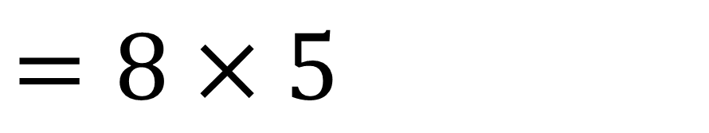
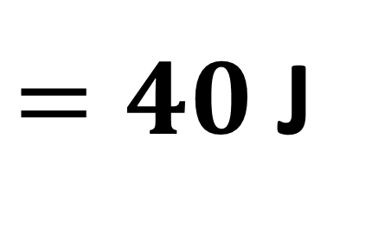
A horizontal force of 8N moves a box 5m across a horizontal floor.
Calculate the work done by the force.
$$8N$$
Work done = Force x Distance
$$=8×5$$
$=40$J

Slide 7
Movement vertically
Finish
Start
There is vertical movement only.

Slide 8
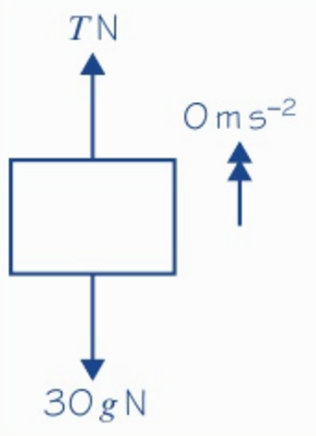
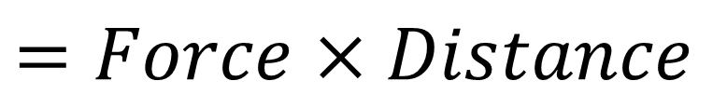
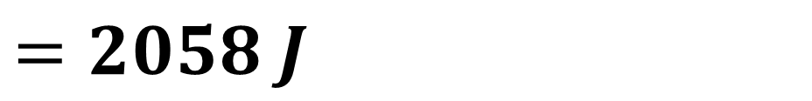
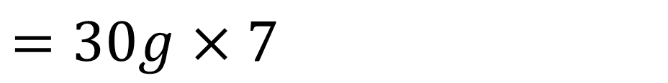
A bricklayer raises a load of brick of total mass 30kg at a constant speed by attaching a cable to the bricks. Assuming the cable is vertical, calculate the work done when the bricks are raised a distance of 7m.
Work Done
$$=Force×Distance$$
$$=30g×7$$
$$=2058 J$$

Slide 9
Movement on a slope
Finish
Start
There is horizontal movement along the slope and vertical movement.

Slide 10
Common types of work you will calculate
will be
work done against friction and gravity.

Slide 11
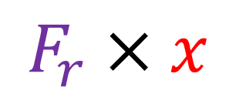



Work Done against Friction
Y
$$x$$
$$F_{r}$$
$$Ɵ$$
Work done against friction =
$$F_{r}×x$$

Slide 12






Work Done against Gravity
$$Y$$
$$x$$
$$x sin Ɵ$$
$$mg$$
$$Ɵ$$
Work done against gravity =
$$mg×x sinƟ$$

Slide 13

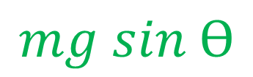

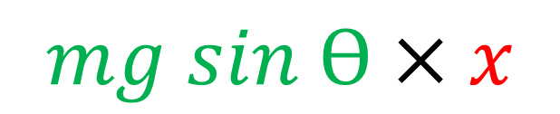

Work Done Against Gravity
$$Y$$
$$x$$
$$mg$$
$$mg sin Ɵ$$
$$Ɵ$$
Work done against gravity =
$$mg sin Ɵ×x$$

Slide 14






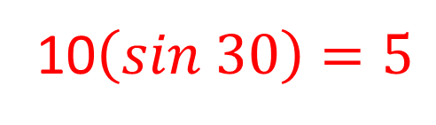



Work Done Against Gravity
$$Y$$
10$\left(sin 30\right)=5$
10
$$2g$$
$$2gsin30$$
$$=g$$
$$30°$$
Work done against gravity
Work done against gravity
$$=2g×5$$
$$=g×10$$
OR
$$=10g$$
$$=10g$$

Slide 15
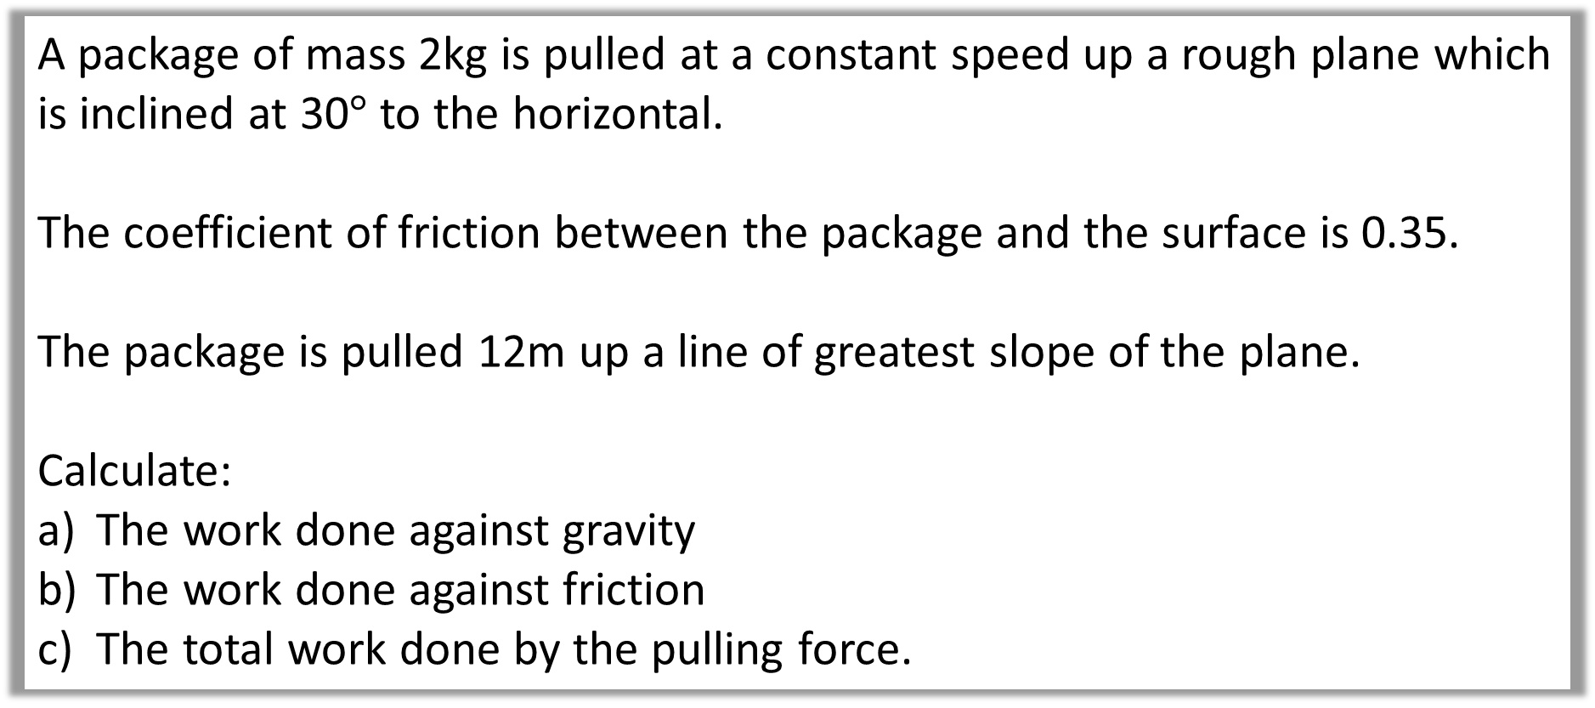
Example A: Slope
A package of mass 2kg is pulled at a constant speed up a rough plane which is inclined at 30$°$ to the horizontal.
The coefficient of friction between the package and the surface is 0.35.
The package is pulled 12m up a line of greatest slope of the plane.
Calculate:
The work done against gravity
The work done against friction
The total work done by the pulling force.

Slide 16
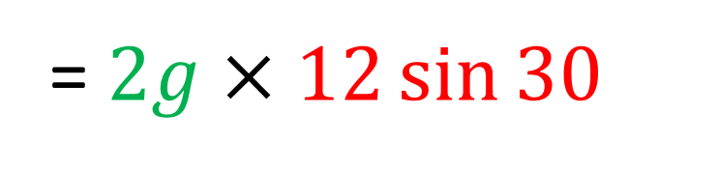


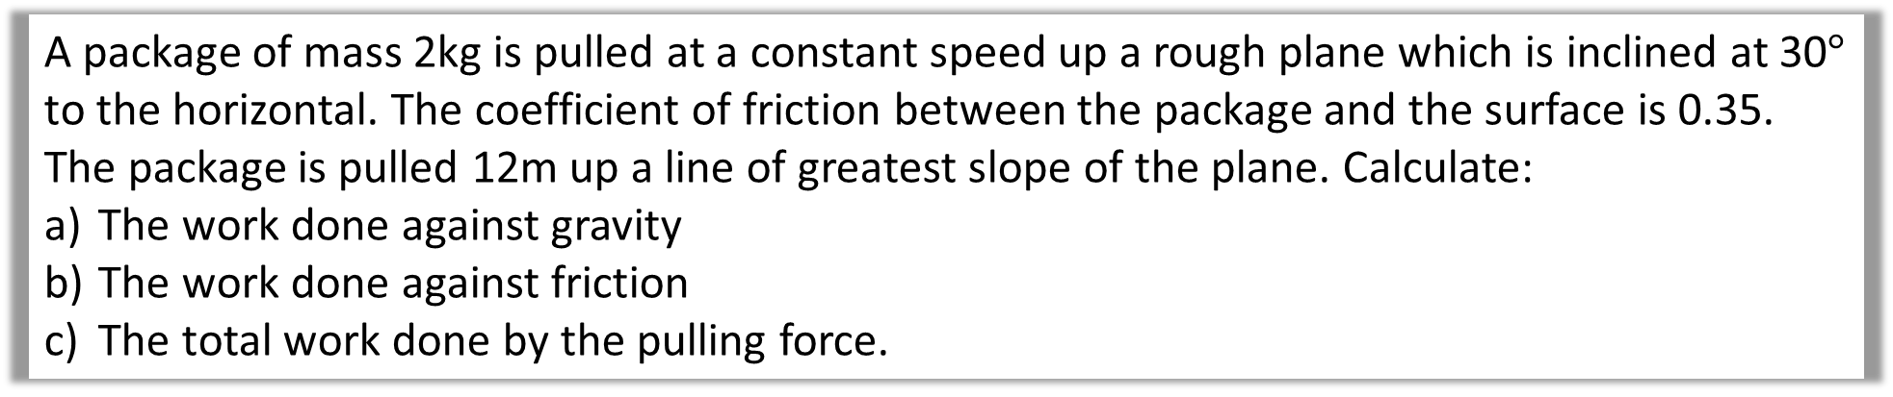

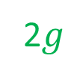


A package of mass 2kg is pulled at a constant speed up a rough plane which is inclined at 30$°$ to the horizontal. The coefficient of friction between the package and the surface is 0.35. The package is pulled 12m up a line of greatest slope of the plane. Calculate:
The work done against gravity
The work done against friction
The total work done by the pulling force.
a)
Work done against gravity
$$R$$
$$P$$
= Force x Distance
= $2g×12\sin{30}$
$$F_{r}$$
12m
2$g$
$$12\sin{30}$$
= 118 J
$$30°$$

Slide 17
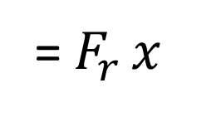

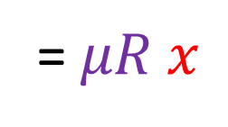
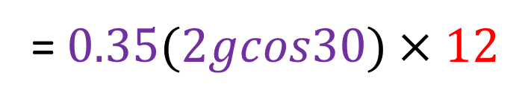
A package of mass 2kg is pulled at a constant speed up a rough plane which is inclined at 30$°$ to the horizontal. The coefficient of friction between the package and the surface is 0.35. The package is pulled 12m up a line of greatest slope of the plane. Calculate:
The work done against gravity
The work done against friction
The total work done by the pulling force.
$$R$$
b)
Work done against friction
$$P$$
= $F_{r }x$
= $μR x$
$$F_{r}$$
=$0.35(2gcos30)×12$
12m
2$g$
$$30°$$
= 71.3 J

Slide 18
A package of mass 2kg is pulled at a constant speed up a rough plane which is inclined at 30$°$ to the horizontal. The coefficient of friction between the package and the surface is 0.35. The package is pulled 12m up a line of greatest slope of the plane. Calculate:
The work done against gravity
The work done against friction
The total work done by the pulling force.
$$R$$
c)
The total work done by P
$$P$$
= 118 + 71.3
$$F_{r}$$
= 189.3 J
12m
2$g$
$$30°$$

