Slide 1
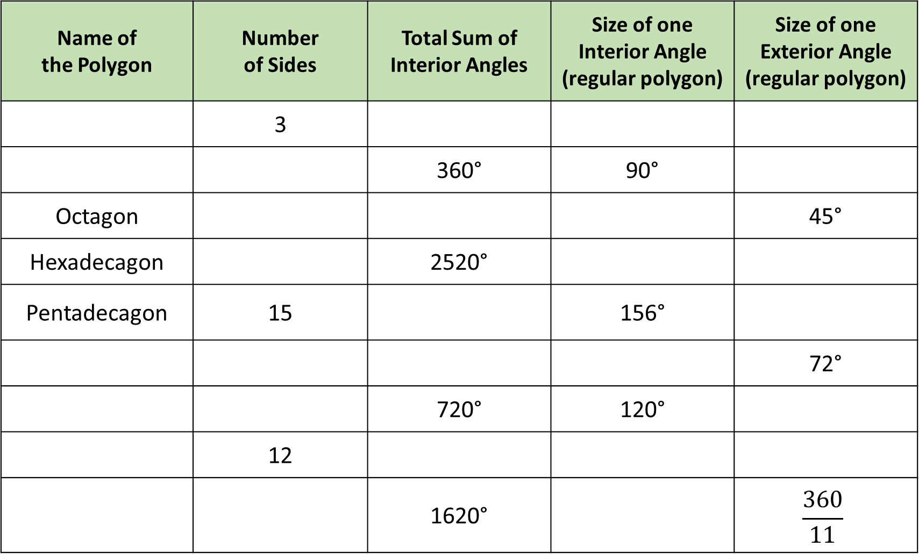
Name of the Polygon | Number of Sides | Total Sum of Interior Angles | Size of one Interior Angle (regular polygon) | Size of one Exterior Angle (regular polygon)
 | 3
 |  | 360° | 90°
Octagon |  |  |  | 45°
Hexadecagon |  | 2520°
Pentadecagon | 15 |  | 156°
 |  |  |  | 72°
 |  | 720° | 120°
 | 12
 |  | 1620° |  | $$\frac{360}{11}$$

Slide 2
1) A regular polygon has an interior angle of 60°.
What is the size of one exterior angle?
6) A regular polygon has an interior angle of 60°.
How many sides does the shape have?
2) A regular polygon has an interior angle of 90°.
What is the size of one exterior angle?
7) A regular polygon has an interior angle of 90°.
How many sides does the shape have?
3) A regular polygon has an interior angle of 108°.
What is the size of one exterior angle?
8) A regular polygon has an interior angle of 108°.
How many sides does the shape have?
4) A regular polygon has an interior angle of 135°.
What is the size of one exterior angle?
9) A regular polygon has an interior angle of 135°.
How many sides does the shape have?
5) A regular polygon has an interior angle of 150°.
What is the size of one exterior angle?
10) A regular polygon has an interior angle of 150°.
How many sides does the shape have?

Slide 3
ANSWERS

Slide 4
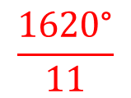
Name of the Polygon | Number of Sides | Total Sum of Interior Angles | Size of one Interior Angle (regular polygon) | Size of one Exterior Angle (regular polygon)
 | 3
 |  | 360° | 90°
Octagon |  |  |  | 45°
Hexadecagon |  | 2520°
Pentadecagon | 15 |  | 156°
 |  |  |  | 72°
 |  | 720° | 120°
 | 12
 |  | 1620° |  | $$\frac{360}{11}$$
Triangle
180°
60°
120°
Quadrilateral
4
90°
8
1080°
135°
16
157.5°
22.5°
2340°
24°
Pentagon
5
540°
108°
Hexagon
6
60°
Dodecagon
1800°
150°
30°
Hendecagon
11
$$\frac{1620\text{°}}{11}$$

Slide 5
1) A regular polygon has an interior angle of 60°.
What is the size of one exterior angle?
6) A regular polygon has an interior angle of 60°.
How many sides does the shape have?
120˚
3 sides
2) A regular polygon has an interior angle of 90°.
What is the size of one exterior angle?
7) A regular polygon has an interior angle of 90°.
How many sides does the shape have?
90˚
4 sides
3) A regular polygon has an interior angle of 108°.
What is the size of one exterior angle?
8) A regular polygon has an interior angle of 108°.
How many sides does the shape have?
72˚
5 sides
4) A regular polygon has an interior angle of 135°.
What is the size of one exterior angle?
9) A regular polygon has an interior angle of 135°.
How many sides does the shape have?
45˚
8 sides
5) A regular polygon has an interior angle of 150°.
What is the size of one exterior angle?
10) A regular polygon has an interior angle of 150°.
How many sides does the shape have?
30˚
12 sides

