Slide 1
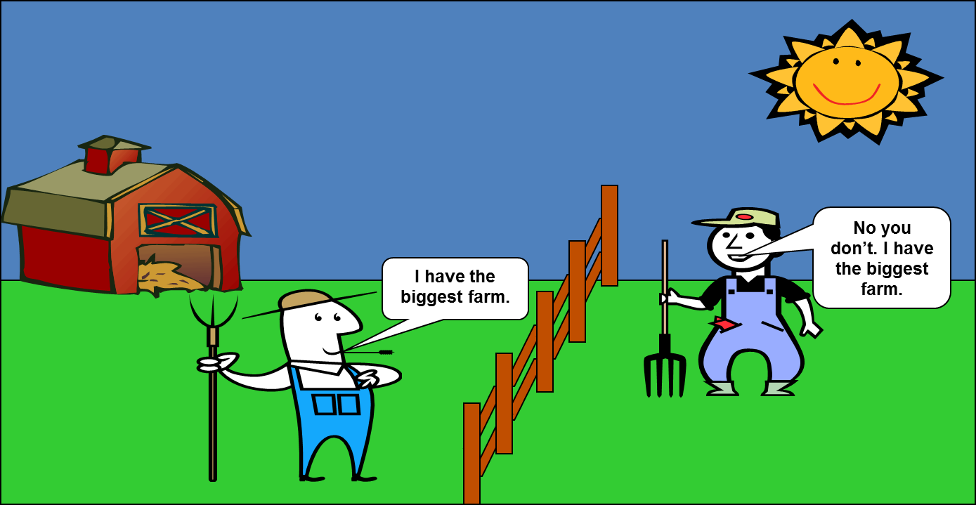
One day there were two farmers having an argument about
who had the biggest (area) farm!

Slide 2
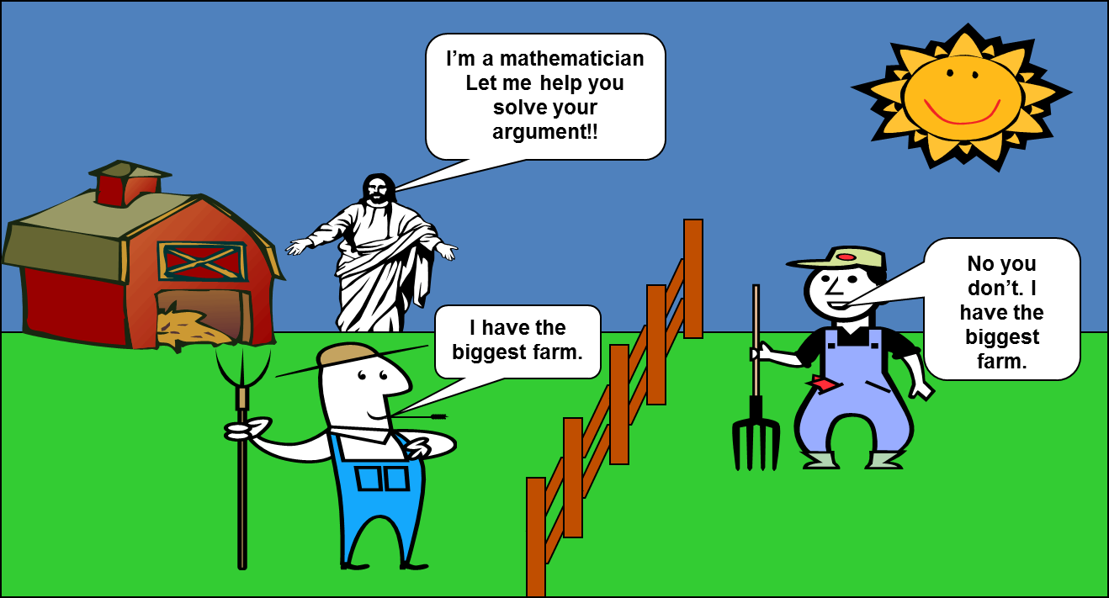
"Then Mr Pythagoras was walking past and other heard their argument.
He told them he was a mathematician and could solve their argument."

Slide 3
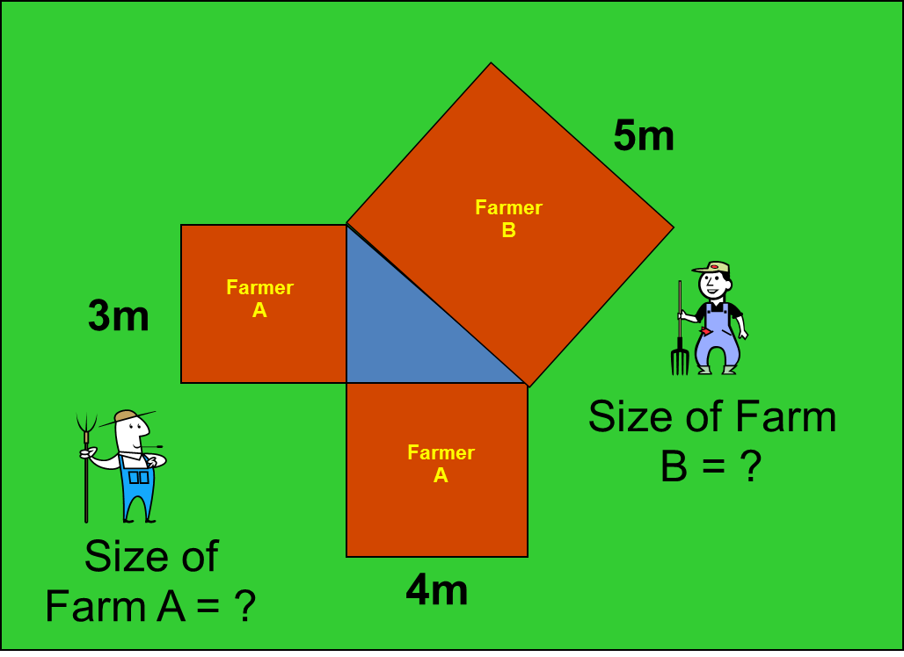
Each field is a square.
Help Pythagoras solve the argument of who has the biggest (area) farm.

