Slide 1
Circles
Midpoints and Line Segments
Chapter 6
(Part 1 of 4)

Slide 2
Circles: Mid-points
B
Centre
A

Slide 3
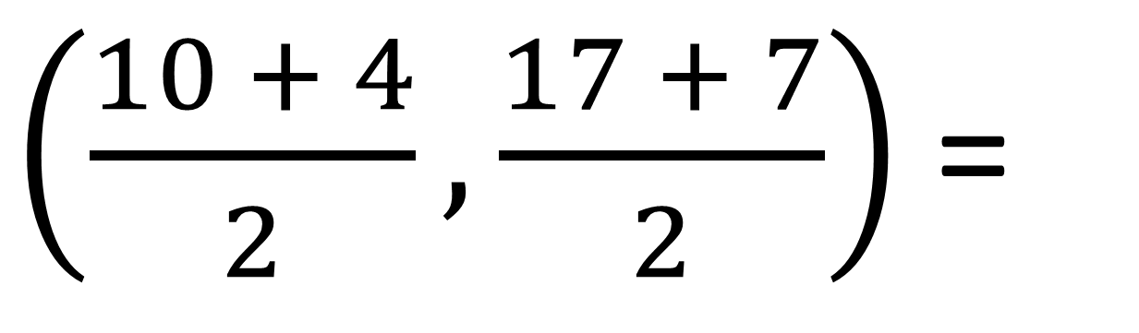
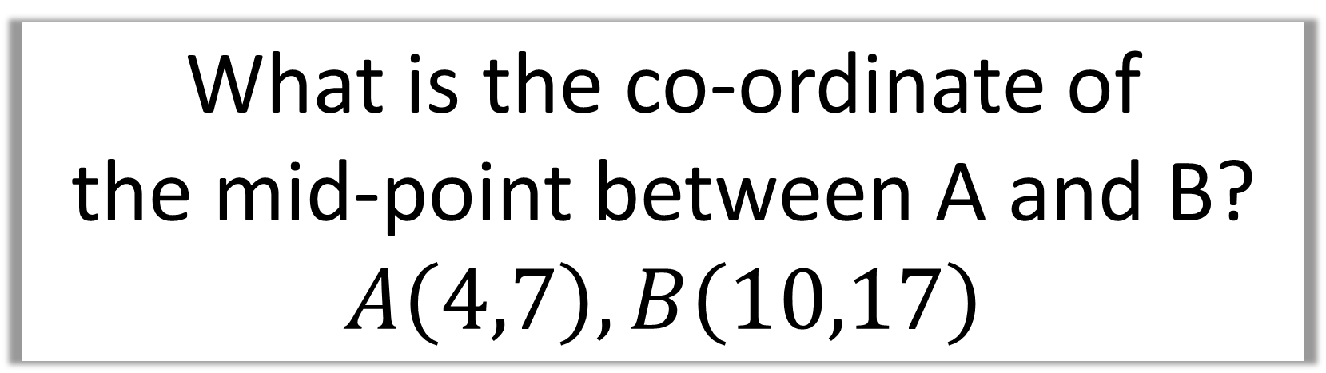
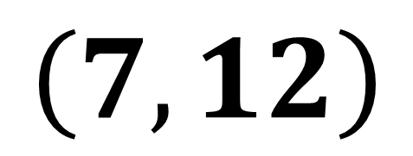
What is the co-ordinate of
the mid-point between A and B?
$$A\left(4,7\right), B\left(10,17\right)$$
$\left(\frac{10 + 4}{2},\frac{17 + 7}{2}\right)$ =
$$\left(7,12\right)$$

Slide 4
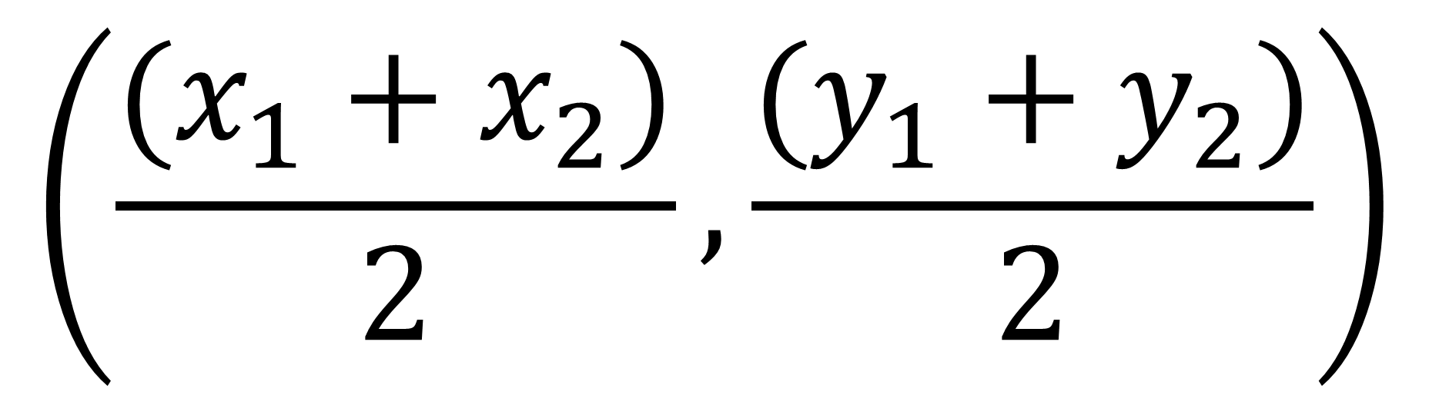
Mid-points
$$\left(\frac{(x_{1}+x_{2})}{2},\frac{(y_{1}+y_{2})}{2}\right)$$

Slide 5
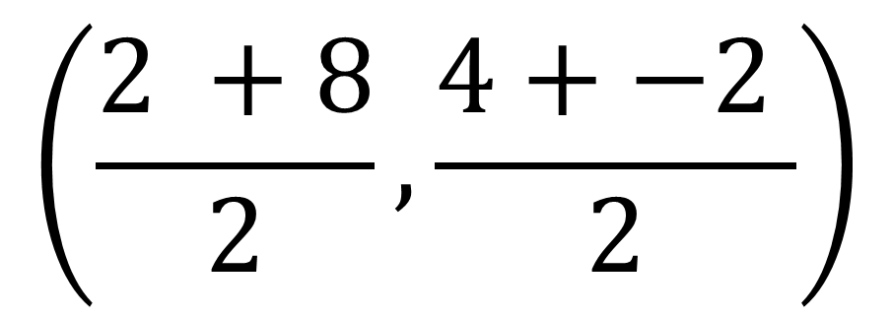
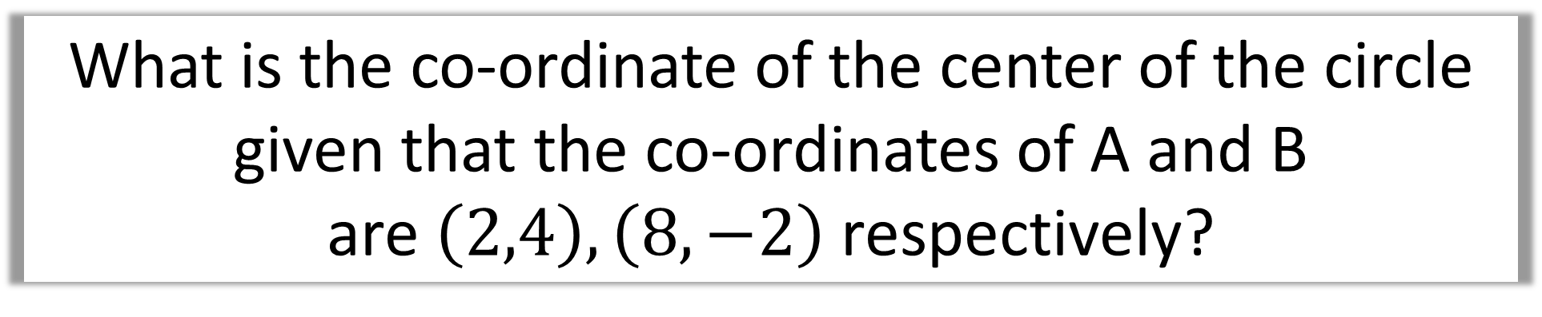
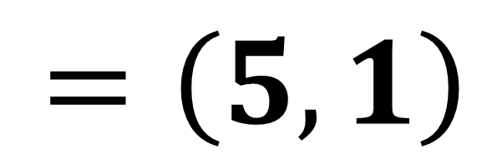
What is the co-ordinate of the center of the circle
given that the co-ordinates of A and B
are $\left(2,4\right),\left(8,−2\right)$ respectively?
$$\left(\frac{2 +8}{2},\frac{4+−2 }{2}\right)$$
B
Centre
A
$=\left(5,1\right)$

Slide 6
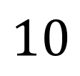
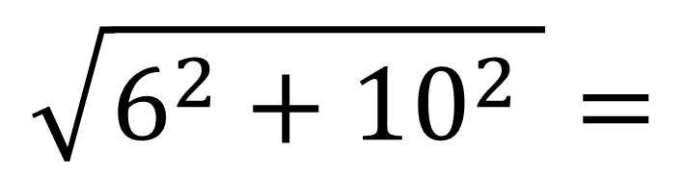
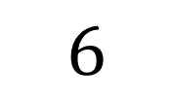
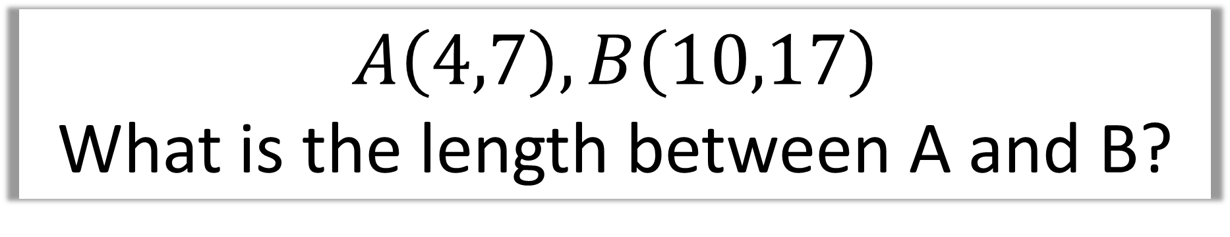
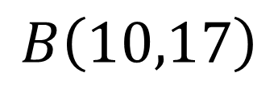
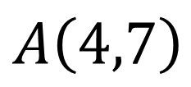
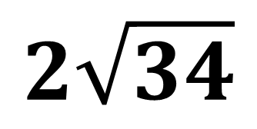
$$A\left(4,7\right), B\left(10,17\right)$$
What is the length between A and B?
$$B\left(10,17\right)$$
$$10$$
$$6$$
$$A\left(4,7\right)$$
$$\sqrt{6^{2}+{10}^{2} }=$$
$$2\sqrt{34}$$

Slide 7
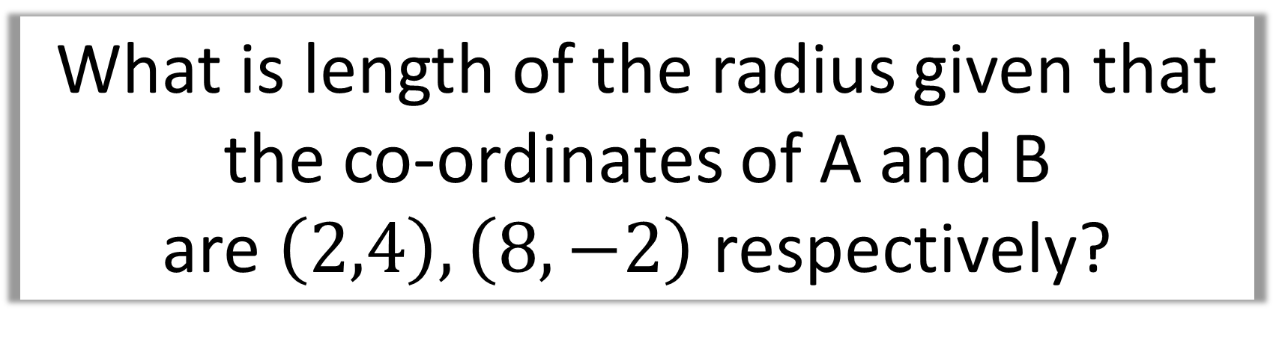
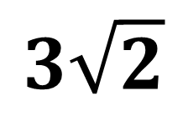
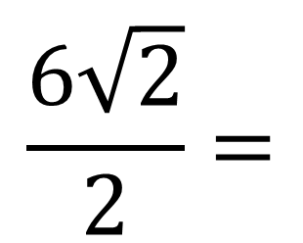
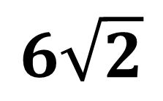
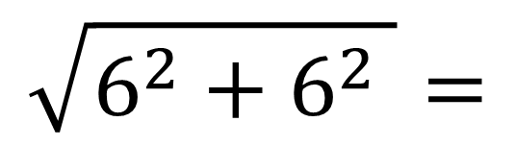
What is length of the radius given that
the co-ordinates of A and B
are $\left(2,4\right),\left(8,−2\right)$ respectively?
Diameter
A
$$\sqrt{6^{2}+6^{2} }=$$
$$6\sqrt{2}$$
Centre
Radius
$$\frac{6\sqrt{2}}{2}=$$
B
$$3\sqrt{2}$$

Slide 8
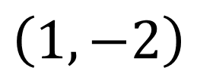

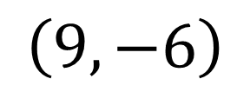

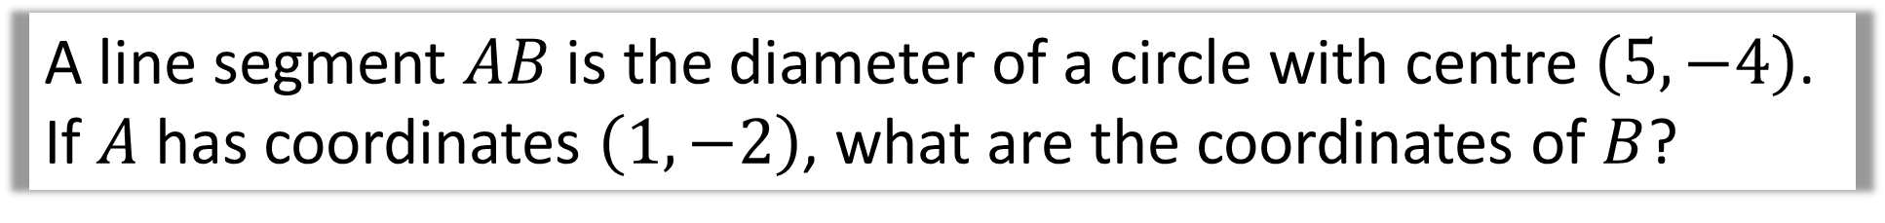


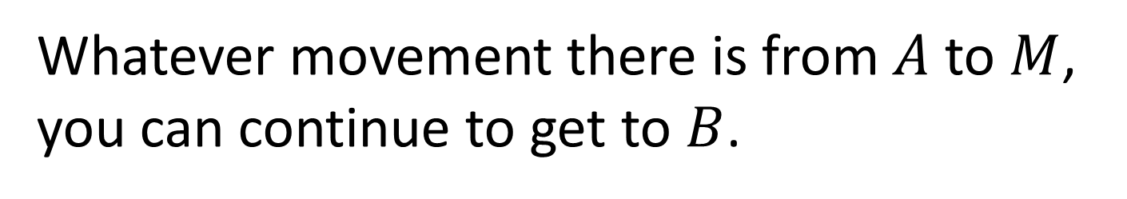



A line segment $AB$ is the diameter of a circle with centre $\left(5,−4\right)$.
If $A$ has coordinates $\left(1,−2\right)$, what are the coordinates of $B$?
Whatever movement there is from $A$ to $M$,
you can continue to get to $B$.
$$\left(1,−2\right)$$
$$A$$
$$−4$$
$$M\left(5,−4\right)$$
$$2$$
$$−4$$
$$2$$
$$B$$
$$\left(9,−6\right)$$

Slide 9
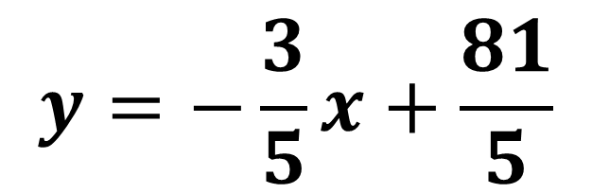
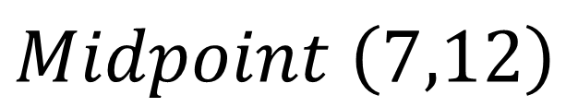
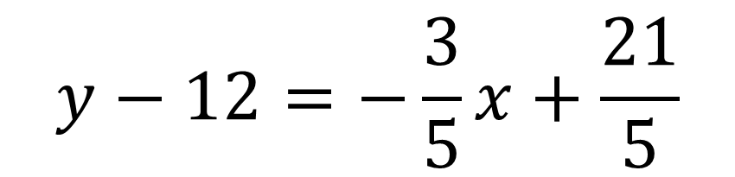
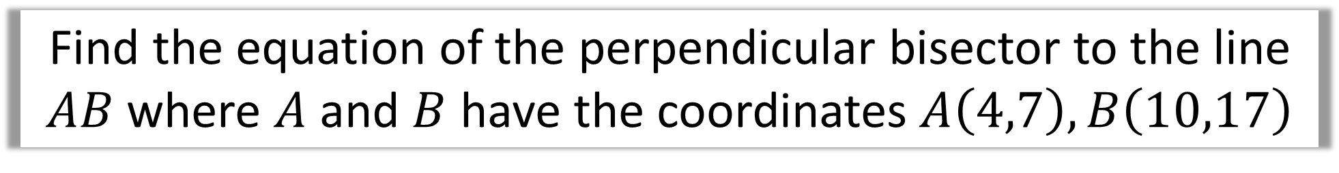
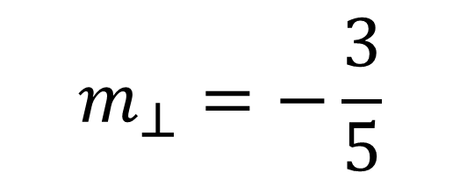
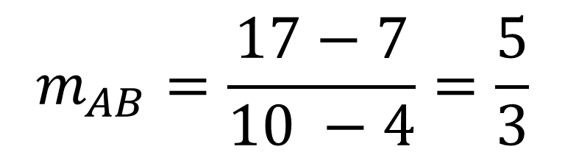
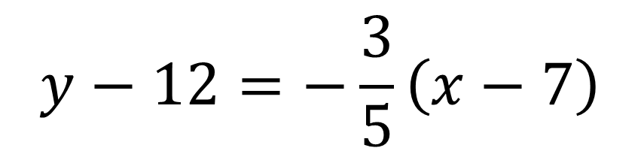
Find the equation of the perpendicular bisector to the line $AB$ where $A$ and $B$ have the coordinates $A\left(4,7\right), B\left(10,17\right)$
$$y−12=−\frac{3}{5}\left(x−7\right)$$
$$m_{AB}=\frac{17−7}{10 −4}=\frac{5}{3}$$
$$y−12=−\frac{3}{5}x+\frac{21}{5}$$
$$m_{⊥}=−\frac{3}{5}$$
$$y=−\frac{3}{5}x+\frac{81}{5}$$
$$Midpoint \left(7,12\right)$$

