Slide 1
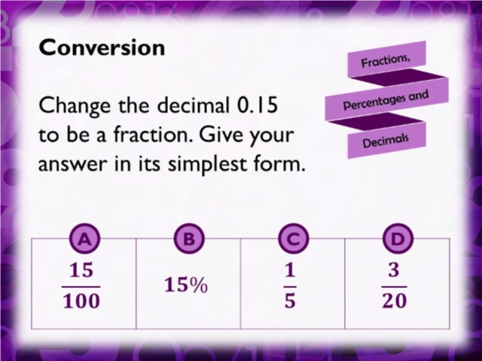
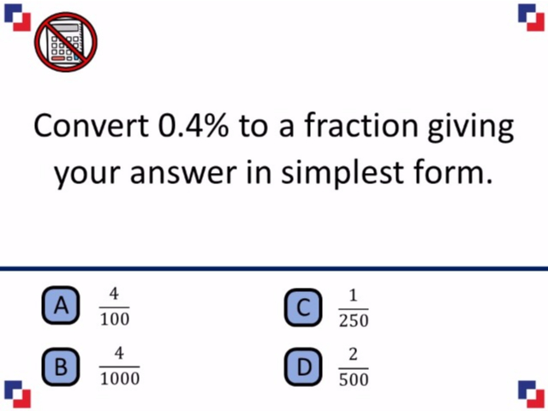
Worst answered question?
Most common wrong answer?

Slide 2
ANSWERS

Slide 3
Worst answered question?

Slide 4
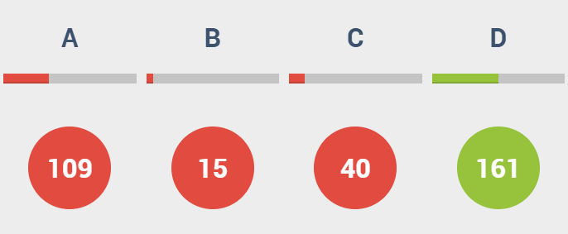
A
They have not simplified.

Slide 5

A
They did not notice that the 4 is in the tenths and not the units.

