Slide 1
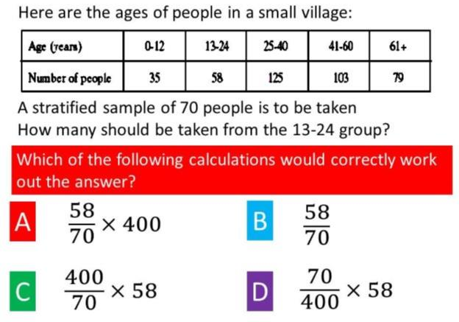
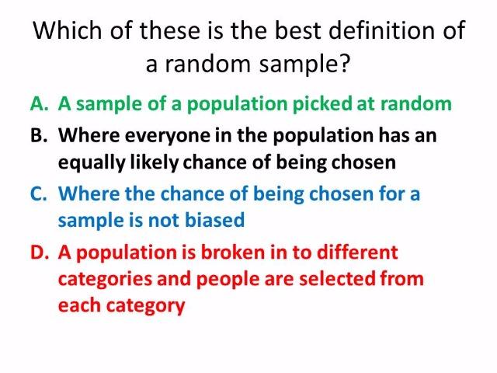
Worst answered question?
Most common wrong answer?

Slide 2
ANSWERS

Slide 3
Worst answered question?

Slide 4
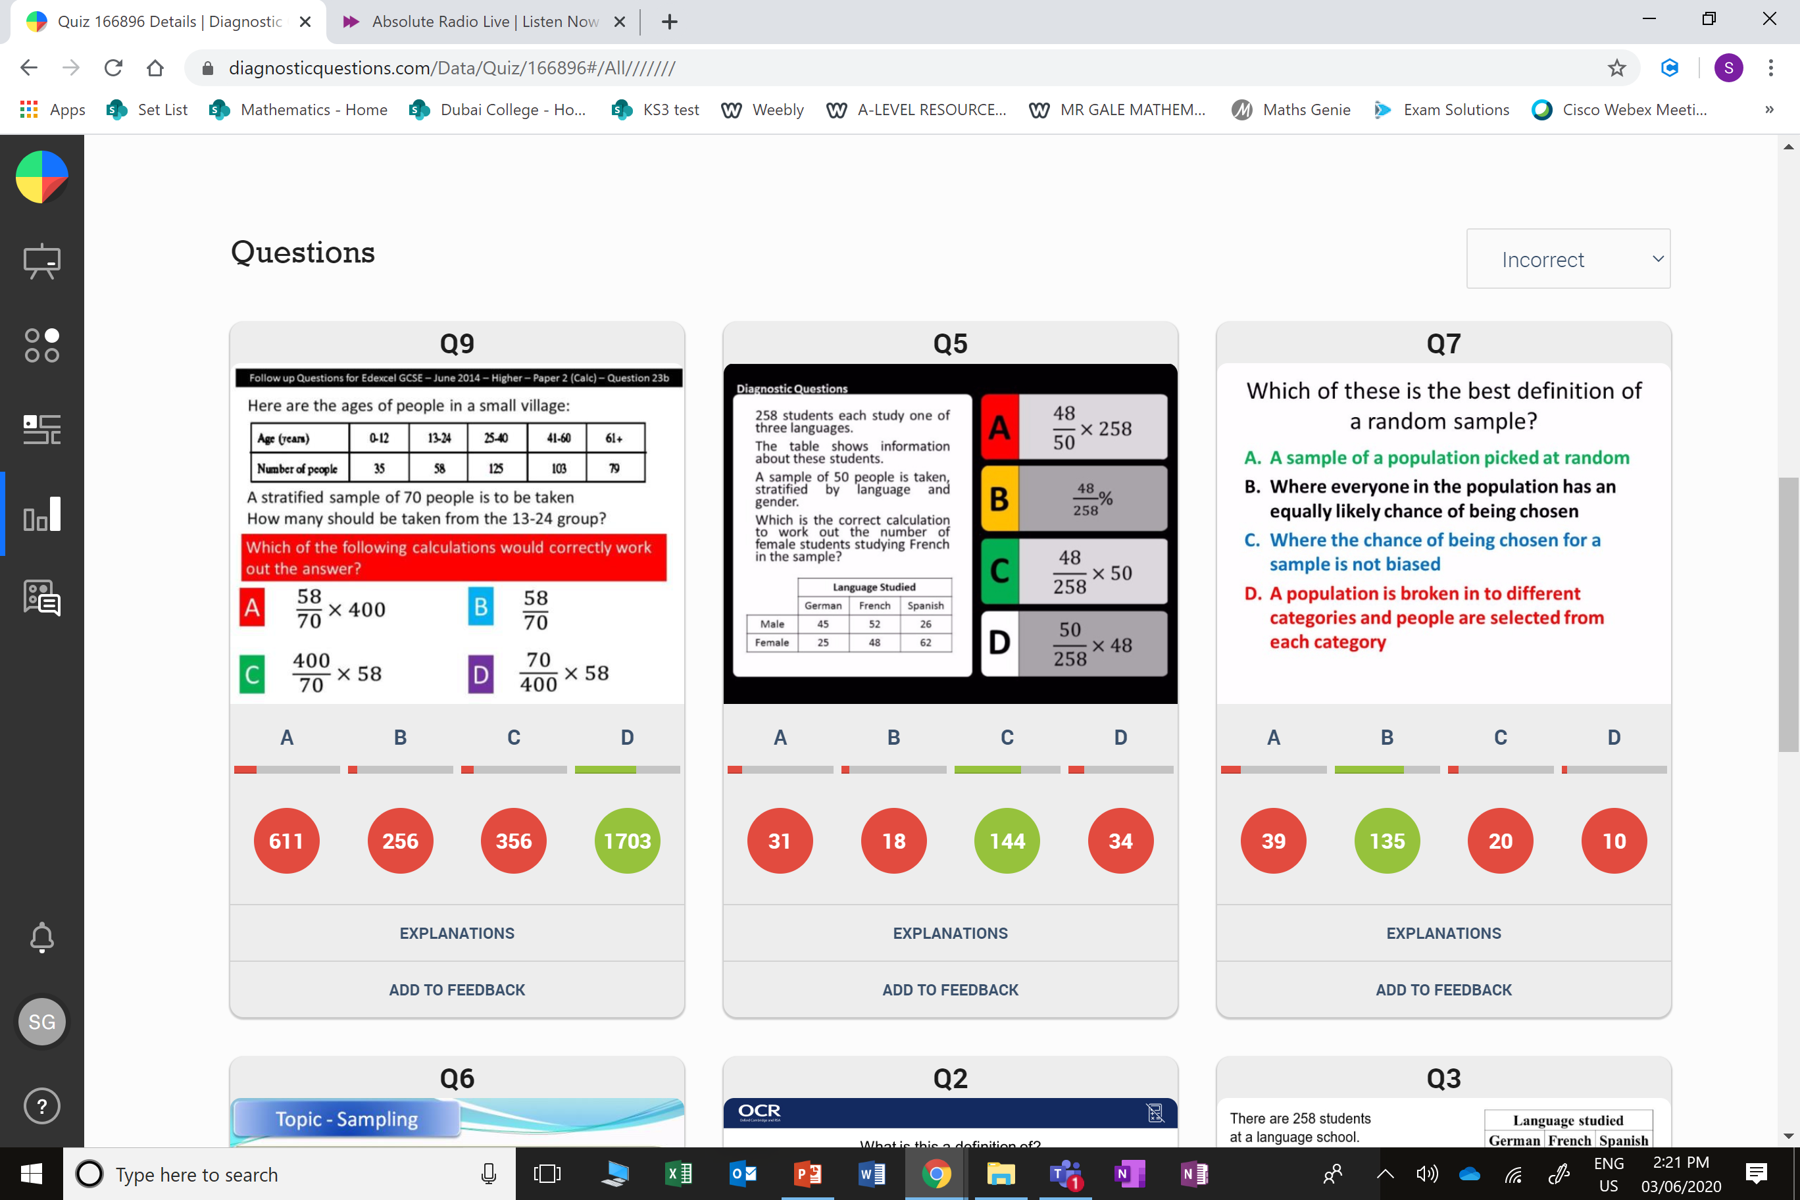
C
They just took the two numbers and made them a fraction.

Slide 5
A
They did not give any detail to their answer.

