Slide 1
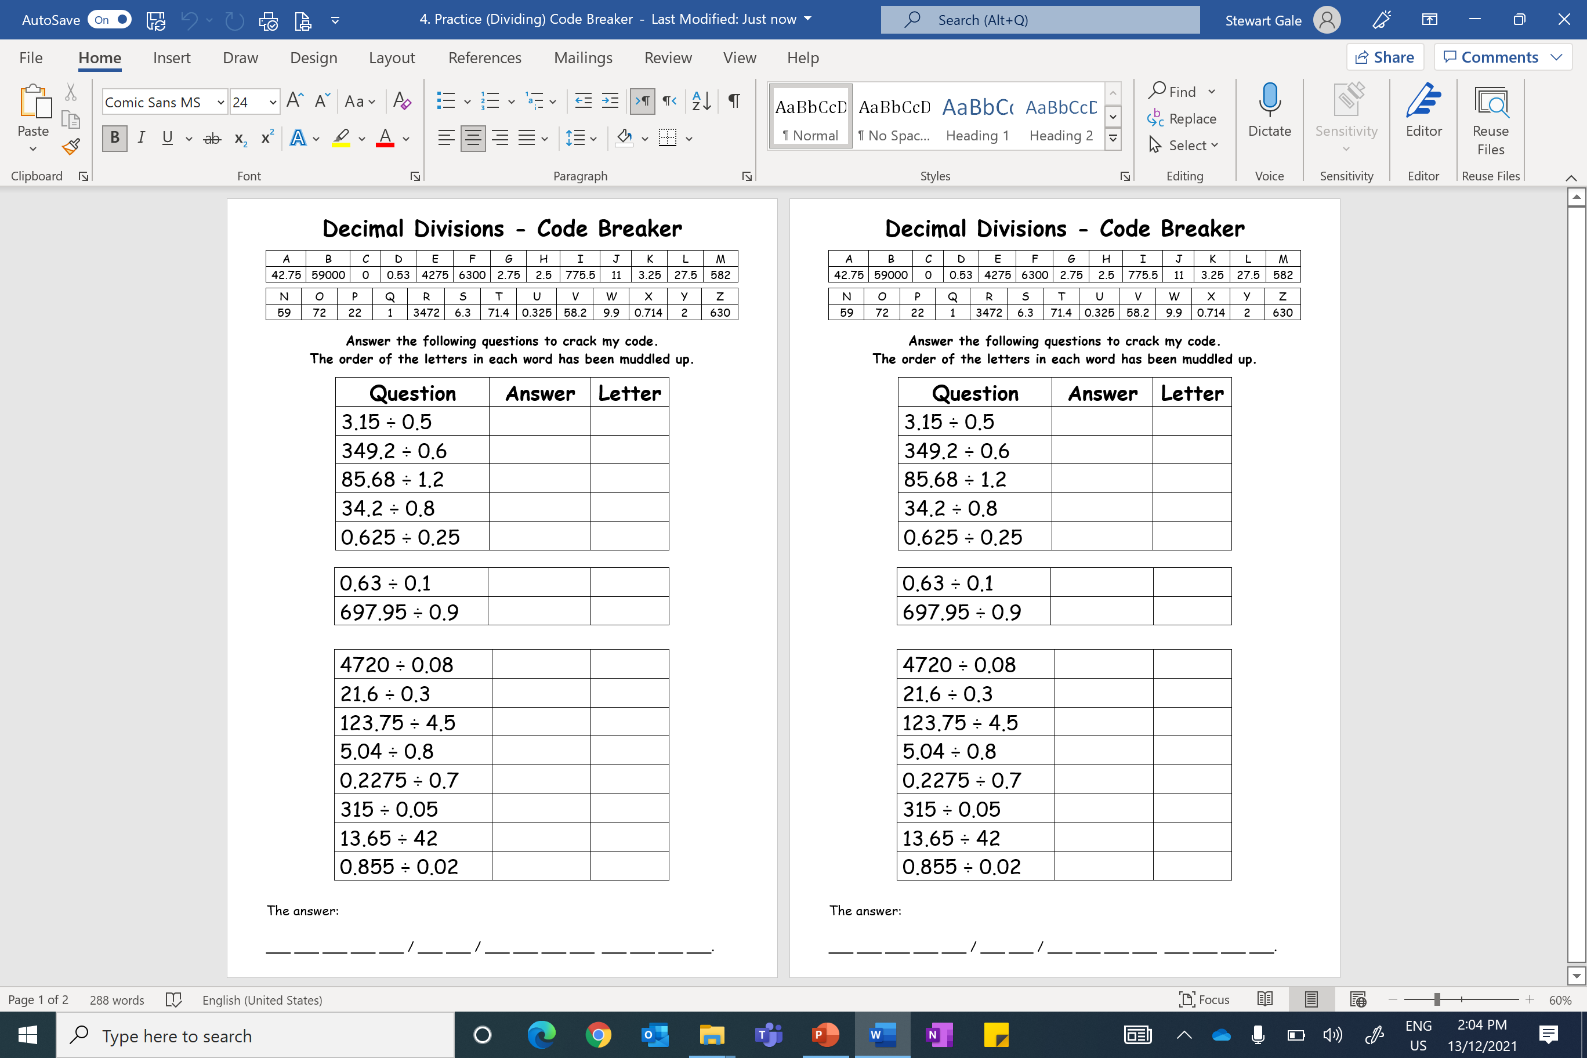

Slide 2
ANSWERS

Slide 3
Question | Answer | Letter
3.15 ÷ 0.5 | 6.3 | S
349.2 ÷ 0.6 | 582 | M
85.68 ÷ 1.2 | 71.4 | T
34.2 ÷ 0.8 | 42.75 | A
0.625 ÷ 0.25 | 2.5 | H
0.63 ÷ 0.1 | 6.3 | S
697.95 ÷ 0.9 | 775.5 | I
MATHS IS FABULOUS
4720 ÷ 0.08 | 59 000 | B
21.6 ÷ 0.3 | 72 | O
123.75 ÷ 4.5 | 27.5 | L
5.04 ÷ 0.8 | 6.3 | S
0.2275 ÷ 0.7 | 0.325 | U
315 ÷ 0.05 | 6 300 | F
13.65 ÷ 42 | 0.325 | U
0.855 ÷ 0.02 | 42.75 | A

