Slide 1
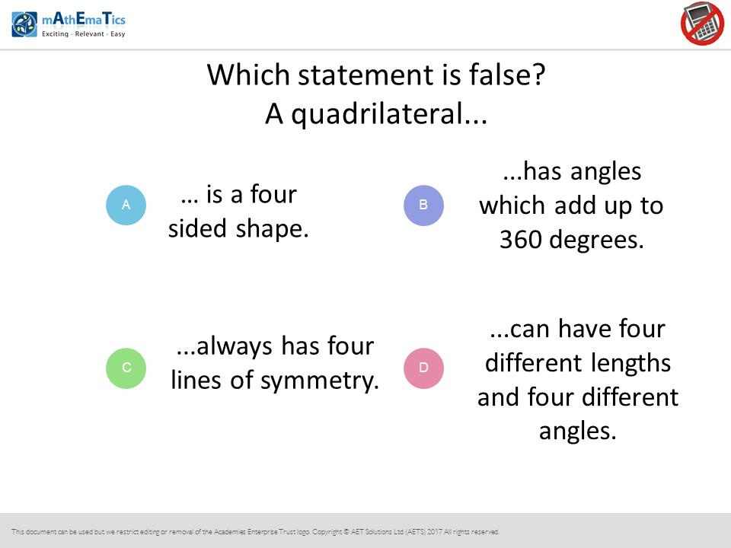
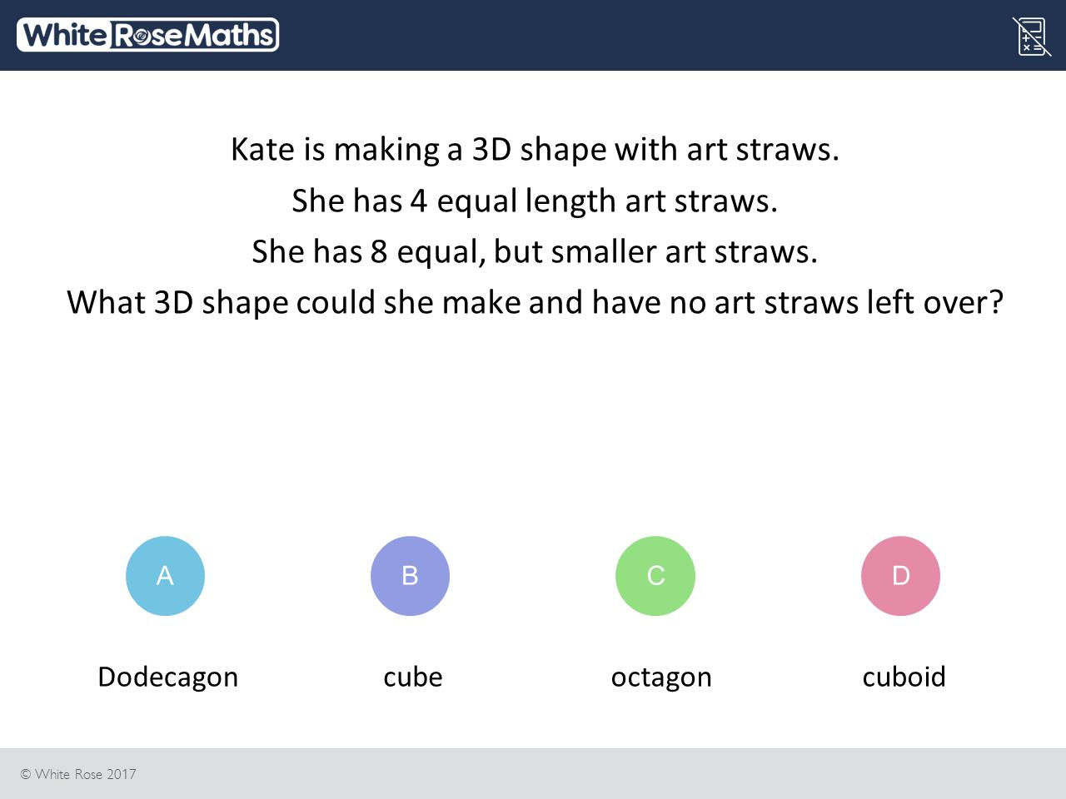
Worst answered question?
Most common wrong answer?

Slide 2
ANSWERS

Slide 3
Worst answered question?

Slide 4
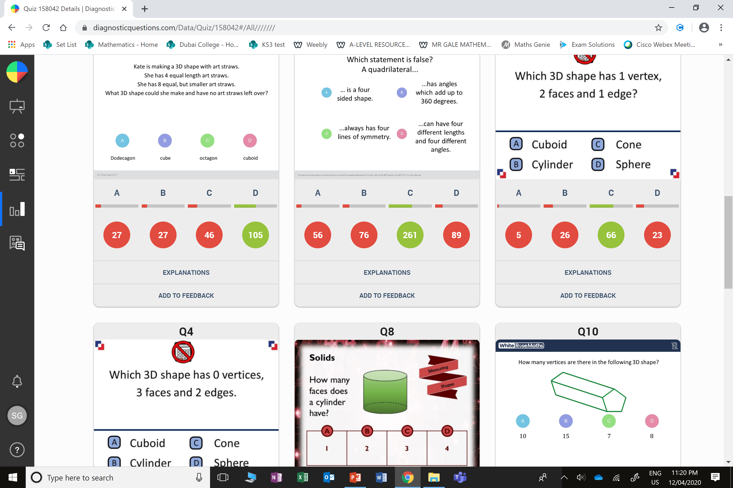
C
They went for 8 sided 2D shape.

Slide 5
D
They focused
the number 4.

