Slide 1
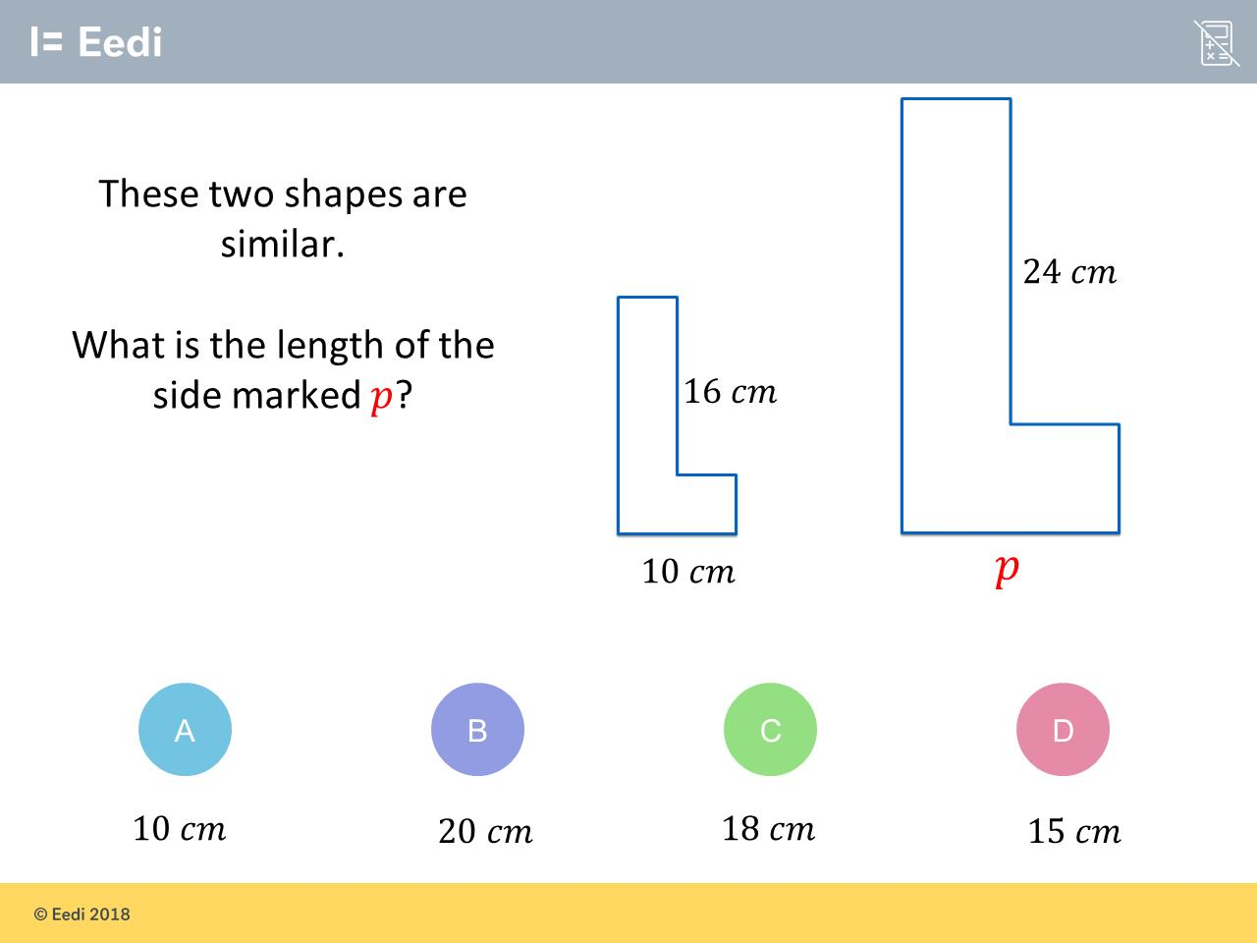
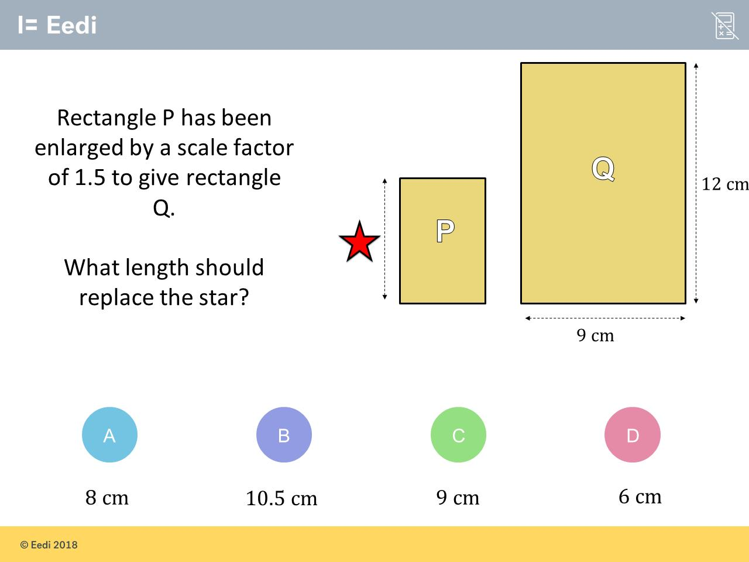
Worst answered question?
Most common wrong answer?

Slide 2
ANSWERS

Slide 3
Worst answered question?

Slide 4

C
They believed each length increased
by 8.

Slide 5
D
They used a scale factor of 2.

