Slide 1
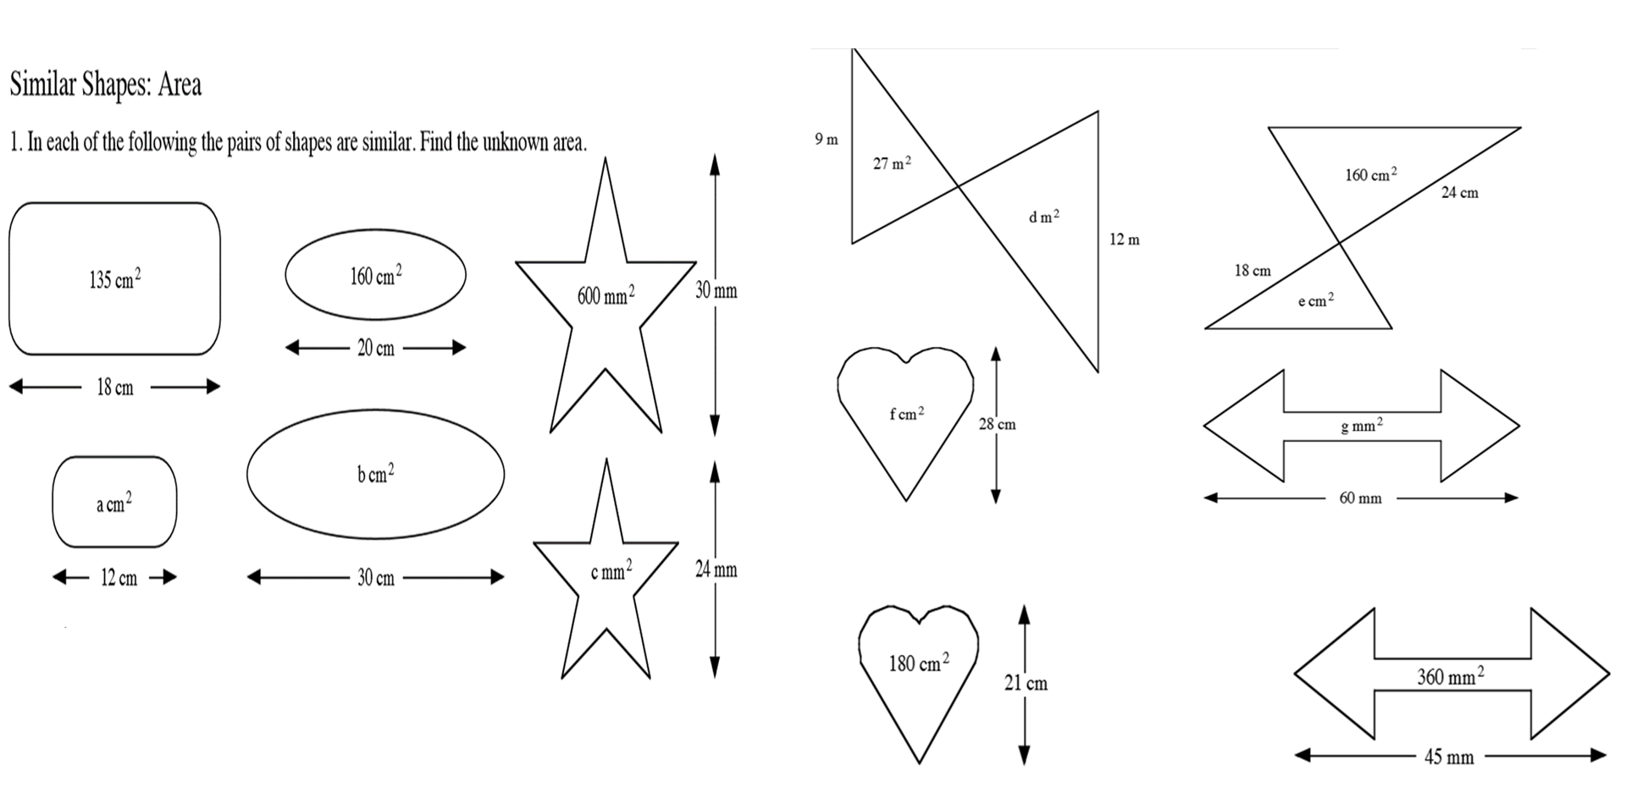

Slide 2
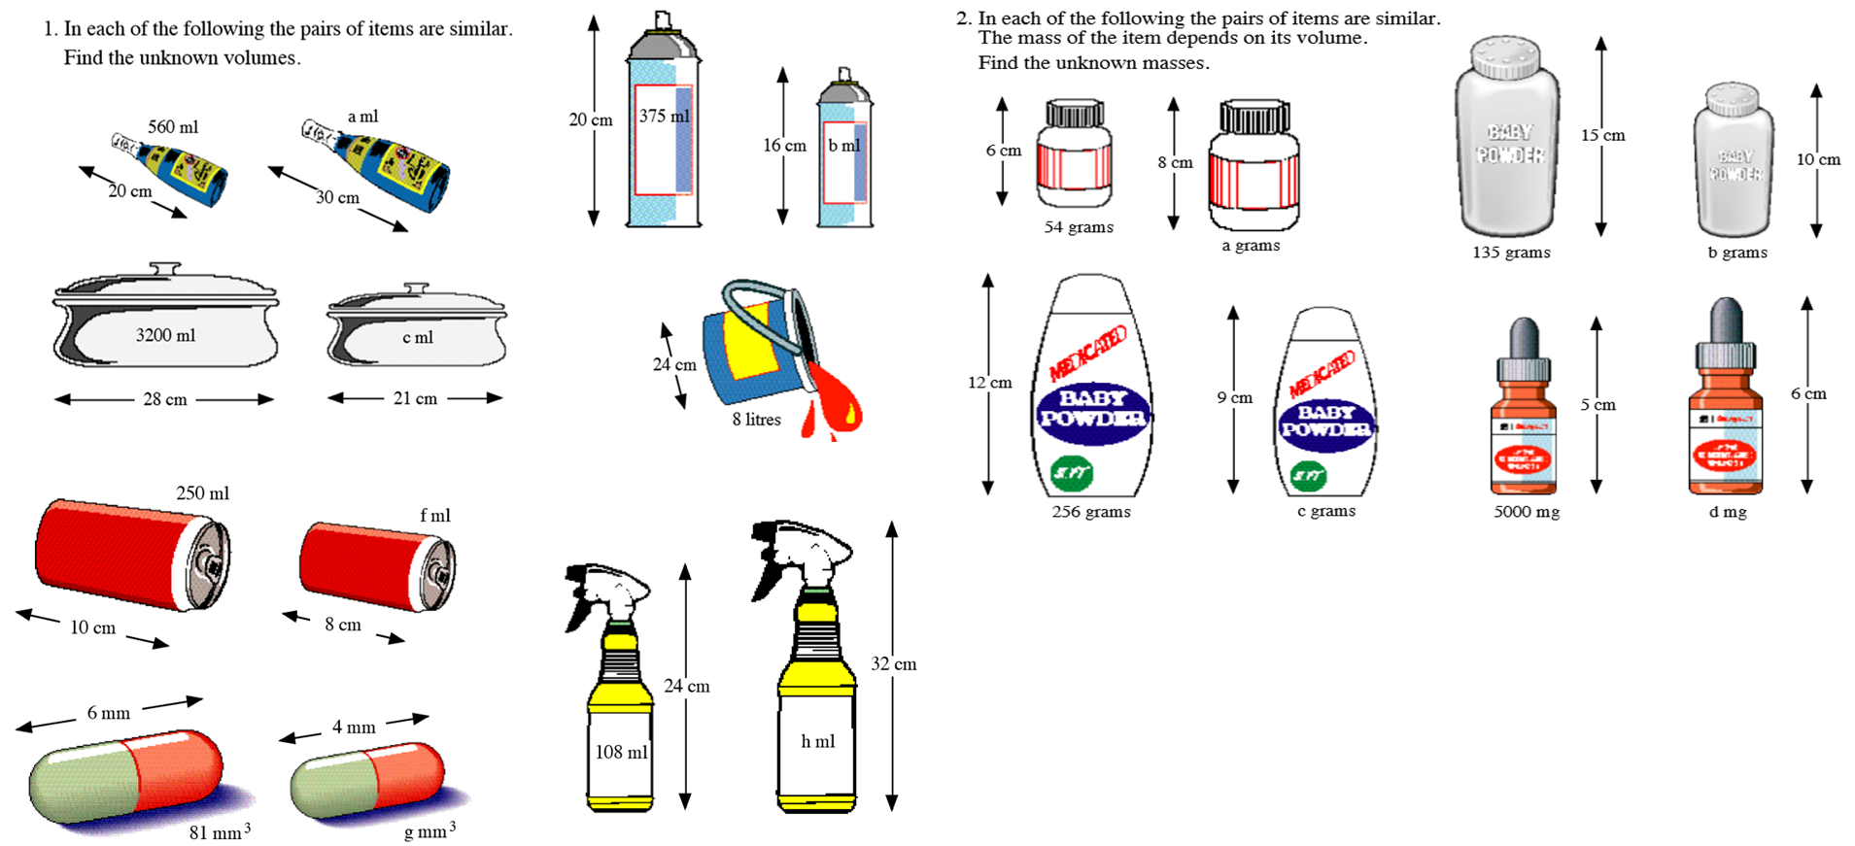

Slide 3
ANSWERS

Slide 4
48
90
320
640
360
60
384

Slide 5
1890
192
128
40
1350
128
108
8640
256
24

