Slide 1
FM: Quadratic Trigonometric Equations

Slide 2

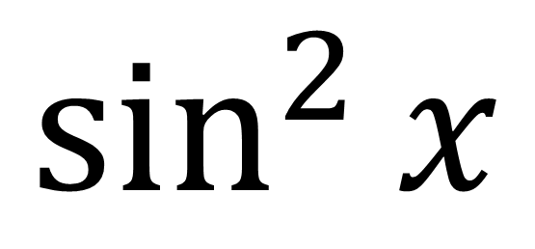
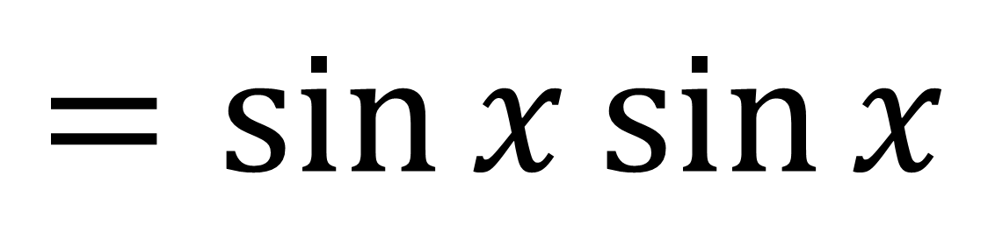
New Notation
$$\sin^{2}{x}$$
$${=(\sin{x})}^{2}$$
$$=sin{x\sin{x}}$$

Slide 3
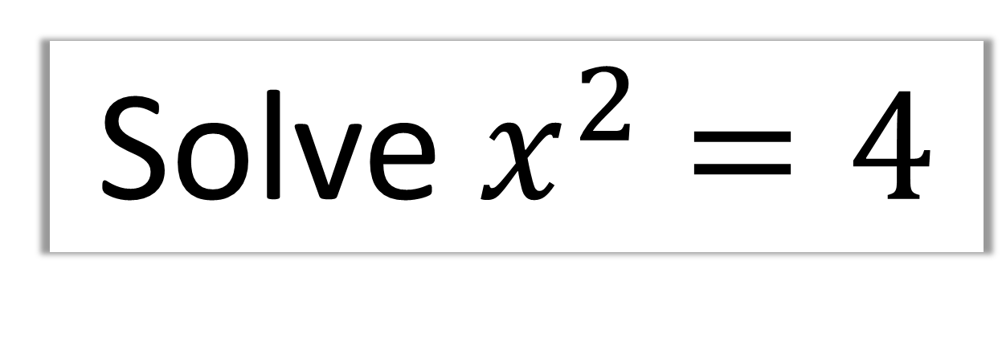
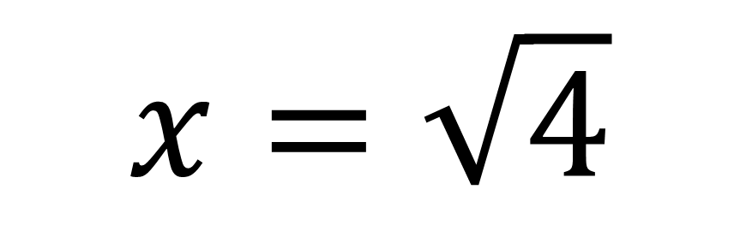
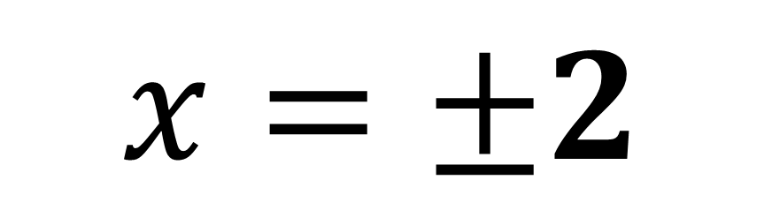
Solve${ x}^{2} =4$
$$x=\sqrt{4}$$
$$x=±2$$

Slide 4
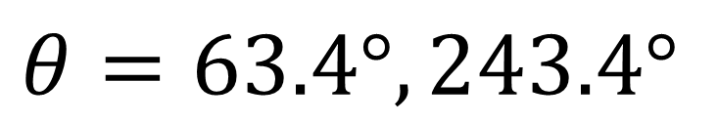
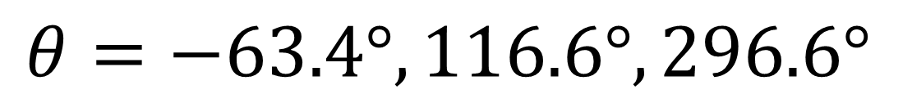
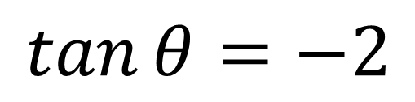
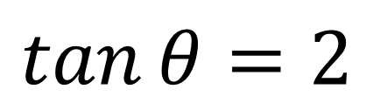
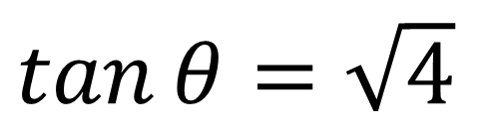
Solve $\tan^{2}{θ}=4$ in the interval $0≤x≤360°$
$\tan{θ}=\sqrt{4}$
$$\tan{θ}=2$$
$$θ=63.4°, 243.4°$$
$$\tan{θ}=−2$$
$$θ=−63.4°, 116.6°,296.6°$$
$$θ=63.4°, 116.6°, 243.4°,296.6°$$

Slide 5
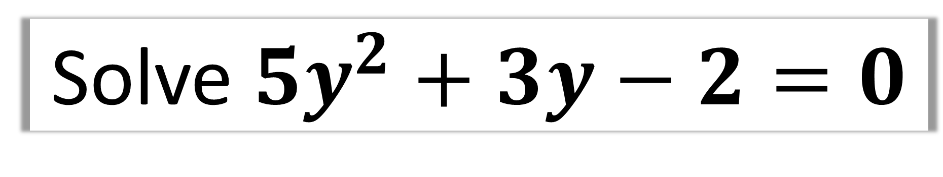

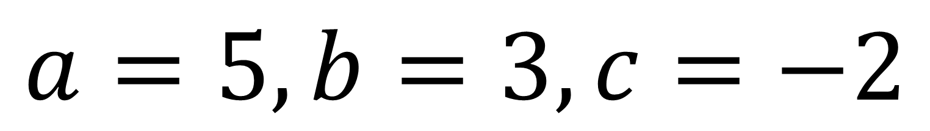
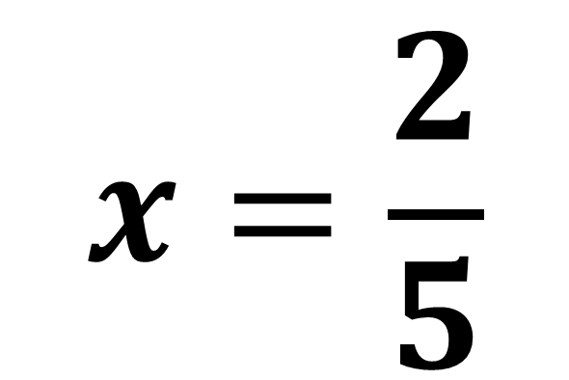
Solve $5y^{2}+3y−2=0$
$$a=5, b=3, c=−2$$
$$x=\frac{2}{5}$$
$$x=−1$$

Slide 6
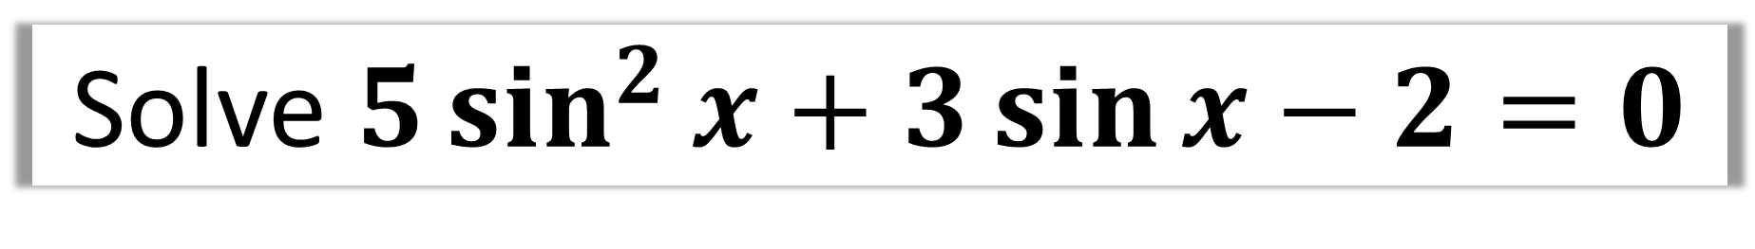
Solve $5\sin^{2}{x}+3\sin{x}−2=0$
What does the above trigonometric equation
remind you of?
A Quadratic Equation!

Slide 7
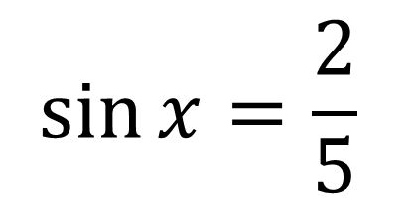
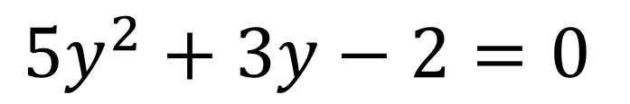
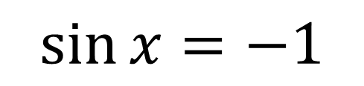
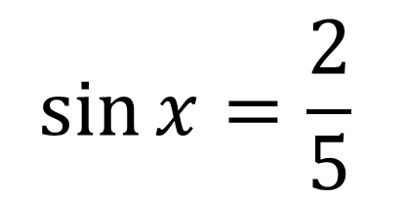

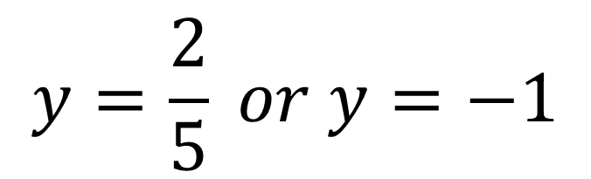
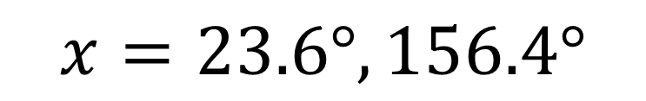
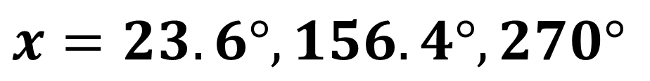
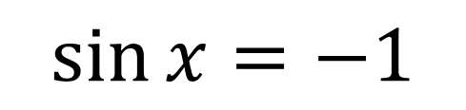
Solve $5\sin^{2}{x}+3\sin{x}−2=0$ in the interval $0≤x≤360°$
$$\sin{x}=\frac{2}{5}$$
$$5y^{2}+3y−2=0$$
$$y=\frac{2}{5} or y=−1$$
$$x=23.6°, 156.4°$$
$$\sin{x}=−1$$
$$\sin{x}=\frac{2}{5}$$
$$x=−90°, 270°$$
$$\sin{x}=−1$$
$$x=23.6°, 156.4°,270°$$

