Slide 1
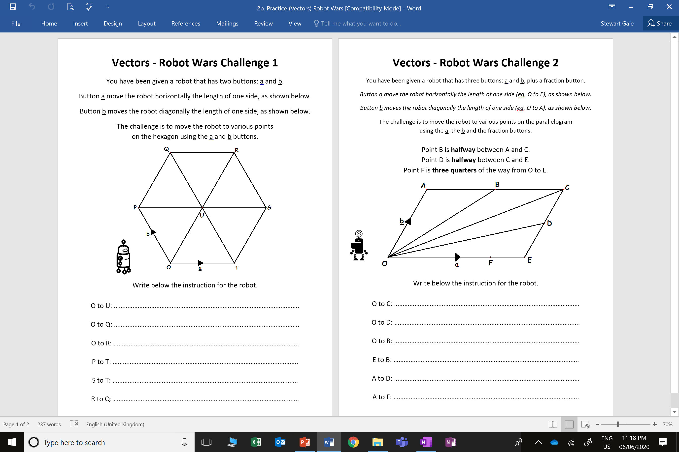

Slide 2
ANSWERS

Slide 3
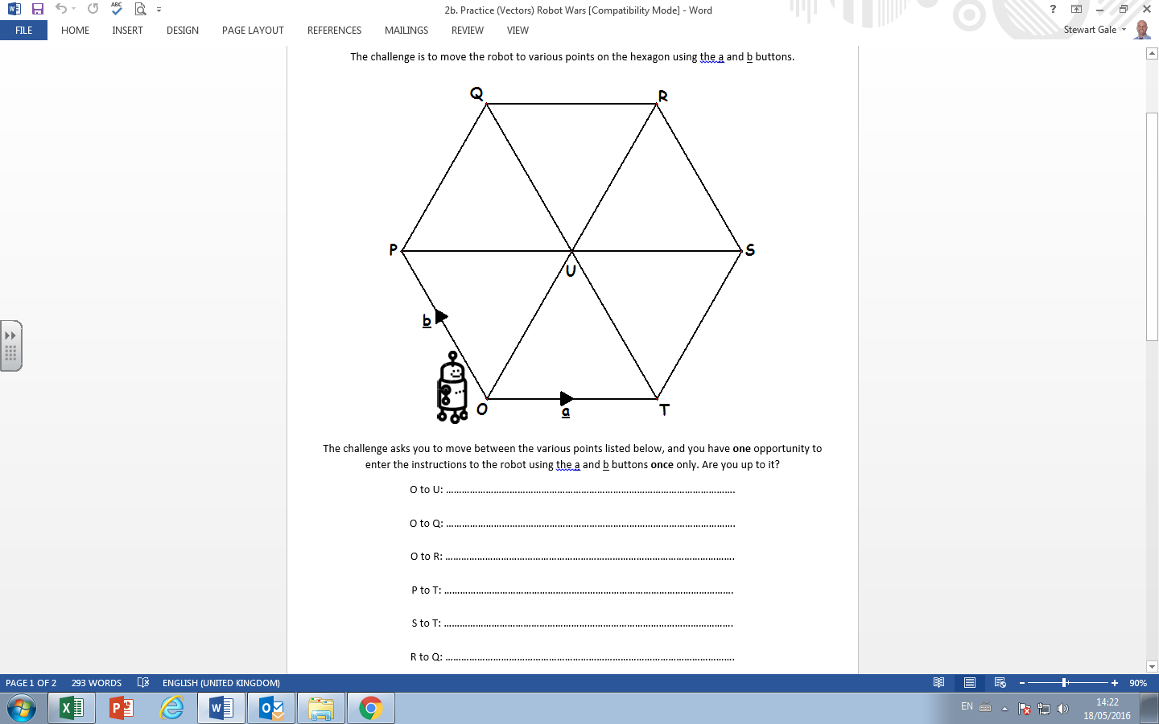
a + b
a + 2b
2a + 2b
a - b
-a - b
-a

Slide 4
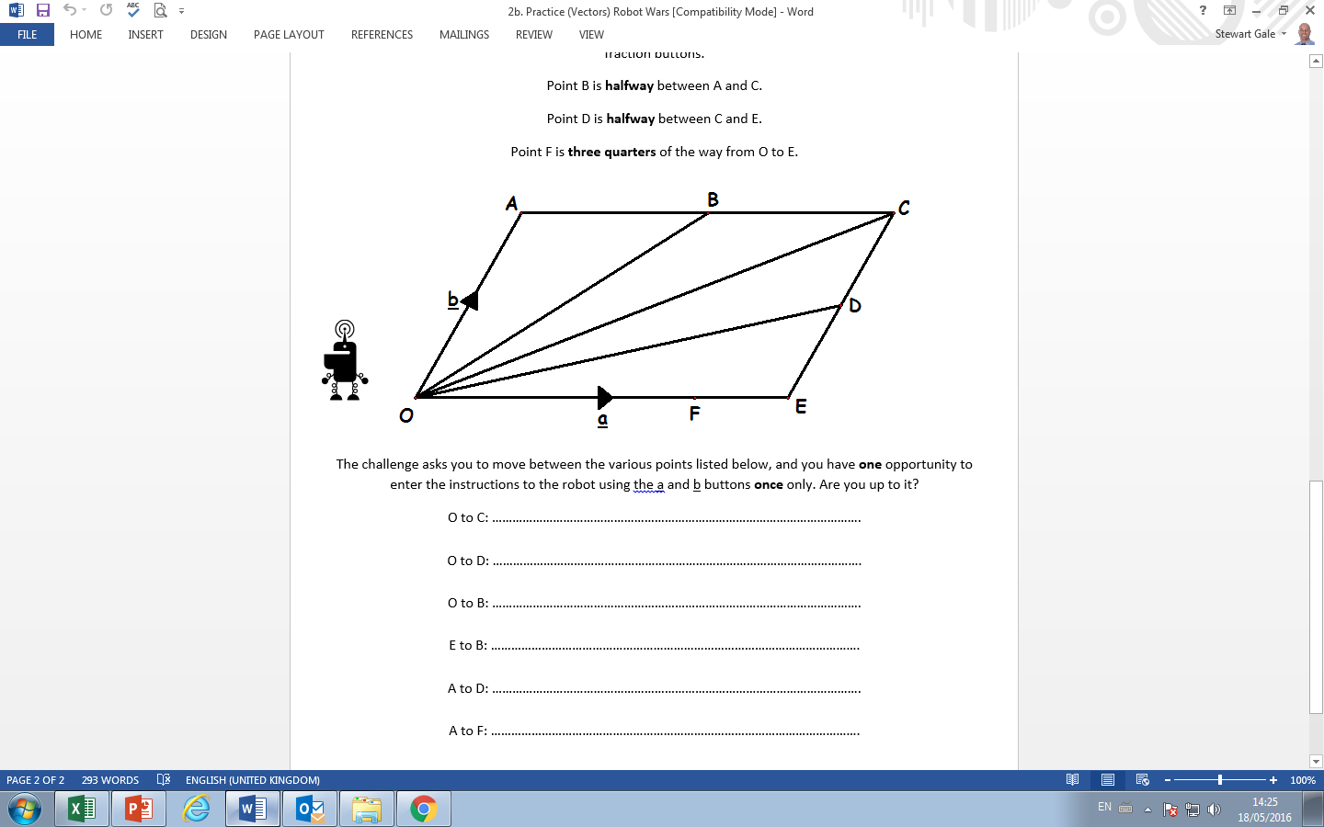
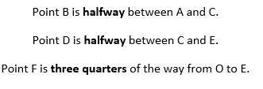
a + b
a + ½b
½a + b
-½a + b
a – ½b
-b + ¾a

